Slide 1
Energy Assistance in DE Cynthia Ventresca Sr. Community Relations Specialist, Delmarva Power

Slide 2
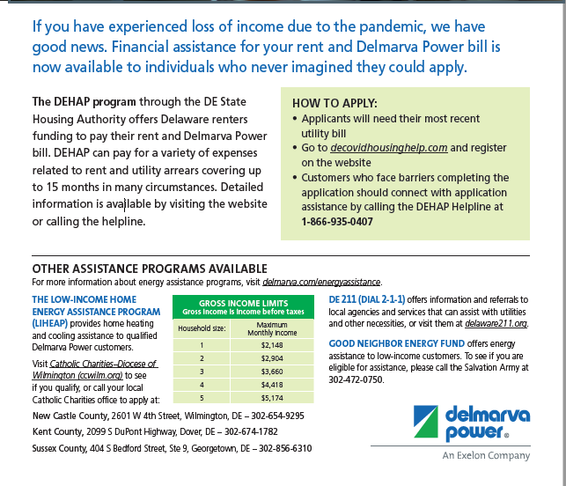

Slide 3

How to Donate To A Customer In Need
Gift of Energy
Make a payment toward a friend or family member's energy bill.
You can give any amount to any Delmarva customer you choose.
Your Gift of Energy will appear on a future bill as a credit to the recipient's account.
Good Neighbor Energy Fund
Pay exactly $1.00 over your Delmarva bill amount.
That dollar will be contributed to the Good Neighbor Energy Fund administered by a local 501(c)3 non-profit organization.
Delmarva Power will match each donation by contributing a dollar to the fund.

