Slide 1
Wilmington Housing Authority (WHA)
Health, Aging & Disability
Services Committee
Presentation
Ray Fitzgerald, 10/26/2022

Slide 2
AGENDA
Introduction
General Overview
Customer Service and Communication
Maintenance Overview
Safety Overview

Slide 3
Introduction
Ray Fitzgerald, Executive Director
rfitzgerald@whadelaware.org
215-416-0960
Sections:
Low Income Public Housing Section 8 Finance
Information Technology Maintenance Procurement
Resident Services Security Human Resources
YouthBuild

Slide 4
General Overview
Agency Demographics
Website: https://whadelaware.org/
7 Board Commissioners: https://whadelaware.org/staff/category/wha-governance-and-board-of-commissioners
100 Staff Members
1,500+ Public Housing Units https://whadelaware.org/housing-opportunities/communities
5 High Rises (Herlihy, Compton, Baynard, Parkview*, Crestview)
5 Mid Rises (1802 West St, Madison*, Kennedy, Evans, 201 Poplar)
3 Family Sites (Riverside, Southbridge, Scattered Sites)
*Note: Parkview and Madison are Tax Credit properties. https://www.huduser.gov/portal/datasets/lihtc.html

Slide 5
General Overview (cont’d)
2,000+ Section 8 Vouchers
Veterans Affairs Supportive Housing (VASH) https://www.hud.gov/program_offices/public_indian_housing/programs/hcv/vash
Emergency Housing Voucher (EHV), https://www.hud.gov/ehv
Single Room Occupancy (SRO), https:///www.hud.gov/hudprograms/sro
Foster Youth to Independence (FYI), https://www.hud.gov/program_offices/public_indian_housing/programs/hcv/fyi

Slide 6
Customer Service and Communication
Site visits since April 2021 (Group or 1:1 Meetings to discuss concerns)
Parkview- 10+ meetings
Crestview- 8-10 meetings
Multiple meetings at all other WHA sites
So far, I’ve met with 100% of resident meeting requests in my office
Agenda for these meetings
Accessibility commitment
Explained/confirmed the process to escalate resident concerns when they feel unheard
Provided my email address and phone number for residents to report concerns
Provided Housing Chief’s email address and phone number for residents to report concerns
Substantive issues raised during meetings
Give priority for housing management team to address
Many of the concerns are addressed in real-time before the meeting is complete

Slide 7
Customer Service and Communication (cont’d)
Agenda for these meetings (cont’d)
Security
Security is WHA’s most important objective, but it takes all of us to improve safety & security
Discouraged the “no snitching” culture as it weakens safety and security
Incident reports or verbal reports needed to document incidents for investigation
Typically, investigations begin within 48 hours from the time of the reported incident
Explained how our comprehensive camera system works
Monitored 24/7
Our security staff are not police. Our security staff is not authorized to arrest or detain
Security staff can’t be everywhere at once. Cameras can
Follow-up from meetings
Meet bi-weekly with housing management team to make sure issues are being addressed
I cannot recall one time a resident from Crestview or Parkview contacted me because concerns they reported to me were not addressed

Slide 8
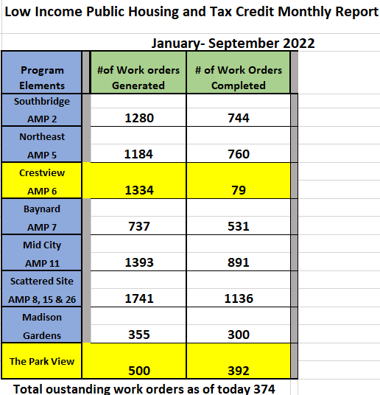
Maintenance
Residents complete work orders to schedule repairs
Work orders
35’ish Maintenance staff members
Emergency work orders are done within 24 hours
Routine work orders are typically done within 30 days
8,524 submitted 2022
8,132 done in 2022

Slide 9
Safety
Present status:
24-hour 7-day a week call center
Staff always on duty to monitor cameras and field reports
Building management on site from 8:30-5pm during the week
Fulfill request for video incidents from Law Enforcement Agencies
Investigate incident reports
Rovers patrol 5pm-8am daily & 24 hours on weekends (Stairwells, Hallways, and Parking Lots)
Monitor for barred individuals and violations – generate a report (dispatch the Rover or call the police if necessary)

Slide 10
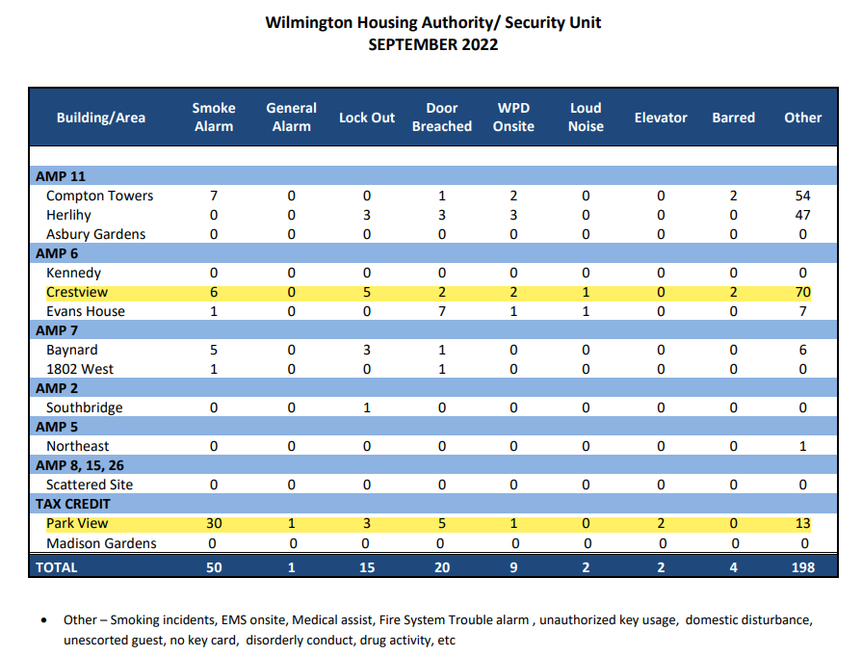
Safety (cont’d)
Security Data Enclosed
Future Plans (Police Agreement)
WHA is working on an agreement with WPD for extra Jobs to patrol buildings
Investigating installing electronic gates at high rises

Slide 11
Safety (cont’d)

Slide 12
Questions?

