Slide 1
Targeting Racial Cancer Health Disparities in Wilmington, Delaware
Scott D. Siegel, Ph.D., MHCDS
Director of Population Health Research
Helen F. Graham Cancer Center & Research Institute
Institute for Research on Equity & Community Health (iREACH)
ChristianaCare

Slide 2
Background

Slide 3
What is a Cancer Health Disparity?
According to the National Cancer Institute, cancer health disparities refer to adverse differences between population groups in:
  Incidence (new cancer cases)
  Prevalence (all existing cancer cases)
  Morbidity (cancer-related health complications)
  Mortality (cancer deaths)
  Survivorship (quality of life after cancer treatment)

Slide 4
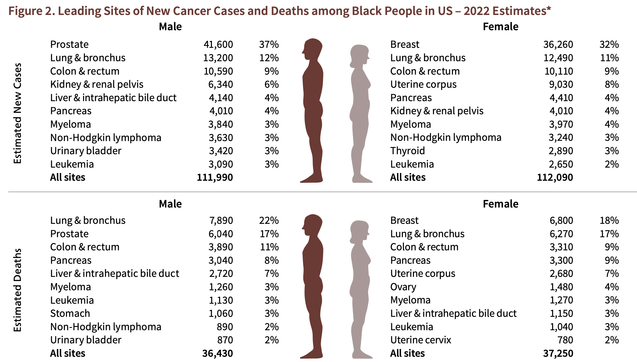
What do we know?
American Cancer Society. Cancer Facts & Figures for African American/Black People 2022-2024. Atlanta: American Cancer Society, 2022.

Slide 5



What causes disparities?
Poor access to prevention, early detection, and treatment health care services
Greater exposure to carcinogens and other risk factors
Inherited genes that predispose toward poor cancer outcomes (a factor in a minority of cases)

Slide 6
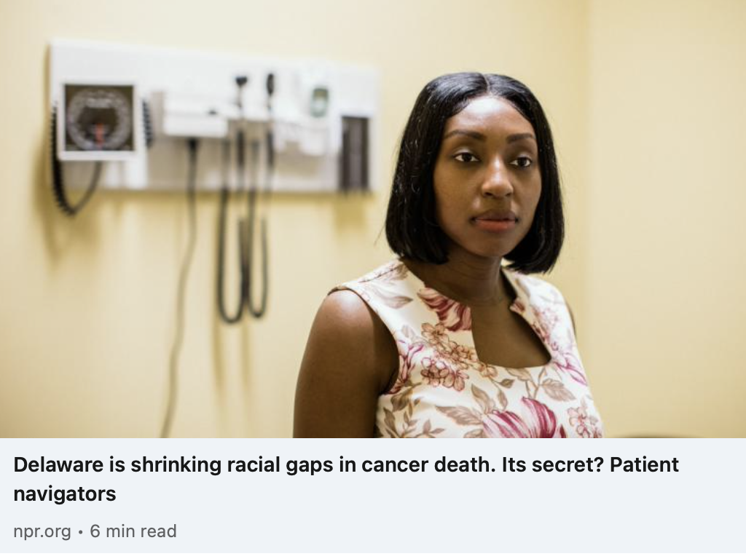

What are we doing about it?
Existing programs focus on community outreach, education, screening, and early detection (e.g., colorectal cancer program)
New research aimed at developing improved programs for cancer prevention and treatment

Slide 7
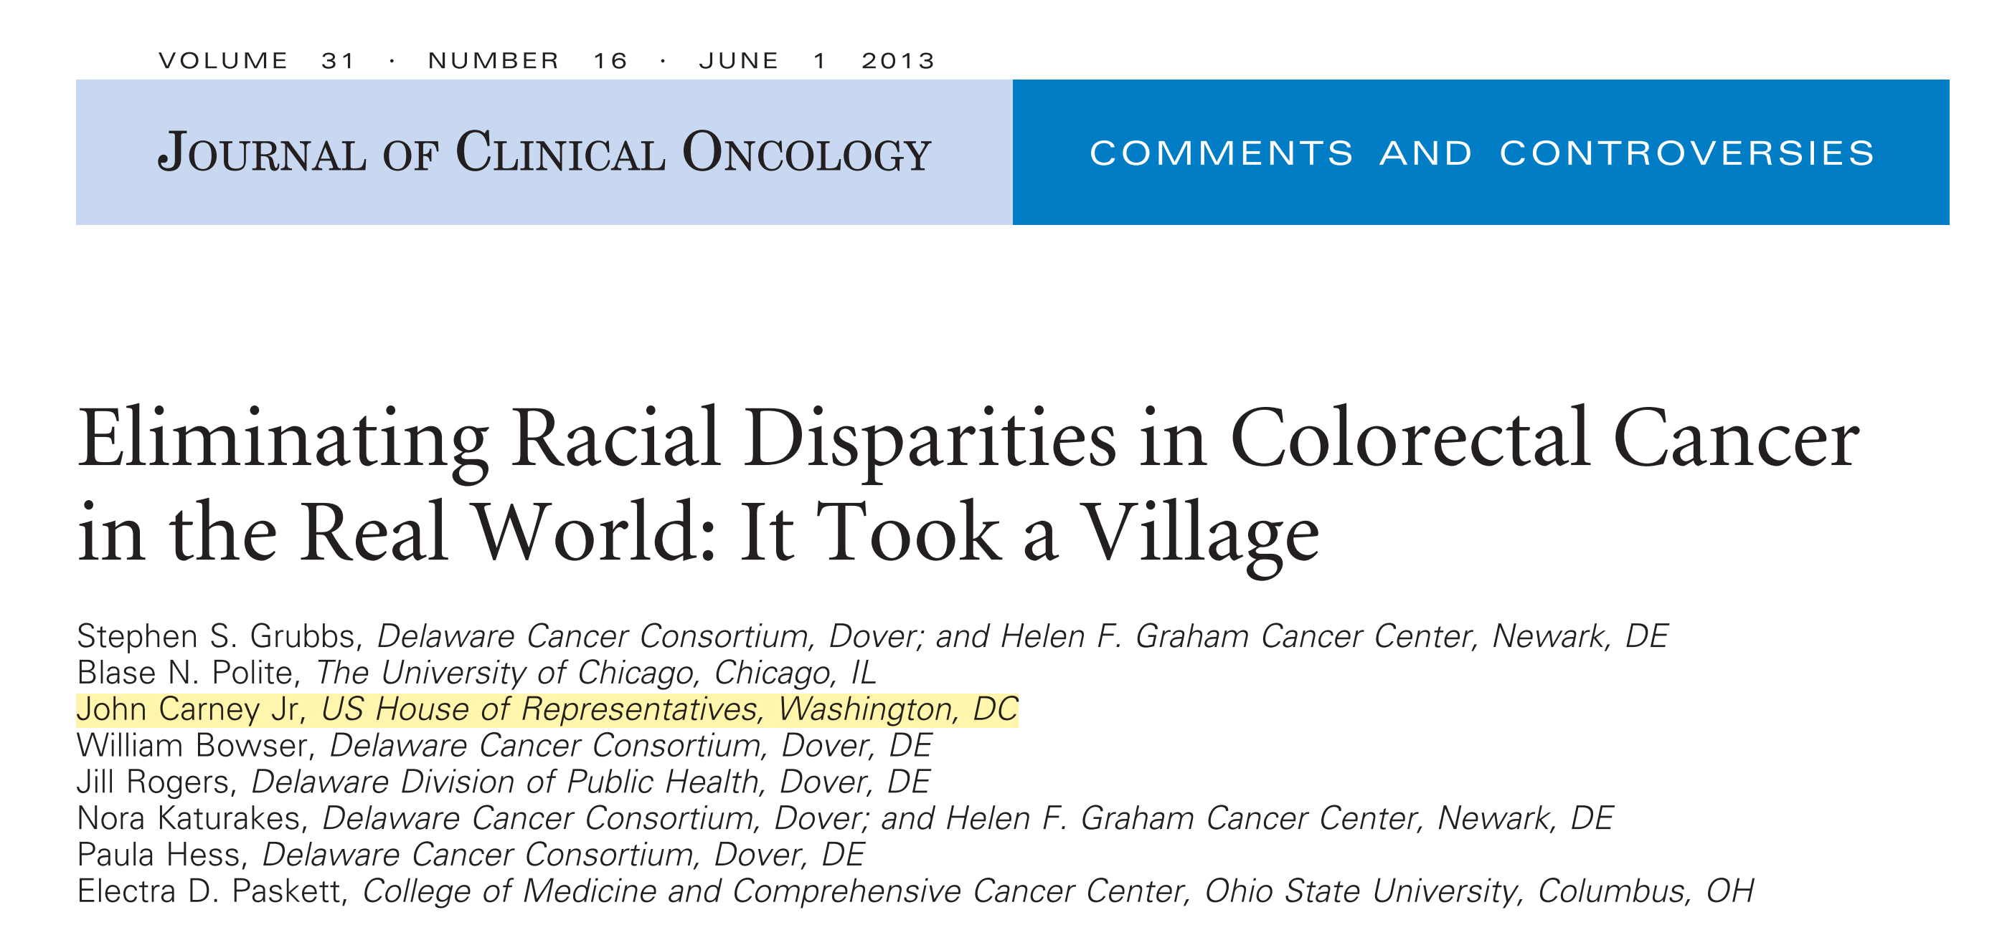
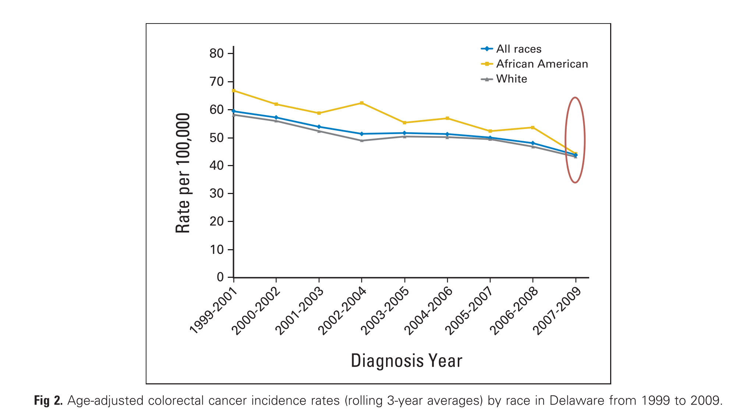

Slide 8
Targeting Breast & Lung Disparities Cancer
New Directions:

Slide 9
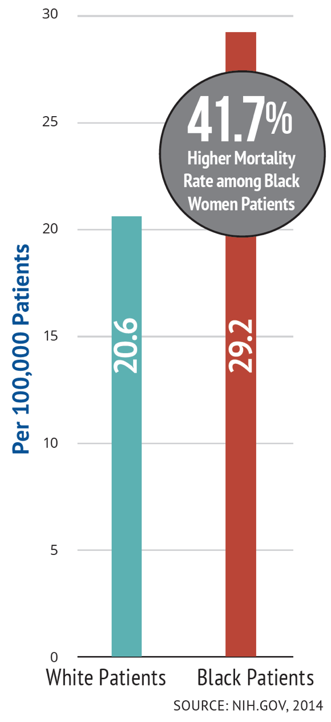
Breast Cancer
  In Delaware:
  Black women more likely to be diagnosed w/advanced breast cancer
  Black women 40-64 years old have 56% higher mortality
  Triple negative breast cancer (TNBC) incidence rates lead the nation
  Highest rates of alcohol-attributable breast cancer

Slide 10
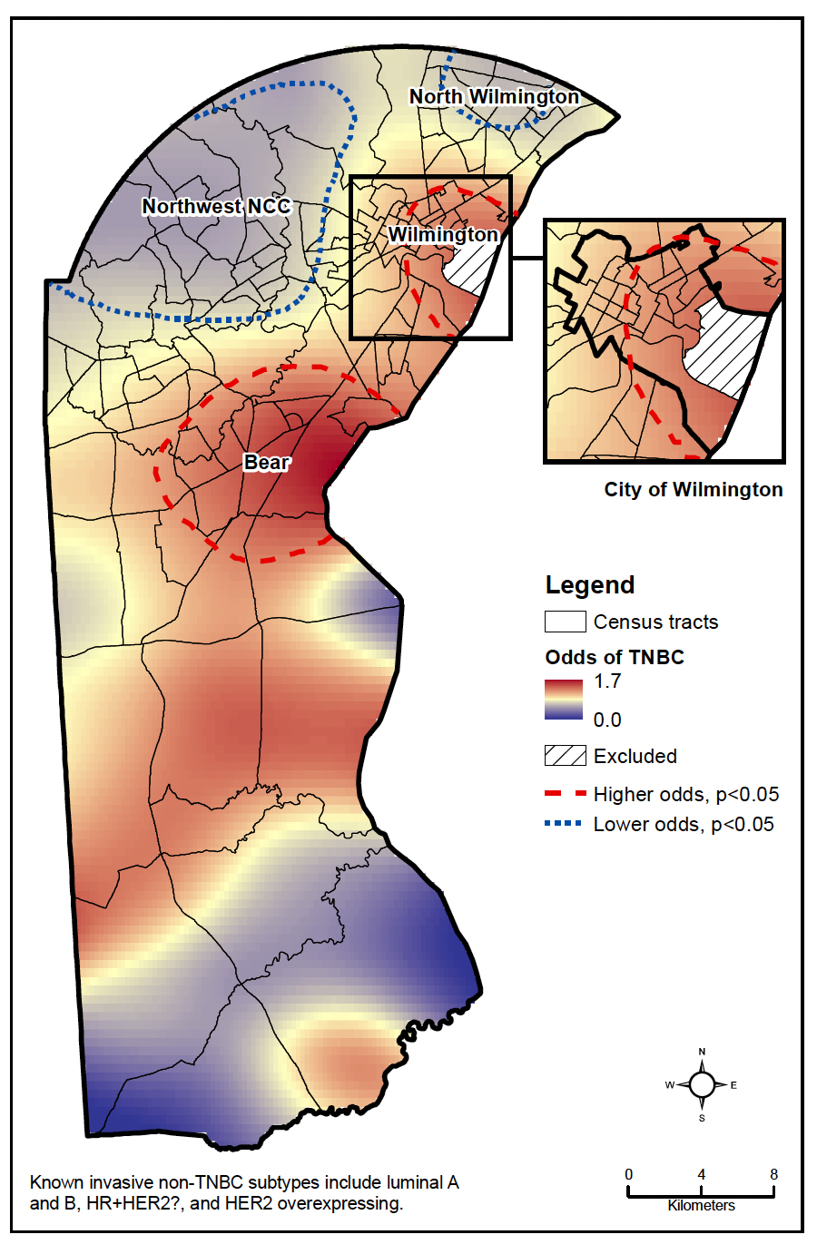
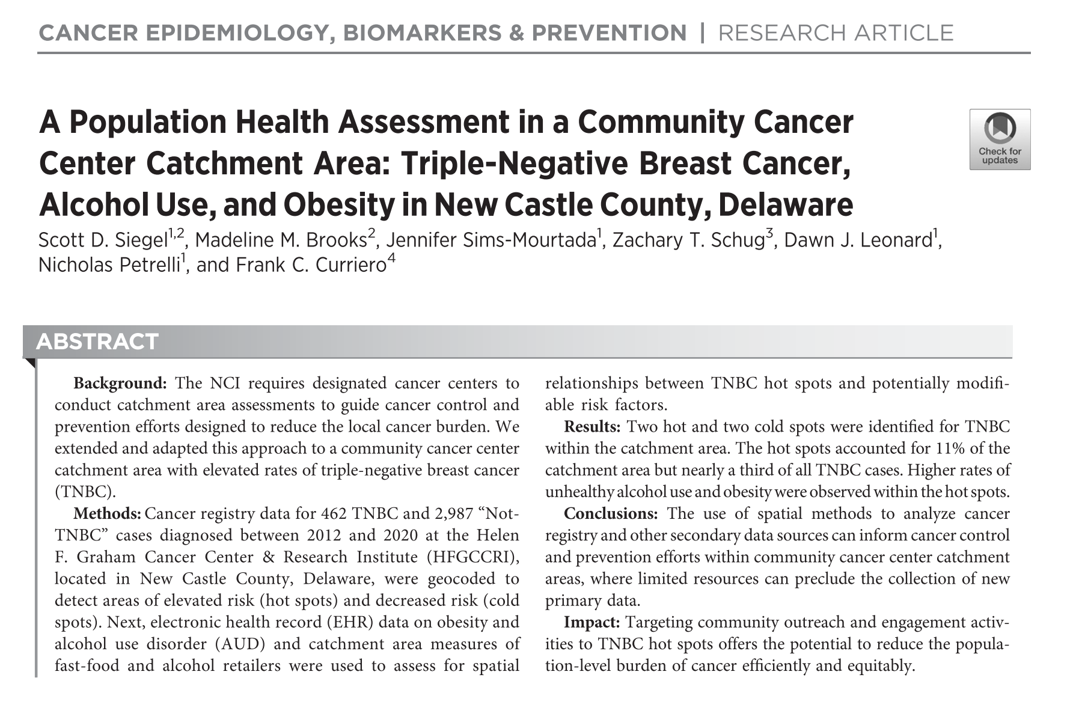

Slide 11
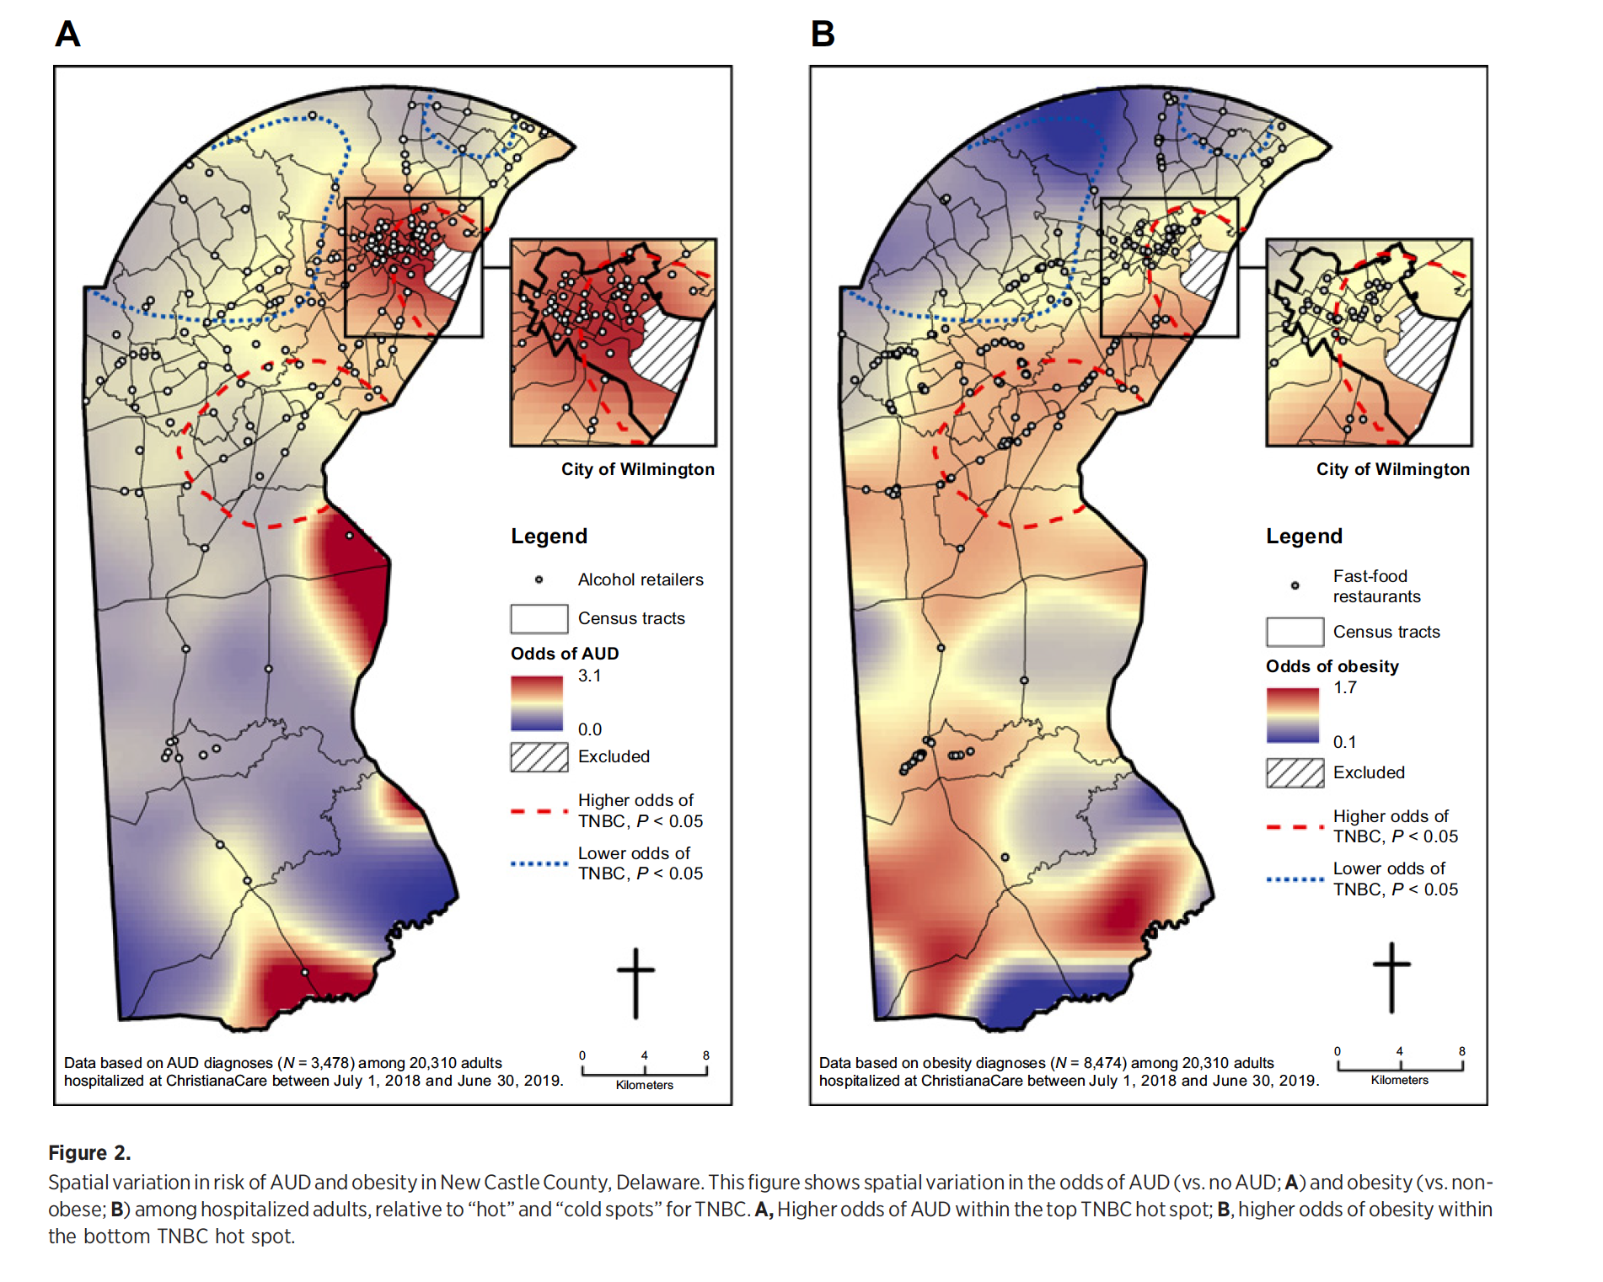
Panel A
We saw evidence of very high rates of unhealthy alcohol use in the Wilmington hot spot.
We also saw a very high density of alcohol retailers in Wilmington
Panel B
In both the Wilmington and Bear hot spots, we saw elevated rates of obesity
We also saw limited healthy food options in these areas

Slide 12
What can we do with this knowledge?
Focus our outreach efforts in these hot spots
Address unhealthy alcohol use and obesity in primary care clinics
Consider policy approaches to further reduce alcohol use and obesity
Translational research to identify biomarkers of risk (e.g., blood test)

Slide 13
Lung Cancer
Lung cancer is the leading cause of cancer mortality in Delaware and the US
Black men have the highest lung cancer mortality rates in the US
Black individuals are more likely to present with lung cancer at a younger age and more advanced stage
Black individuals at high-risk for lung cancer less likely to receive screening

Slide 14
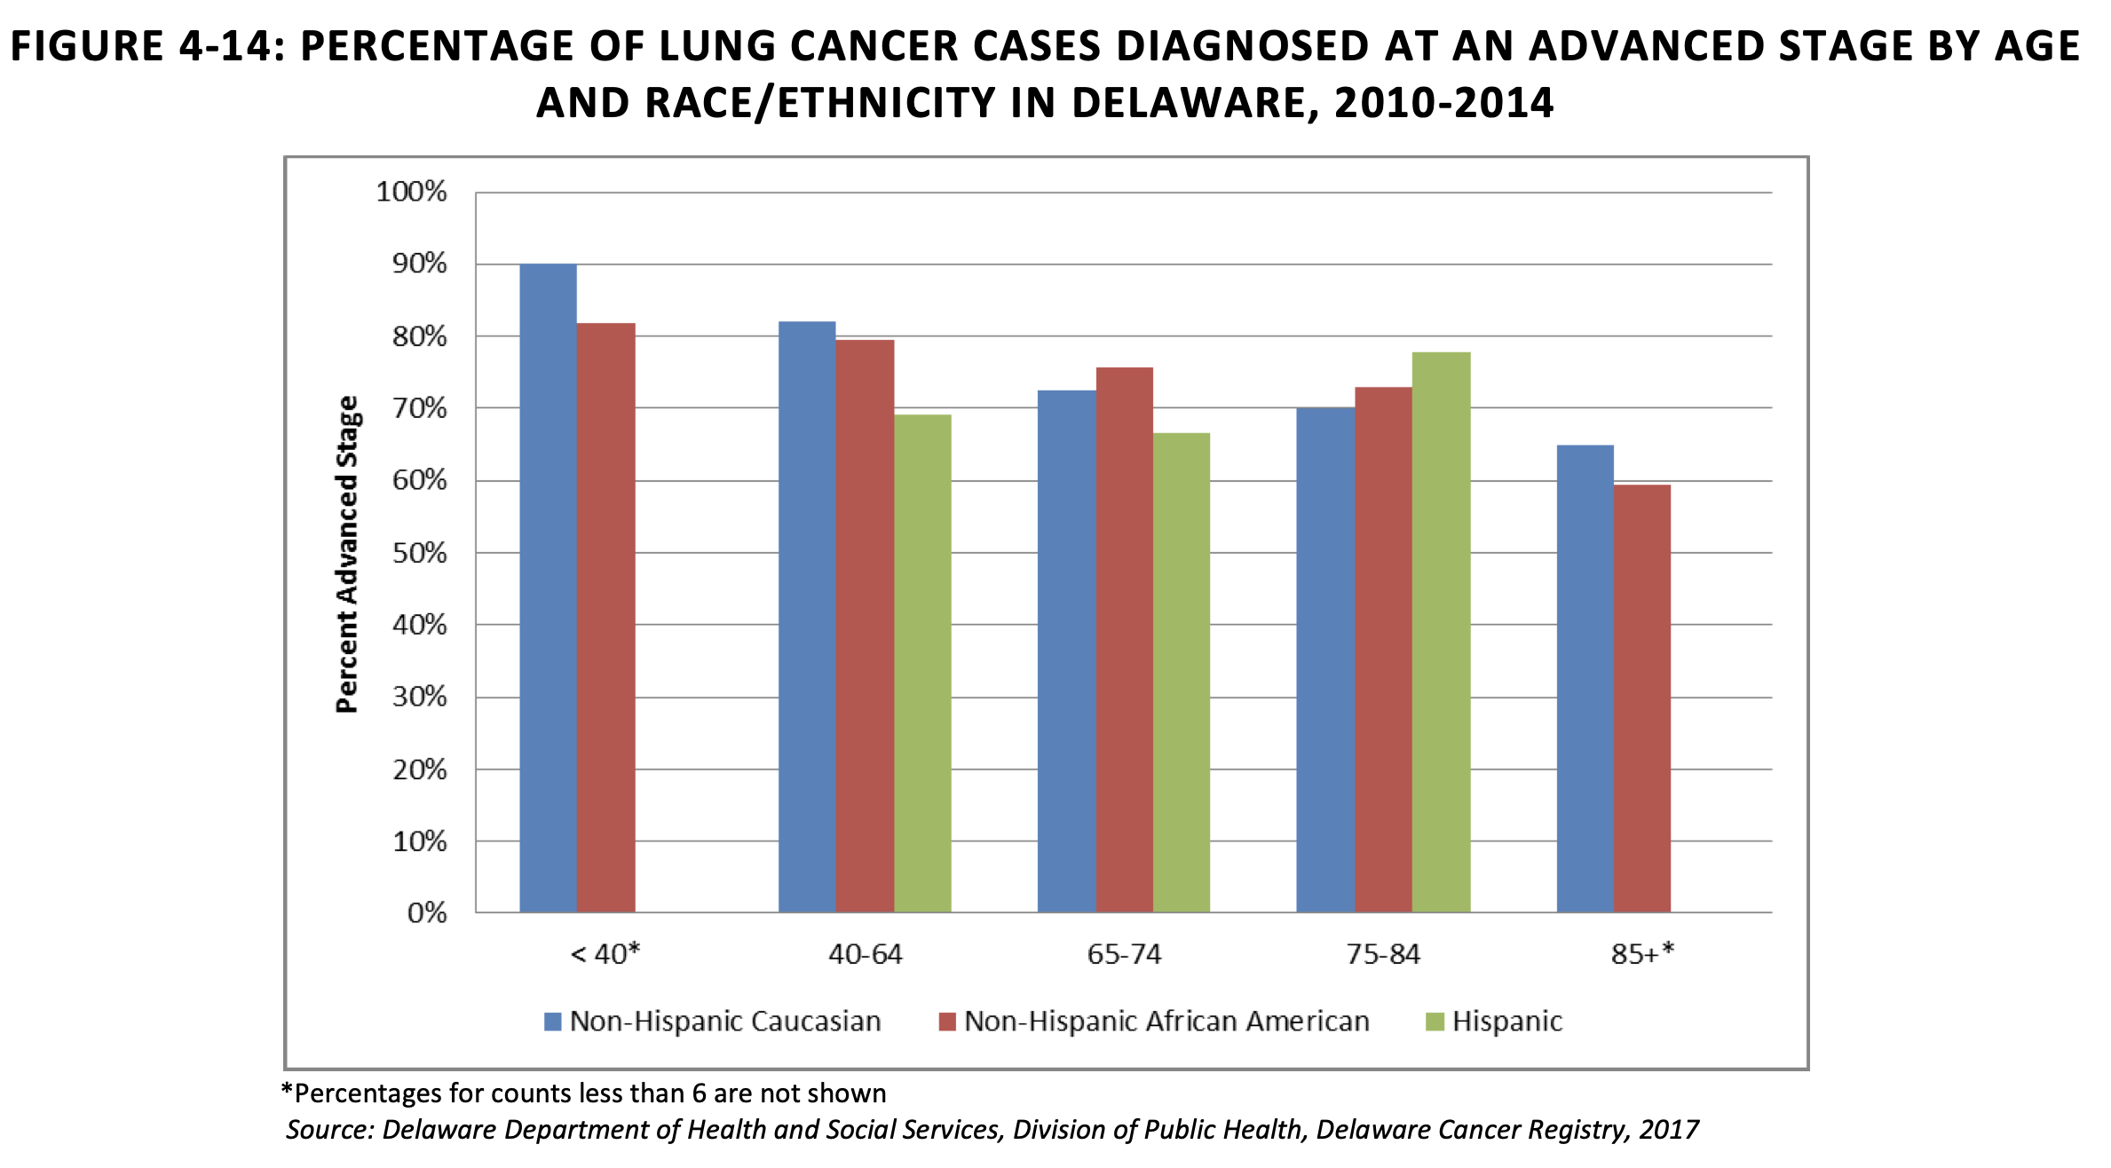
Screening Guidelines:
Age 50-80
20 pack-year smoking history
Currently smoke or have quit within the last 15 years

Slide 15
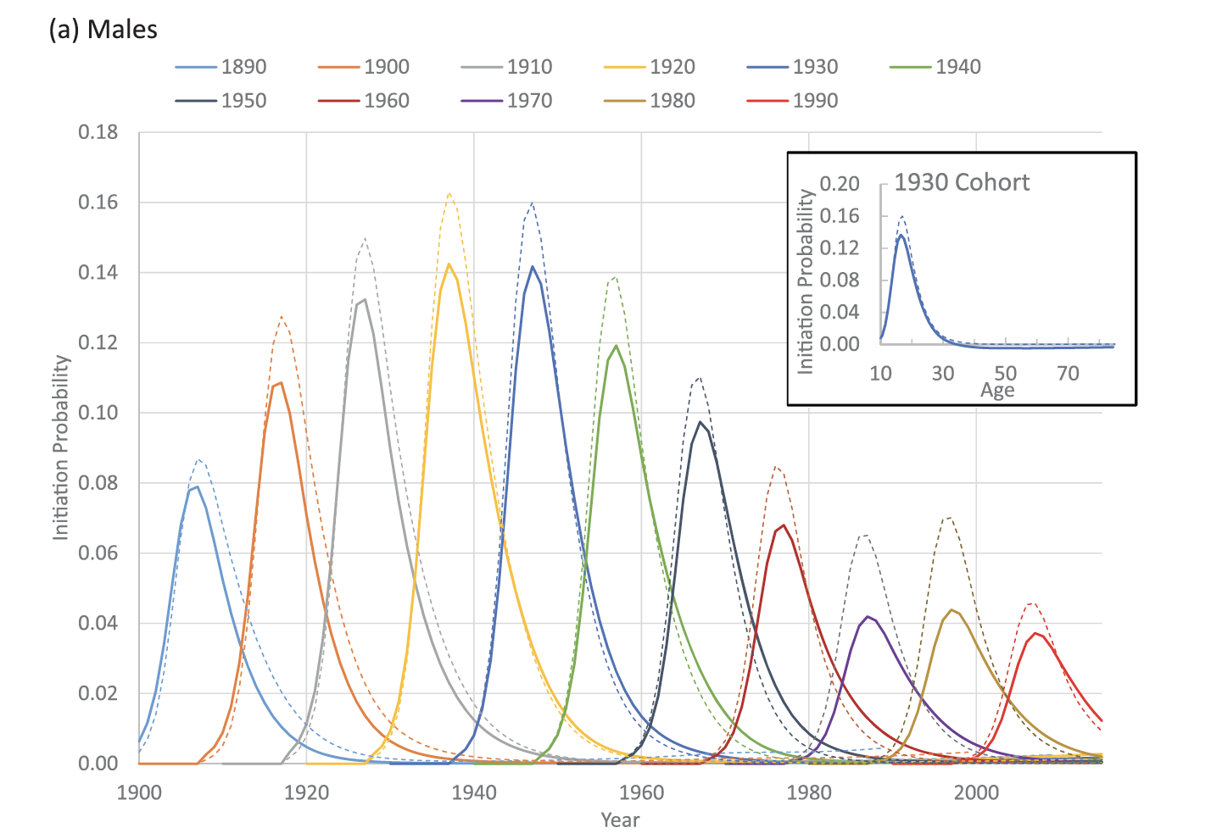
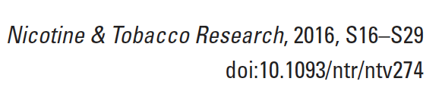
Smoking initiation rates are lower among Black (solid lines) than White individuals (dashed) across every generation going back to 1900

Slide 16
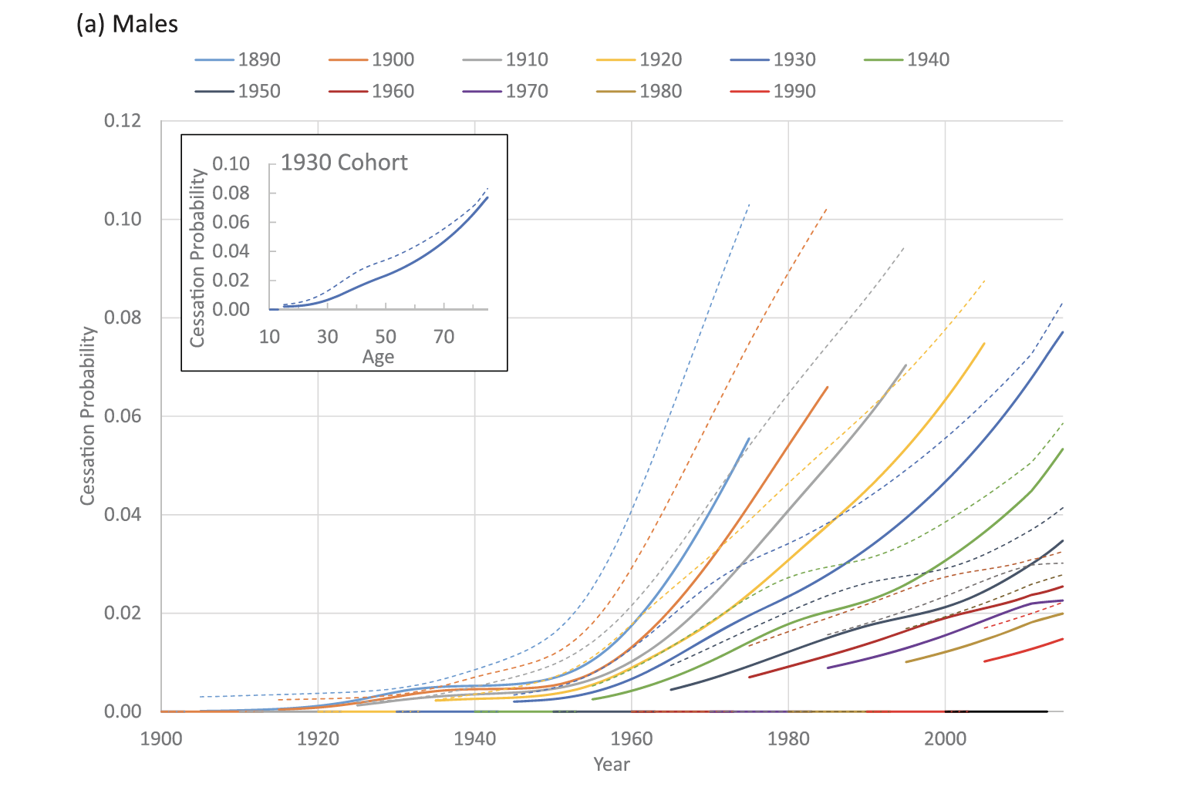
But… smoking cessation rates are lower among Black (solid lines) than White individuals (dashed) across generations
This leads to a greater overall exposure to carcinogens among Black individuals who smoke

Slide 17

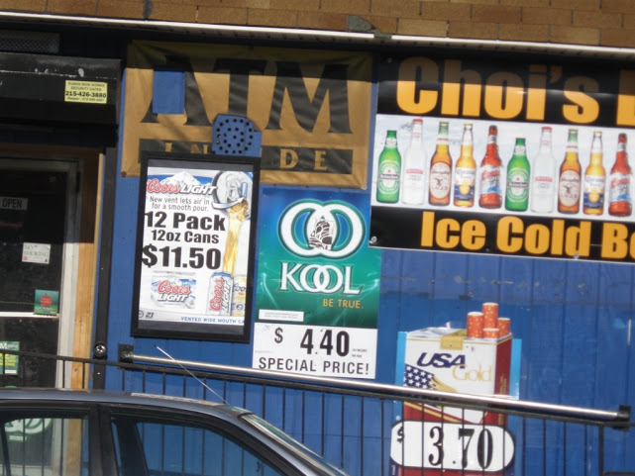
Why are smoking cessation rates lower?
Physicians are less likely to advise Black individuals to quit or provide smoking cessation treatment; when provided, treatments are less effective
Exposure to a high density of tobacco retailers reduces the odds of quitting

Slide 18


Slide 19
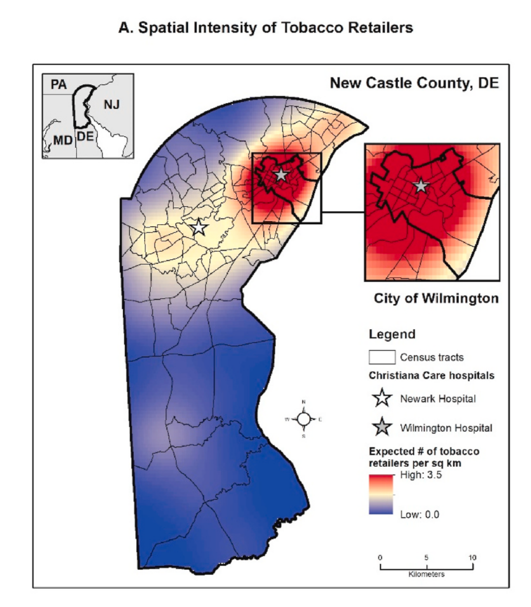
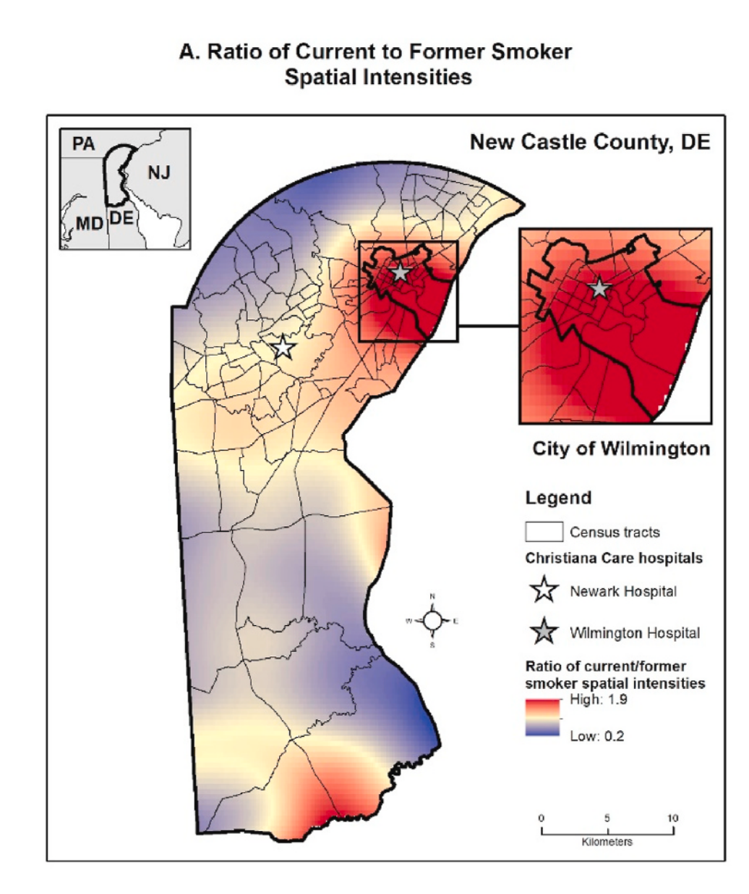
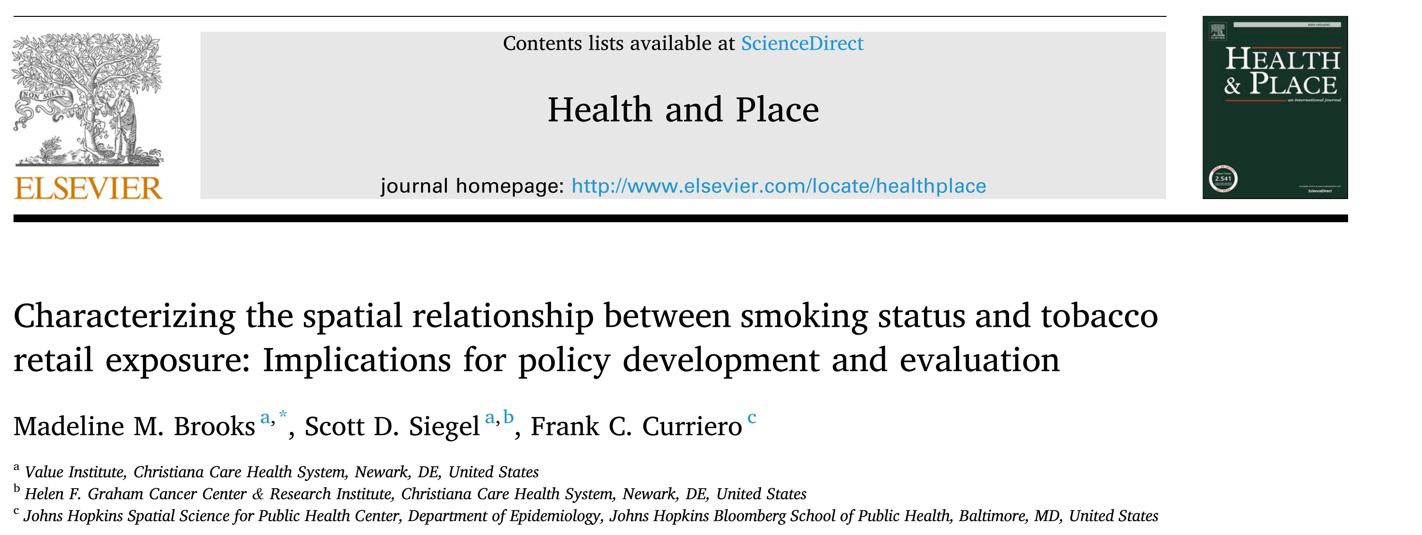

Slide 20
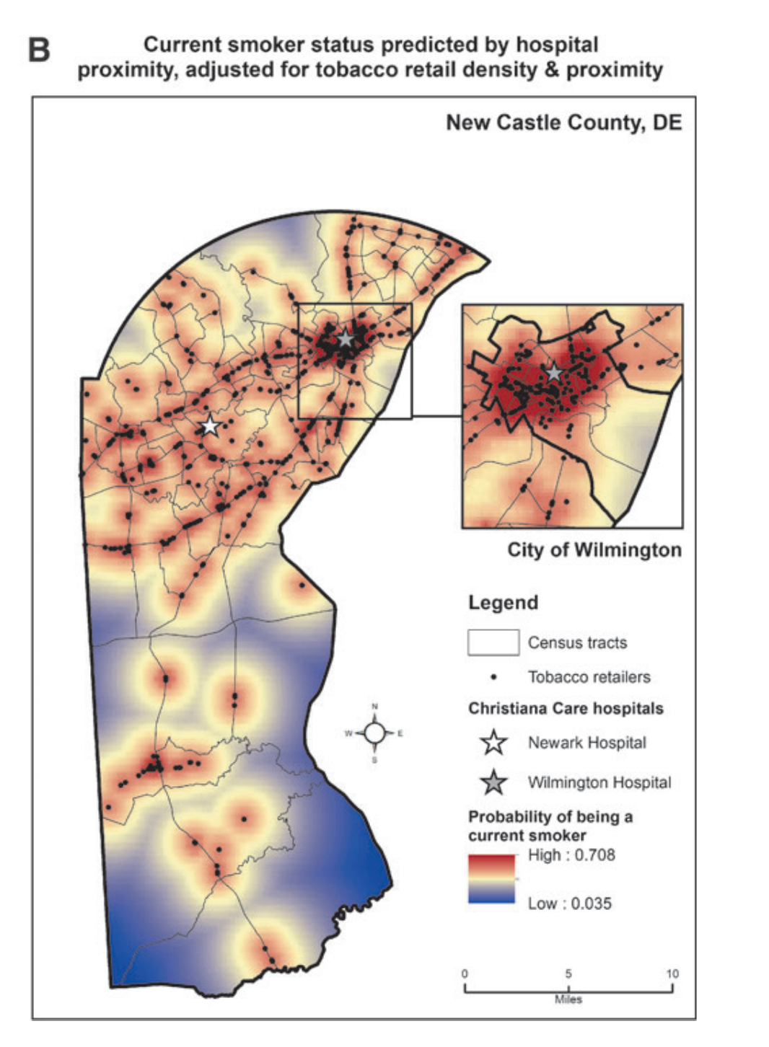
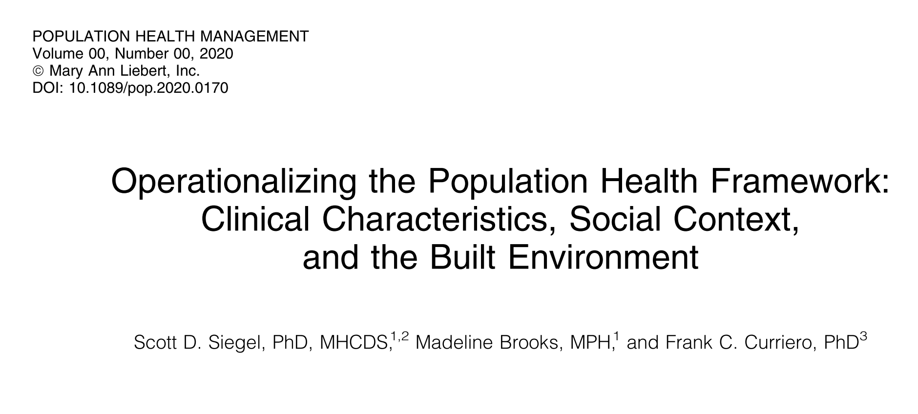

Slide 21
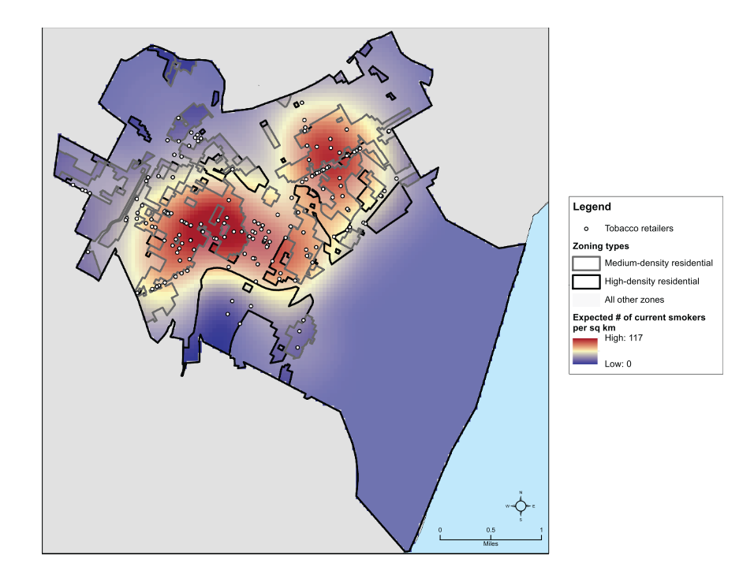
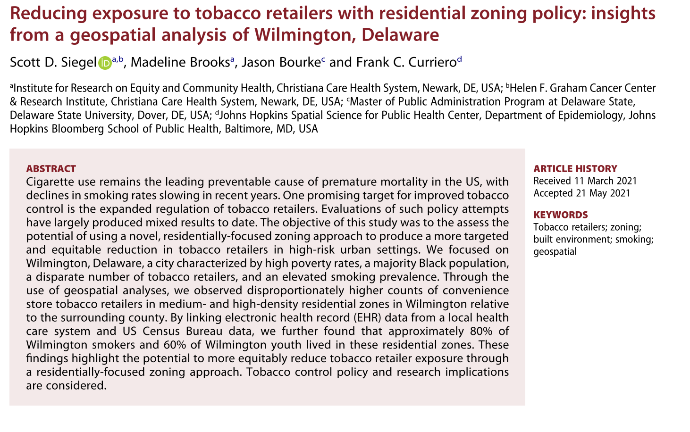

Slide 22
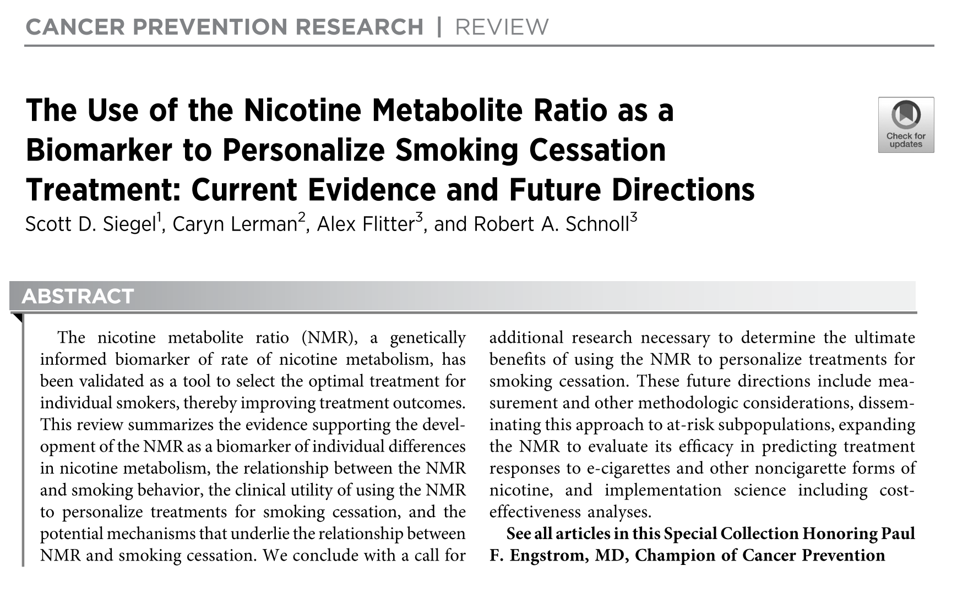
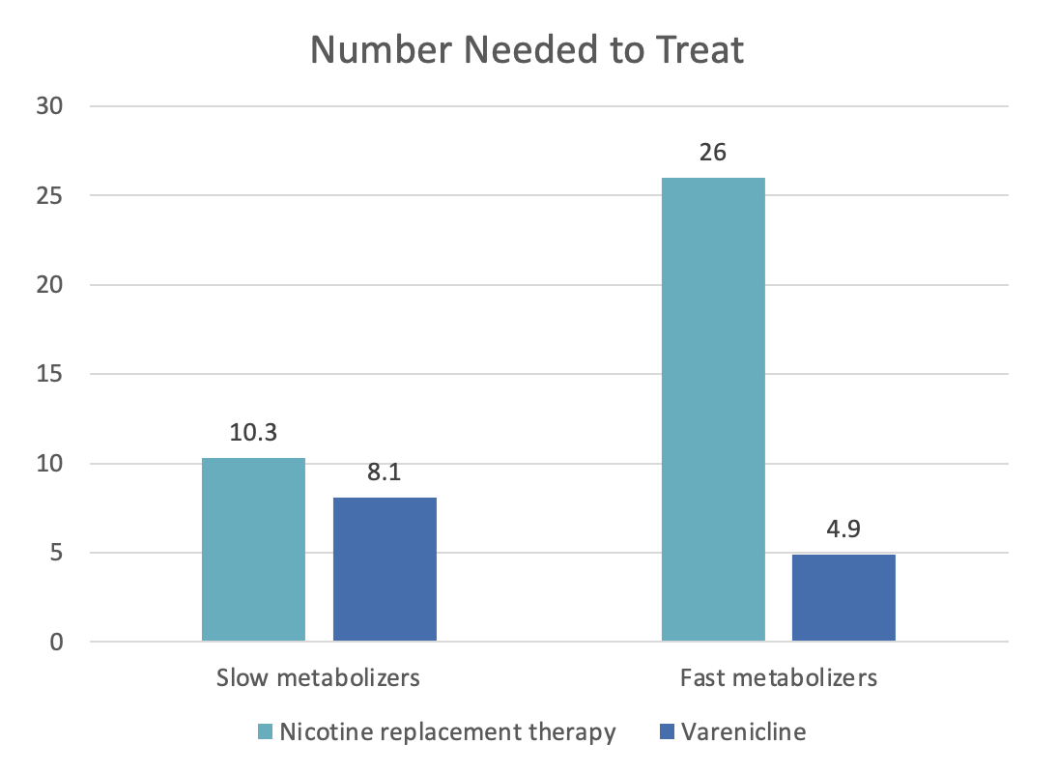
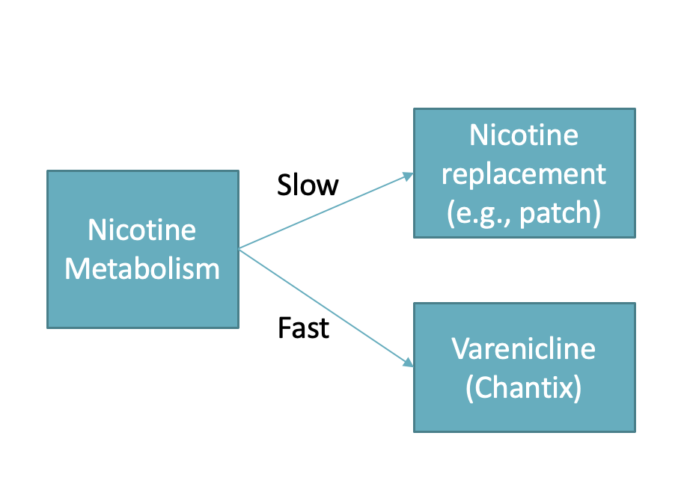
Using a personalized approach,
QUIT RATES INCREASE BY 5X
for those who typically have a harder time quitting
Important policy issue:
Delaware Medicaid requires patients must fail nicotine replacement therapy to qualify for Varenicline

Slide 23
What can we do with this knowledge?
We can equitably increase access to lung cancer screening
We can increase access to smoking cessation treatment and offer personalized treatment to improve outcomes
We can consider policy approaches to further reduce smoking
Translational research to identify biomarkers of lung cancer to improve early detection

Slide 24
Conclusion

Slide 25

New Playbook
Targeted outreach to improve access for screening & risk reduction
Policy approaches to make neighborhoods healthier
Research to continually improve our current approaches

Slide 26

We are committed to reducing racial cancer health disparities
We have a strong track record
We have our new playbook
Success requires strong partnerships, resources, & new policies

Slide 27


Slide 28


Slide 29


