Slide 1
Wilmington Transit Corridors Improvement
Public Works and Transportation Committee
February 16, 2020

Slide 2
Project Team
Project Design
DART Planning
Matthew Vincent, DelDOT, Chief of North Project Development
Diane Gunn, Century, Project Manager for DelDOT
Matt Goudy, RK&K, Designer
Catherine Smith, DTC, Planning Manager
John Calnan, DTC, Planner
Notes:
Recognize Elected Officials

Slide 3
Project Location and Goals
Wilmington Transit Corridors Improvement Project located in the Wilmington Central Business District
Orange Street, King Street, 8th Street and 9th Street will be corridors for transit improvements
Reconfigure Orange Street between Martin Luther King Blvd and 10th Street

Slide 4
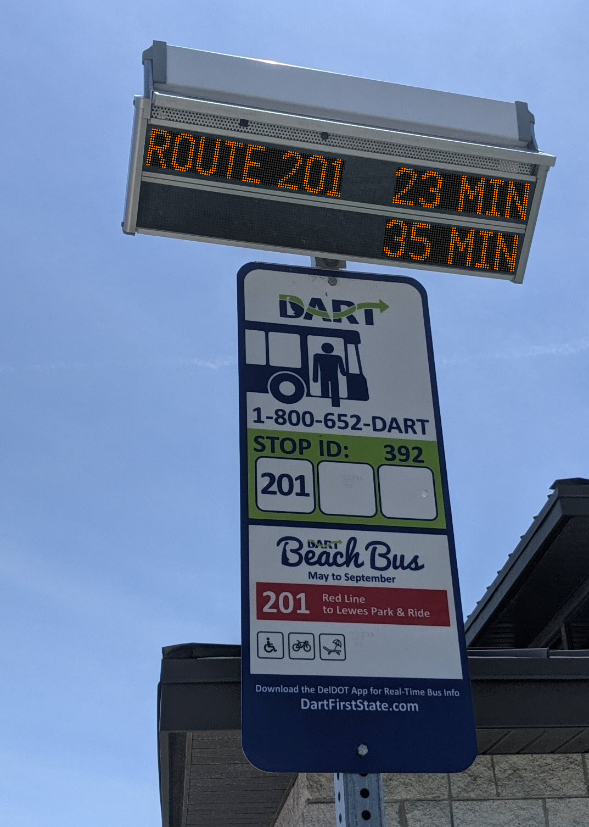
Project Location and Goals (Cont.)
Provide curb “Bump Outs” to allow better bus access
Reduces boarding and unloading times
Provide Real Time Signs to bus shelters to give riders current bus schedule information
Newly Designed Bus Shelters provide wider pedestrian walkways for ADA accessibility while still protecting users from the weather

Slide 5
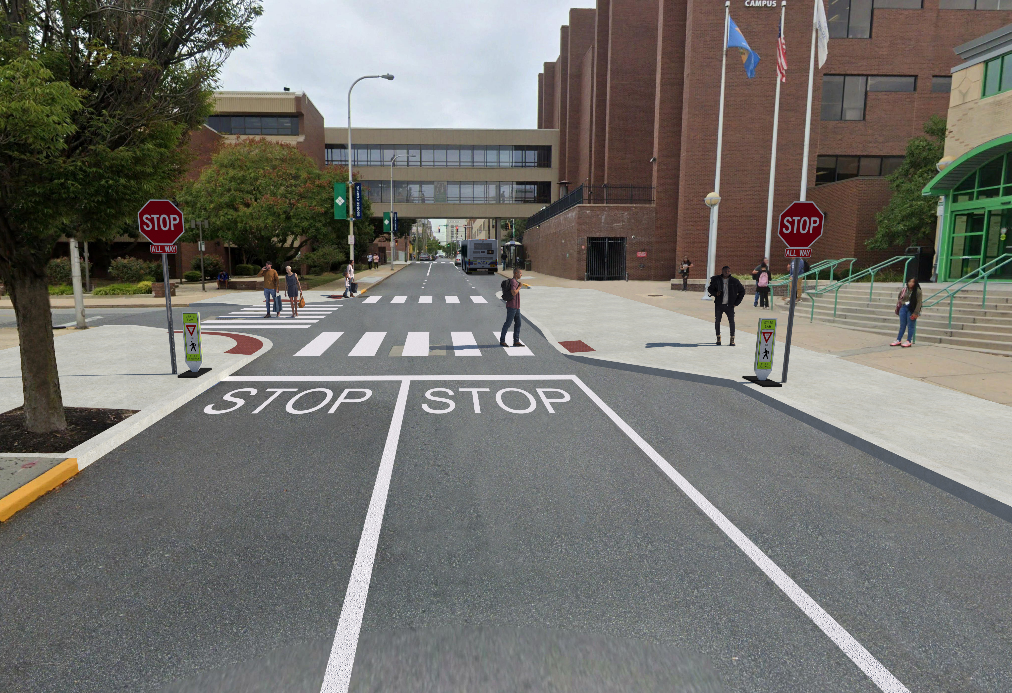
ORANGE STREET: Martin Luther King Blvd to 4th Street
DelTech Pedestrian Safety Improvements
Parking moved to east side of roadway between 2nd and 3rd Streets
DelTech shuttle bus pull-off on east side of road
Oversized stop signs and additional pavement markings at 3rd Street
Bump out at main entrance to reduce pedestrian crossing distance
For all locations, see concept plans at https://de.gov/wilmtransitcorridors
3rd and Orange Streets

Slide 6
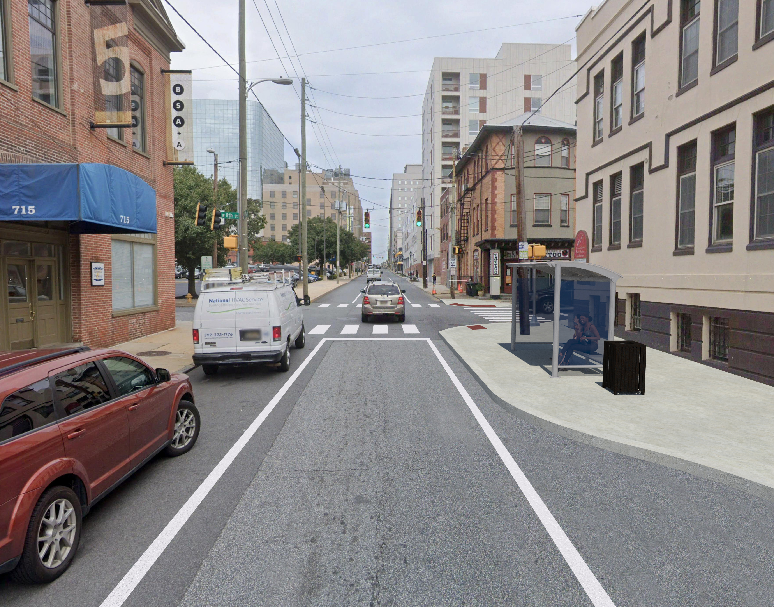
ORANGE STREET: 4th Street to 10th Street
One Travel Lane from 5th Street to 9th Street
Additional Parking on Both Sides of the Road from 5th Street to 9th Street for an added 42 parking spaces with no loss of loading zones
Bump Outs at bus stops at 6th Street and 8th Street, with Real Time signs at Bus Shelters
For all locations, see concept plans at
https://de.gov/wilmtransitcorridors
8th and Orange Streets

Slide 7
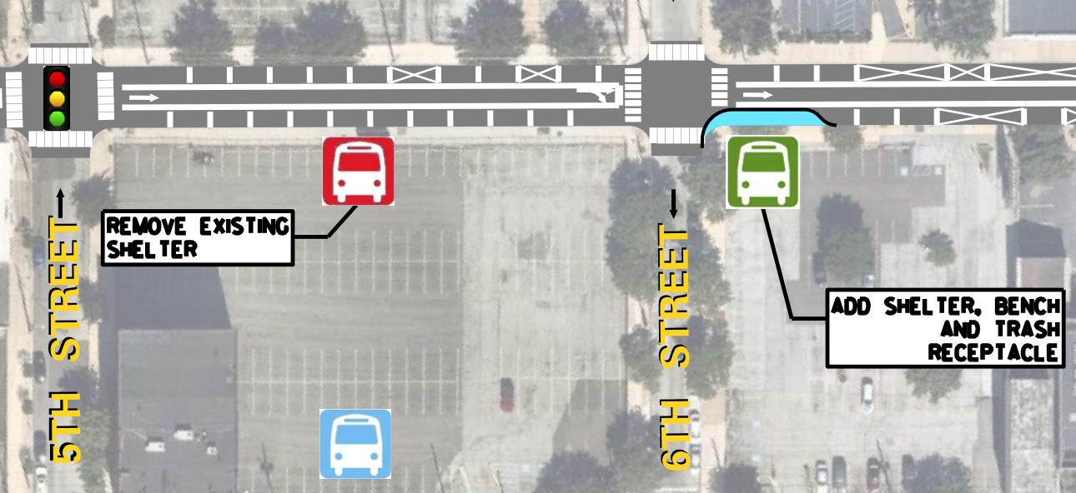
ORANGE STREET: 5th Street to 6th Street
DART Service Changes
Move Bus Stop between 5th and 6th Streets to a new stop on the north side of 6th Street

Slide 8
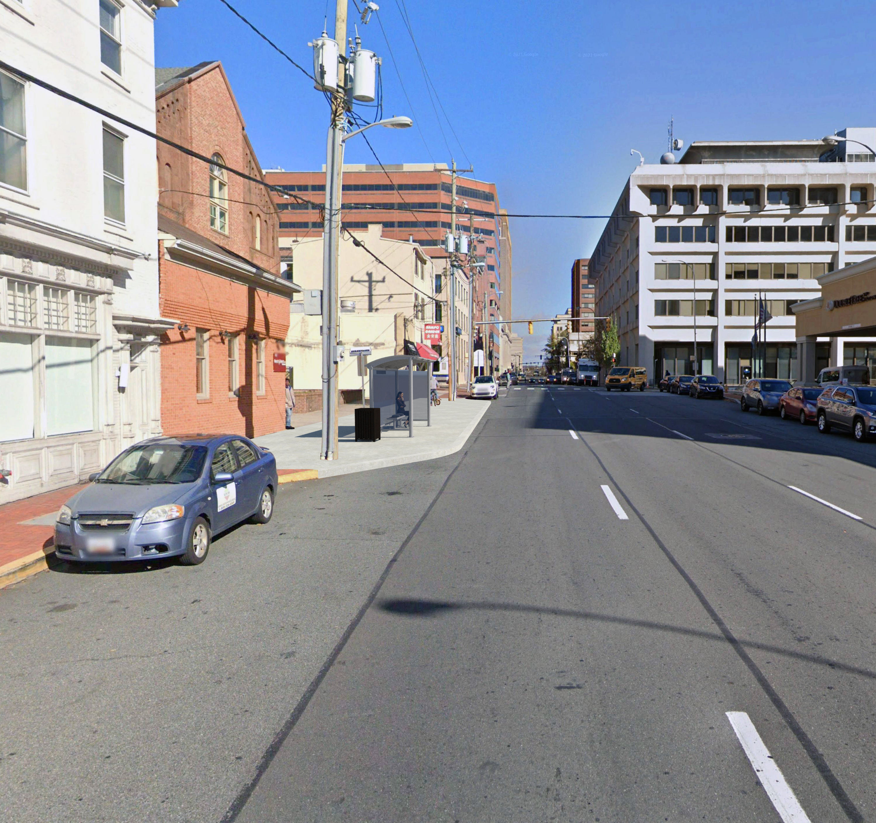
KING STREET: Martin Luther King Blvd to 10th Street
Bus Stops remain in existing locations
Shelters replaced with new style DART bus shelters
Real Time signs will be installed at each shelter
Bump outs constructed at all bus stops
No loss of parking spaces or loading zones
For all locations, see concept plans at https://de.gov/wilmtransitcorridors
6th and King Streets

Slide 9
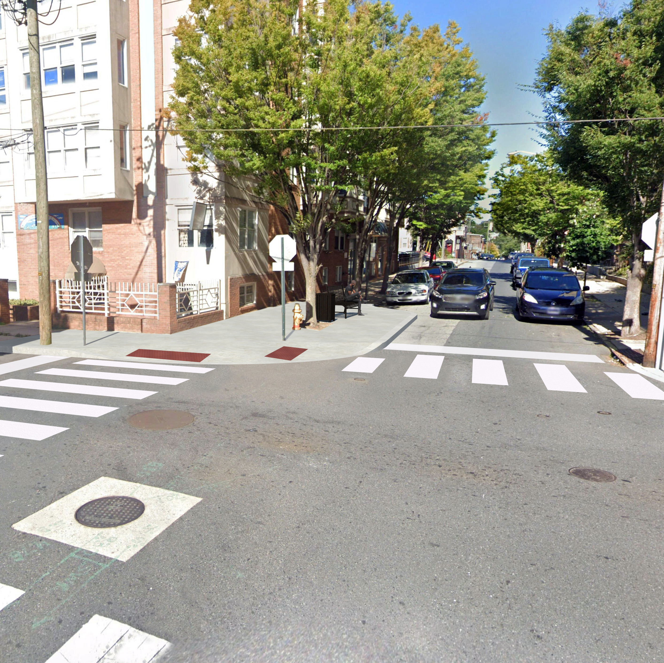
9th STREET:
Adams Street to Church Street
Bus Stops removed at Madison, Washington, Walnut, Lombard and Pine Street
Bus Stops added at West and Clifford Brown Walk
Benches and Trash Receptacles installed at every stop
Bump outs constructed at Monroe, Jefferson, West and Clifford Brown Walk
Real Time Signs will be installed at Bus Shelter Locations
There will be 2 parking spaces added along the 9th Street corridor
For all locations, see concept plans at https://de.gov/wilmtransitcorridors
9th and West Streets

Slide 10
DART Service Changes
9th STREET: Monroe to West Street
Monroe Street and Jefferson Street will be improved bus stops
Madison Street and Washington Street bus stops will be removed
West St will have a new bus stop

Slide 11
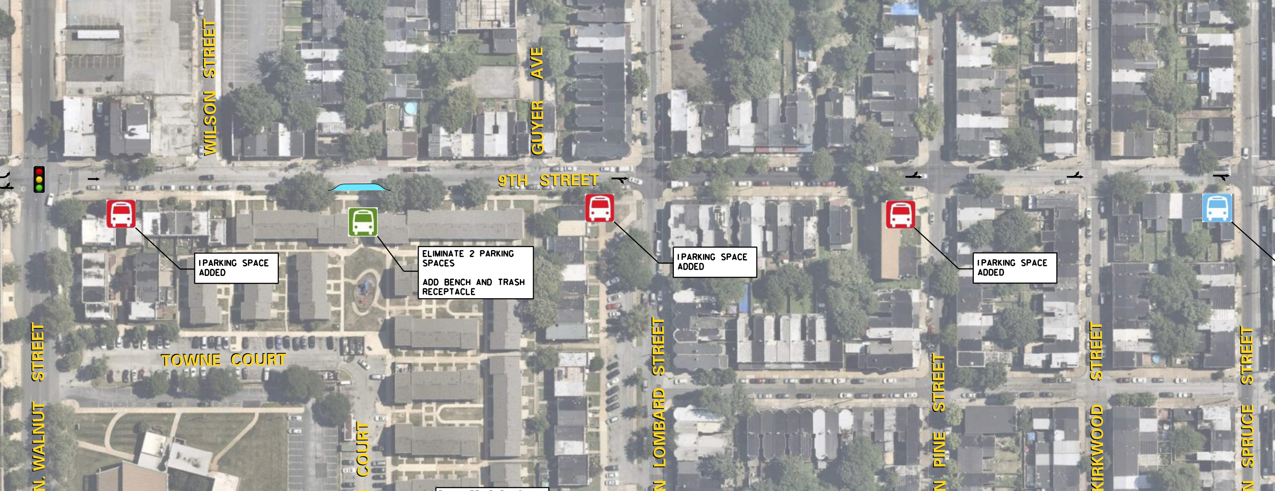
9th STREET: Walnut St to Spruce St
DART Service Changes
Walnut St and Lombard St bus stops will be removed and consolidated into a new bus stop at Clifford Brown Walk
The bus stop at Pine Street will be removed

Slide 12
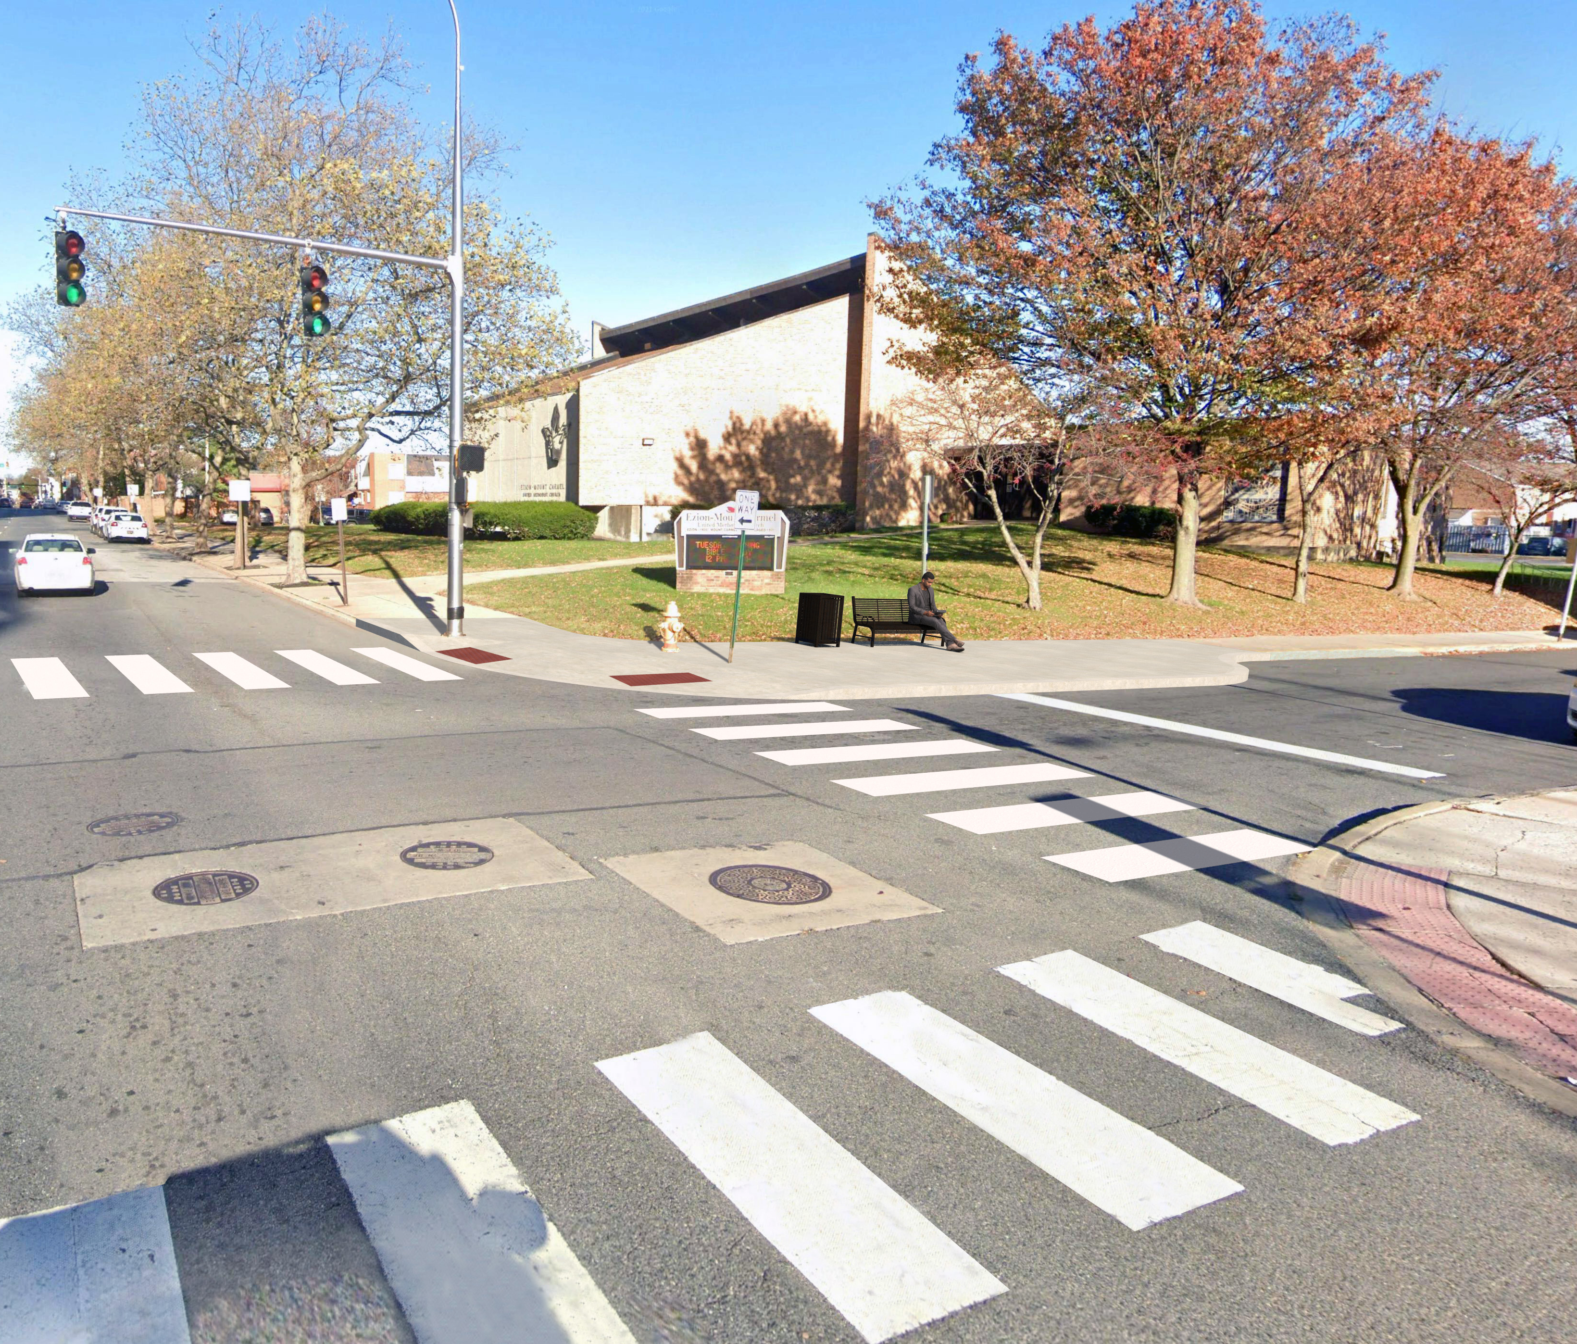
8th Street:
Adams Street to Church Street
Bus Stops removed at Morrow, Washington, and Orange Streets
Bus Stops added at Jefferson Street and moved from east corner to west corner at 8th & West Street and 8th & Lombard Street
Benches and Trash Receptacles installed at every stop
Bump outs constructed at Adams, Jefferson, West, King, Walnut and Lombard Streets
Real Time Signs will be installed at Bus Shelter Locations
There will be one parking space less along the 8th Street corridor
For all locations, see concept plans at https://de.gov/wilmtransitcorridors
8th and Walnut Streets

Slide 13
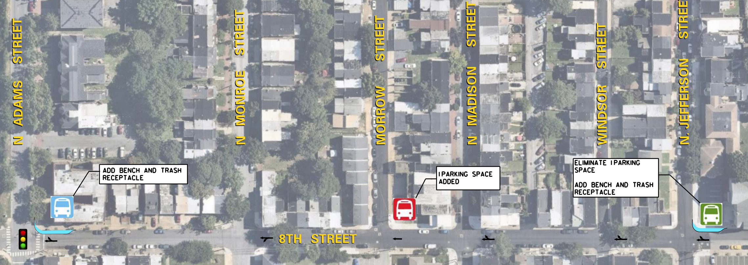
8th Street: Adams Street to Jefferson Street
DART Service Changes
Adams Street will have an improved bus stop
Morrow Street Bus Stop will be removed
Jefferson Street will have a new bus stop

Slide 14
8th Street: Jefferson Street to Orange Street
DART Service Changes
Jefferson Street will have an improved bus stop
Washington Street bus stop will be removed
West Street bus stop will be moved from the east side to the west side of the street
Orange Street bus stop will be removed

Slide 15
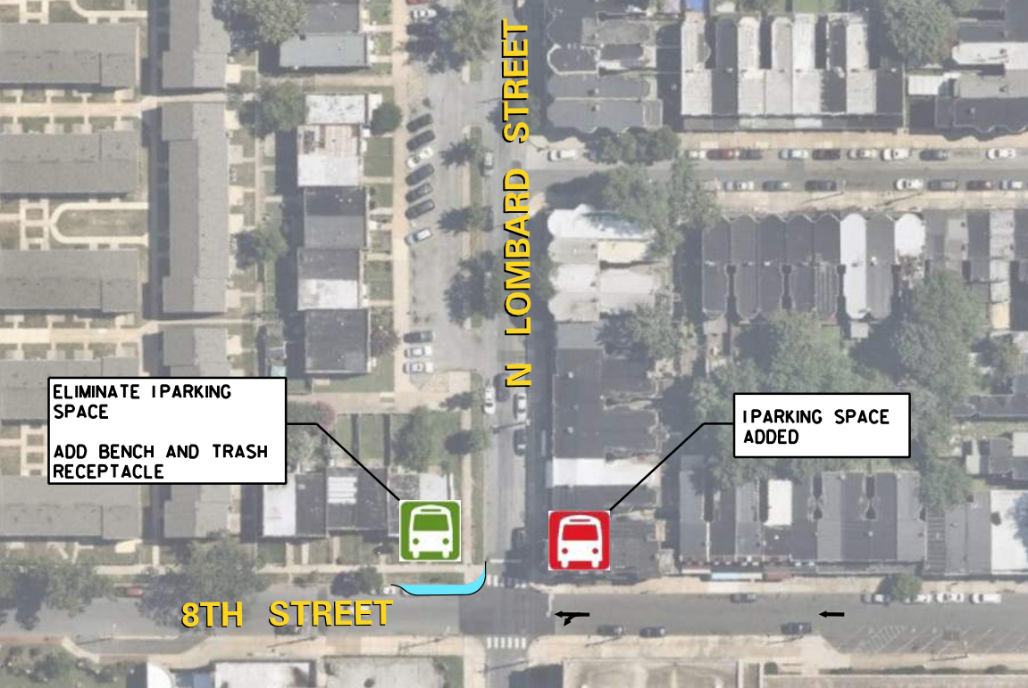
8th Street: Lombard Street
DART Service Changes
Move bus stop from the east side to the west side of Lombard to keep DART buses separated from school buses

Slide 16
Project Schedule
Final Design
Fall/Winter
2021
Advertisement Winter
2021/ 2022
Construction
Spring 2022
Project is constructed in coordination with the Restore the Corridor project (I-95)

Slide 17
More Information…..
Go to https://de.gov/wilmtransitcorridors
Concept Plans are located on the Website
Video recording of the Information Session is on the website

