Slide 1
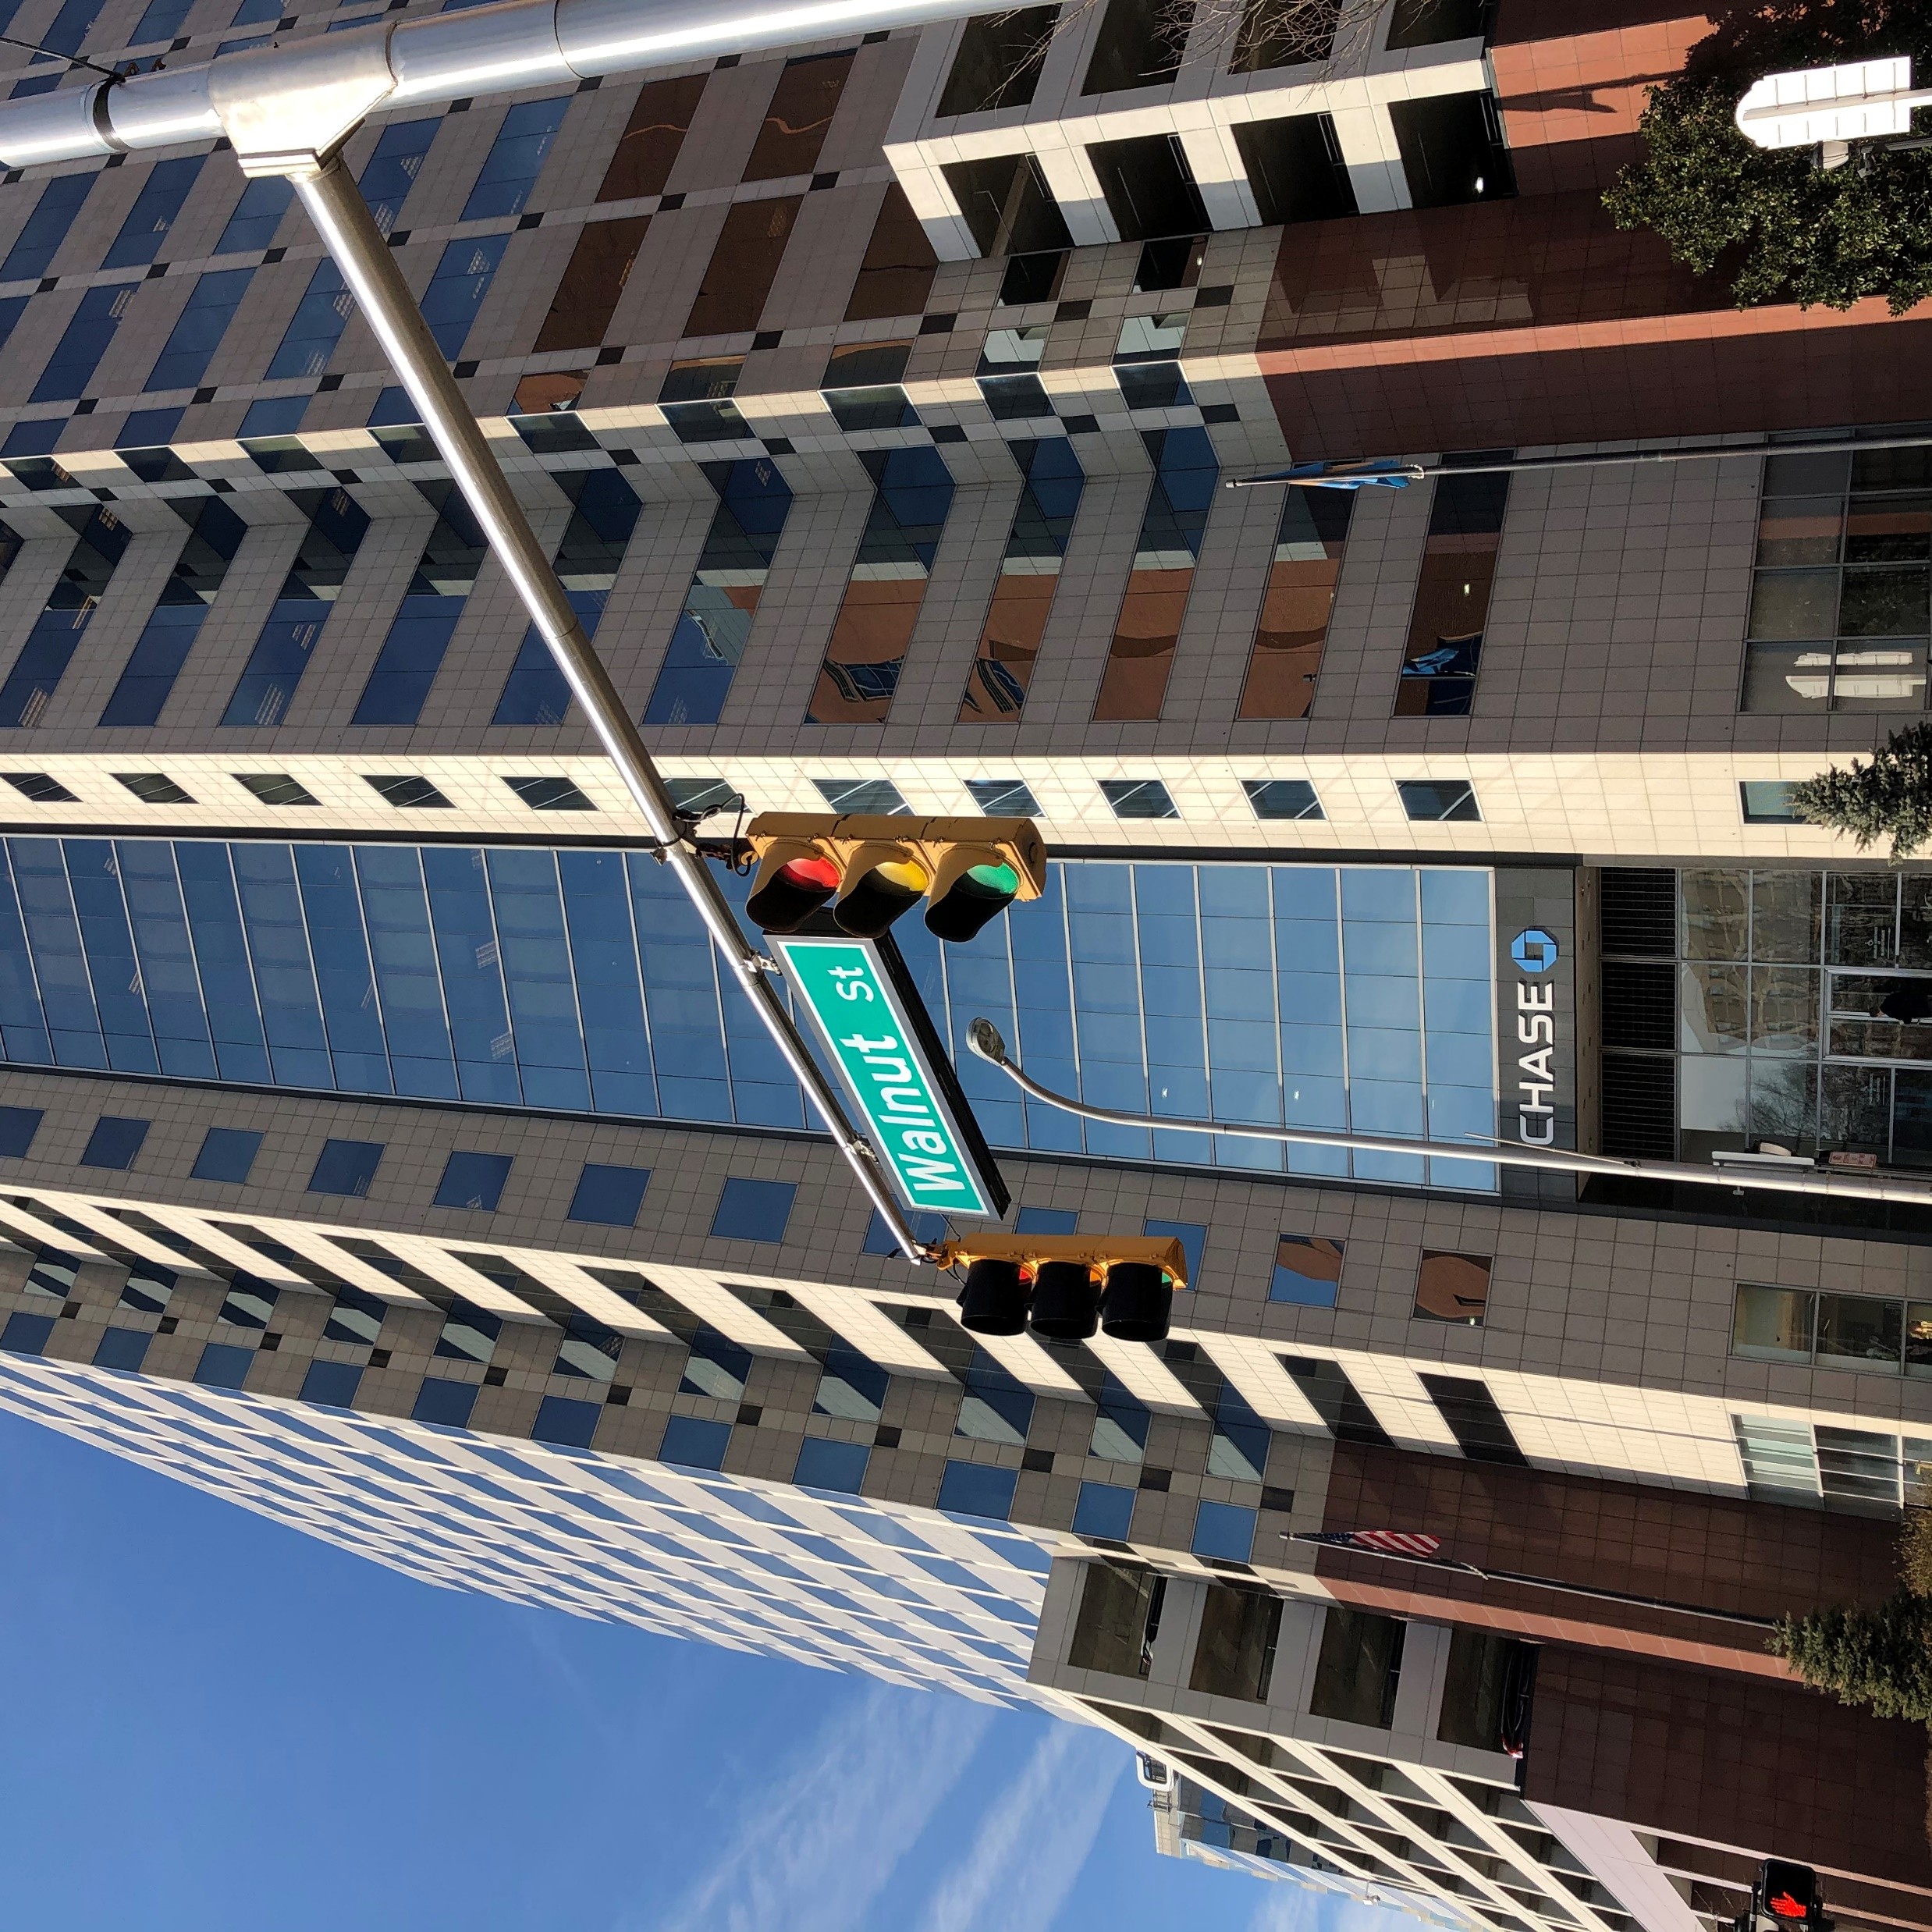
Public Works and Transportation Committee
February 16, 2022
Walnut Street Improvements

Slide 2
Project Design Team
Matthew Vincent, DelDOT, Chief of North Project Development
Diane Gunn, Century, Project Manager for DelDOT
Matt Goudy, RK&K, Designer
Project Partners
Walnut Street Improvements

Slide 3
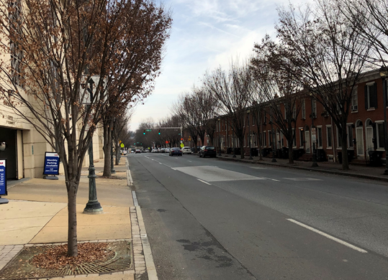
Project Limits and Goals
Integrate Bicycle Connectivity According to Wilmington’s Comprehensive Plan and Bicycle Plan
Reconnect the East Side neighborhoods to the Central Business District
Reduce Speeding by reducing the width of travel lanes and reconfiguring lanes
Create a more attractive, useable, safe corridor for pedestrians, bicyclists, motorists, and transit
Business District
Transition Area
Residential Area
Walnut Street Improvements

Slide 4
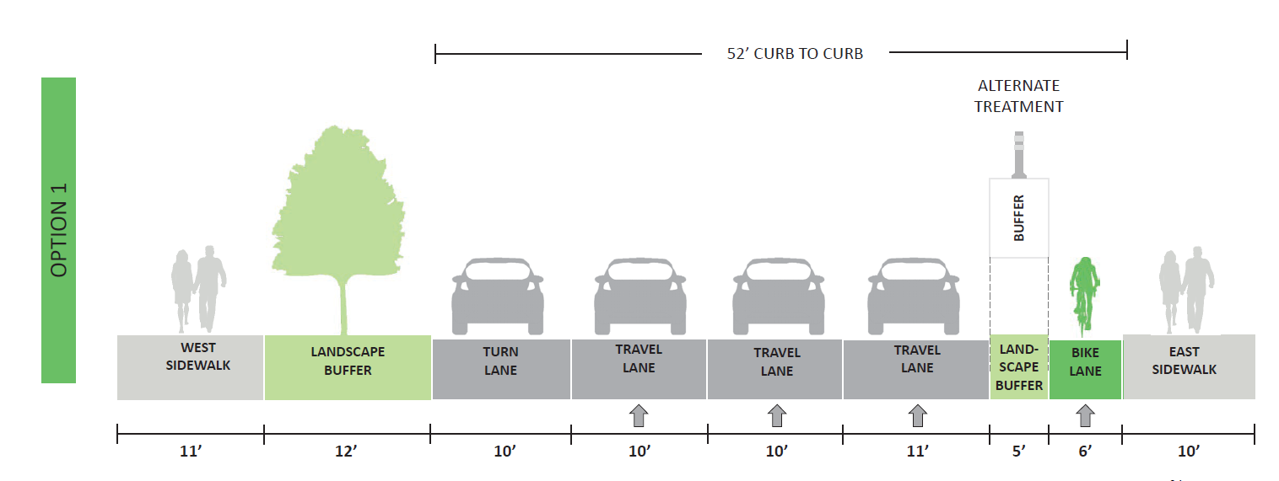
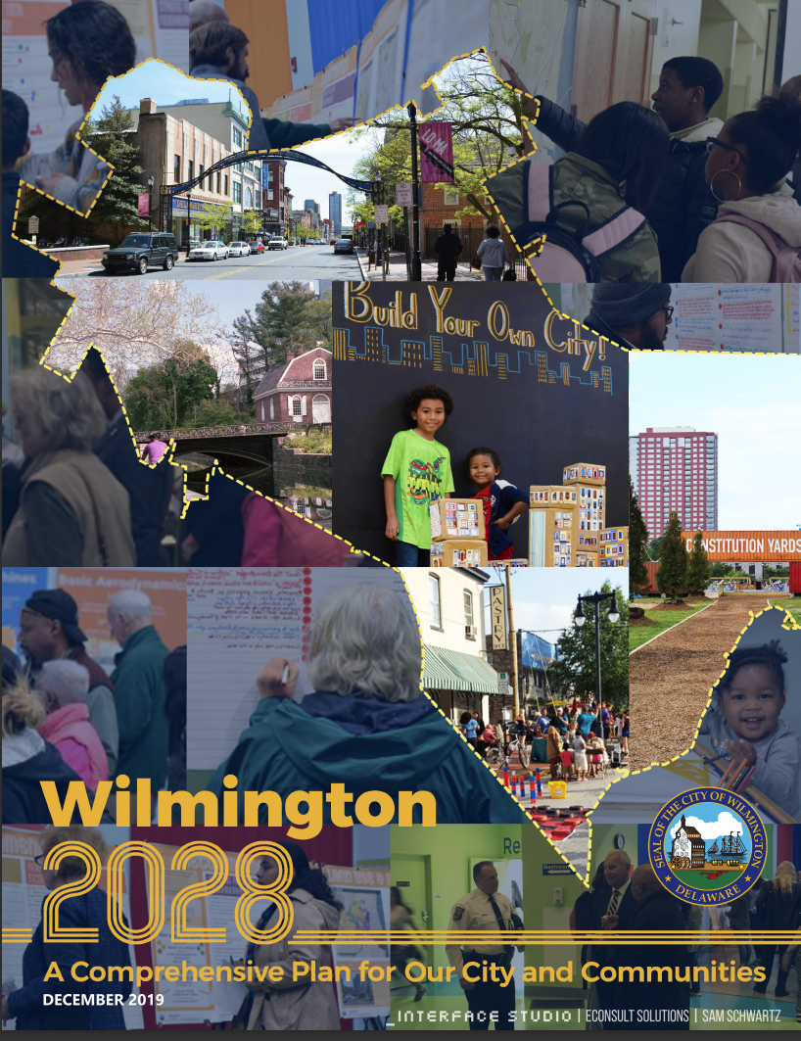
Planning Studies
Source: Wilmington Bike Plan, Priority Corridor Concepts Report
Walnut Street Improvements

Slide 5
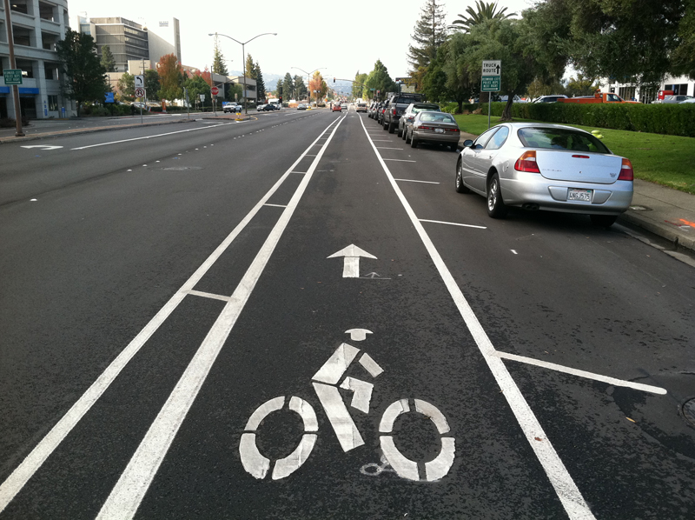
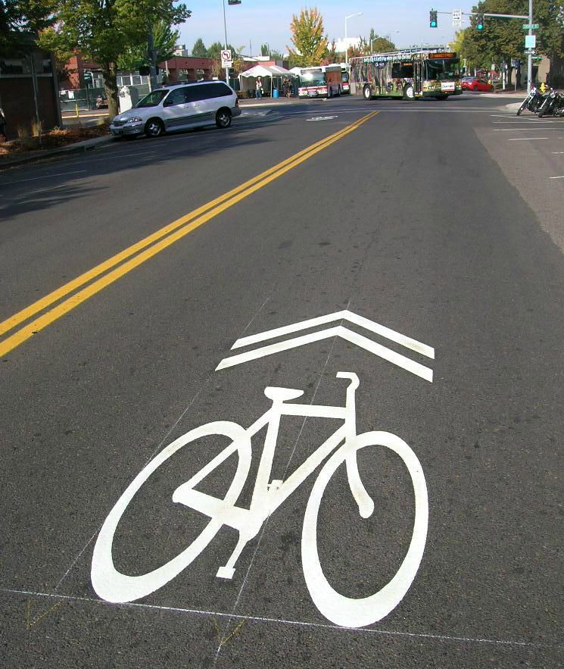
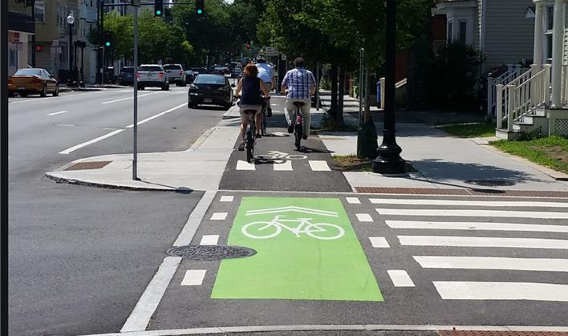
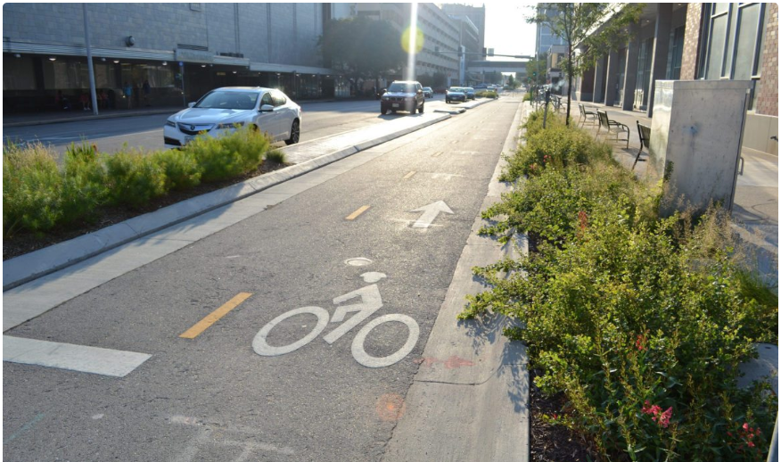
Bicycle Connectivity
Protected Bicycle Lanes
Buffered Bicycle Lanes
Shared Use Lanes
Right Side Bicycle Lanes
Cycle Track
Buffered Bicycle Lane
Protected Bicycle Lane
Shared Bicycle Lane
Cycle Track
Walnut Street Improvements

Slide 6
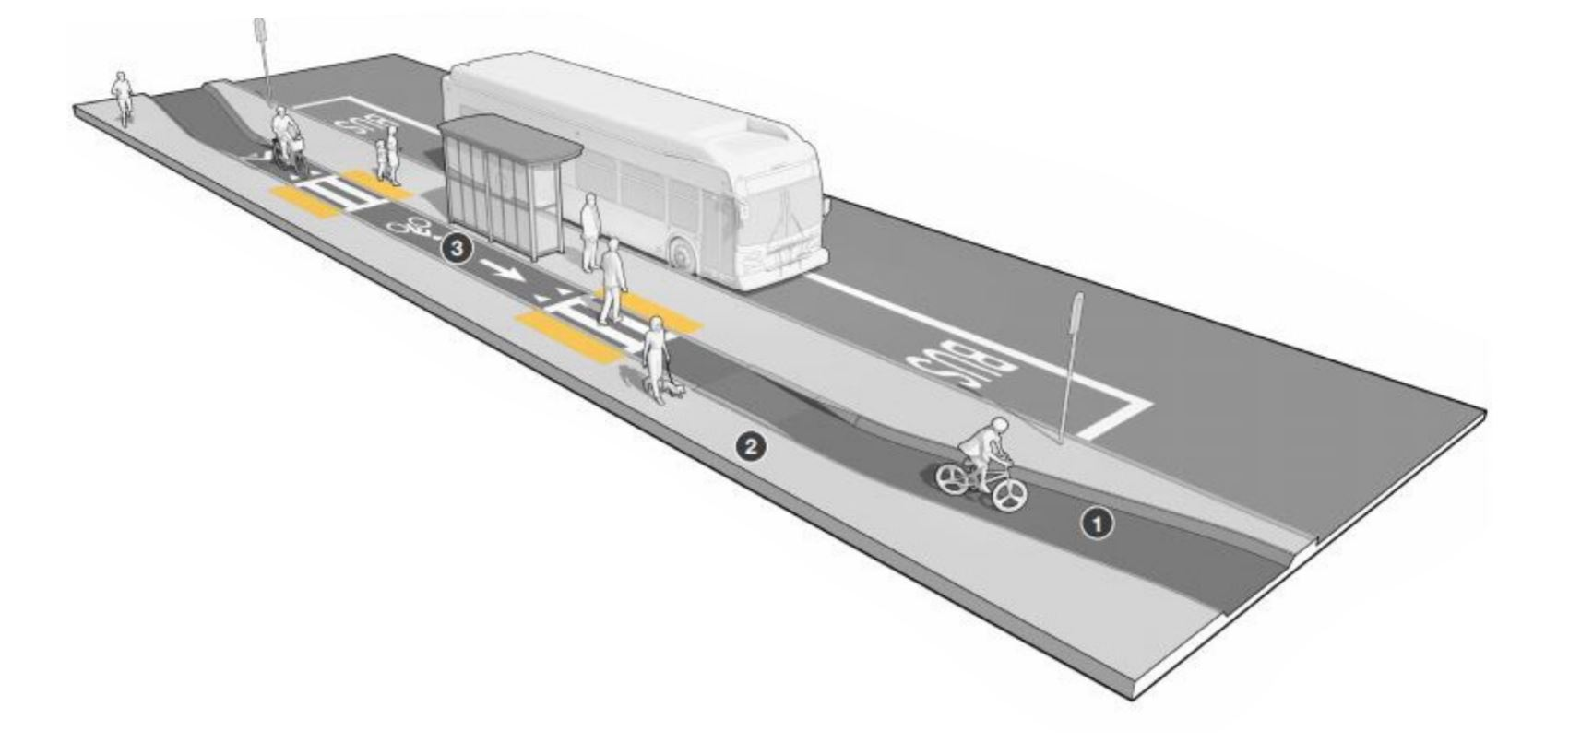
Floating Bus Stop
Allows Buses to Stop Curbside and Limit Stopping Times and Congestion and Delay
Provides Bicycle Buffer from Vehicles Reducing Conflicts
Provides More Space for Passengers Exiting Buses and Better Access to Sidewalks
Provides More Space for Amenities such as Benches, Shelters and Signage`
Walnut Street Improvements

Slide 7
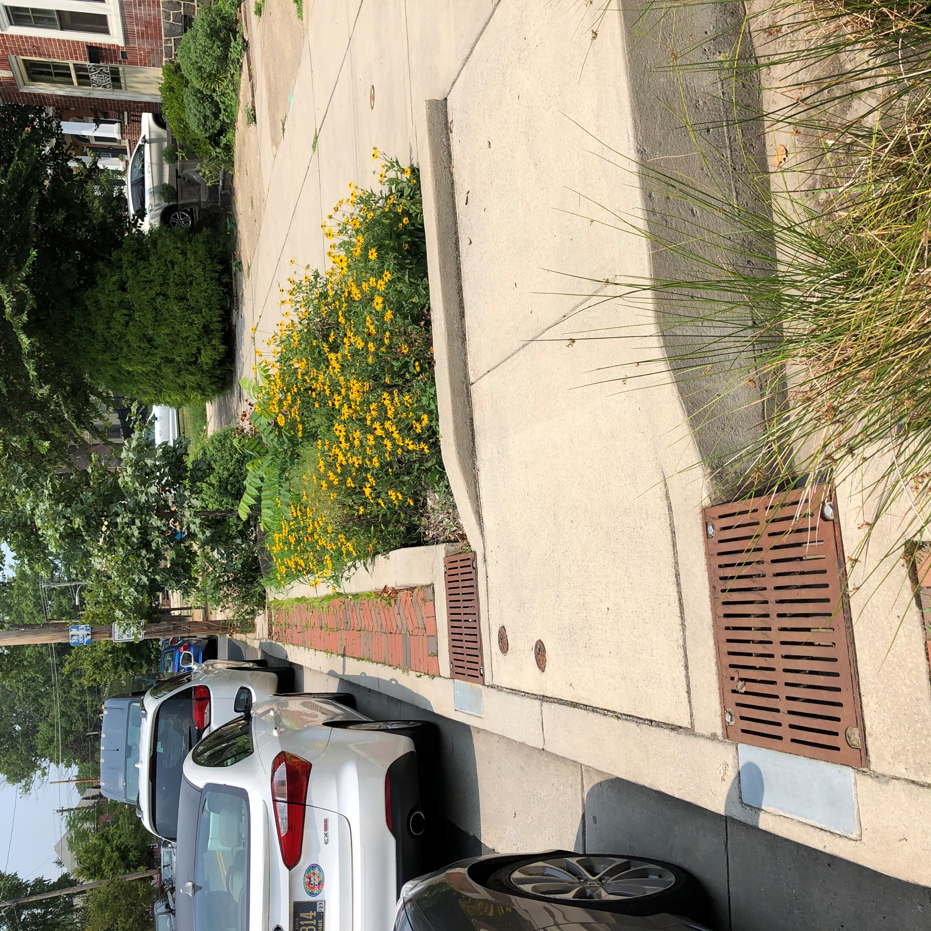
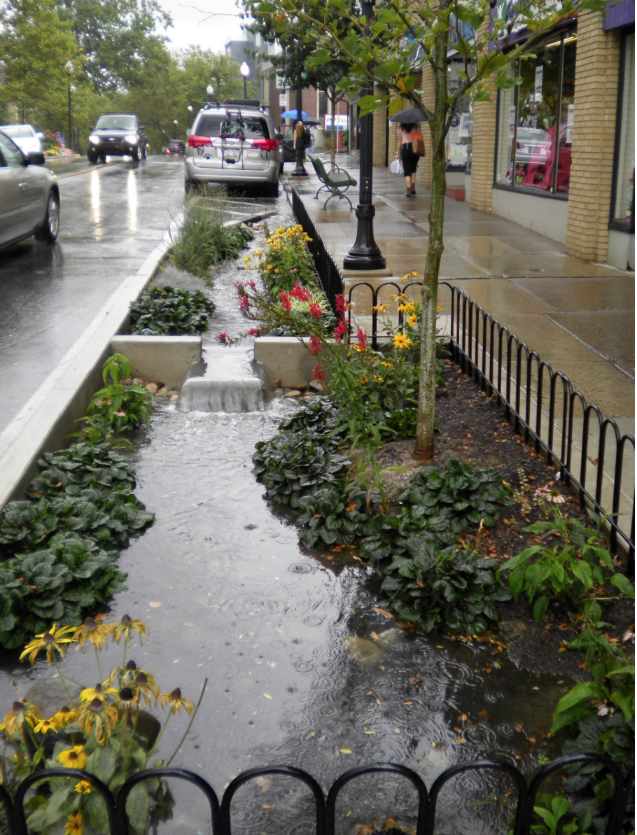
Beautification/Green Stormwater Management
Source: State College Borough
Delaware Avenue/
North Lincoln Street
Walnut Street Improvements

Slide 8
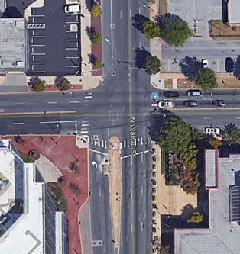
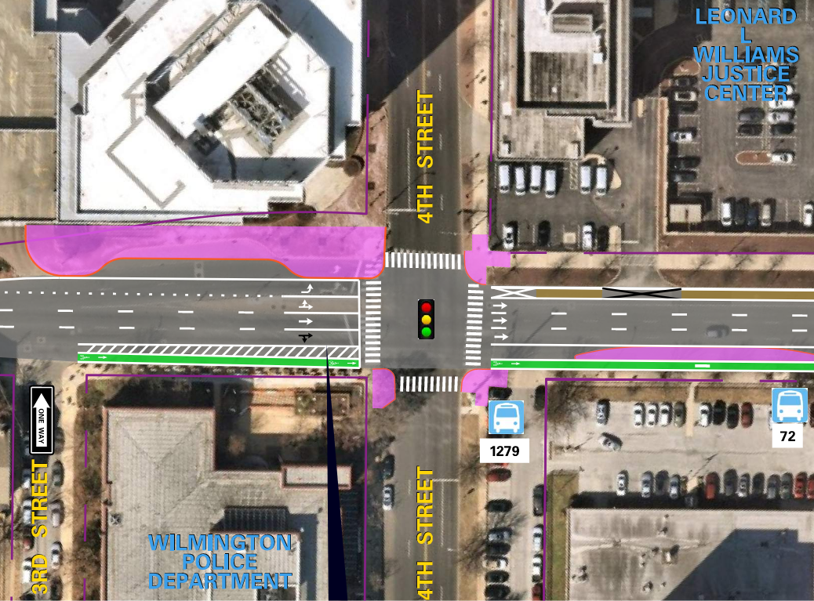
Walnut Street Visioning – 4th Street Intersection
Existing
Proposed
Walnut Street Improvements

Slide 9
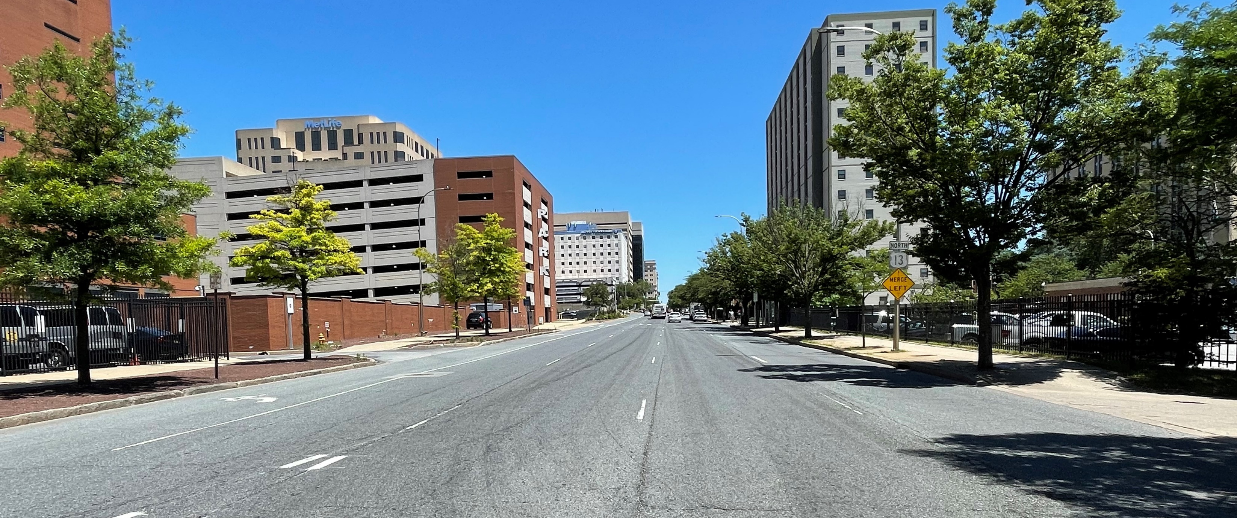
Walnut Street Visioning – 4th Street to 8th Street
Three Through Travel Lanes
On Street Parking on Right Side
Evaluate Left Turn Lane/Parking from 4th to 8th Streets
Right Side Bicycle Facility
Evaluate Floating Bus Islands at Bus Stop Locations
Walnut Street Improvements

Slide 10
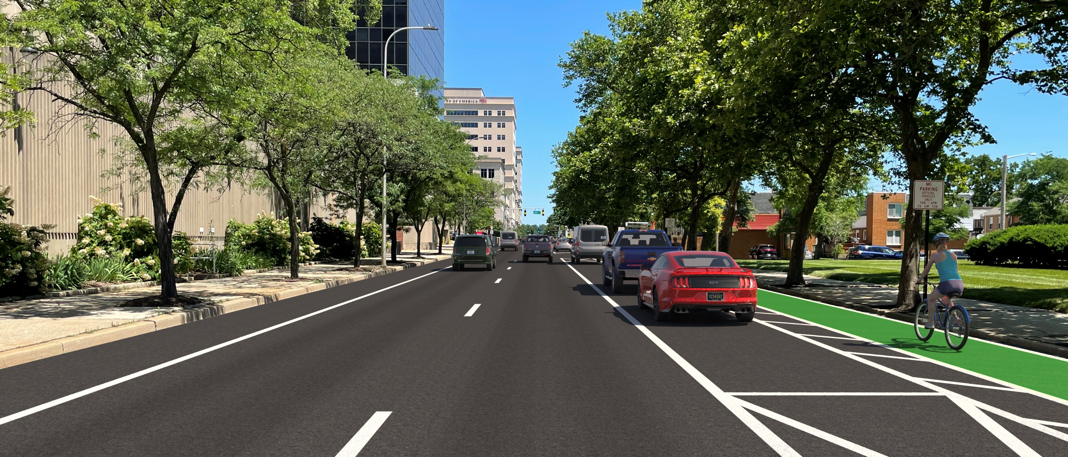
Walnut Street Visioning – 8th Street to 12th Street
Two Through Travel Lanes
On Street Parking on Right Side
Evaluate Off Peak Parking Lane
Right Side Bicycle Facility
Left Lane Heavy Parking Garage Traffic
Evaluate Floating Bus Islands at Bus Stop Location
Walnut Street Improvements

Slide 11
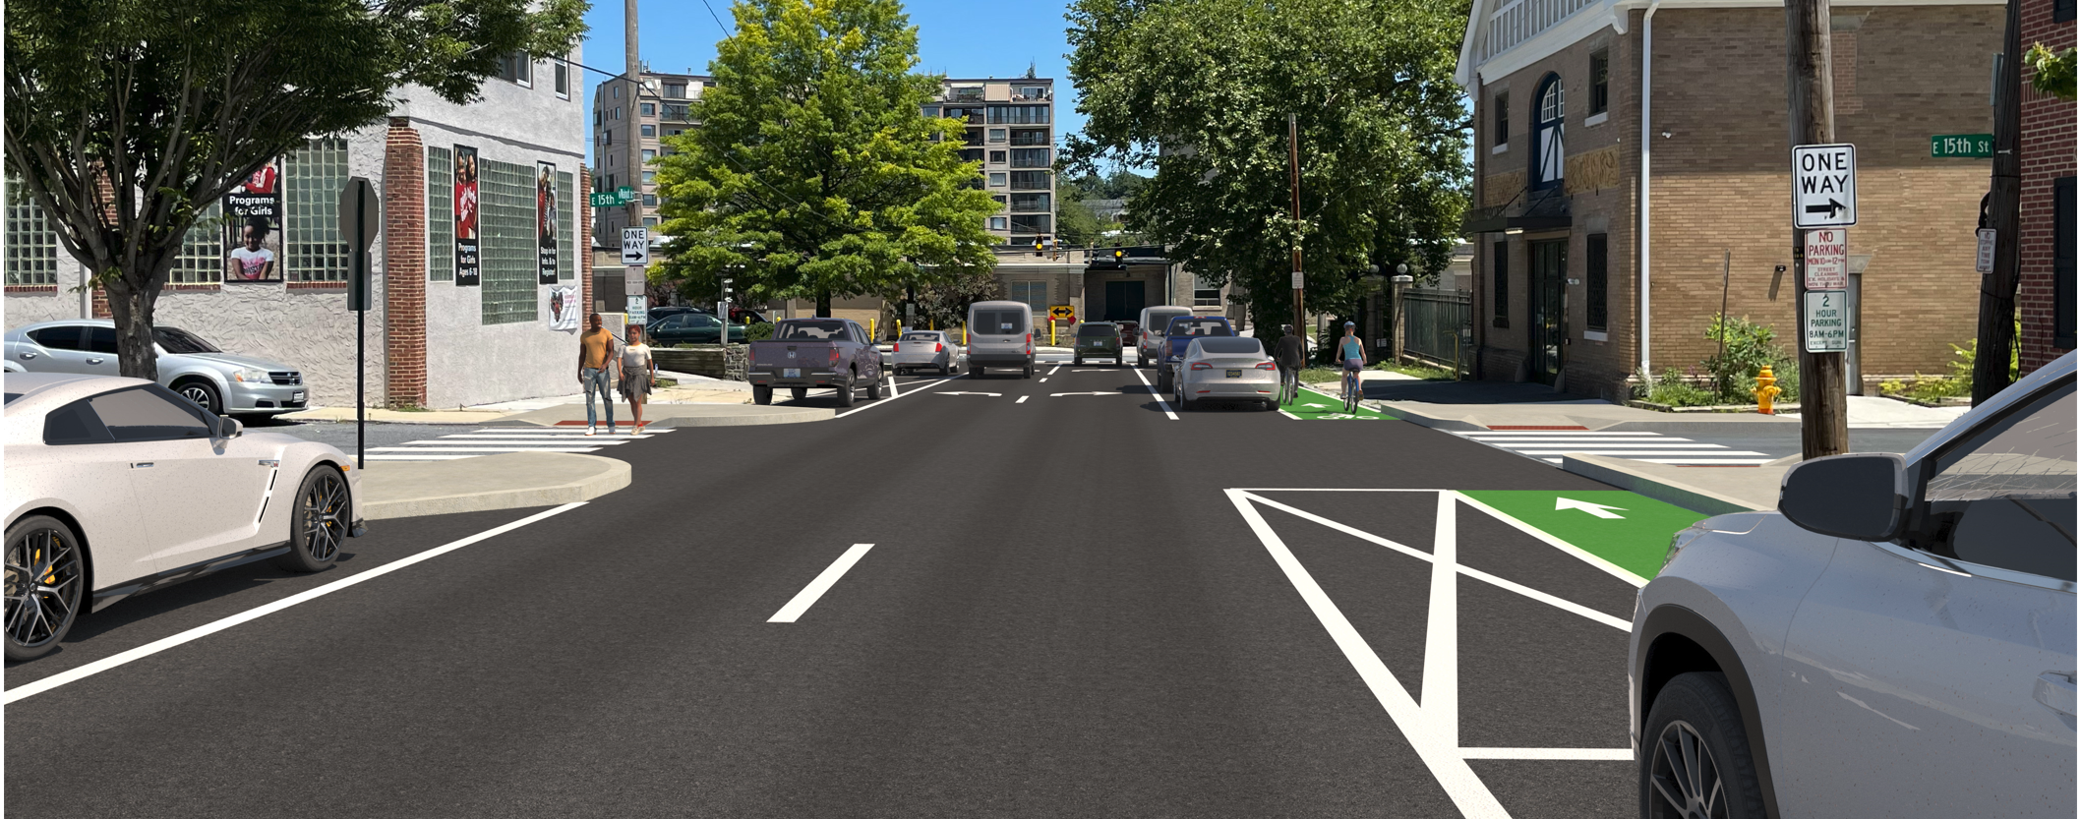
Walnut Street Visioning – 12th Street -16th Street
Two Through Travel Lanes
On Street Parking on both sides
Right Side Bicycle Facility Adjacent to Parking
Strategic Bump Outs to Minimize Pedestrian Crossing Distances
Bike Racks Placed Strategically near Businesses
Walnut Street Improvements

Slide 12
Walnut Street Visioning – Public Outreach
Virtual Public Workshop from February 8 to March 10
Live Presentation was held on February 8
26 Attendees
How do you currently use Walnut Street?
94% Drive
33% Walk
17% Bike
0% Transit
What is your biggest concern with Walnut Street in its current configuration?
32% Speeding
11% Accidents
32% Lack of Bicycle Facilities
16% Corridor Too Wide/Lacking Character
11% Other - Pedestrian Accidents
Website at https://de.gov/walnutst
Link to survey https://s.surveyplanet.com/okhxopu2
View the February 8th presentation on YouTube
View the PowerPoint presentation
Walnut Street Improvements

Slide 13
Walnut Street Visioning – Next Steps
https://de.gov/walnutst
Concept Development
2022
Design
2023
Construction 2024
Ongoing Public Outreach
Project is constructed after the Restore the Corridor project (I-95)
Walnut Street Improvements

