Slide 1
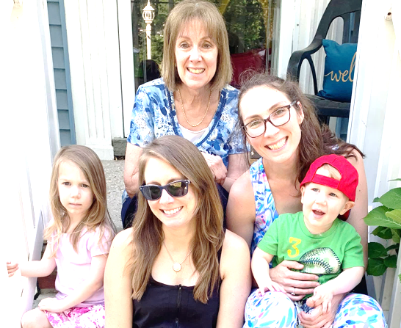
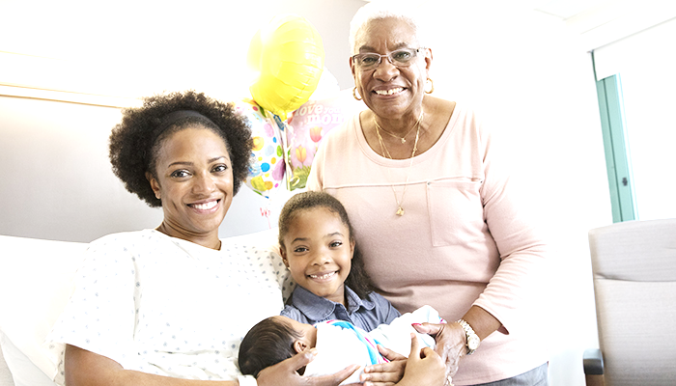
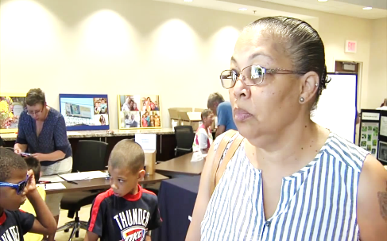
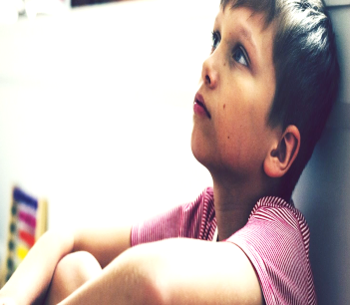
HIGH IMPACT 2B
Bernadette Mills, M.Ed.
Grandparents raising grandchildren

Slide 2
HIGH IMPACT 2b GRANDPARENTS Raising grandchildren
I. INTRODUCTION
BACKGROUND & RESEARCH
II. HIGH IMPACT GRANDPARENTS SPEAK (1 MINUTE)
LESIE LINDSEY
SYLVA KING
JUDY HUTT
JANICE LAMMONS
PROPOSED PROGRAMMING & RESOURCES
CONTACT INFORMATION
“You don’t really understand something until you can simply explain it to your grandmother” Albert Einstein

Slide 3
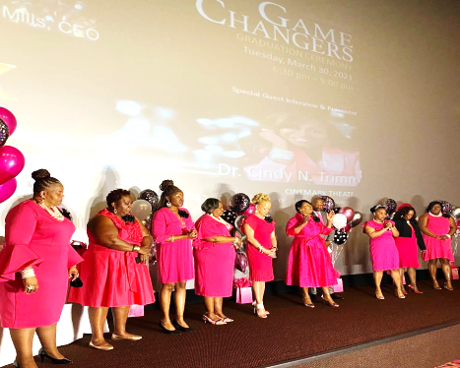
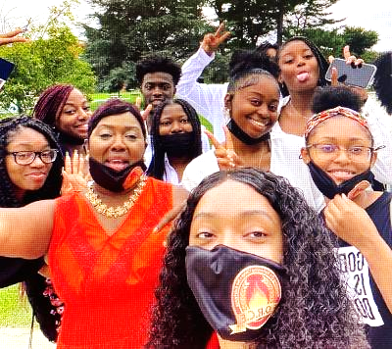
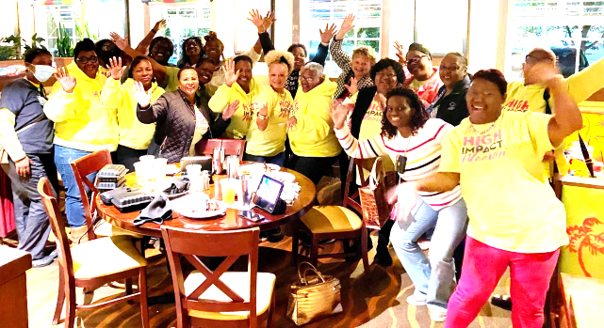
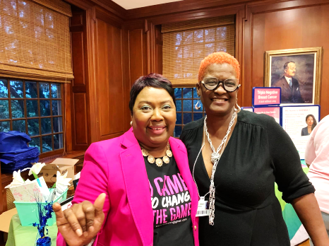
High Impact 2B (501c3) New Castle, DE 19720 (302) 740-1546 Email: Highimpactbm@gmail.com
HIGH IMPACT 2B (501C3), was created in 2015 to equip, educate and empower women, parents and students specifically. This has been accomplished through partnerships with schools, community agencies and faith based institutions such as; The Delaware Fatherhood & Family Coalition, Delaware Department of Prevention and Behavioral Health, Stubbs Elementary School, Parents as Teachers, A.I. DuPont Middle School, Through the Word Church and the Delaware State University. In 2020, I was invited to co-present at the Atlanta World Congress as a result of the outcomes accomplished with parents and students through my partnership with A.I.DuPont Middle School alongside, Dr. Susan Huffman, Principal at that time. Also, High Impact has reached over 100,000 homes here in the state of Delaware as a result of a grant from the Delaware Department of Prevention and Behavioral Health which underwrote the summer television program “High Impact Parenting”, on TV 28. High Impact has been intentional about contributing to the mental health of women throughout the pandemic. This has been done by hosting “GAME CHANGERS”, a four-week in-person session covering topics such as Self-Care, Mental Health & Wellness, Vision Boarding, Parents & Zoom, Entrepreneurship, Women in Transition and Women in Leadership. This allowed women to connect with other like-minded women, change their environment, and share their story . This enabled them to regain their personal power, their voice and have an exchange of resources. We held three cohorts in 2021 and graduated 21 to 42 women with each cohort. There was no cost to the attendees to participate and the sessions were held at the Buena Vista Conference Center.
BERNADETTE MILLS, CEO
Harvard University
Family Engagement
Certification
12-week Program 2021
Wilmington University
M.Ed. Secondary School
Counseling
Temple University B.A.
Business Education
Proctor Education Award
Ordained Minister
Married over 31 years
Five Millennial Children
Author
Certified Prepare & Enrich Marriage Counselor
High Impact Parenting
Bernadette Mills, 2022 Cover, Women of More Magazine, Presenting at the Atlanta World Congress w/Dr. Susan Huffman, Game Changers Graduation, DSU students connect, High Impact Women Outing, Christiana Care Breast Cancer Awareness

Slide 6
HIGH IMPACT 2b GRANDPARENTS Raising grandchildren
HIGH IMPACT GRANDPARENTS SPEAK (1 MINUTE)
Lesie Lindsey, Owner Of Tropical Café Smoothie
Sylva King, Retired, Crafter, Volunteerism
Judy Hutt, M.Ed., Mental Health
Janice Lammons, Author, Faith-based, Drama
“You don’t really understand something until you can simply explain it to your grandmother” Albert Einstein

Slide 7
High impact 2b
Bernadette Mills, M.Ed.
HIGH IMPACT GRANDPARENTS ACADEMY (In their community)
Facilitators: High Impact Team
Each Session Would Include: (transportation necessary for some)
Needs Assessment 10 Minutes (First Session Only)
Goal Setting 5-10 Minutes
LUNCH 30 Minutes
Guest Presenters (i.e. topics: technology support, tutoring for grandchildren, trauma counseling for angry youth, social services, parents in prison, on drugs or deceased, health/nutrition, transportation, self-care, estate planning, caregivers, life/rental insurance, summer programs, after school programs, interface with schools, mindfulness) 20-30 minutes (including application)
Activities & Engagement: Crafts, Dance Lessons, Pottery, Resume Writing, Social Media, Volunteer/Service, Cooking Session & More 30 Minutes
Celebration Ceremony Upon Completion of the Series

Slide 8
High impact 2b
Bernadette Mills, M.Ed.
RESOURCES:
EASTER SEALS, Nancy Ranalli, (302) 221-2033
Adult Day Care
Caregiver Stipends For Those Caring For Loved Ones
Transportation Services
Social Services
Geralyn Aellis, Delaware State Division of Services for the Aging and Adults with (DSAAPD)
Representatives to come to the community
The Libraries Of Delaware
provide free classes of all kind

Slide 9
High impact 2b
Bernadette Mills, M.Ed.
CONTACT INFORMATION
BERNADETTE MILLS, M.Ed.
New Castle, DE 19720
(302) 328 5557
(302) 740 1546 (cell)
Highimpactbm@gmail.com

