Slide 1
The Healthy Village at Saint Francis
Partnership for the Common Good
September 2022

Slide 2

“If we are known as an organization that does more for its communities in connecting clinical care with social needs, then we will have made a difference.”
Mike Slubowski, CEO, Trinity Health, May 2022
“The wings of transformation are born of patience and struggle.”
Janet Dickens
September 2022

Slide 3

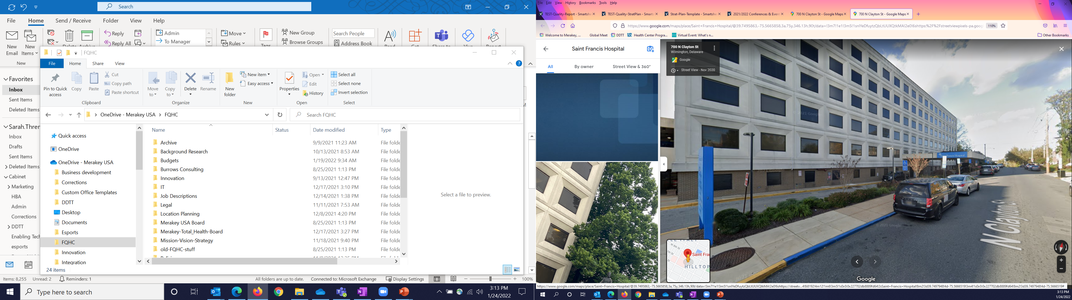




The Wilmington Community is Facing Challenges that are Familiar in the State of Delaware
Affordable Housing
Equitable access to health care
Career training and education
Substance use and mental health
Impact of trauma on health due to gun violence and crime
September 2022

Slide 4
Interviews with Community Members &
Saint Francis Staff Highlight the Community’s Needs
Behavioral Health (including substance abuse services)
Education, Job Training, and Skills Development
Senior Services
Affordable Housing
PRIMARY CARE
September 2022

Slide 5

What is a Healthy Village
The Power of the Platform
Healthy Villages are communities of varying scale created at the intersection of neighborhood planning and community health. Through the coordination and integration of investments and services, Healthy Villages improve quality of life and enrich the vitality of neighborhoods while protecting their heritages, histories, and residents. The Healthy Village model is designed to enhance the traditional safety-net hospital model. The partners are selected according to investments in health and the Social Determinants of Health (SDOH).
September 2022

Slide 6
The Opportunity
The Healthy Village model is appropriate for safety-net hospitals.
Saint Francis is ideal for a Healthy Village transformation.
Implementation and financial challenges are mitigated due to anchor hospital use supplemented by the the Power of the Platform and collaborative social impact investing (ESG - Environmental, Social, Governance).
Healthy Villages resonate with the future of healthcare.
September 2022

Slide 7
Healthy Village Partners Will Jointly Create an Integrated System of Care
Whole-Person Care is at the center of the Healthy Village model and is the gateway to connection with other services and supports in the community
A team-based approach utilized by participating partner organizations is essential to creating a whole-person model of care
Services and programs can be housed together in one building and spread throughout the community – the essential elements bringing the village together are communication and information sharing
September 2022
7

Slide 8
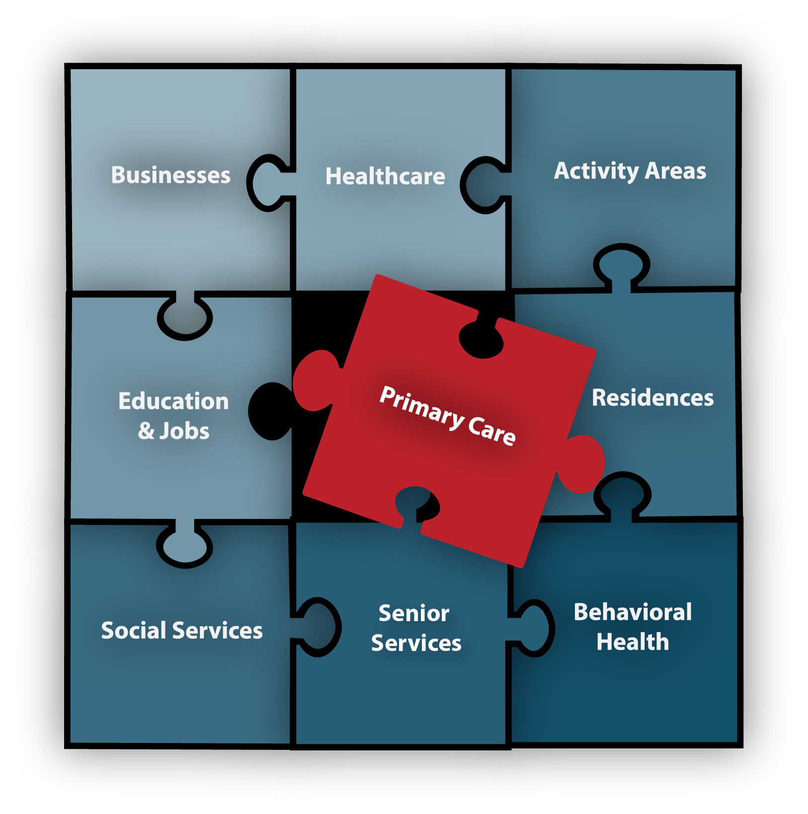
The Healthy Village Model
Addressing Safety-Net Hospitals’ Challenges
Hospitals located in communities with high percentages of Medicaid, Medicare, and self-pay, are struggling throughout the U.S.
The pandemic exposed and accelerated existing trends, placing more stress on these hospitals.
New models of care are needed that integrate treatment and services which address SDOH.
Healthy Villages do not replace critically needed treatment services, rather they enhance them in manners which are relevant to value-based reimbursement models and the future of challenged neighborhoods.
Underutilized space at these safety-net hospitals can be renovated to house partners who focus on the SDOH.
The Healthy Village planning process identifies partners and services and integrates them in an optimal manner. Integrated behavioral health and primary care provides the glue.
September 2022

Slide 9
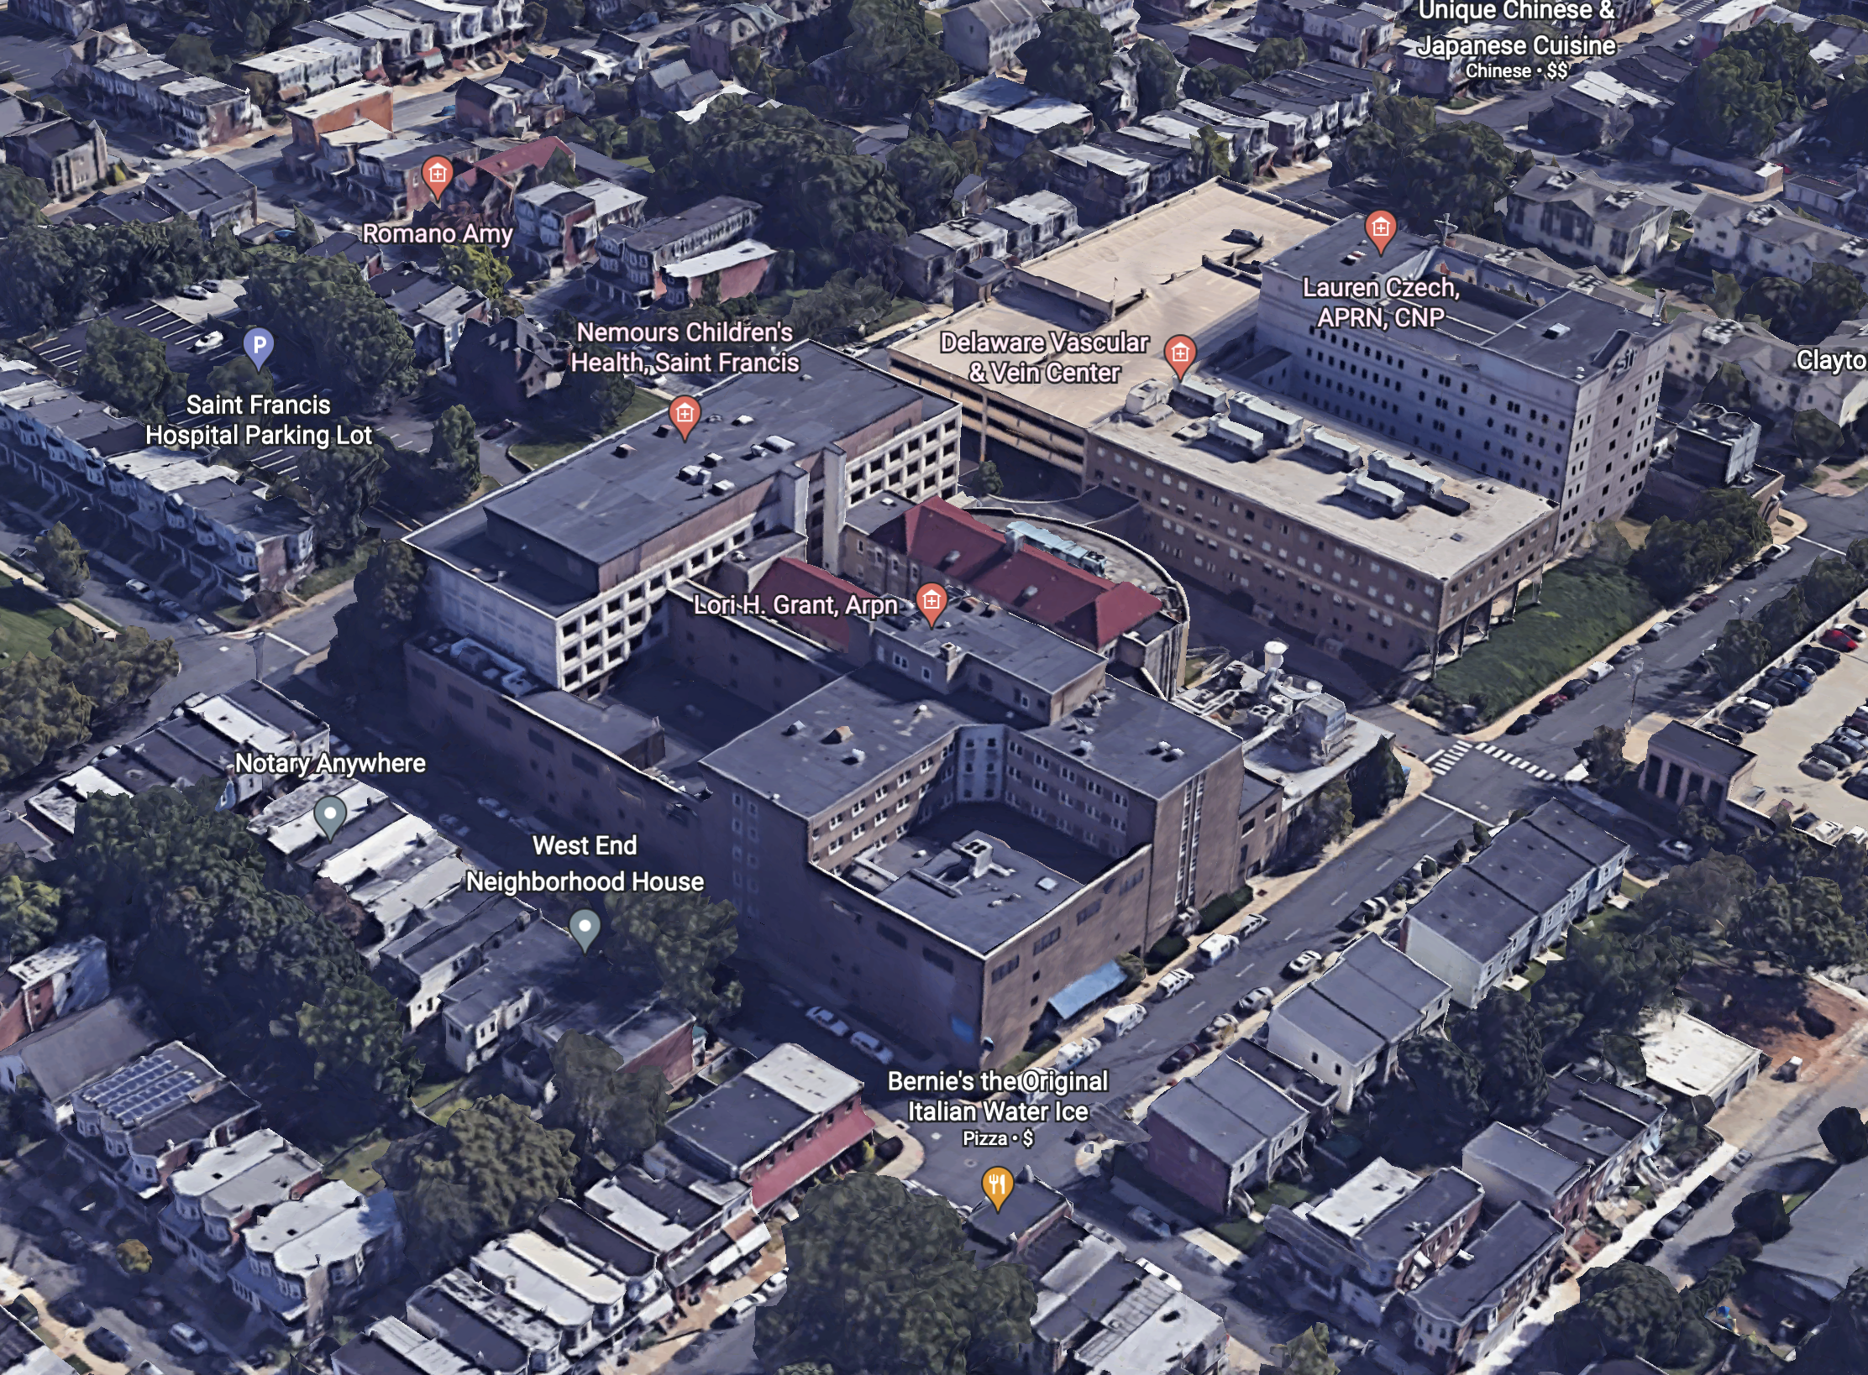
Saint Francis Transformation
Conditions That Make Saint Francis Ideal for a Healthy Village Demonstration
Anchor Hospital Foundational Platform
Underutilized Space
Serious Interest Expressed by:
  State
  Partners
    Integrated Primary Care (Physical and Behavioral Health)
    Outpatient Behavioral Health / Substance Abuse
    Education and Workforce Training
    Senior Services
    v. Affordable Housing
  Funders
Saint Francis Caring Brand
Buildings have been well maintained
Replacement cost would amount to $ hundreds of millions
but for a fraction of this total, we can make Saint Francis partner ready
September 2022

Slide 10
Recommendation for Healthy Village at Saint Francis
Partnership for the Common Good
Saint Francis will create a financially stable, centralized, purposefully-designed facility that strives to take care of the whole person and their community – emergency and acute health needs, behavioral healthcare, Long-Term Services and Supports, education and skills development, SDOH investments and economic revitalization. The ultimate one-stop community center of care, trusted location that creates and promotes partnerships, diversity, equity, synergies, and opportunities for the sustainable common good.
September 2022

Slide 11
Partner Responsibilities and Relationships
Challenging others to invest and partner is foundational to the Healthy Village model.
Stakeholders include community-based organizations, managed care organizations and other payers, social impact investors, risk-bearing entities, foundations, governments, behavioral healthcare and senior care providers.
Each partner, including Saint Francis, is focused on a different aspect of health and the SDOH; partners will be added incrementally.
Investments will be made to leverage synergies from the co-location.
A key objective is to lower occupancy costs for Saint Francis and partners.
We Listen We Partner We Make it Easy
September 2022

Slide 12
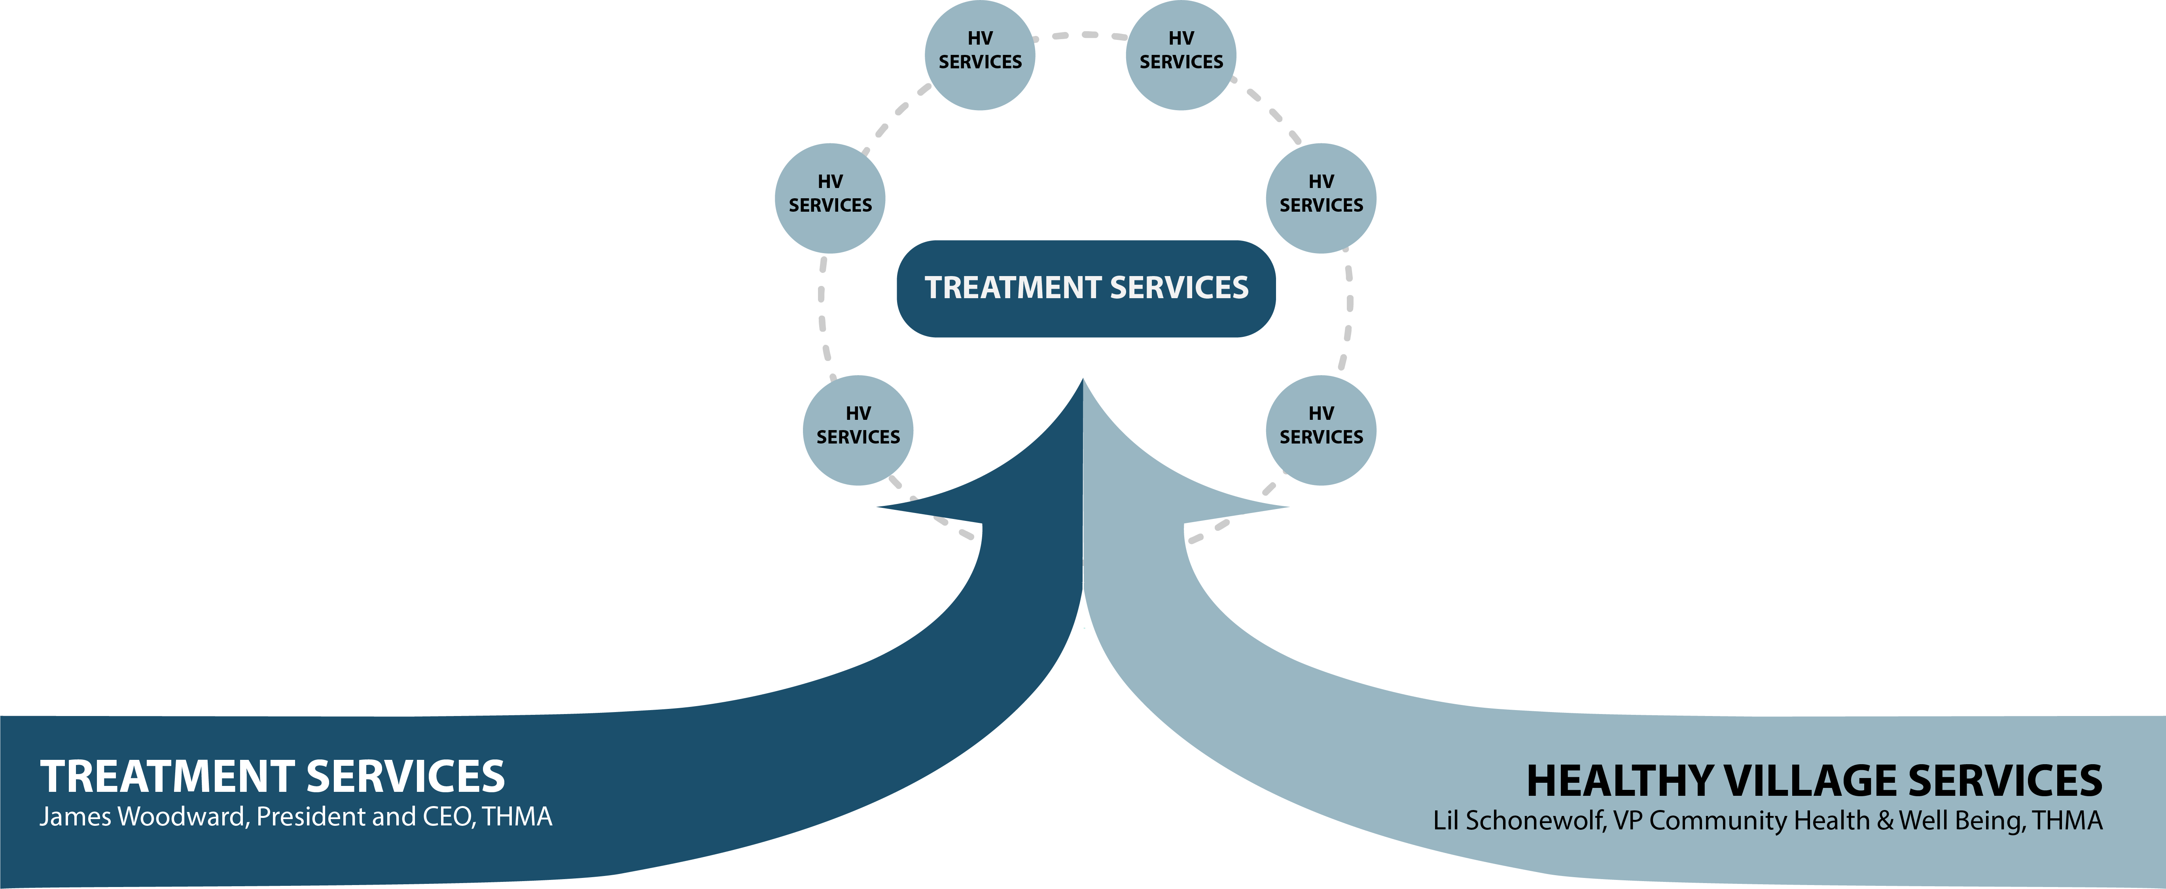
Two Converging Paths
September 2022

Slide 13
Healthy Village Design Principles
Realizing the Power of the Platform
Provides neighborhoods with a strategy for economic stability.
Furnishes components necessary to create a healthy community and for residents to “grow in place.”
Fosters the interaction between each of the service providers.
Promotes health and safety, encourages new inquiry and solutions, and improves the overall sense of belonging.
Focuses on places of solutions - the informal common areas and formal meeting spaces that traditionally have been where interactions occur.
Creates a sense of community where citizenry has ownership, purpose, and social connectivity.
September 2022

Slide 14
Critical Need to Make Saint Francis Partner-Ready
Original chapel and hospital
Short-term, acute-care hospital design focuses on the care and movement of patients as a process with staff, materials and the patients themselves following prescribed paths governed by efficiency and surveillance.
A Healthy Village design places high value on informal interactions, the free movement of people and ideas with a balanced distribution of quiet, thoughtful and focused spaces, interlaced with places of social activity and interaction.
The Healthy Village concept and design encourages modern cross-disciplinary approaches critical to whole- person care.
.
As the fee-for-service, episodical care model has evolved, hospitals have become fortresses walling themselves off from the neighborhoods surrounding them
September 2022

Slide 15
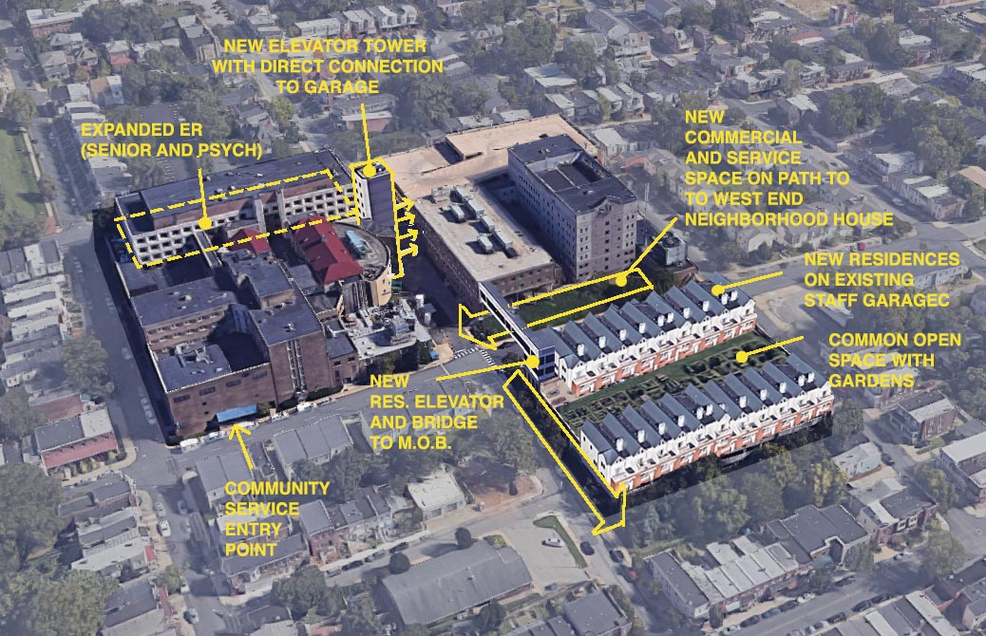
Creating the Platform
Plans to resolve Saint Francis’s historically restricted access points have been developed
Implementation began June 1, 2022
Platform consists of:
      More open, community accessible
      Street oriented and friendly
      Preserves traditional hospital entrances (lobby and ER) and security
      Saint Francis Constable program will secure entire property
  Investments in the common areas to make Saint Francis partner-ready
  Allows for incremental buildout of specified space for partners as they commit
  Supports affordable, assisted, independent and workforce housing in neighborhoods nearby.
Horizonal and vertical Main Street design allows for partners to locate in easily accessible locations
September 2022

Slide 16
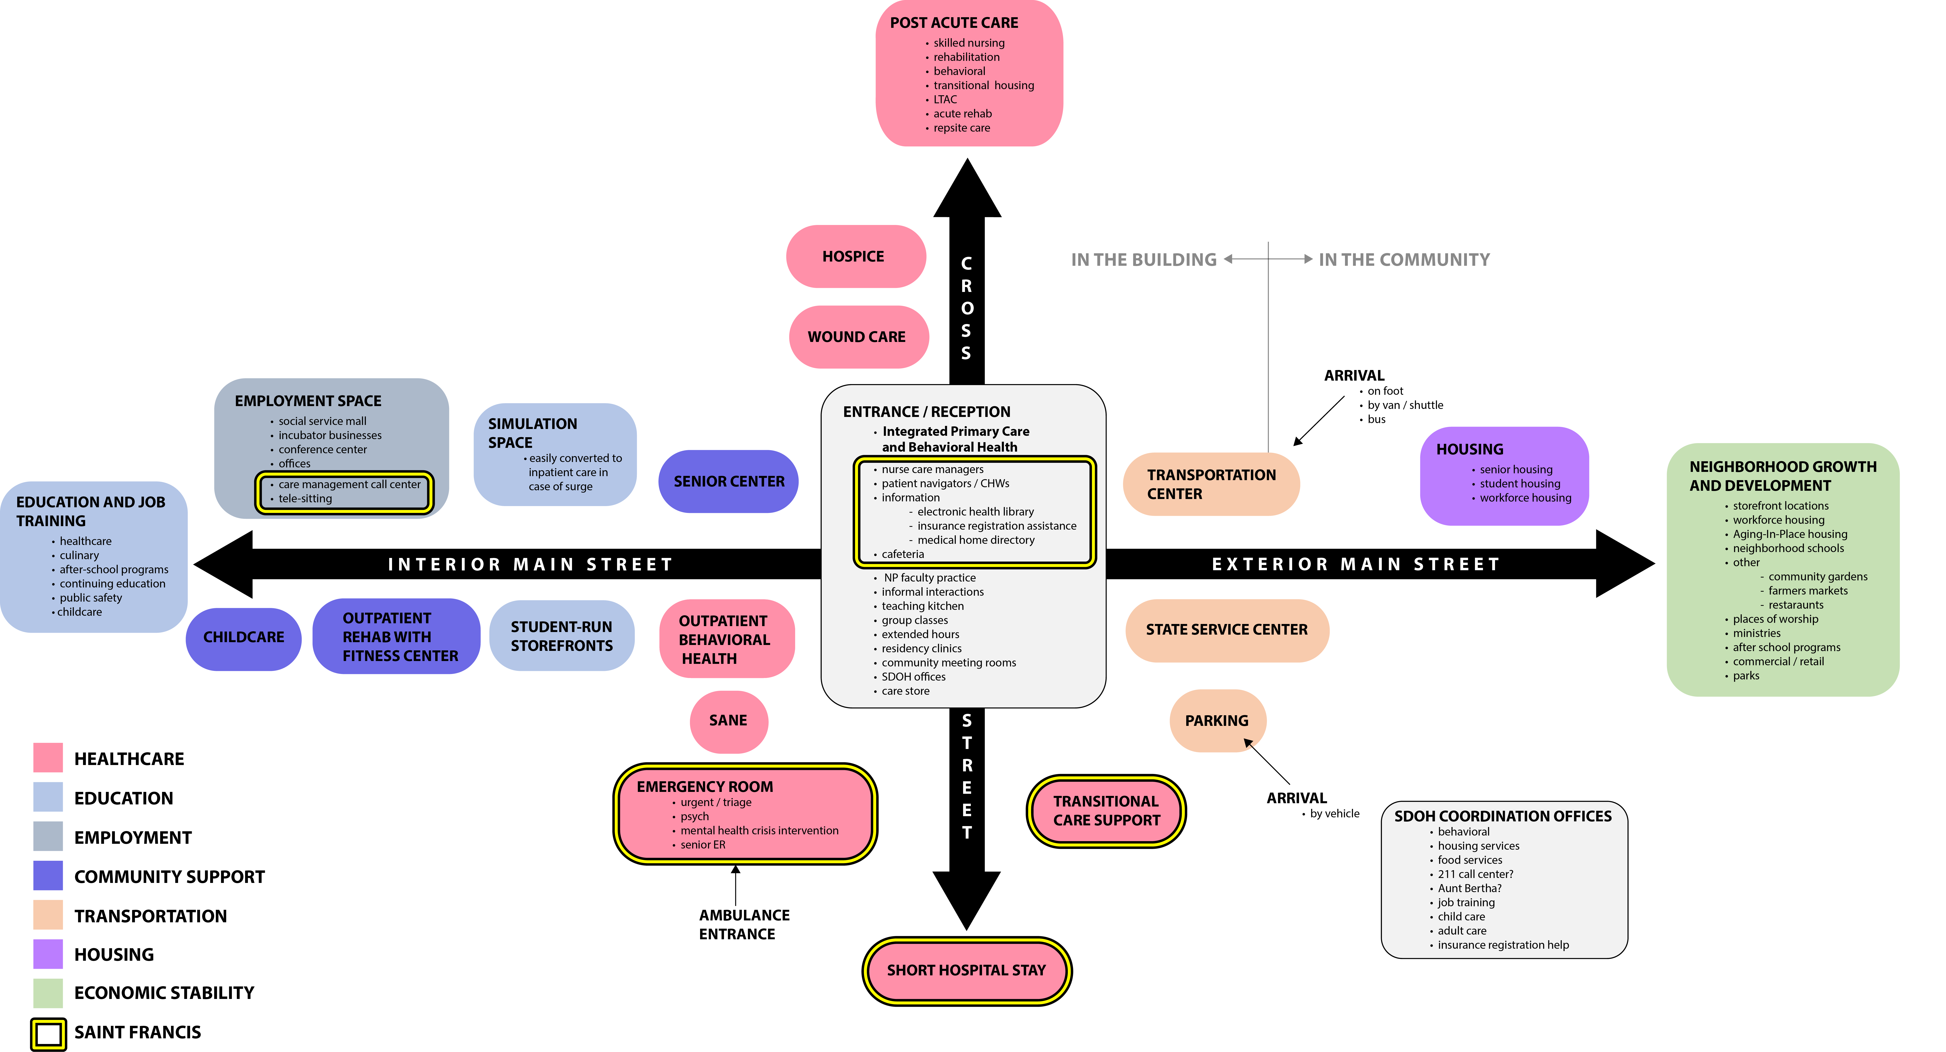
Main Street Design
The “Main Street” design provides the primary path for students, patients, staff and visitors in their daily use of the campus.
Main Street is three-dimensional, with movement of people via stairs and elevators being as important as the direction and paths people take.
The intersections of the corridors and primary stairways in a 3-D Main Street design provide some of the best settings for human interactions.
.
HVSF Program Planning Diagram
Pre-Architectural Design Step
September 2022

Slide 17
The Healthy Village at Saint Francis - Functional Partners
September 2022

Slide 18
Saint Francis Clinical Services
September 2022

Slide 19
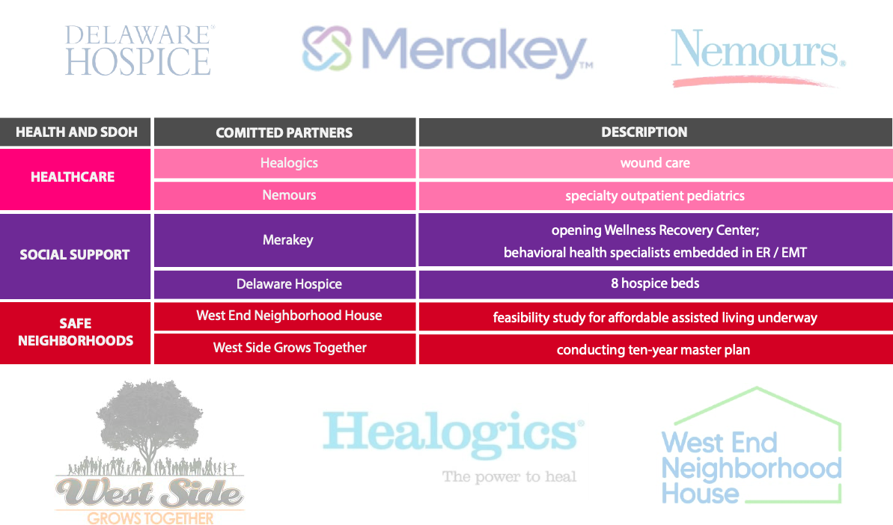
HVSF – Committed Partners
September 2022

Slide 20
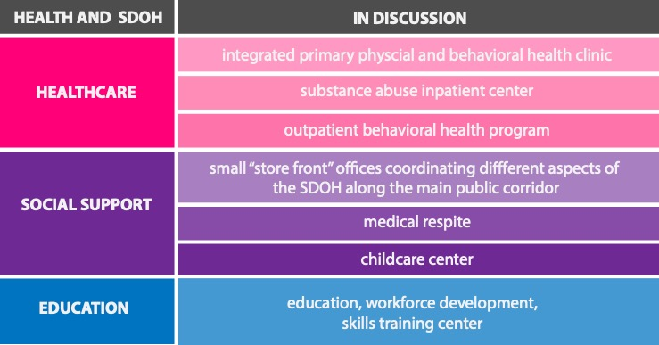
Partnerships in Discussion
September 2022

