Slide 1
DHSS: REIMAGINING SERVICES
daniel walker
Deputy Cabinet Secretary
Department of Health and Social Services (DHSS)
Wilmington City Council October 26, 2022

Slide 2
MEETING GOALS
Introduce the Reimagining State Service Initiative
Present the approach, plan, and timeline
Request for help with participation
Questions

Slide 3
REIMAGINING STATE SERVICE DELIVERY
Goal: streamline and improve service delivery to enhance the client experience
Assess
the service model
Engage
community leaders and impacted people
Shift
toward accessible and trauma-informed service delivery
This process of rethinking services and operations will require
integration across divisions and departments & coordination of resources

Slide 4
IDEAL USER JOURNEY

Slide 5
REALISTIC USER JOURNEY

Slide 6
PHASES OF REIMAGINING SERVICES
Phase 1: Assess
Phase 2: Engage
Phase 3: Implement
Research
Interviews State Service Center Staff
Understand current State Service Center processes
Interview and survey stakeholders, leaders and community members
Develop new approaches with DHSS and stakeholders
Interview and survey stakeholders, leaders and community members
Develop new approaches with DHSS and stakeholders
Where are we now? → Engaging stakeholders and surveying impacted people

Slide 7
Phase 2: community engagement
GOAL: Examine the current system to understand how DHSS can offer effective, person-centered services, easily accessible to those who need them across our state.
What services have Delawareans received from the state?
What is the experience of Delawareans seeking, receiving and/or providing state services?
What services do Delawareans need from the state that they are not currently receiving, or cannot currently receive?
How can the state improve the user experience?
BIG QUESTIONS

Slide 8
ENGAGING ALL PERSPECTIVES
Service Center Approach
Community Approach
Key staff of the five centers with the highest volume each year
Key service providers
Key social service organizations
Community leaders from communities near the five centers with the highest volume each year
Community-based organizations
Impacted people

Slide 9
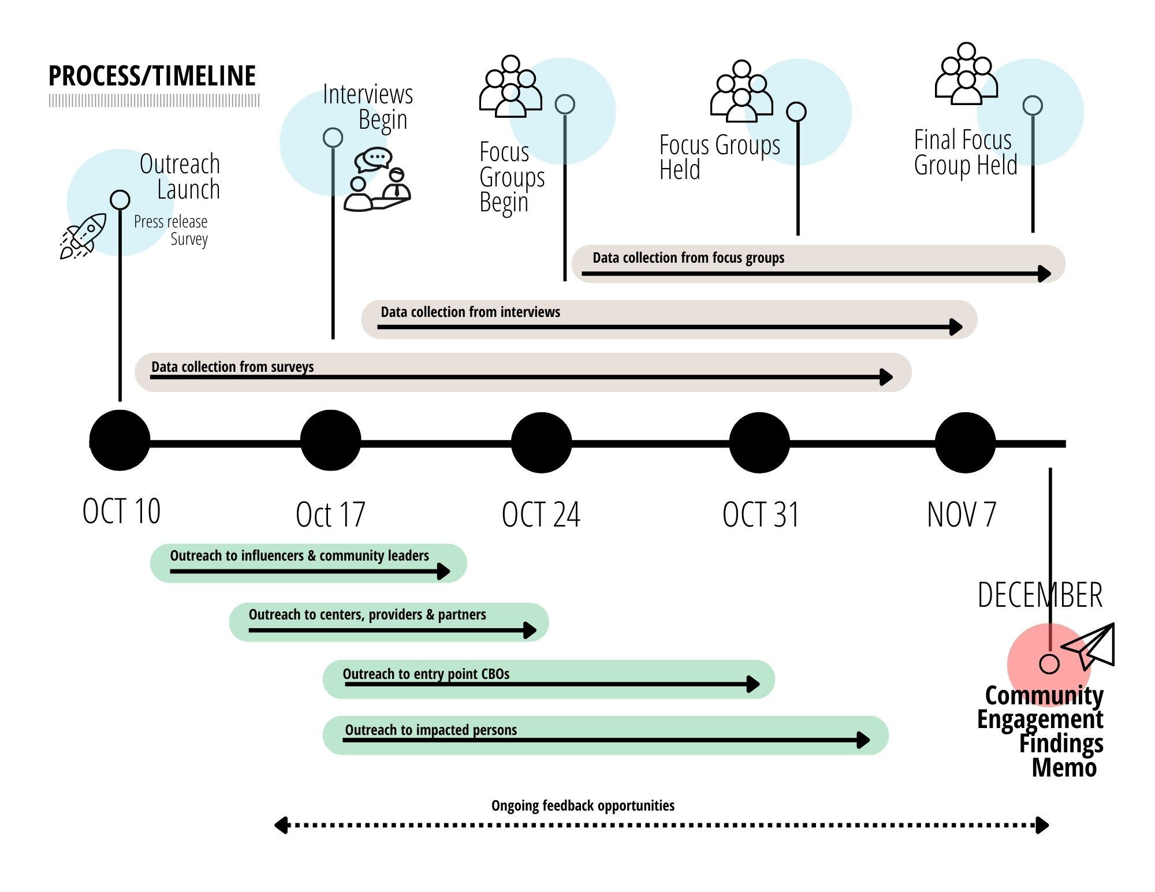

Slide 10
ENGAGEMENT TOOLS
Emails and Phone Calls
Online User Experience Survey (on de.gov/community)
Stakeholder Survey
Focus Groups
One-on-one Interviews

Slide 11
REQUESTS FOR YOUR SUPPORT
Community Organizations: The names of key individuals from organizations in your community that provide services.
Outreach to Constituents: Help us spread the word to your constituents to complete the user experience survey.
See the tools and templates available in the communications package.

Slide 12
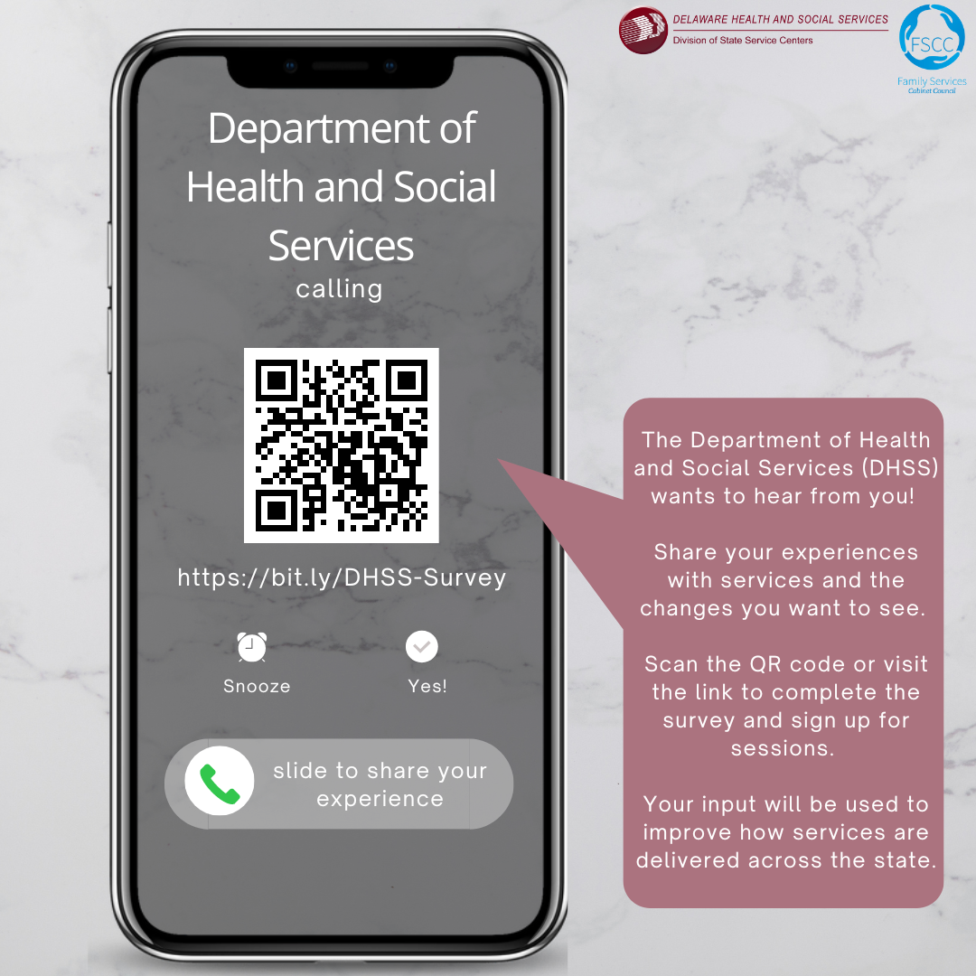
MORE AT OUR WEBPAGE: DE.GOV/COMMUNITY

Slide 13
THANK YOU

