Slide 1

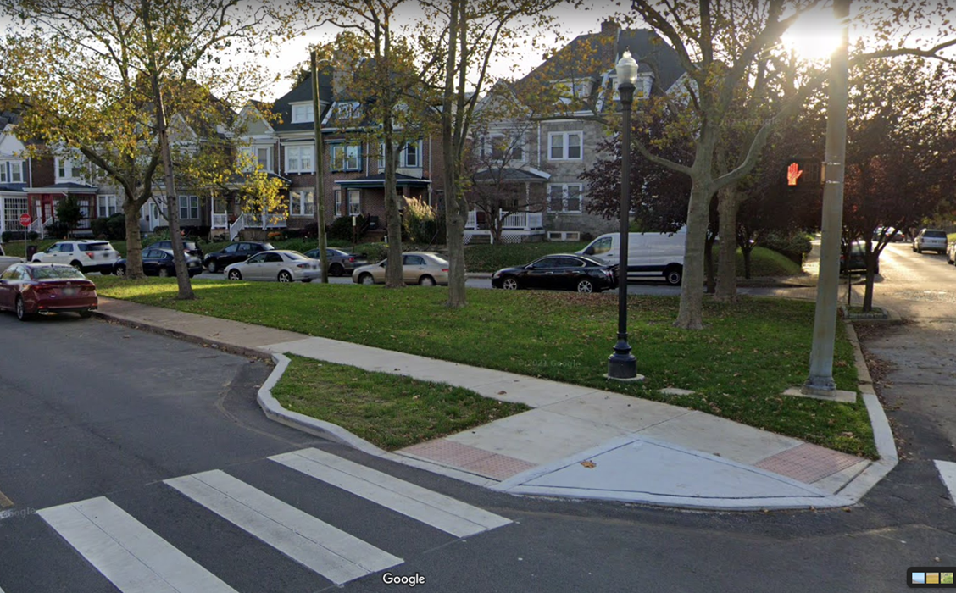
Community Development and Urban Planning Committee September 8, 2022 Ord. 22-026: Proposal to Name the Concord/Madison Triangle to “Ms. Beatres Dunn Triangle”

Slide 2
City Planning
Commission
Resolution 5-22

Slide 3
Beatres Dunn Biography

Slide 4

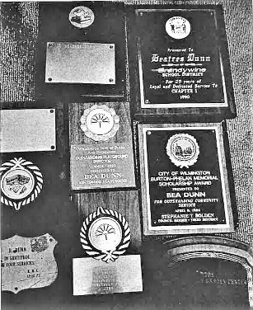
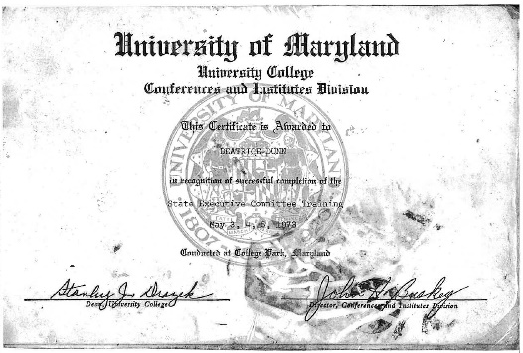
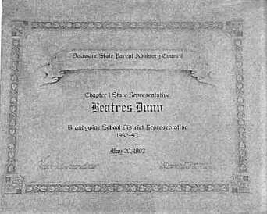
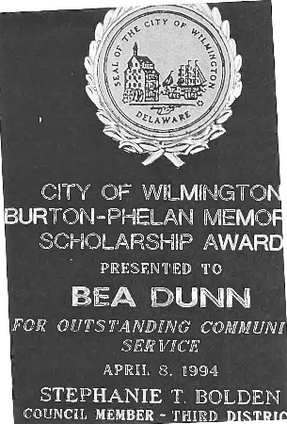
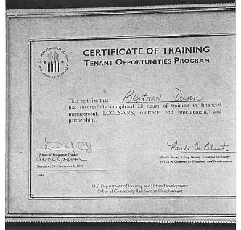
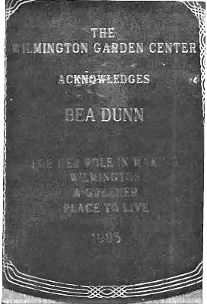
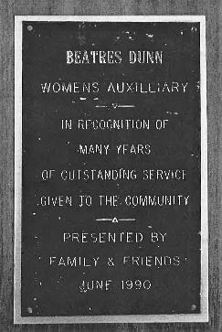
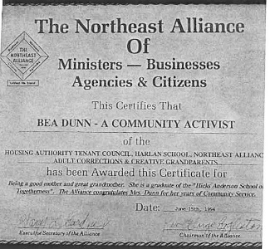
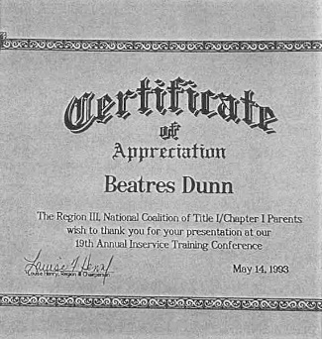
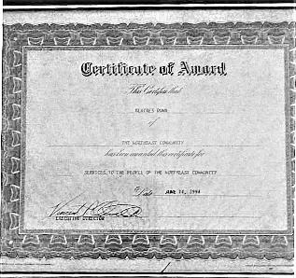
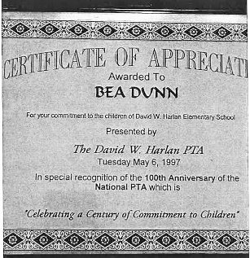
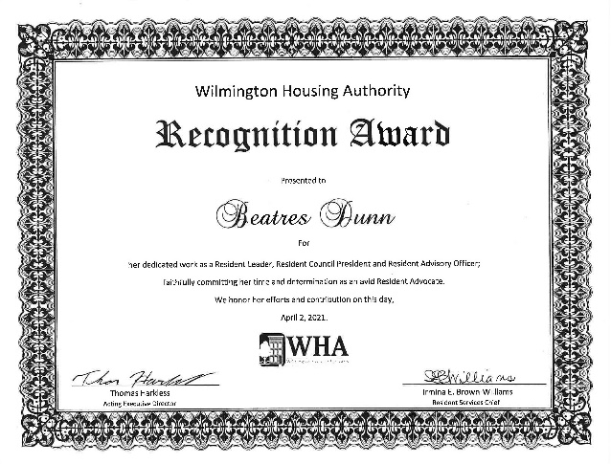
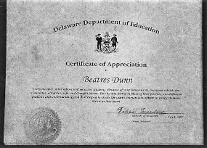
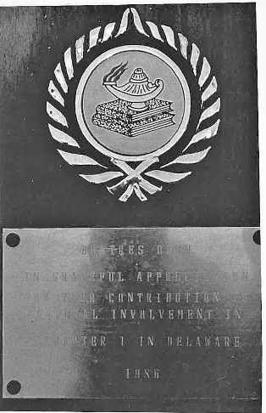
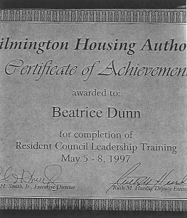
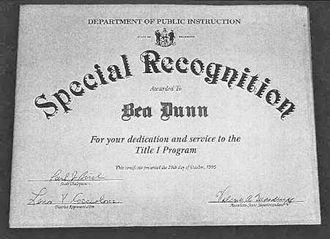
Achievements / Recognition

Slide 5
Posthumous Resolutions

Slide 6
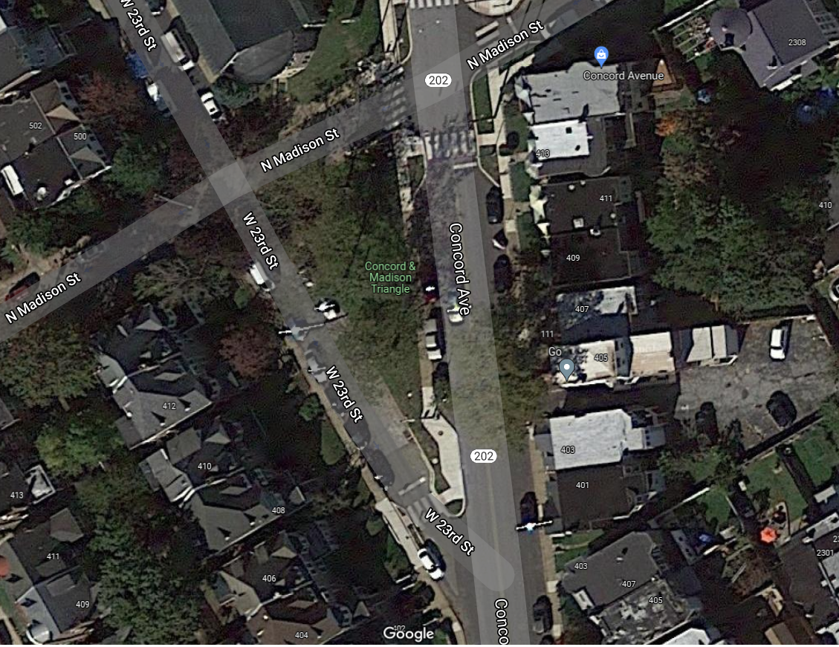
Concord / Madison Triangle - Aerial View
City-Owned Tax Parcel 260-153-0128
0.04 acres; R-2 Residential Zoning

Slide 7

Site Improvements
(Facing Southwest from Concord Ave. and Madison St. Intersection)

Slide 8
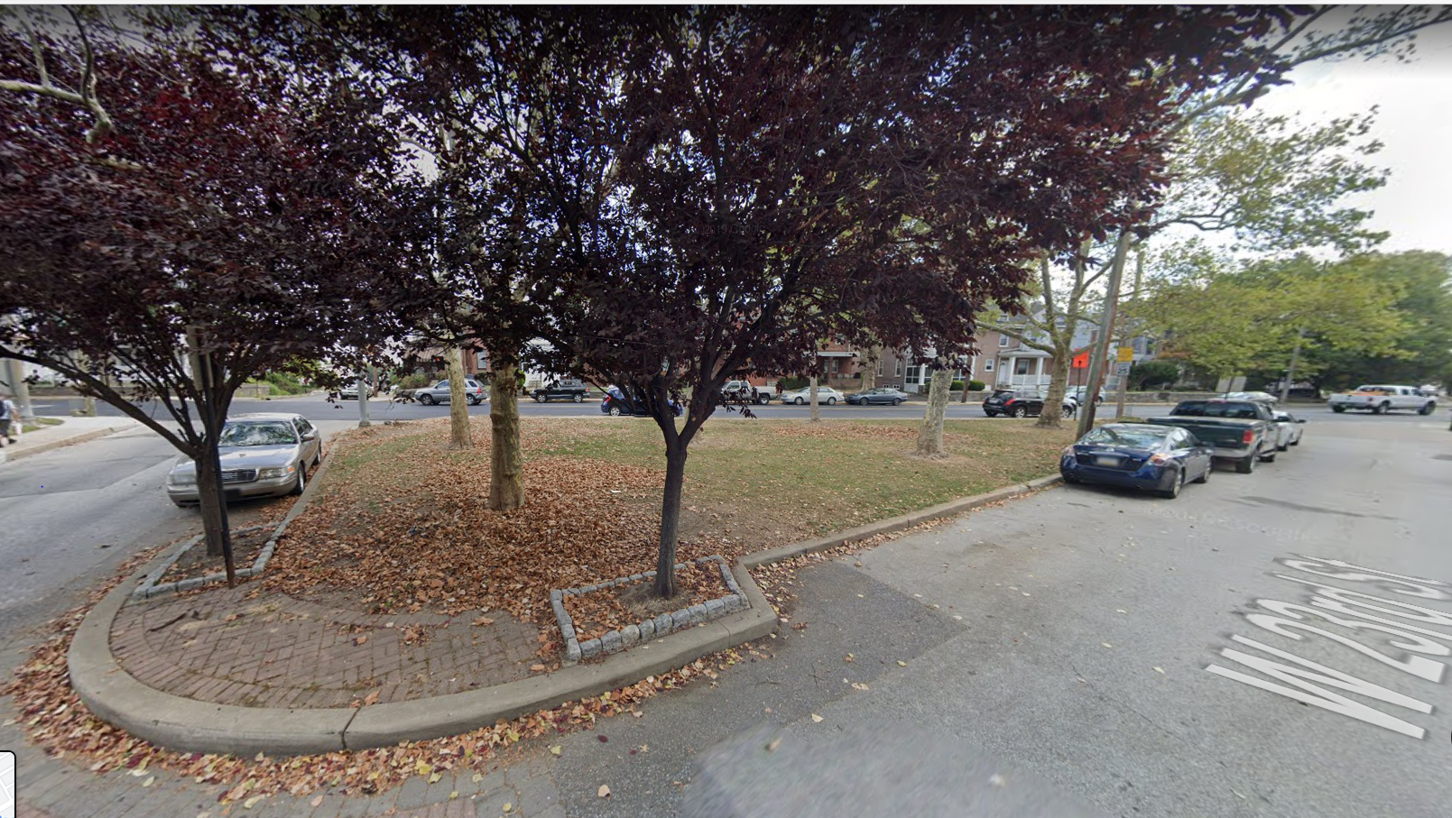
On-Street Parking Surrounds Triangle
(Facing East from W. 23rd and Madison Streets Intersection)

Slide 9
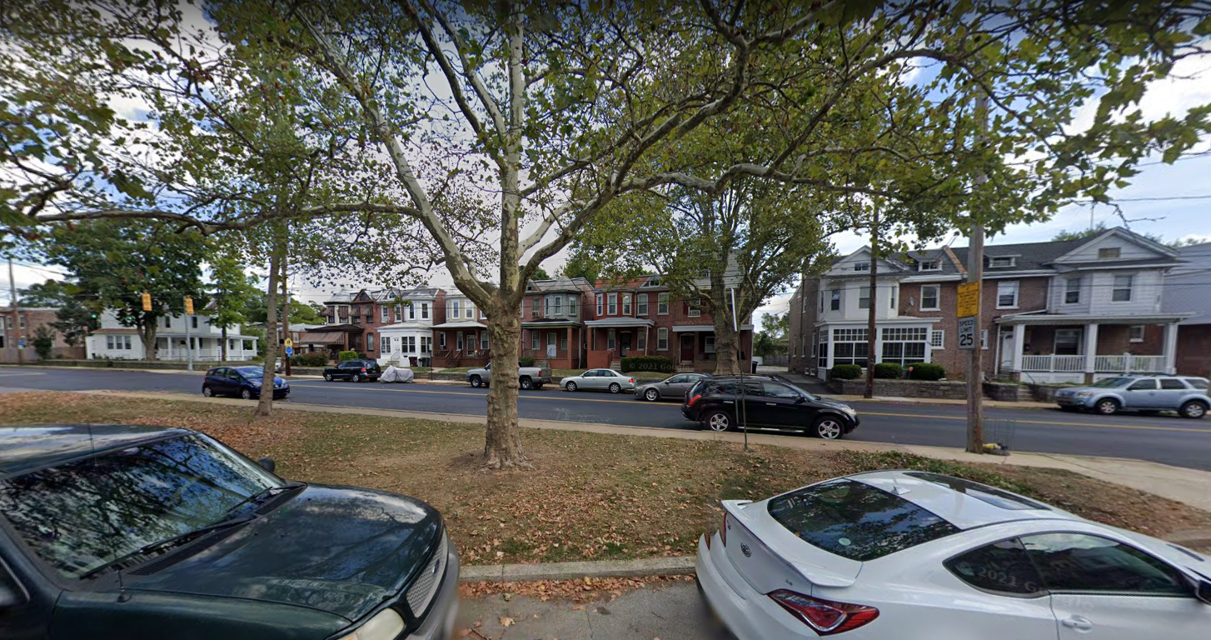
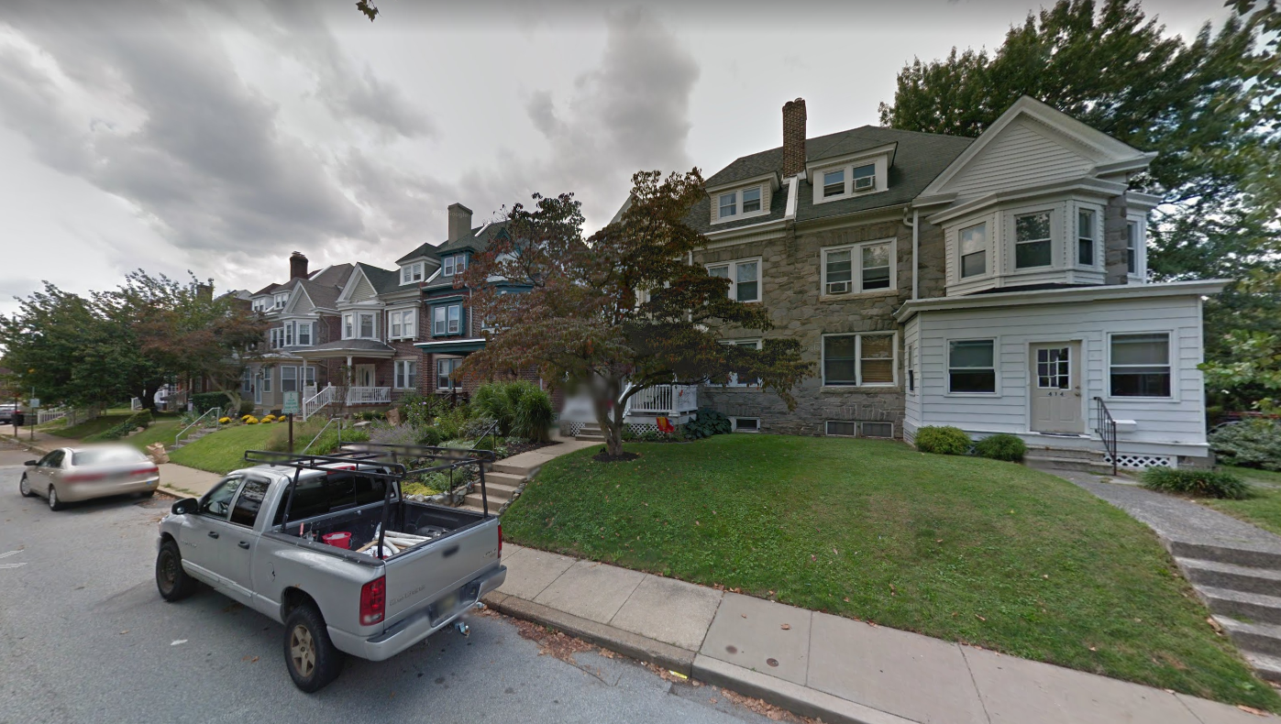
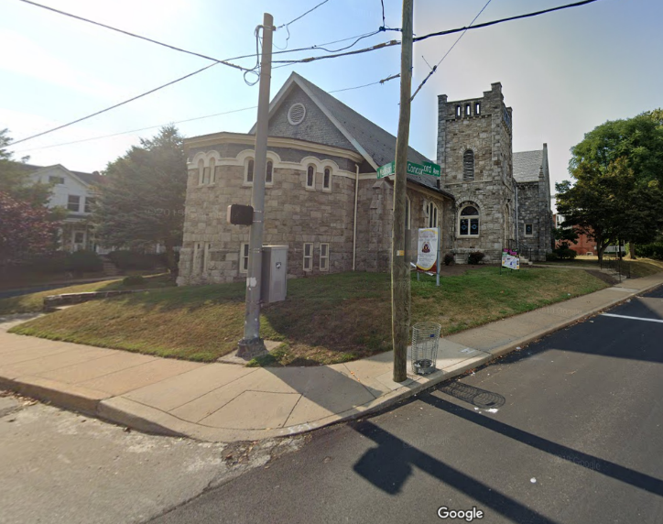
Adjacent Land Use: Residential and Institutional

Slide 10
Naming Guidelines CPC Res. 8-92 Adopted May 19, 1992

Slide 11
Comments
The Department of Planning notes that the proposed name is generally consistent with the naming guidelines adopted by the CPC.
The Departments of Public Works and Parks and Recreation has no objections to the proposal.

Slide 12
Planning Commission Recommendation
The City Planning Commission reviewed this request at their May 17, 2022 Regular Meeting
The Commission voted to approve CPC Resolution 5-22, which recommends approval of the proposed naming request.

Slide 13

SUMMARY _______ City Planning Commission recommends to City Council that the Concord & Madison Triangle be named “Ms. Beatres Dunn Triangle”

