Slide 1
African American Heritage Institute of Delaware
Wilmington City Council
Community Development and Urban Planning Committee
June 9, 2022

Slide 2
AAHI HISTORY WITH THE CITY OF WILMINGTON
2016 Agreement, valid through December 31, 2021
Financial obligations met by August, 2021
$625,000 DNREC subsidy for participation in Brownfield Development Program, with Brightfields projected to complete remediation work

Slide 3
AAHI CURRENT AGREEMENT WITH CITY OF WILMINGTON
2022 Agreement projected to go to settlement in July, 2022
Working with various Professional Services Providers
Real Estate Attorney
Architects
Accountant

Slide 4
AAHI PAST CAPITAL FUNDRAISING SUCCESSES
State public funds (non-federal funds)
Private local foundation funds

Slide 5
AAHI Prospective AAHI Investment Partners
DE Public Investment
Diverse constituents
Multi-year grants
Financial and in-kind support

Slide 6
THE 1039 WORKSHOP
The structure at 1039 Clifford Brown Walk will undergo a major capital renovation:
Wired to support 21st century technology (LEED-Certified)
ADA-compliant
The 1039 Workshop will house AAHI program delivery of educational and cultural-based high-tech, high-touch services to youth and Eastside residents, and to those journeying with us online around the county, state and country.
PRELIMINARY
DESIGN

Slide 7
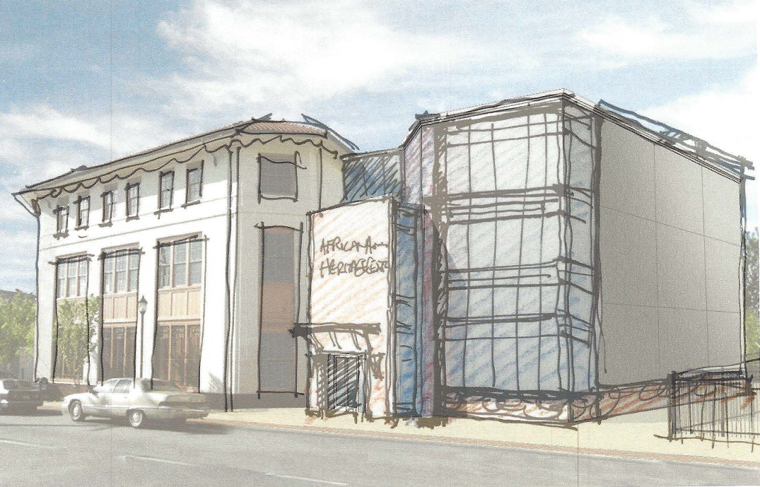
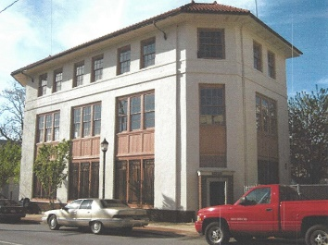
THE AAHI INSTITUTE
Expanding programming into the former Allied Kid Building will allow AAHI to maximize its onsite services.
Leverage Federal or state tax credits—Allied Kid Building was added to the National Register of Historic Places in 1985 (National Register Information System ID 85003191)

Slide 8
THE NEED
Youth programming to address a lack of positive identity, a missing sense of self-value.

Slide 9
THE OPPORTUNITY
Our American Story: Knowing the Past Opens Doors to the Future
BUILDING POSITIVE IDENTITY in African American youth (particularly ages 16-21) through education of our history and its power to inspire; the power to affect the head, heart, ideals and ideas, to reveal the truth, to change lives.

Slide 10
AAHI MISSION - VISION
The Power of Inspiration
To establish and operate the African American Heritage Institute (AAHI), anchored in the African American Heritage Zone on the Eastside of Wilmington, Delaware.
Our youth take in information in more diverse ways in the 21st century than ever. One thing has not changed. That is the need to draw inspiration and guidance from the past. Through that inspiration, they will find tools and paths that help them live their lives.
We seek to operationalize the only designated African American Heritage Zone in Delaware.

Slide 11
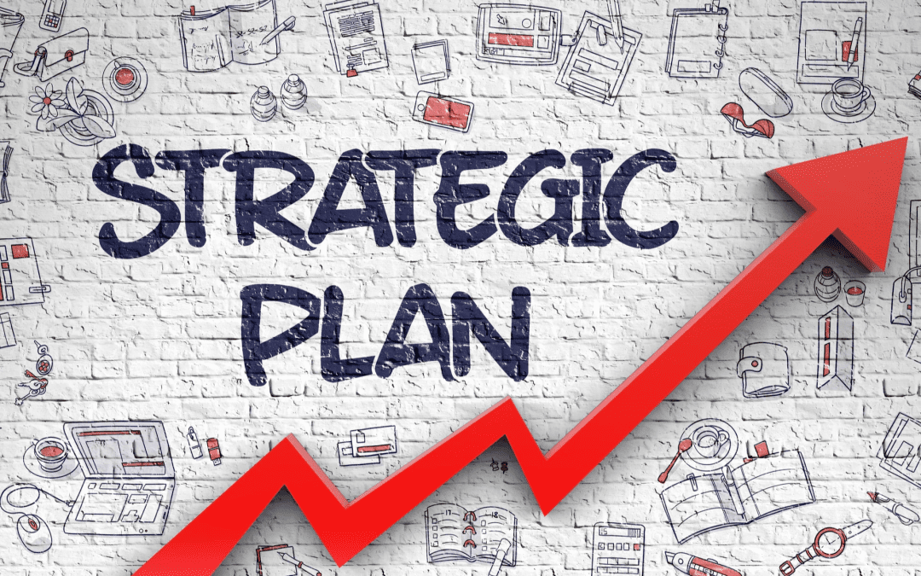
2023-26 STRATEGIC PLAN
DANA has been retained to consult in the process of creating a three-year Strategic Plan and an Annual Operational Plan, projected for completion in December 2022.
Youth participation in the strategic planning process will inform our detailed programmatic development, along with input from other stakeholder groups.
The Annual Operational Plan will document how we will attract youth and maintain their engagement with our programming.

Slide 12
SHORT-TERM SUSTAINABILITY EXAMPLE
INTERNSHIP PILOT
College students will work with faculty members and Oral History professionals to research, expand current histories, and develop the skills, knowledge and abilities necessary to produce and preserve oral histories of African Americans initially from the Eastside, then, across greater Wilmington and the State.

Slide 13
LONG-TERM SUSTAINABILITY EXAMPLE
AAHI ORAL HISTORY PROFESSIONAL INSTITUTE
Scaling programming into1043 Clifford Brown Walk, the AAHI Institute, will allow us to maximize AAHI onsite services.
A Certificate Program in Oral History will promote stronger integrated content across multiple disciplines of study.

Slide 14
LONG-TERM SUSTAINABILITY EXAMPLE
AAHI ORAL HISTORY PROFESSIONAL INSTITUTE
Institute coursework will be delivered in a hybrid curriculum, onsite at the AAHI Institute and in a virtual setting. (Analogy: UD/Winterthur Museum Art Conservation Program.)
AAHI is working to partner with DSU and UD to create the physical and virtual “space” to support reflection, discussion, challenge, and reconciliation as we, together, re-imagination inclusive American History and culture through the lens of the African American experience and collectively work to build a brighter future.

Slide 15
Rev. Lawrence Wright
lwright019@aol.com
302-528-7353

