Slide 1
The City of Wilmington
October 2022

Slide 2


Finance and Economic Development Committee: New businesses and jobs announced since 2021
Employment
1069 | 241
Potential jobs announced in 2021 | Businesses Tracked
Business Licenses (Tolemi)
2209 | 1968 | 2078 | 2027
Business Licenses in 2019 | Business Licenses in 2020 | Business Licenses in 2021 | Business Licenses in 2022

Slide 3
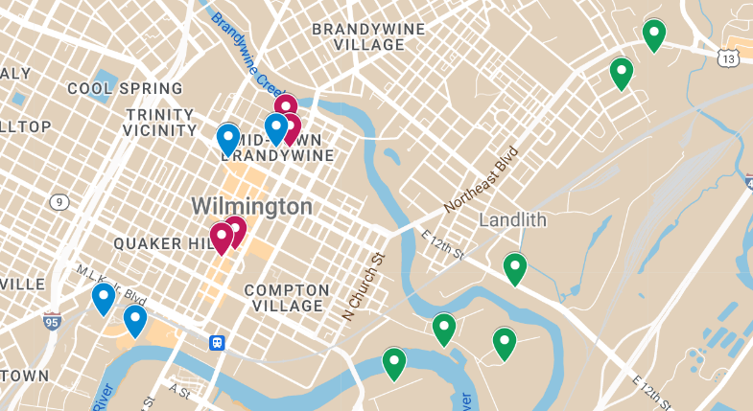


Fintech
Hospitality
Eastern Highway Specialists
17 Jobs
Investor Cash Management
395 jobs
Nerd It Now
75 Jobs
Chancery Market
Fair Square Financial
150 Jobs
Staybridge Suites
Today Media
33 Jobs
Quoin Hotel & Restaurant
Advantage Building Supply Corporation
118 Jobs
Bardea Steakhouse
Goldman Sachs
200 Jobs
Challenge Program Furniture
10 Jobs
Barclays
300 Jobs
Light Action Pine Box
85 Jobs
B&M Meats
100 Jobs

Slide 4
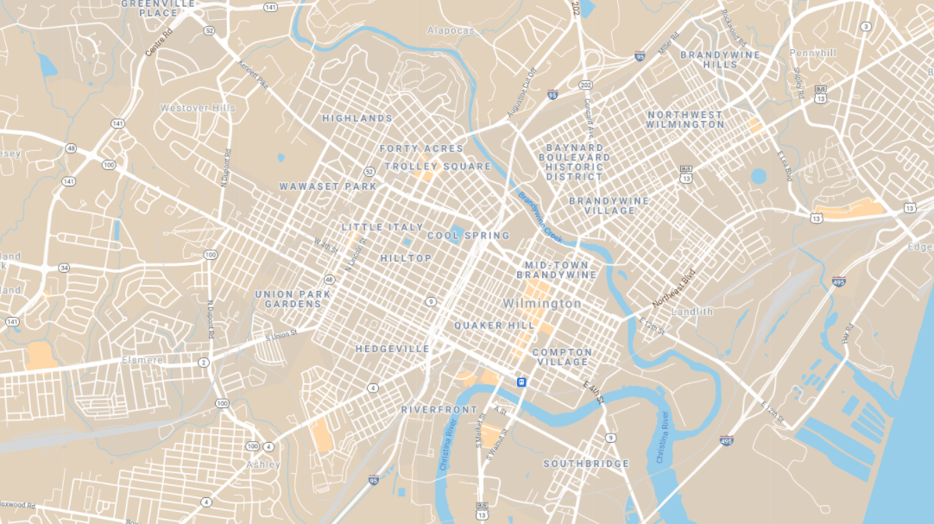







Strategic Fund (Minority Owned)
Strategic Fund Agreement
Grow Wilmington Fund
WEDCO
True Access Capital
State Job Incentive Agreement
ARPA Support

Slide 5
Small Business Support: 2021 - 2022
Category | Number | Minority Owned
Technical assistance provided to businesses | 40 | 31
Grant and loan referrals to partners | 13 | 13
Community organization group participation | 7 | N/A
Highlights:
The Juice Joint
Books and Bagels
Notes:
In total, OED has $21,800 in funds under the SMBEO budget for FY 22. Planned expenses remaining for FY 22 are:
On May 10 we are hosting a Minority Business Mixer here at the City building. We have invited partners from the county and state government offices in order to create relationships and foster new opportunities for our businesses. We’ll have some expenses for water and supplies, but I expect those to be relatively low. This is a networking event intended to bring resources to our minority business community.
We intend to follow this event up in a few months during the fall with a more formal event where we’ll rent space at one of our local halls and invite some local large businesses to gather in a similar fashion with the goal of introducing any interested minority owned businesses to new opportunities. We intend to use a significant part of the budget for this event.
Additionally, we would like to use some of our consulting budget to hire a marketing firm to help communicate these programs and other elements of our program to the community. This amount is not yet known.
We also plan to get out into the community to walk some of your districts and to get in front of some of the civic associations to talk about the tools and services we have available to help our small and minority businesses. If any of the council members have any groups you know of or belong to, please forward their contacts to our office and we'll schedule time to come to the meetings. We recently accompanied Council Member Darby on a walkthrough in her district and were able to takeaway a handful of businesses that we are working to help in various ways.

