Slide 1
Department of parks and recreation
Youth & Families Division
Recreation
Hicks
NRPA

Slide 2
Who Are We?
The Youth & Families Division is comprised of several programs, events, and community trips for youth and their families.
College Series
Summer Camps
Afterschool Programs
Nutrition Program
Youth Employment
Youth Programs
Community Trips

Slide 3
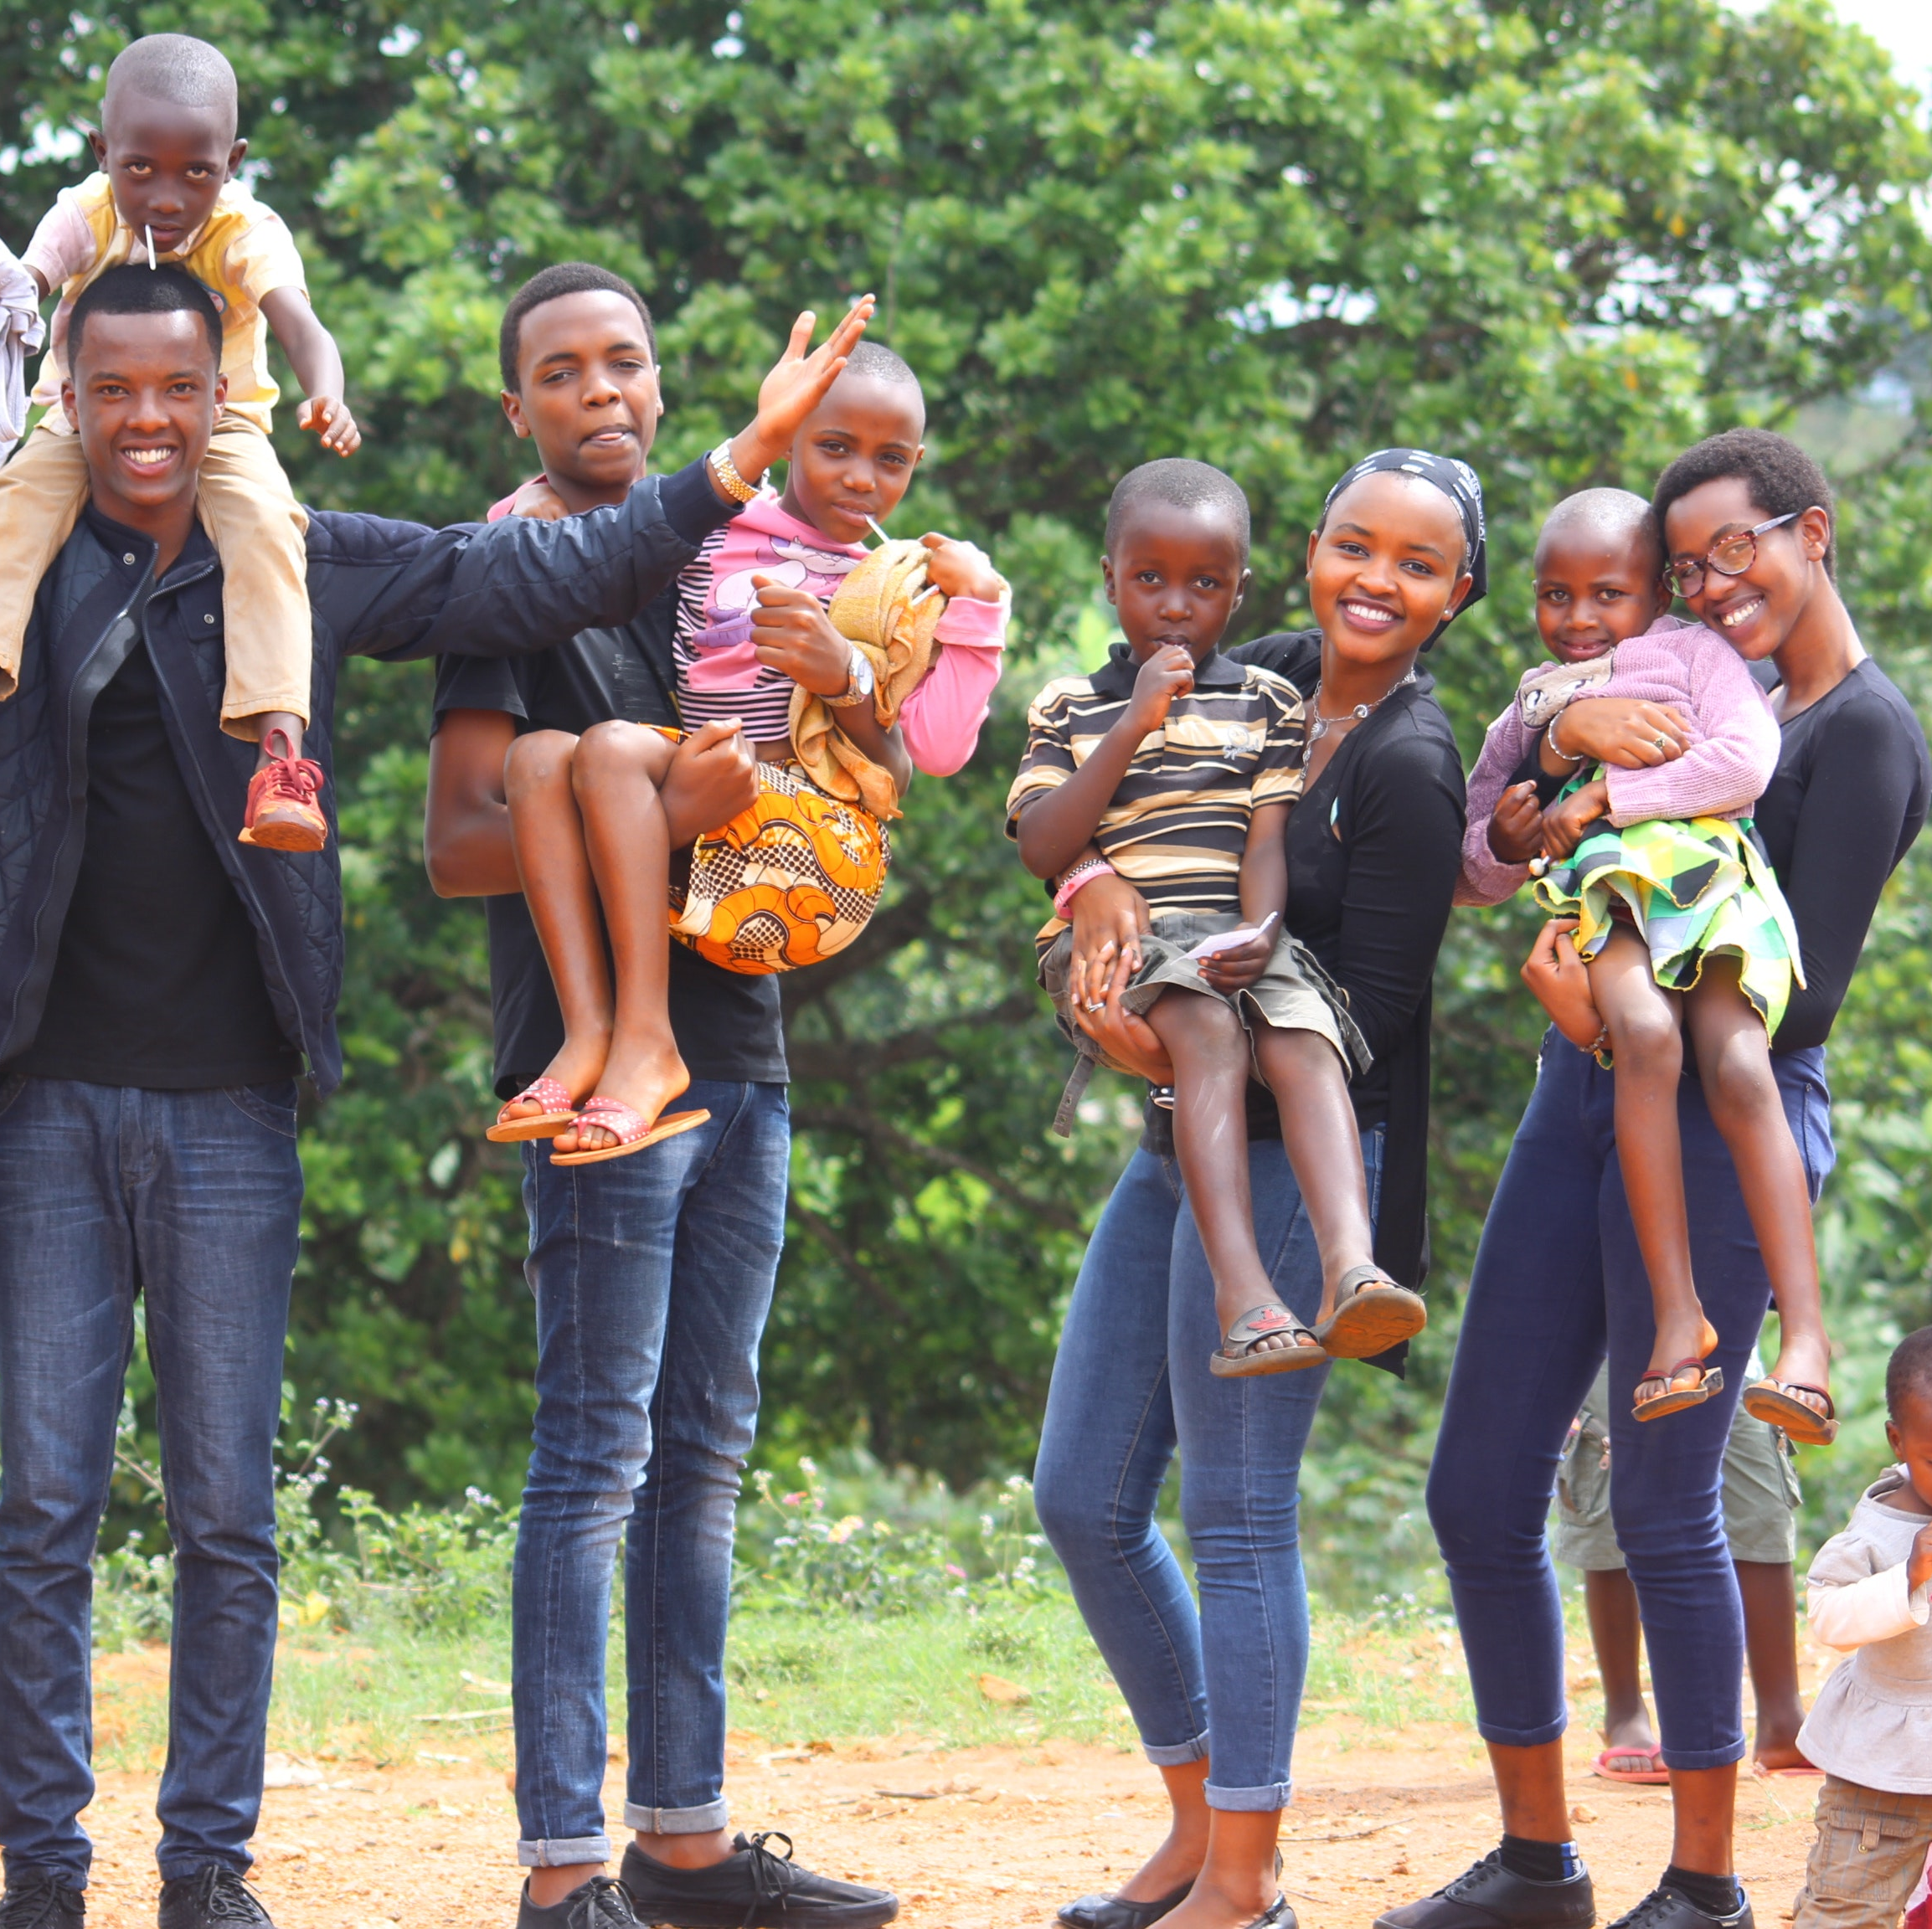
(Summer Activities)

Slide 4
youth & FAMILIES
Summer Track
Drug screening began the week of May 31st.
To date there are 249 youth that have successfully turned in their documents and have completed the intake interview.
Parent Night/Worksite Training TBA.
Internship Track
There are youth that will be scheduled for interviews with Rodney Street Tennis Association.
Interns began on Wednesday June 8th.

Slide 5
YOUTH & FAMILIES
Green Jobs Overnight
Green Jobs youth will have a two- day orientation and pre-employment activities from June 15-16, 2022.

Slide 6
Summer Camp Experience
Camp Barnes
Session 1 (boys 8-10) July 8-11, 2022 | Session III (Boys 11 & 1) July 25-25, 2022
Session II (girls 8-10) July 15-18, 2022 | Session IV (girls 11 &12) July 29-Aug 2022
Hicks Summer Camp
June 27th – August 12, 2022 | 9am-2pm / Ages 9-13

Slide 7
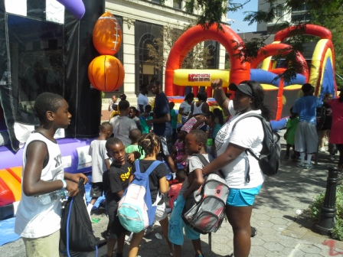
Nutrition programs

Slide 8
SUMMER FOOD SERVICE PROGRAM (sfsp) Sites

Slide 9
What is SFSP?
The Summer Food Service Program (SFSP) is a USDA, federally-funded program administered by States that operates during the summer months when school is not in session. The SFSP was established to ensure that low-income children continue to receive nutritious meals when school is not in session. Free meals, that meet Federal nutrition guidelines, are provided to all children, 18 years old and under, at approved SFSP sites in areas with significant concentrations of low-income children. This program takes place between June 2022 to September 2022.

Slide 10
YOUTH CAREER DEVELOPMENT formally summer youth employment program

Slide 11
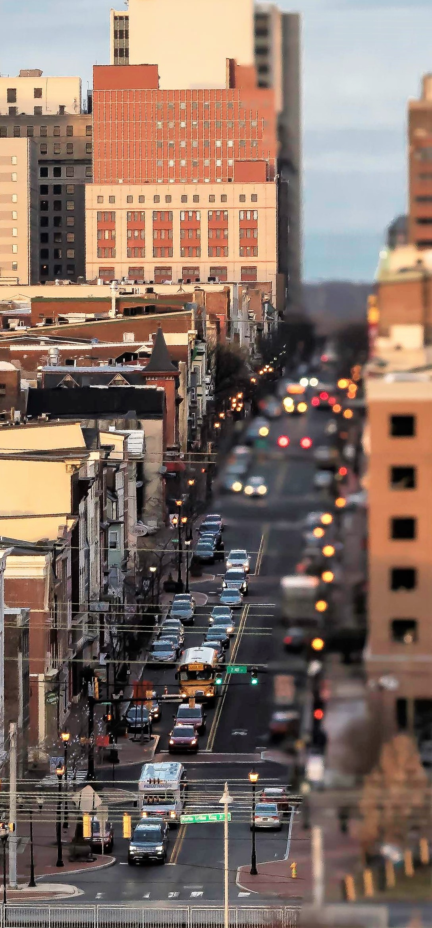
Youth Career Development
The City of Wilmington has been providing employment and internship opportunities for youth for over 50 years. The program is open to all household income levels with a focus on youth from lower-income households. By promoting work readiness, career exploration and financial literacy, YCD helps to prepare young people for the adult workforce.
Notes:
In existence for over 50 years
Open to all income levels with a focus on lower-income households
The program promotes work readiness, career exploration and financial literacy
And finally, YCD helps to prepare young people for the adult workforce.

Slide 12
About the YCD Program
Career Pathway Track
(Oct – Apr)
Workforce Track Internship Track
(June-Aug)
Notes:
Started out as the City’s Summer Youth Employment program
2 years ago, we changed the name to Youth Career Development (YCD) after realizing we wanted to do more than just place kids in jobs.
We wanted to provide workforce training in addition to providing a paycheck. So we rebranded and split the summer program into two tracks.
This year, for the first time in the programs existence, we are a year-round youth employment program.
the fall and winter program places emphasis on placing youth, as best we can, in jobs that correspond to their career pathway

Slide 13
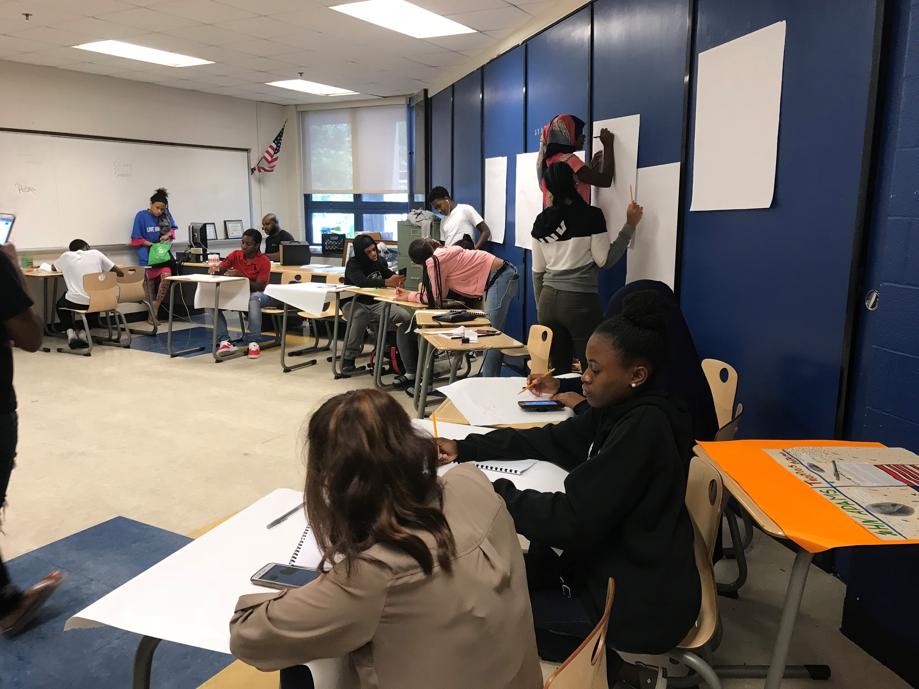
Workforce Training
All three YCD tracks provide training in the following areas:
Work-based learning,
leadership training,
soft skills development, and
career readiness

Slide 14
Workforce Track
8 – Week Term (June – August)
Salary = $10.50/Hr. - 20 hours per week
Must be 14-20 years of age
Placement is NOT based upon the youth’s career pathway or career interest.
Weekly training provided
Youth Symposium
Assigned a youth counselor

Slide 15
Internship Track
6 – Week Term (June – August)
Assigned a youth counselor
Must be 14-20 years of age
Salary = $10.50/Hr. - 20 hours per week
Placement is based upon successful interview and selection by prospective employer.
Work-based project and presentation.
Youth Symposium

Slide 16
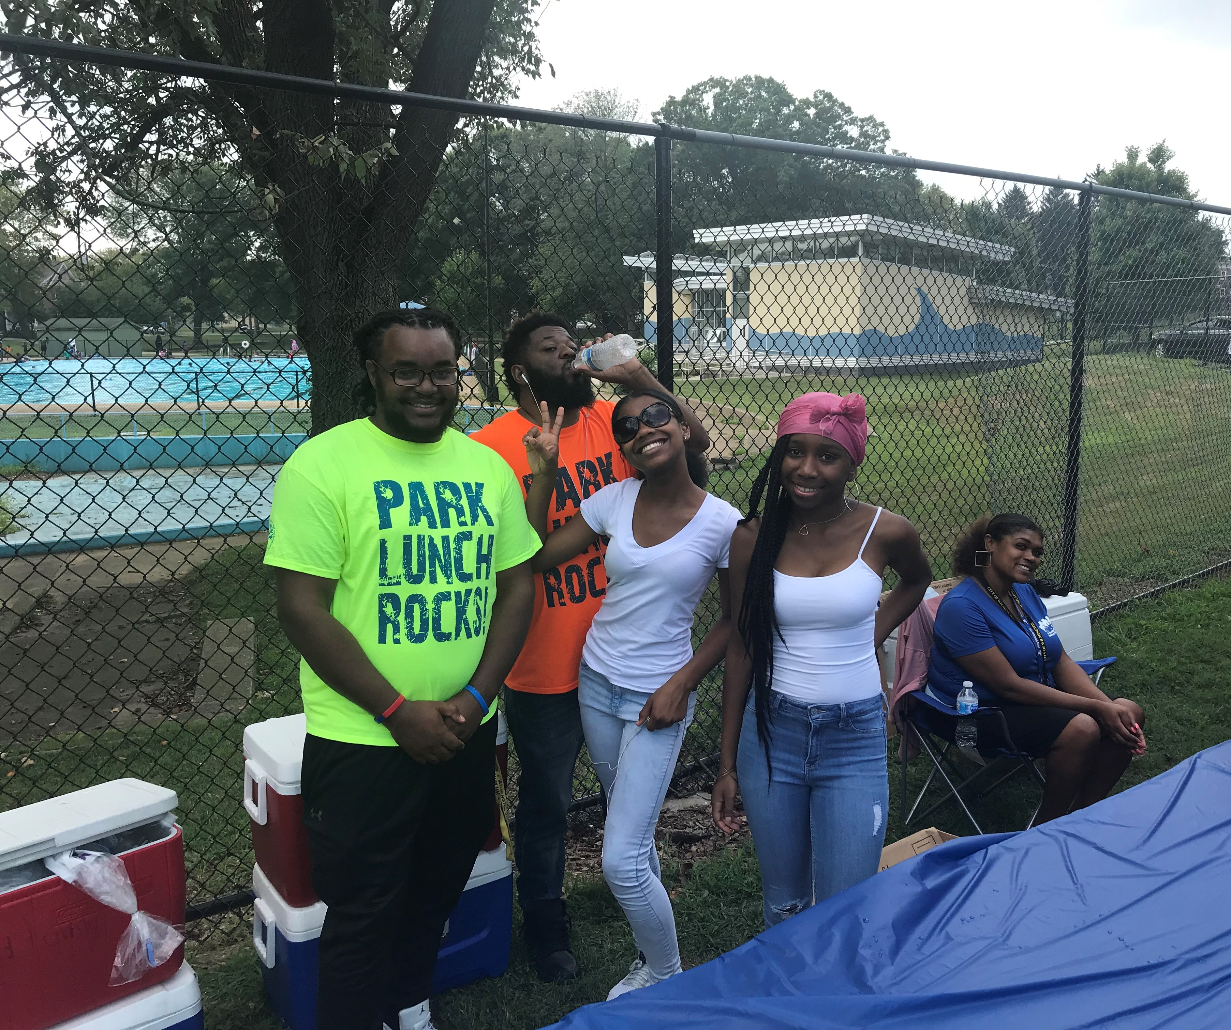
Youth Career Development
Summer Programming begins June 21st

Slide 17
UPCOMING EVENTS
Gazzin In the Grass
Movie In the Park
Playstreet
Fitness In the Park
NRPA-National Recreation & Park Assoc.

Slide 18
Grazzin in the grass
EACH TUESDAY IN JULY! 6:00-8:00PM
JULY 5 PRICES PARK , 2313 N. Locust Street
JULY 12 ELBERT PARK , Townsend & C Streets
JULY 19 KOSCIUSZKO PARK , 1320 Beech Street
JULY 26 HAYNES PARK, 32nd & Harrison Streets
Followed by a featured Movie!!!

Slide 19
Wilmington city cinema
AN EVENING OF FAMILY-FRIENDLY , SNACKS, GAMES AND MOVIE FUN!
2022 Summer Movie Schedule:
TUESDAY, JULY 5 Aladdin (PG) Prices Park District 3
TUESDAY, JULY 12 Raya and the Last Dragon (PG) Elbert Park District 4
THURSDAY, JULY 14 Trolls World Tour (PG) Eastlake Park (30th St.) District 2
TUESDAY, JULY 19 The Lion King (PG) 2019 Kosciuszko Park District 6
TUESDAY, JULY 26 The Lion King (PG) 2019 Haynes Park District 1
TUESDAY, AUG. 2 The Lion King (PG) 2019 Tilton Park District 5
TUESDAY, AUG. 9 Encanto (PG) Woodlawn Park District 7
THURSDAY, AUG. 11 The Addams Family 2 (PG) Stapler Park District 8
For all movie showings, free drinks and snacks
are available for anyone in attendance.
ALL MOVIES BEGIN AT 8:30 P.M.
For more information contact: (302) 576-3810
or visit www.WilmingtonDE.gov

Slide 20
Playstreet

Slide 21
Fitness in the park
Tues/Thursday Holloway Park 12noon

Slide 22
JULY IS Npra month
NRPA is a not-for-profit organization dedicate to building strong communities through the power of parks and recreation, they strive to advance parks, recreation and environmental conservation efforts that enhance the quality of life for all people, During the month of July this event is celebrated over the region. Parks and Recreation will participate in this regional celebration by highlighted memorial events that has taken place in our parks. For more information, visit www.nrpa.org .

