Slide 1



Slide 2













Partners

Slide 3
People Powered Fair Maps Background
LWVUS seeks to improve, protect and influence redistricting processes and create a roadmap for the future.
LWVDE is engaged in the LWVUS 50-state plus DC People Powered Fair Maps advocacy program that aims to:
Promote a fair and representative redistricting process in 2020.
Create state-based campaigns to influence, engage and educate members of the public, community partners, lawmakers and the media in the creation of fair maps.

Slide 4
The Role of Redistricting
Redistricting: the periodic—usually decennial—redrawing boundaries of districts that elect representatives who serve specific geographic areas.
U.S. Supreme Court held in 1960’s that districts must be equal in population -- “one-person, one-vote” requirement.
Maps redrawn after every decennial census to create equally populated districts.
All electoral bodies that elect representatives from districts must be redistricted: Congress, state legislatures, cities, counties, other local entities.

Slide 5
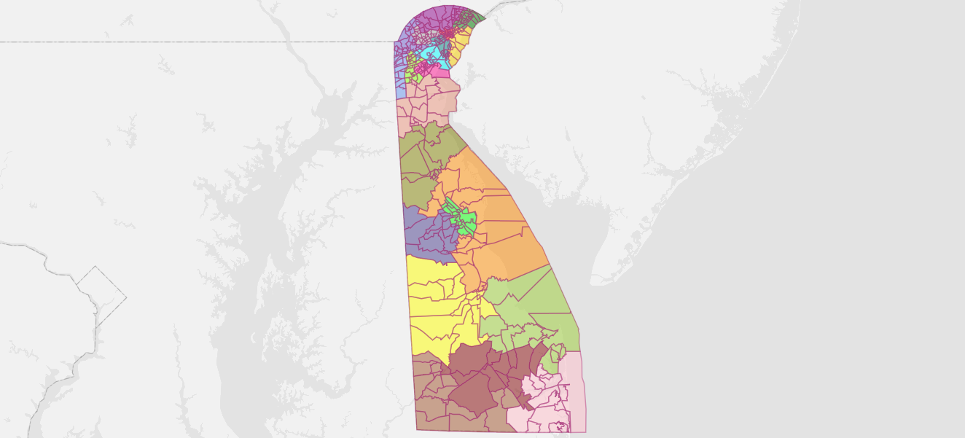
Project Goals
Establish a knowledge base among Delawareans.
Address the significance and process of redistricting across the state.
Develop a Fair Map process for Delaware’s General Assembly.
Institute a Road Map for the future.

Slide 6
Why is Redistricting important to me?
In a democracy, elected representatives must be accountable to voters. Representatives make important decisions that impact every area of your life. The location of district lines decides which communities vote for which representatives. These lines are very powerful. How these lines are drawn can be the difference between empowering your community or muting your influence.

Slide 7
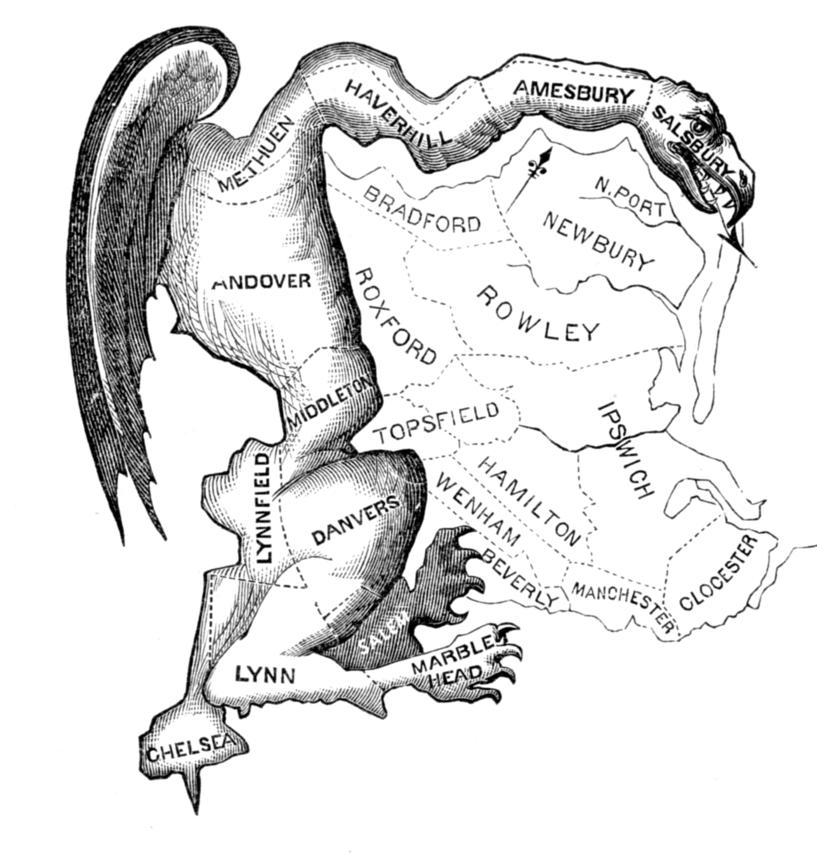
Gerrymandering and Other Mischief
Massachusetts Governor Eldridge Gerry, in 1812, created a partisan district in the Boston area that was compared to the shape of a salamander.
Thus was born the practice of Gerrymandering -- manipulating district boundaries to draw a map that provides a political advantage for a particular party or group.

Slide 8
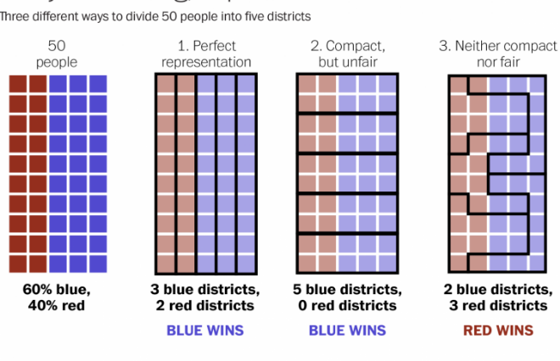
Other Mischief: Packing & Cracking
Packing concentrates voters of one party or community in as few districts as possible to reduce their influence in the remaining districts.
Cracking reduces the voting power of a party or community by splitting its population and spreading its members among several districts where they become an irrelevant minority.

Slide 9
Transparency
Transparency is the key to accomplishing the process reforms necessary for communities to become effectively engaged in meaningful communication with redistricting authorities. Communities are the foundations of good districts. In order to recognize cohesive communities, legislators and other decision makers need to hear from their constituents about what they care about and where they believe the boundaries of their communities are located.
A redistricting process that is sufficiently accountable to voters must be open, transparent, allow public engagement and time for the public to provide feedback for the proposed redistricting plan.
An open and transparent redistricting process can help ensure that public servants are elected who actually serve citizens.

Slide 10
Communities of Interest
A community of interest is a group of people concentrated in a geographic area who share similar interests and priorities – whether social, cultural, ethnic, economic, religious, or political.
To facilitate the articulation of more precise communities of interest, public testimony and public participation in redistricting helps to define the nature and footprint of specific local communities.

Slide 11
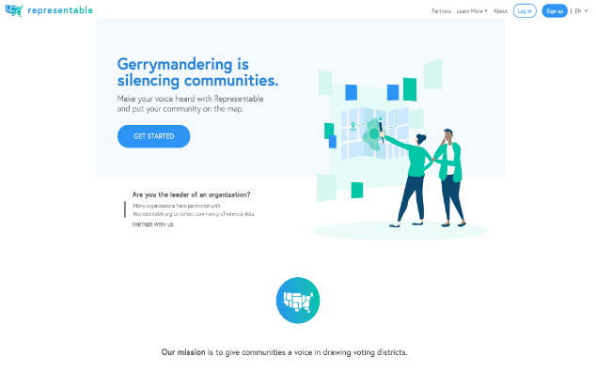
Representable
Representable is a mapping tool for drawing communities of interest. We are mobilizing communities to get the representation they deserve by helping to identify shared community interests and present this information to mapmakers.
Add your community to the map today and make your voice heard.
representable.org/drive/lwvde-people-powered-fair-maps-2021/

Slide 12
Expected Outcomes
Fair Maps for DE House & Senate created
Broad-based advocacy for Fair Maps.
Final project report documenting activities, progress and results.
Public educated on history of redistricting, legal requirements, case law, “best practices.”
Library/archives established with reference materials & documentation of project, online.

Slide 13
Connect with us
FaceBook Page
https://www.facebook.com/fairmapsde
League Site
https://my.lwv.org/delaware/fair-maps-redistricting
Kyra Hoffner
K_Hoffner@yahoo.com

Slide 14

Thank you
Racial Gerrymandering is the intentional manipulation of the redistricting process by the people in Political power to reduce the political power of a certain racial group. ~LWVUS

