Slide 1
SBA Disaster Loans for New Castle County, DE November XX at XX EST

Slide 2
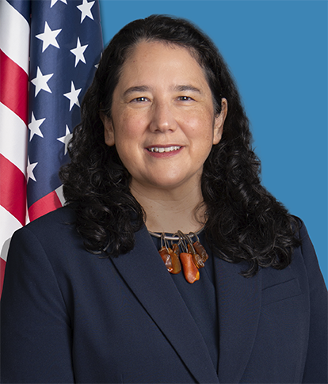
SBA’s Role in Disaster Recovery for
Federal Disaster Declarations
SBA disaster loans are the primary source of federal assistance to help private property owners pay for disaster losses not covered by insurance or other recoveries.
SBA offers low-interest federal loans to businesses of all sizes, private nonprofit organizations, homeowners and renters.
SBA Administrator
Isabella Casillas Guzman

Slide 3
Types of SBA Disaster Declarations
Declarations for Physical Damages/Natural Disasters
Presidential
Individual Assistance – Includes all SBA loan programs to residents and businesses in declared counties/parishes/tribal nations
Public Assistance – Includes SBA loans to certain private nonprofits of a governmental nature
Administrative (Agency)
Includes all SBA loan programs to residents and businesses in declared counties/parishes/tribal nations

Slide 4
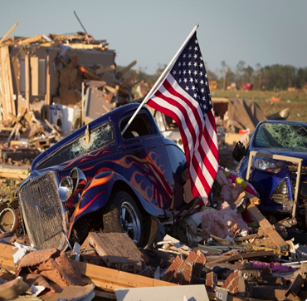
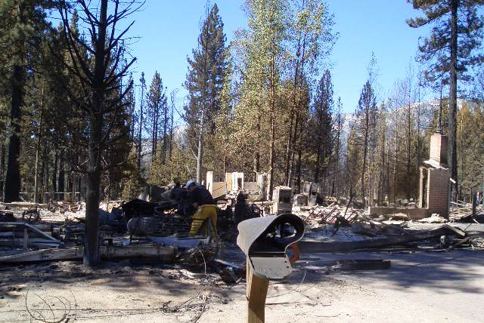
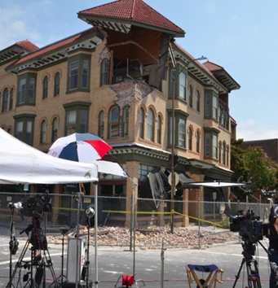
SBA’s Disaster Loan Programs
Business and Home Loans for Property Damages
Low-interest direct loans to businesses, nonprofits, homeowners and renters not covered by insurance or other recovery funds
Economic Injury Loans for Working Capital Needs
Low-interest direct loans to small businesses and most private nonprofit organizations

Slide 5
SBA Disaster Loan Limits
Types of Loans | Borrowers | Purpose | Max. Amount
Business Loans | Businesses and private nonprofits | Repair or replace real estate, inventory, equipment, etc. | $2 million *
Economic Injury Loans | Small businesses and private nonprofits | Working capital loans | $2 million *
Home Loans | Homeowners | Repair or replace primary residence | $200,000
Home Loans | Homeowners and renters | Repair or replace personal property | $40,000
Mitigation | Businesses, private nonprofits and homeowners. | Mitigate / prevent future loss of the same type | 20% of verified physical damage. Homeowners limited to $200,000.
*The maximum business loan is $2 million, unless the business qualifies as a Major Source of Employment (MSE).
Notes:
The maximum business loan is $2 million, unless the business qualifies as a Major Source of Employment.

Slide 6
SBA New Jersey Disaster Declaration 17143/17144 in conjunction with FEMA Presidential Declaration for Individual Assistance
Incident: REMNANTS OF HURRICANE IDA occurring: September 1 - 3, 2021 in the primary New Jersey counties of: Bergen, Essex, Gloucester, Hudson, Hunterdon, Mercer, Middlesex, Morris, Passaic, Somerset, Union, and Warren; for economic injury only in the contiguous New Jersey counties of: Atlantic, Burlington, Camden, Cumberland, Monmouth, Salem, and Sussex; for economic injury only in the contiguous Delaware County of: New Castle; for economic injury only in the contiguous New York counties of: Bronx, New York, Orange, Rockland, and Westchester; and for economic injury only in the contiguous Pennsylvania counties of: Bucks, Delaware, Monroe, Northampton, and Philadelphia.
Which county(ies) are eligible | New Castle
Who can apply? | Only small businesses, small agricultural cooperatives, small businesses engaged in aquaculture, and most private, non-profit organizations of all sizes.
What type of loan is available? | SBA Economic Injury Disaster Loan (EIDL) for working capital needs due to the disruption in business caused by Hurricane Ida.
Filing deadline | June 6, 2022
What can the loan proceeds be used for? | These working capital loans may be used to pay fixed debts, payroll, accounts payable, and other bills that could have been paid had the disaster not occurred.
What is the maximum loan amount? | The law limits EIDLs to $2,000,000 for alleviating economic injury caused by the disaster. The actual amount of each loan is limited to the economic injury determined by SBA, less business interruption insurance and other recoveries up to the administrative lending limit.
What is the interest rate? | 2.855% for Eligible Small Businesses & Small Agricultural Cooperatives 2% for Eligible Private Nonprofit Organizations
How to apply? | Applicants may apply online using the Electronic Loan Application (ELA) via SBA’s secure website at https://DisasterLoanAssistance.sba.gov/ela/s/ and should apply under SBA NJ declaration #17143 or 17144 not the COVID-19 incident.

Slide 7
SBA Pennsylvania Disaster Declaration 17165/17166 in conjunction with FEMA Presidential Declaration for Individual Assistance
Incident: REMNANTS OF HURRICANE IDA occurring: August 31, 2021 through September 5, 2021 in the primary Pennsylvania counties of: Bedford, Bucks, Chester, Delaware, Montgomery, Northampton, Philadelphia, and York; for economic injury only in the contiguous Pennsylvania counties of: Adams, Berks, Blair, Cambria, Carbon, Cumberland, Dauphin, Fulton, Huntingdon, Lancaster, Lehigh, Monroe, and Somerset; for economic injury only in the contiguous Delaware County of: New Castle; for economic injury only in the contiguous Maryland counties of: Allegany, Baltimore, Carroll, Cecil, and Harford; and for economic injury only in the contiguous New Jersey counties of: Burlington, Camden, Gloucester, Hunterdon, Mercer, and Warren.
Which county(ies) are eligible | New Castle
Who can apply? | Only small businesses, small agricultural cooperatives, small businesses engaged in aquaculture, and most private, non-profit organizations of all sizes.
What type of loan is available? | SBA Economic Injury Disaster Loan (EIDL) for working capital needs due to the disruption in business caused by Hurricane Ida.
Filing deadline | June 10, 2022
What can the loan proceeds be used for? | These working capital loans may be used to pay fixed debts, payroll, accounts payable, and other bills that could have been paid had the disaster not occurred.
What is the maximum loan amount? | The law limits EIDLs to $2,000,000 for alleviating economic injury caused by the disaster. The actual amount of each loan is limited to the economic injury determined by SBA, less business interruption insurance and other recoveries up to the administrative lending limit.
What is the interest rate? | 2.855% for Eligible Small Businesses & Small Agricultural Cooperatives 2% for Eligible Private Nonprofit Organizations
How to apply? | Applicants may apply online using the Electronic Loan Application (ELA) via SBA’s secure website at https://DisasterLoanAssistance.sba.gov/ela/s/ and should apply under Pennsylvania SBA declaration #17165 or 17166 not the COVID-19 incident.

Slide 8
SBA Maryland Disaster Declaration 17229/17230 SBA Administrative (Agency) Declaration – NO FEMA
MARYLAND Declaration 17229 & 17230 (Disaster: MD-00043) Incident: REMNANTS OF TROPICAL STORM IDA occurring: August 31 – September 4, 2021 in the Maryland counties of: Anne Arundel, Cecil, and Montgomery; the contiguous Maryland counties of: Baltimore, Baltimore City, Calvert, Frederick, Harford, Howard, Kent, and Prince Georges; the contiguous Delaware County of: New Castle; the District of Columbia; the contiguous Pennsylvania counties of: Chester and Lancaster; and the contiguous Virginia counties of: Arlington, Fairfax, and Loudoun
Which Delaware county(ies) are eligible | New Castle
Who can apply? | Businesses of any size, nonprofit organizations, homeowners and renters can apply for their physical damages. Only small businesses, small agricultural cooperatives, small businesses engaged in aquaculture, and most private, non-profit organizations of all sizes are eligible to apply for economic injury.
What type of loan are available? | Physical disaster loan proceeds are available to repair and replace damaged real estate and contents. SBA Economic Injury Disaster Loan (EIDL) for working capital needs due to the disruption in business caused by Tropical Storm Ida.
Filing deadline | December 17, 2021, for physical damages and July 18, 2022, for economic injury disaster loans (EIDL) only applications
What is the maximum loan amount? | Disaster loans up to $200,000 are available to homeowners to repair or replace disaster-damaged or destroyed real estate. Homeowners and renters are eligible for up to $40,000 to repair or replace disaster-damaged or destroyed personal property. Up to $2 million for physical damages to real property, business assets and economic injury. Applicants may be eligible for a loan amount increase up to 20 percent of their physical damages, as verified by the SBA, for mitigation purposes.
What is the interest rate? | As low as 2.855% for eligible businesses, 2% for eligible Private Nonprofit Organizations and 1.563% for homeowners/renters
How to apply? | Applicants may apply online at https://DisasterLoanAssistance.sba.gov/ela/s/ and should apply under SBA declaration #17229 or 17230 for EIDL only, not the COVID-19 incident.

Slide 9
SBA Delaware Disaster Declaration 17238/17239 (DE-00113) in conjunction with FEMA Presidential Declaration for Public Assistance
Incident: REMNANTS OF HURRICANE IDA occurring: September 1 through September 7, 2021, for New Castle County, Delaware
Which county(ies) are eligible | New Castle
Who can apply? | Private Non-Profit organizations (PNP)s in Delaware that do not provide critical services of a governmental nature may be eligible to apply for low-interest disaster loans. Examples of eligible non-critical PNP organizations include, but are not limited to, food kitchens, homeless shelters, museums, libraries, community centers, schools and colleges.
What type of loan are available? | Physical disaster loan proceeds are available to repair and replace damaged real estate and contents. Also available are SBA Economic Injury Disaster Loans (EIDLs) for working capital needs due to the disruption in business caused by Hurricane Ida.
Filing deadline | The filing deadline to apply for physical property damage is December 23, 2021. The deadline to submit economic injury only applications is July 25, 2022.
What can the loan proceeds be used for? | Up to $2 million for physical damages to real property, business assets and economic injury. Economic Injury Disaster Loans (working capital loans) may be used to pay fixed debts, payroll, accounts payable, and other bills that could have been paid had the disaster not occurred. Applicants may be eligible for a loan amount increase up to 20 percent of their physical damages, as verified by the SBA, for mitigation purposes.
What is the maximum loan amount? | Up to $2 million for physical damages to real property, business assets and economic injury. The actual amount of each loan is determined by SBA, less business interruption insurance and other recoveries up to the administrative lending limit.
What is the interest rate? | 2% for Eligible Private Nonprofit Organizations
How to apply? | Apply online at https://DisasterLoanAssistance.sba.gov/ela/s/ apply under the SBA Delaware declaration #17238 or 17239 for only economic injury, not the COVID-19 incident.

Slide 10
Making Recovery Affordable
The Small Business Act and additional disaster laws provide SBA tools to make disaster loans affordable:
Low-interest rates are set for the life of the loan
Affordable long terms (up to 30-year maturity)
Payments are based on borrower’s ability to pay
In certain circumstances, borrowers may be able to refinance existing liens or mortgages, or may use an SBA loan to relocate (cases have specific criteria and limits)
(NOTE: Loan amounts and terms are set by SBA and based on each applicant’s financial condition)

Slide 11
Loan and Insurance Requirements
Requirements for loan approval
Borrowers must obtain and maintain appropriate insurance as a condition of most loans.
Eligibility
Damaged property must be in a declared area.
Credit History
Applicants must have a credit history acceptable to SBA.
Repayment
Applicants must show the ability to repay all loans.
Hazard Insurance
Required on all secured loans.
Flood insurance
Required for properties located in a Special Flood Hazard Area (SFHA) and for properties damaged in a flood disaster.

Slide 12
Loan Eligibility Restrictions and Requirements
Only uncompensated losses (disaster losses not compensated by insurance or other recoveries such as FEMA grants, reimbursement by another party, settlement of a lawsuit, etc.) are eligible.
Applicants are not eligible if they have not complied with the terms of previous SBA loan agreements or other Federal obligations (e.g., failure to maintain required insurance, court-ordered child support, student loans, or Federal Income Tax filing requirements).
Disaster loans for physical losses in excess of $25,000, require collateral. Disaster loans for economic injury in excess of $25,000 require collateral. However, a business may receive up to $25,000 for their physical damages and up to another $25,000 for their economic injury and the total loan of $50,000 would be unsecured (no collateral required).

Slide 13
Section Three
Preparedness
Recovery
Mitigation

Slide 14
Don’t Wait! Mitigate. Protect Your Business From Future Disaster
Disaster mitigation is the effort to reduce loss of life and property by lessening the impact of disasters. Disasters can happen at any time and any place.
The number of disasters each year is increasing, but only 50% of events trigger Federal assistance.
Building back smarter and stronger now can be an effective recovery tool for future disasters.
Strengthening your business doesn’t need to cost a fortune. Projects such as maintaining gutters can be low-cost, while getting a backup generator requires greater financial investment.
$1 spent on mitigation today defers an estimated $6 in future damages.

Slide 15
Disaster Loans Help with Resilient Recovery Plans
Business and Home Loans can provide additional funds to help build back better / more resilient
Before disaster strikes, many property owners may not be aware of all their risks. After disaster strikes, there is a heightened awareness, prompting them to take steps in recovery to mitigate against future damages from a similar event.
Making loan payments also gives property owners an incentive to protect their investment against damages from future disasters.
SBA can increase loans to cover added costs for new building codes/required upgrades; mitigation improvements against future damages or to increase the safety of property; and, to utilize modern and more resilient construction methods.

Slide 16
SBA Disaster Loans Promote Mitigation Project Examples
Flood Mitigation
Seal your roof deck
Elevate structures
Wildfire Mitigation
Install a Class A fire-rated roof
Wind Mitigation
Brace/upgrade to wind-rated garage doors
Earthquake Mitigation
Add a sump pump
Relocate outside of a flood plain
Install noncombustible
Install hurricane roof straps
Upgrade to pressure-rated windows
Anchor roof-top mounted equipment
Install window film to prevent shattered glass injuries
Landscape your property to improve water runoff and drainage
Remove roof and gutter debris that can be ignited by airborne embers
Notes:
SBA Disaster Loans Promote Mitigation
Before disaster strikes, many people may not be aware of all their risks.
After disaster strikes, property owners have a heightened awareness of their risk, prompting them to take steps to mitigate against future damage from a similar disaster.
Making loan payments gives property owners an incentive to protect their investment and mitigate against damages from future disasters.
SBA disaster loans cover the cost of compliance with building codes, including:
Code required upgrades
Mitigate against future damages
Increase safety of property
Utilize modern construction methods
Following disasters, rebuilding codes require construction that meets current code. In many cases current codes are much more stringent regarding:
Elevation of the structure
Concrete roof shingles & sprinklers
Retaining walls & sump pumps
Roof tie downs & storm shutters
After a disaster new codes may be implemented, and local officials may more rigorously enforce the building code.

Slide 17


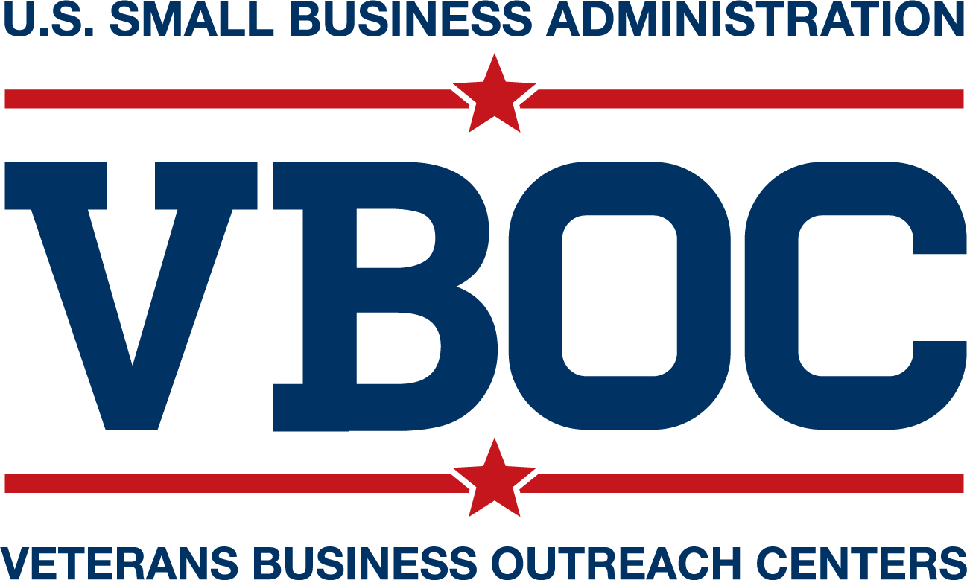
Role of SBA Resource Partners
Consulting provided by SBA’s Resource Partners is a vital form of disaster assistance and helps businesses:
Successfully stay in operation.
Develop operational, financial and marketing plans.
Consider alternative sources of revenue.
Identify ways to reduce costs.
Update management and technical services.
With applying for SBA disaster loans
Women’s Business Centers

Slide 18
Questions and Answers
Q: I own a business, where can I get help with preparing financial statements and submitting my application?
A: You can contact your local Small Business Development Centers (SBDC), Women’s Business Centers (WBC), Veteran Business Outreach Centers (VBOC) & SCORE office for free assistance.
Businesses and residents may call SBA’s Customer Service Center 1-800-659-2955 (1-800-877-8339 for the deaf and hard-of-hearing) or email DisasterCustomerService@sba.gov for answers to their questions and help.
Q: If I already have a disaster loan, can I still apply?
A: Yes, you can have more than one SBA disaster loans including loans for COVID-19, however the loans cannot be consolidated.

Slide 19
Questions and Answers
Q: What happens if I am declined for an SBA disaster loan?
A: SBA will provide you a written decision with the reason(s) for the decline decision. You will have up to six (6) months in which to request reconsideration. The reconsideration request must be in writing and contain information to overcome SBA’s decision.
Q: What are the filing requirements for businesses?
A: A completed loan application, an IRS Form 4506C and a copy of the latest Federal Income Tax Return. Depending on the type of business and type of loan requested more information may be required. To find the filing requirements and prepare for applying online, it may be helpful to review the paper applications at:
https://DisasterLoanAssistance.sba.gov/ela/s/article/paper-forms

Slide 20
SBA Office of Disaster Assistance
Contacts for the Public
For More Information about SBA Disaster Assistance programs, go to:
www.sba.gov/disaster
Contact SBA’s
Customer Service Center at:
1-800-659-2955 / 1-800-877-8339 (TTY)
Or by email at:
disastercustomerservice@sba.gov
20

