Slide 1
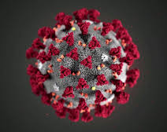
ChristianaCare COVID-19 Updates
Marshala Lee, MD, MPH
Carla Aponte Johnson, MS
Christopher Moore, BA, LSSGB

Slide 2
Presentation Topics
COVID-19 data, national trends, information on health disparities exacerbated by the pandemic.
ChristianaCare’s COVID-19 response.
  Testing.
  Vaccine distribution.
  Community-based work.

Slide 3



Presenters:
Marshala Lee, MD, MPH
Family Medicine Physician
Director, Harrington Value Institute Community Partnership Fund
Carla Aponte Johnson, MS
Manager, Community Health
Christopher Moore, BA, LSSGB
Manager, Community Health

Slide 4
COVID-19 Data

Slide 5
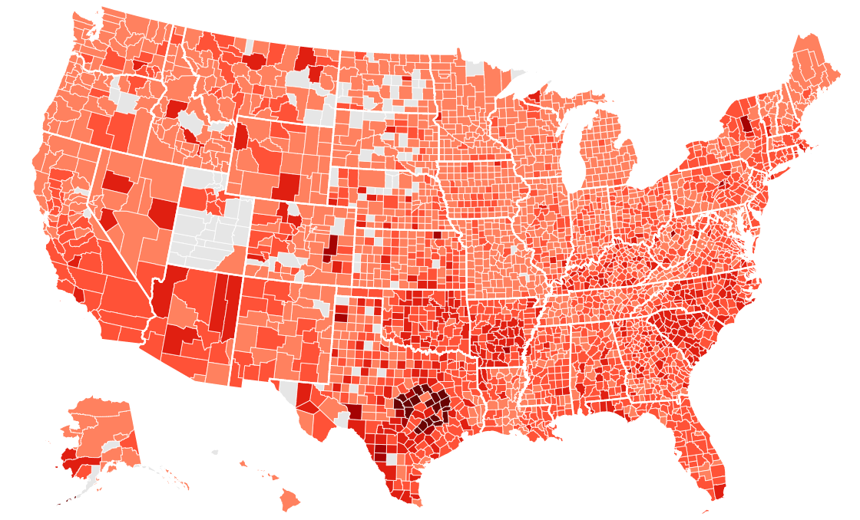
U.S. COVID-19 Stats
Cases
27,908,859
Deaths
493,670
Last updated: February 19, 2021 at 12:45 p.m. ET
https://www.cnn.com/interactive/2020/health/coronavirus-us-maps-and-cases/
Source: Johns Hopkins University Center for Systems Science and Engineering

Slide 6
COVID-19 Disparities
https://www.statista.com/statistics/1127489/covid-19-us-hospital-rate-by-ethnicity/

Slide 7
COVID-19 Disparities
https://www.apmresearchlab.org/covid/deaths-by-race

Slide 8
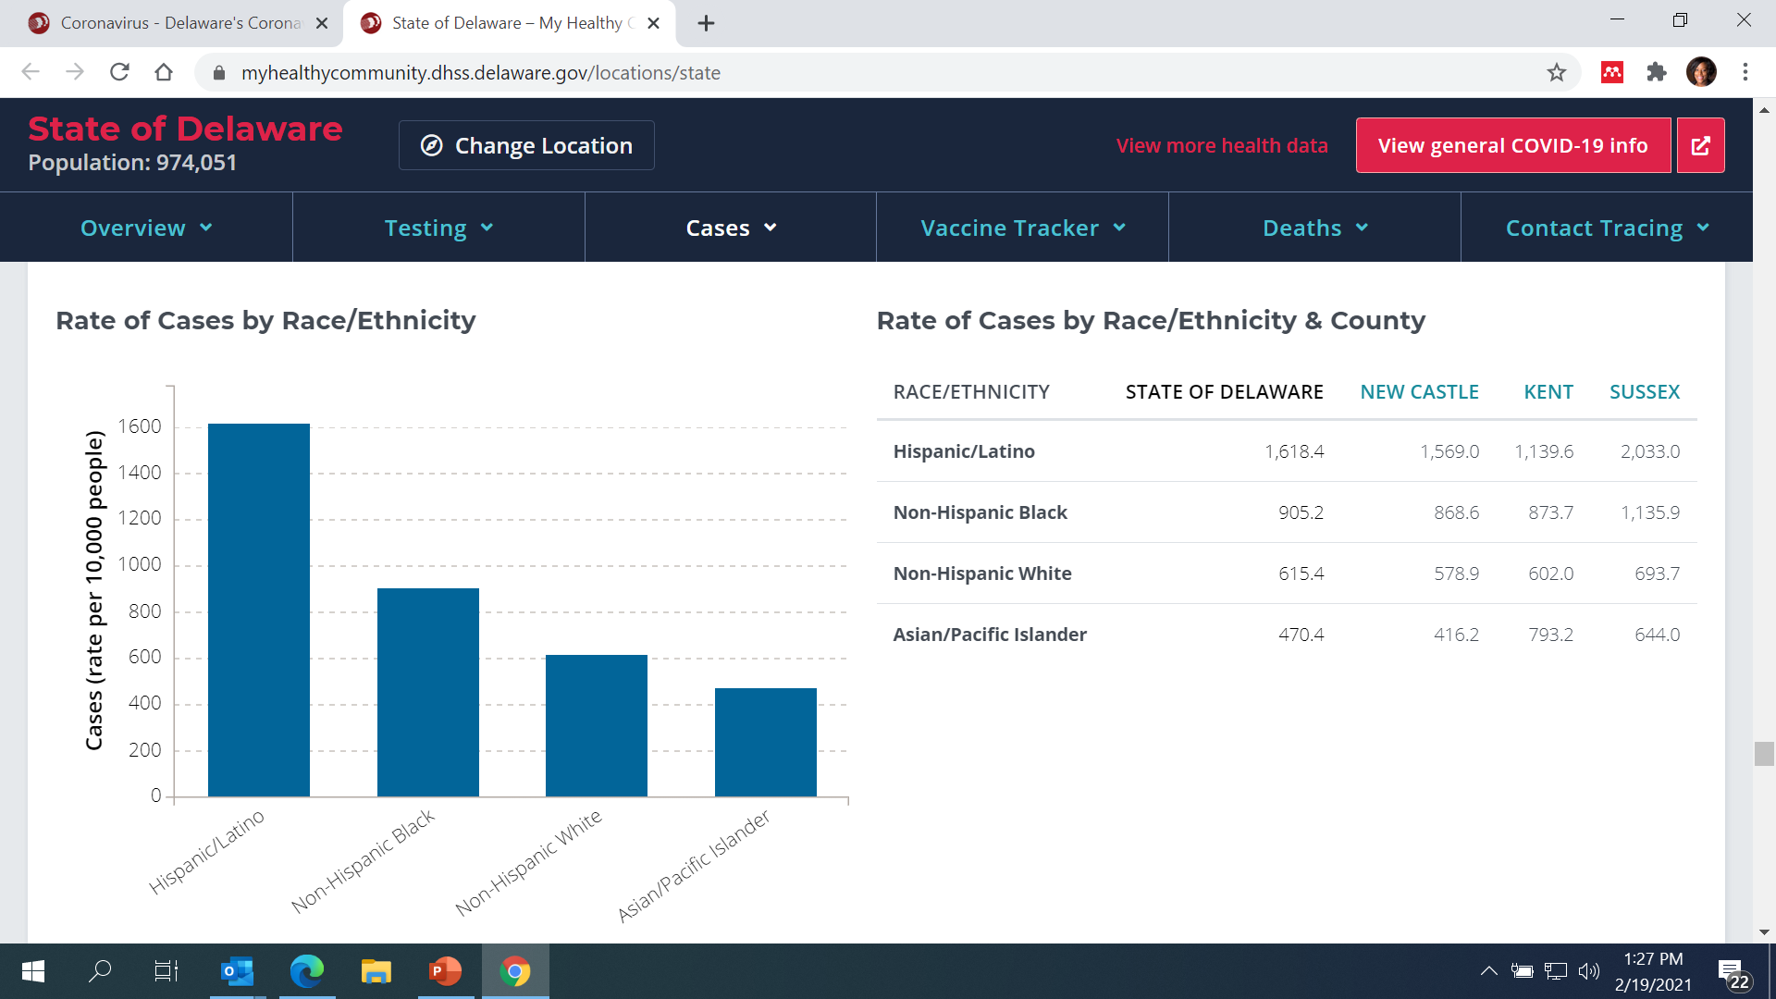
COVID-19 Disparities in Delaware
Rate of Cases by Race/Ethnicity
Last updated: February 19, 2021
https://coronavirus.delaware.gov/

Slide 9
COVID-19 Disparities in Delaware
Rate of Cases by County (Rate Per 10,000 People)
Last updated: February 19, 2021
https://coronavirus.delaware.gov/

Slide 10
COVID-19 Disparities
Higher COVID-19 Incidence & Mortality Among Minorities
Increased Exposure
- Frontline Occupations
- Residential Crowding
- Public Transportation
- Poverty
- Limited access to PPE
Chronic Disease Disparities
Testing & Treatment
- Unequal Access
- Affordability & Health Insurance Gaps
- Provider Bias & Racism
- Lack of Trust & Stigma
- Miscommunication

Slide 11
Long-Term Health
Complications
Cardiovascular: inflammation of the heart muscle.
Respiratory: lung function abnormalities.
Renal: acute kidney injury.
Dermatologic: rash, hair loss.
Neurological: smell and taste problems, sleep issues, difficulty with concentration, memory problems.
Psychiatric: depression, anxiety, changes in mood.
Notes:
A recent study reported that 45 percent of American adults have factors that place them at risk for serious COVID-19 complications. Because those attending churches are on average older than the general population, an even higher proportion of church congregants are at risk for serious COVID-19 complications.

Slide 12
Treatment
The FDA granted emergency use authorization of monoclonal antibody treatments.
  Bamlanivimab, a combination of Bamlanivimab and Etesevimab and a combination of Casirivimab and Imdevimab.
  Treatments have been approved for non-hospitalized adults and children over age 12 with mild to moderate COVID-19 symptoms who are at risk for developing severe COVID-19 or being hospitalized for it.
  In these patients, the approved treatments can reduce the risk of hospitalization and emergency room visits. These therapies must be given intravenously (by IV) soon after developing symptoms.
FDA has approved one drug, Remdesivir to treat COVID-19.
Several clinical trials under way.

Slide 13
ChristianaCare
COVID-19 Response

Slide 14
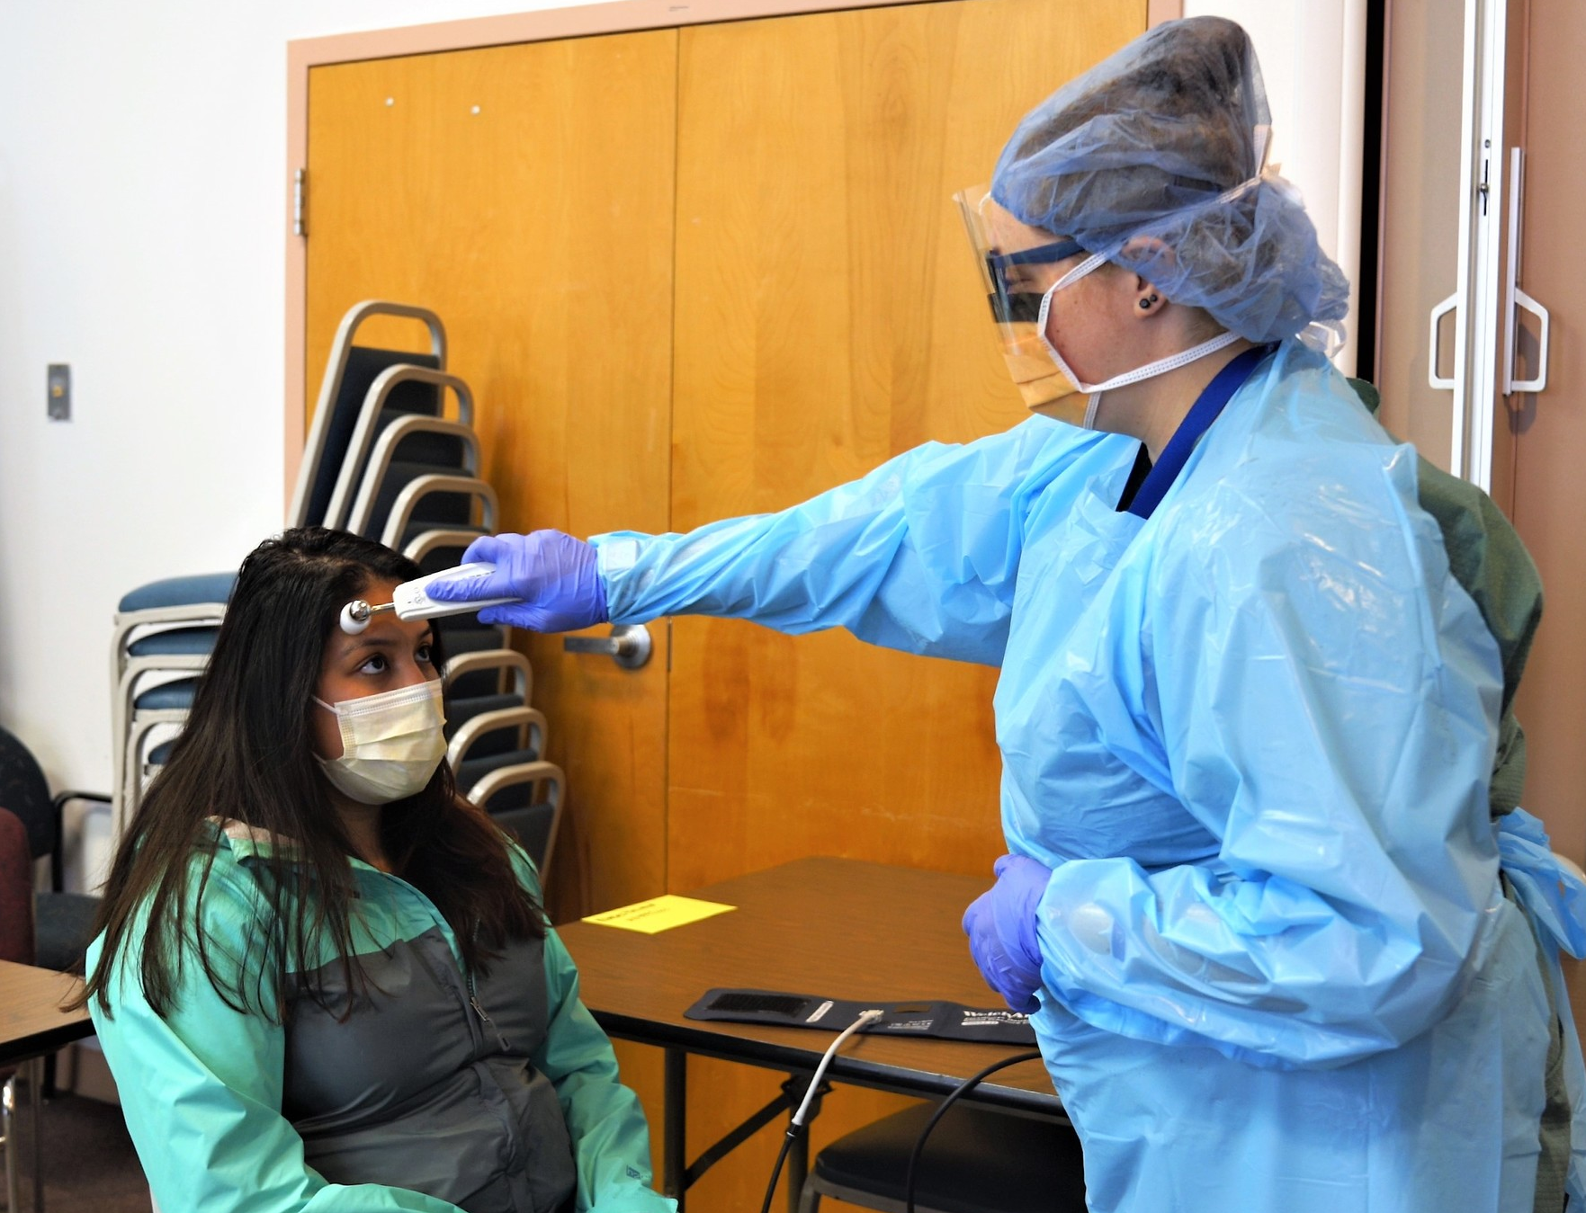
Testing Sites
In Spring 2020, ChristianaCare identified two locations for community-based testing sites:
    Kingswood Community Center.
    Latin American Community Center.
Sites were created to provide free community testing, along with wrap-around supports to address COVID-related issues and social determinants of health.
Community Health Worker on site to work with patients.
Language Services on site to remove any barriers for non-English speaking patients.

Slide 15
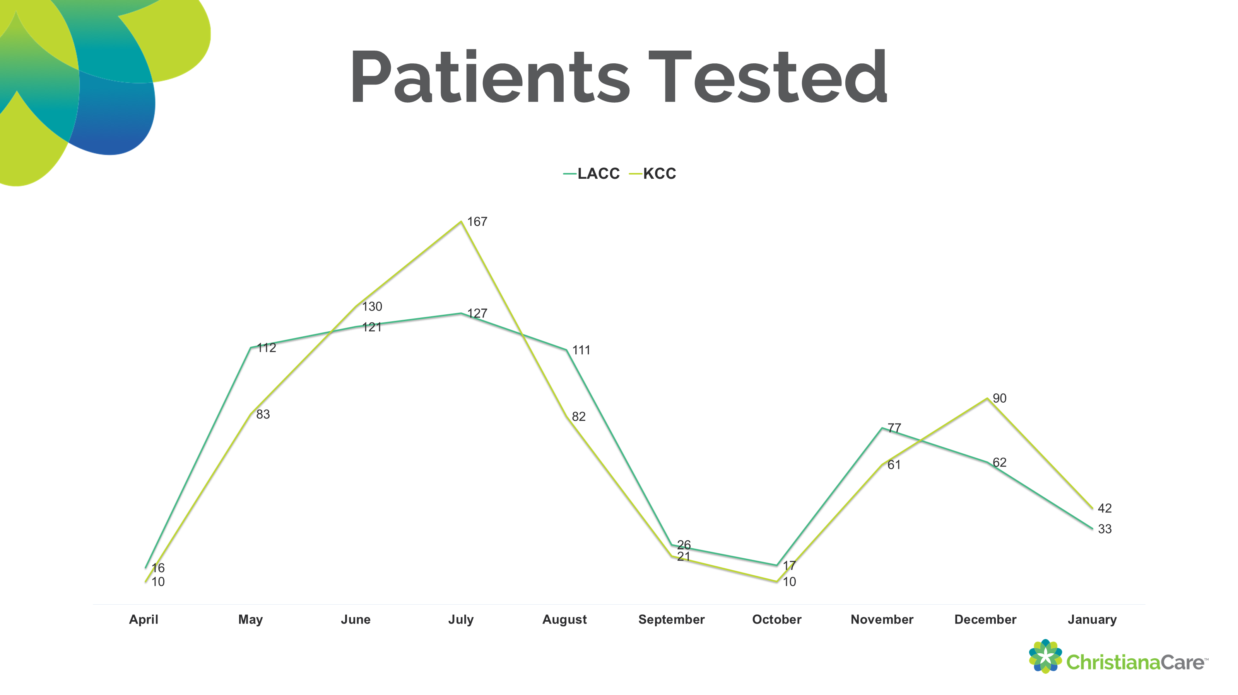
Testing
ABCD
ABCD
ABCD

Slide 16
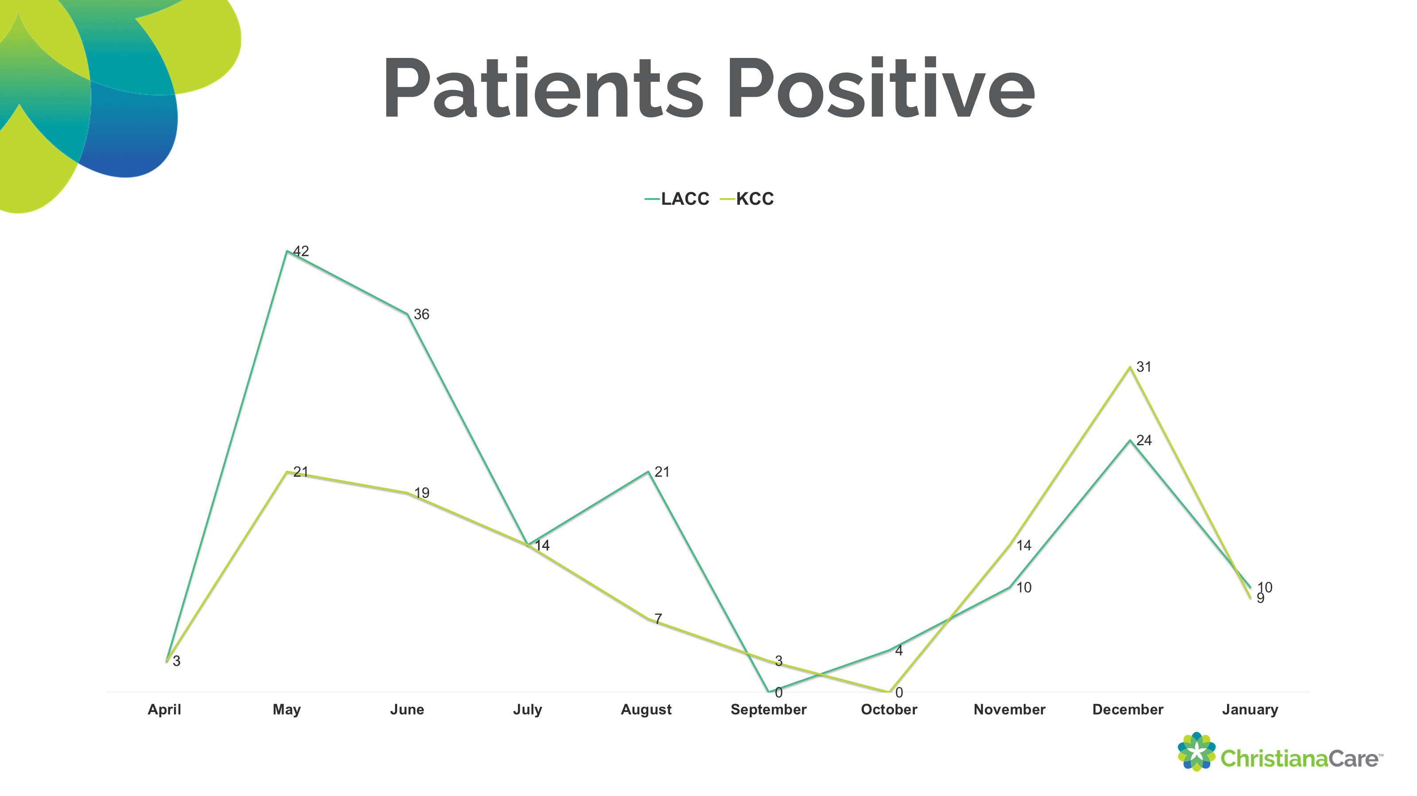
Testing
ABCD
ABCD
ABCD

Slide 17
COVID-19 Vaccine
 | Pfizer | Moderna
Type | mRNA | mRNA
Dose timing | 2 doses, 21 days apart | 2 doses, 28 days apart
Storage | Requires ultra-cold storage | Requires routine cold storage
Effectiveness | 95% effective | 94.1% effective
Emergency Auth. | Approved for individuals 16+ | Approved for individuals 18+

Slide 18

COVID-19 Vaccine
Vaccine Side Effects | Pfizer | Moderna*
Pain at injection site | Yes | Yes
Headache | Yes | Yes
Fever | Yes | Yes
Fatigue | Yes | Yes
Chills | Yes | Yes
Muscle and joint pain | Yes | Yes
Severe side effects were rare and temporary | Yes | Yes
*Side effects particularly common after 2nd dose.

Slide 19
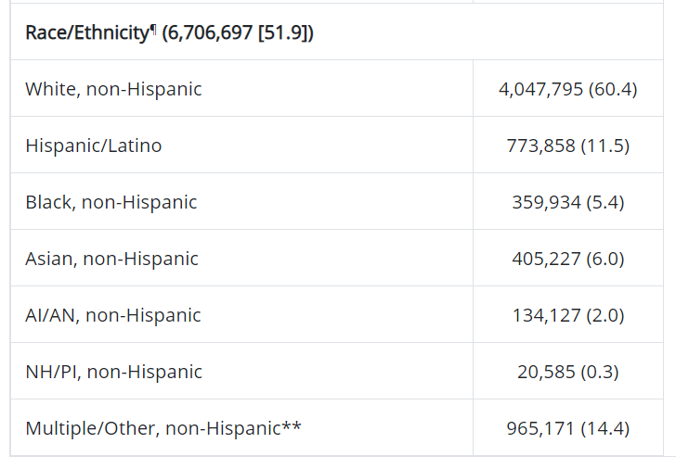
COVID-19 Vaccine
Demographic characteristics of persons initiating COVID-19 vaccination in the US:
12/24/20– 1/14/21
https://www.cdc.gov/mmwr/volumes/70/wr/mm7005e1.htm#T1_down

Slide 20
COVID-19 Vaccine
Community Planning
Equity
Authorization
Supply
Demand
Distribution

Slide 21
Improving Equity in
Vaccine Distribution
Use Data and Feedback to Inform Strategy
Community Engagement
Partner with Trusted Community Partners
Increase Vaccine Availability
Be Culturally Competent & Address Hesitancy
Provide Translation Services and Literacy Supports
Develop Effective Systems for Tracking Distribution
Be Accessible for Questions and Concerns

Slide 22
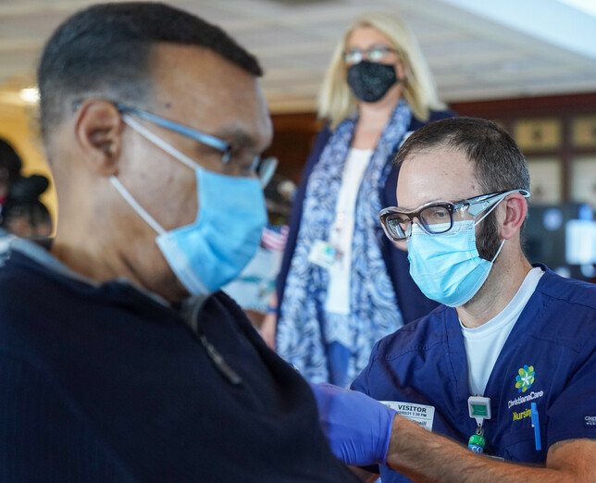
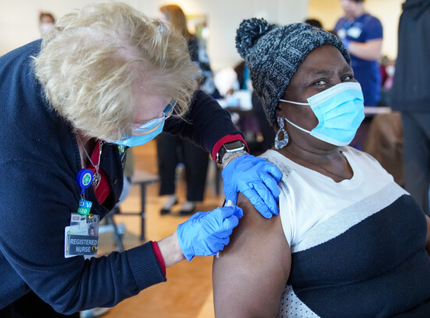
Vaccination Events
In collaboration with DHSS, hosted a 10-hour community event at the Community Education Building to provide first doses of the Pfizer vaccine to 850+ individuals age 65+ in alignment with 1B.
Concentrated effort to connect with community partners and leaders to get word out through their networks.
Social determinants of health screening included in the intake form.
    Follow-up calls for any patient who screened positive.
Second-dose event scheduled for Thursday, 2/25.

Slide 23
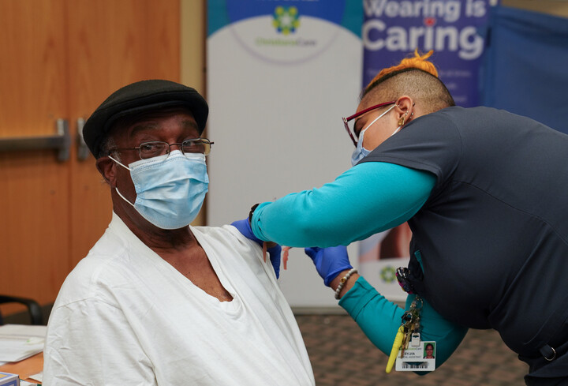
Vaccination Event – Feb 5
852 people vaccinated
Zip codes: 81 – 19701; 44 – 19702; 5 – 19703; 17 – 19707; 36 – 19709; 40 – 19711; 43 – 19713; 124 – 19720; 2 – 19734; 62 – 19801; 128 – 19802; 25 – 19803; 15 – 19804; 58 – 19805; 25 – 19806; 5 – 19807; 24 – 19808; 24 – 19809; 29 – 19810; 35 – other
18 Asian, 564 African American; 6 Native Hawaiian; 32 other race; 43 preferred not to answer; 20 unknown; 169 White.
94 Hispanic; 405 Not Hispanic.
43 Spanish language; rest English.
Notes:
Community Education Building

Slide 24
Community Supports
Connection to internal and external partners to support health and social care needs:
    Increased access to virtual care.
    Community Health programs supporting individuals and families in need.
    Unite Delaware expansion.
Increased focus on addressing mediators of health outcomes or social determinants of health.
Social determinants of health screener as part of intake process.
    Linkage to Unite Delaware.
Increased capacity to serve non-English speaking patients in person and virtually.

Slide 25

Community Supports
Leveraging resources to better support neighbors, partners.
Increased access to testing in community-focused sites.
Community messaging and education around safety, PPE use, testing, vaccines.
Expansion of virtual presence:
    Healthcare services.
    Education on Facebook Live, town halls, etc.

Slide 26


Slide 27


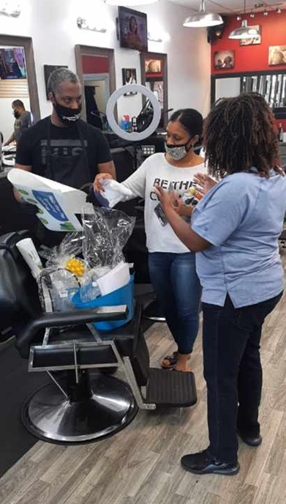
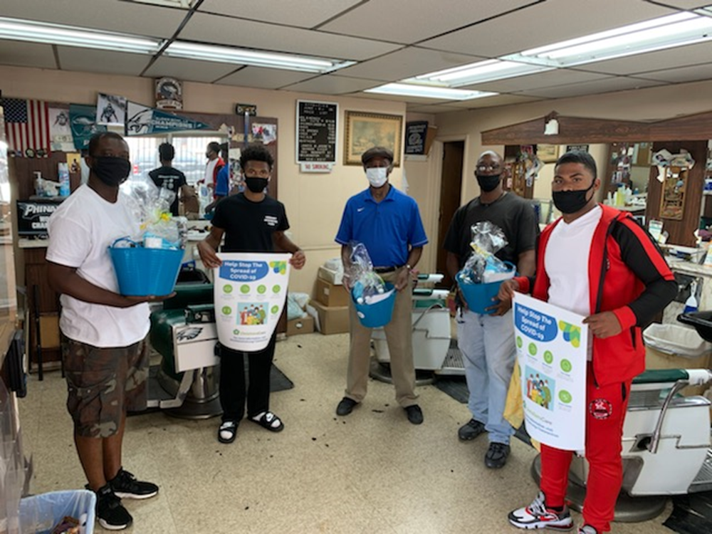
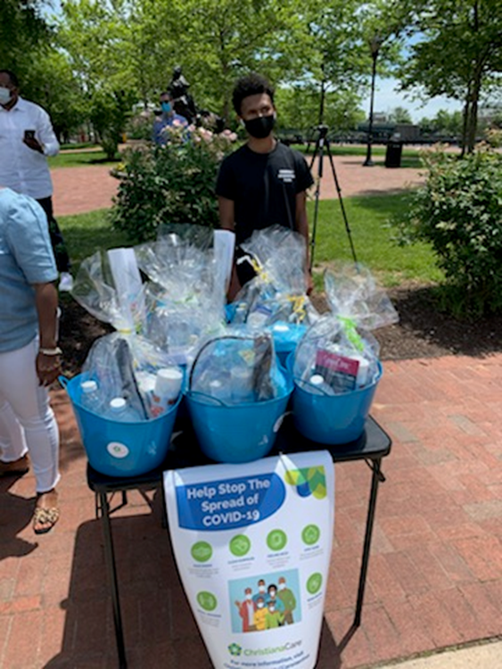
Barbershop and Salon COVID-19
Safety Kit Distribution Event

Slide 28



Community Health Virtual Programming

Slide 29
Resources
Centers for Disease Control and Prevention (CDC) – Coronavirus Information
  https://www.cdc.gov/coronavirus/2019-ncov/index.html
2-1-1 Coronavirus Help Page (for general info, connection to help for essential services)
  http://www.211.org/services/covid19
Centers for Disease Control and Prevention (CDC) – Coronavirus Information
  https://www.ama-assn.org/delivering-care/health-equity/states-tracking-covid-19-race-and-ethnicity-data
COVID-19 Quick Tips: CDC Educational Graphics for Social Media or Print
  https://www.cdcfoundation.org/covid-19-public-health-resources
National Alliance on Mental Illness (NAMI) COVID-19 Information and Resources
  https://www.nami.org/Support-Education/NAMI-HelpLine/COVID-19-Information-and-Resources
  NAMI HelpLine 1-800-950-NAMI, Monday through Friday, 10 am - 6 pm ET
National Suicide Prevention Lifeline
  1-800-273-8255

Slide 30
Presenter Contacts
Marshala.R.Lee@christianacare.org
Carla.P.Aponte.ohnson@christianacare.org
chmoore@christianacare.org

