Slide 1
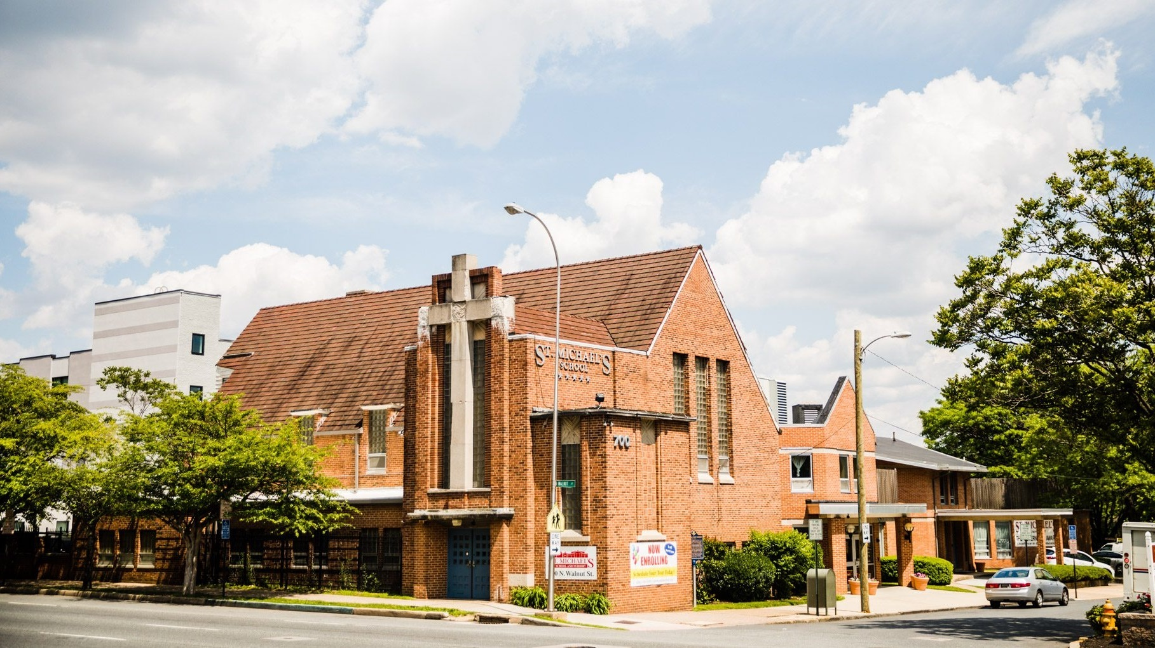
St. Michael’s School and Nursery
PRESENTATION TO THE WILMINGTON CITY COUNCIL
SEPTEMBER 8, 2021

Slide 2
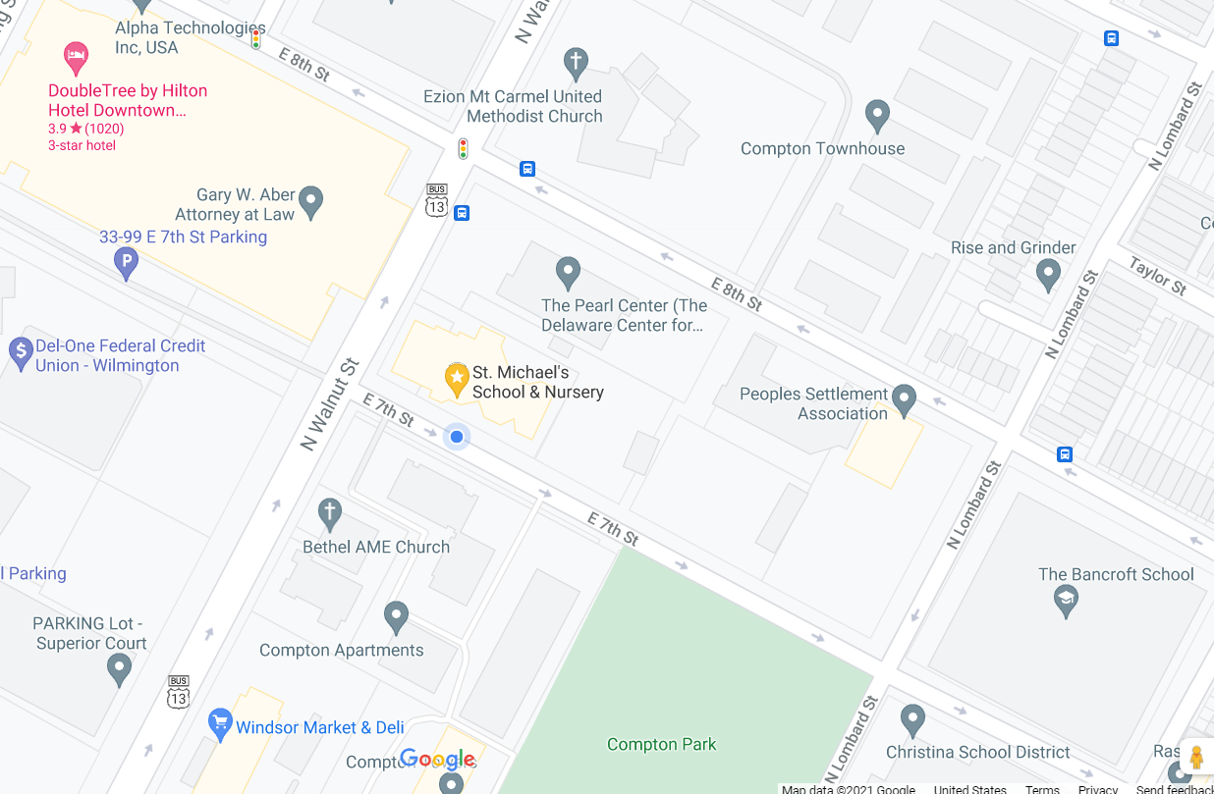
Overview
$5-$6 Million Campaign to Strengthen Our
Physical and Programmatic Footprint
BUILDING IMPROVEMENTS ($3-$4 million)
St. Michael’s operates a 28,885 sq. foot facility consisting of the purpose-built facility created in 1967 joined with the former St. Matthew’s Episcopal Church at the corner of 7th and Walnut Streets in the early 2000’s.
The combined buildings provide 16 classrooms and destination areas including an infant and toddler motor playroom, a preschool gross motor playroom, a large family-style dining room, a sunny library, administrative offices and a Teacher Resource Room. 25,000 sq. ft. of outdoor playground space is a hidden gem!
The building systems are in urgent need of significant capital investment to ensure the ongoing vitality and safety of our program. The roofs, doors, windows, HVAC, plumbing and electrical systems need to be replaced or upgraded and masonry needs repointing.
Located at the corner of 7th and Walnut Streets in the city ’s Eastside community

Slide 3
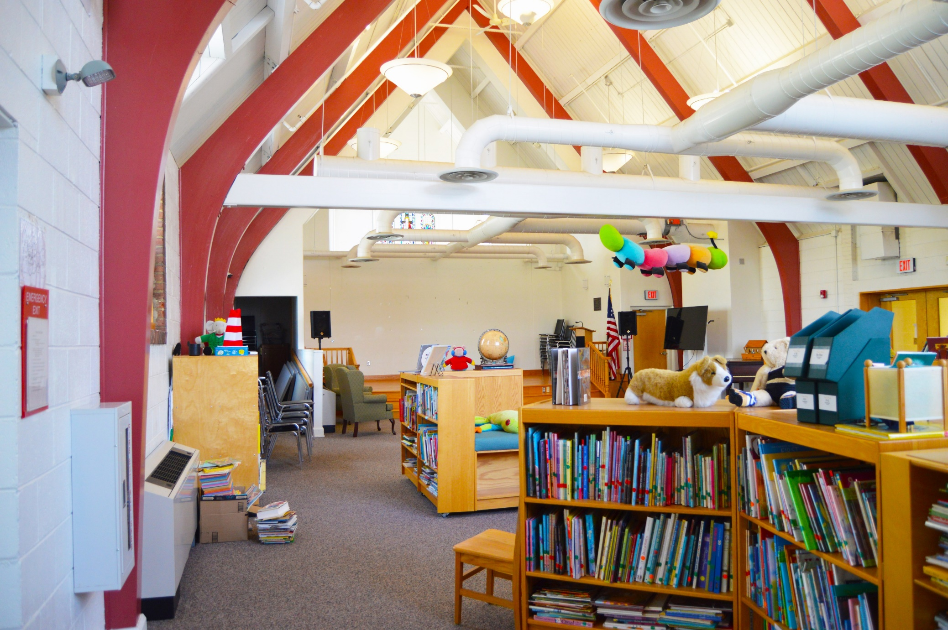
Overview
$5-$6 Million Campaign to Strengthen Our
Physical and Programmatic Footprint
PROGRAM AND ENDOWMENT ($1-$2 million)
Renovations to the 3rd story space that houses the library and stage will create a community space with a separate, secure entrance for neighborhood families to access social services and activities such as parent education trainings and family literacy programs.
The space will also be used as a means to address the workforce crisis through a pilot program that supports a small cohort of teachers in completing their CDA (Child Development Associates) certificate. The initial planning phase for this program could begin with current St. Michael’s staff before expanding to include other ECE professionals seeking to advance in the field
To ensure long-term sustainability, a portion of campaign dollars will create an endowment to support ongoing building maintenance needs and unforeseen operating costs.

Slide 4
Background A 5-Star Level Early Learning Center for Newborn – Pre-School Ages
A History of Service: 131 years of serving working families in the city of Wilmington and acting as a neighborhood anchor and resource.
High Quality Program in Under-Resourced Community: One of only three Delaware Stars 5-Star level early childhood centers in the city’s Eastside community.
Strong Family-School Partnership: Year-round, full-day hours support working families and engage parents as active participants in children’s education.
Commitment to Professional Development: Recruit and retain qualified teachers and support staff in furthering their education and skills.
Nurturing Environment: Low student-teacher ratios and a trauma-aware approach so each child is prepared for success in kindergarten.

Slide 5
Background A 5-Star Level Early Learning Center for Newborn – Pre-School Ages
OUR SCHOOL COMMUNITY
Families primarily in or near the Eastside, one of Wilmington’s most impoverished areas where over 50% of residents live below the poverty line.
80% of our students are eligible for Purchase of Care, the childcare subsidy from the state for families living in poverty.
Many children have already experienced traumatic life events such as domestic violence, physical or emotional abuse, substance abuse, gun violence, house fires, neglect or separation from parents.
Our 19801 zip code has been identified as 1 of 8 Promise Communities by the United Way due to being a high need, low resource area whose residents face complex social and economic challenges.
Average Enrollment = 160 students ages 2 months - 5 years Current Enrollment (due to COVID) = 105 | Fall Enrollment est. = 130
93% of children are from families of color
Over 50% live in single parent homes

Slide 6
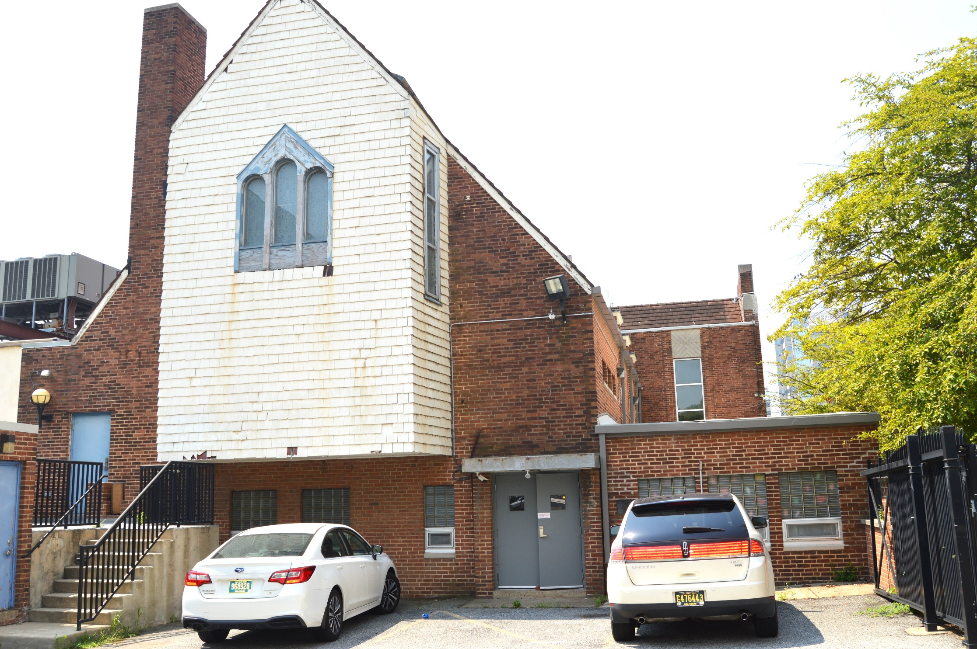
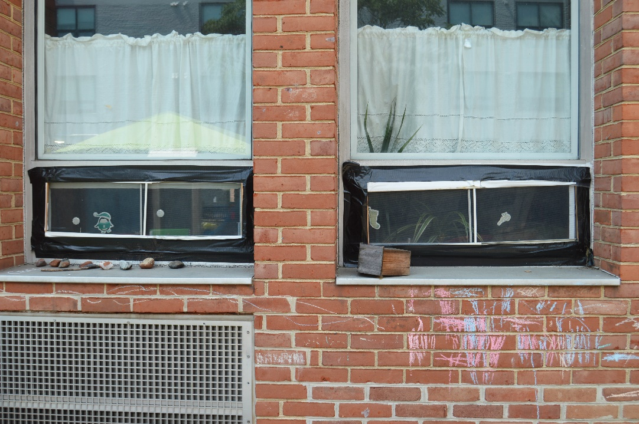
The Need
Duct taped pipes and classroom windows
Many major physical infrastructure needs threaten the safety and well-being of our school community:
Cracked brick on the façade of the former St. Matthew’s Church on Walnut Street
Outdated, inefficient electrical and ventilation systems
Exposed, leaking pipes
Crumbling brick and shingles
Aging doors and windows

Slide 7
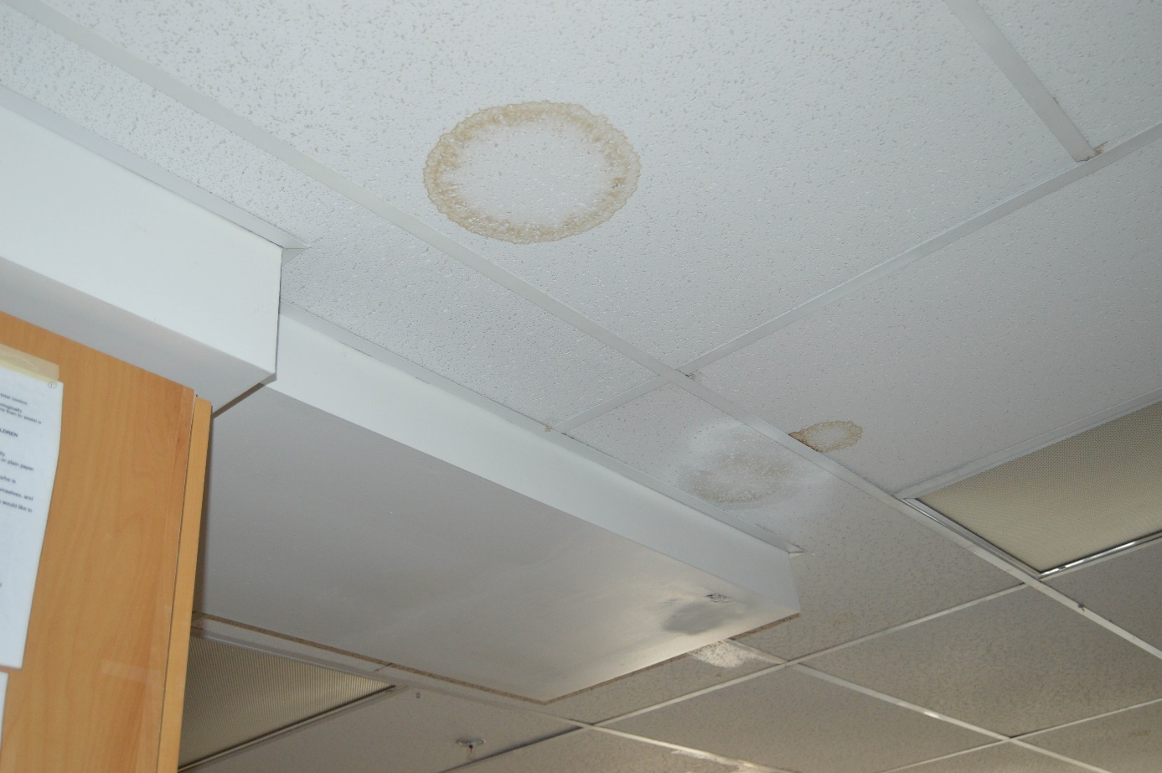
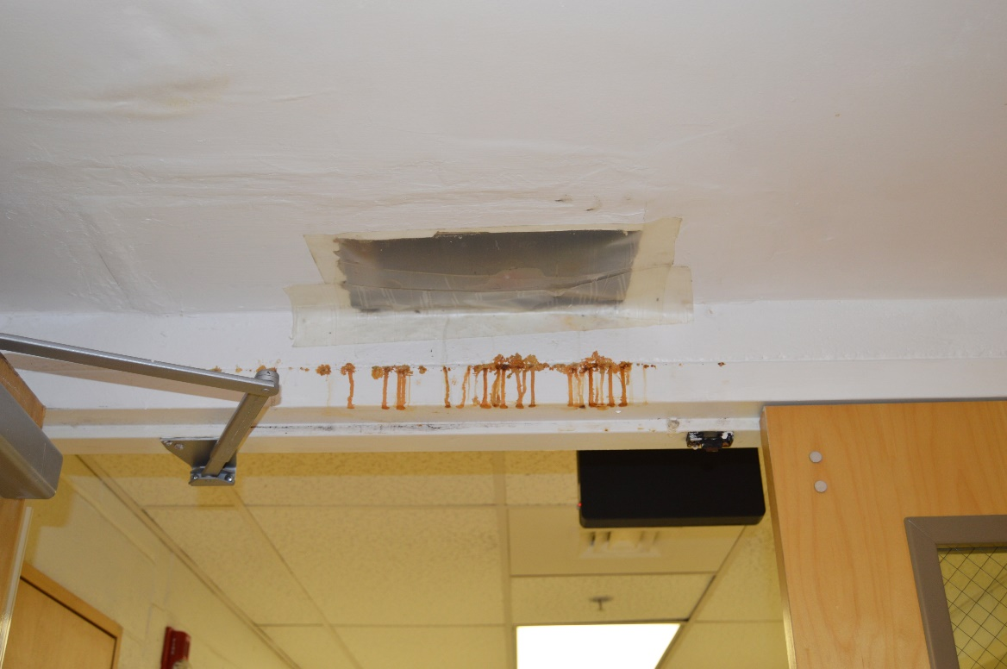
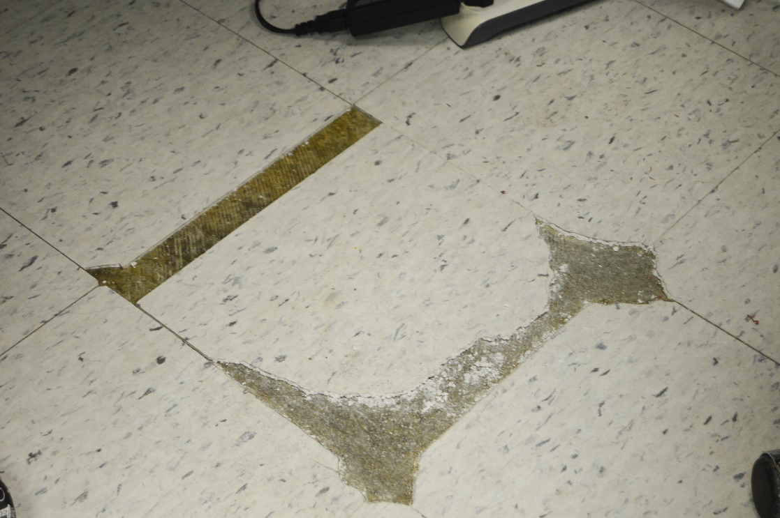
The Need
Chipped flooring
Leaking ceilings, missing tiles and mold issues
Outdated safety and security equipment
Last fiscal year, electric, plumbing, water and repair costs totaled over $122,000 due to inefficient systems.

Slide 8
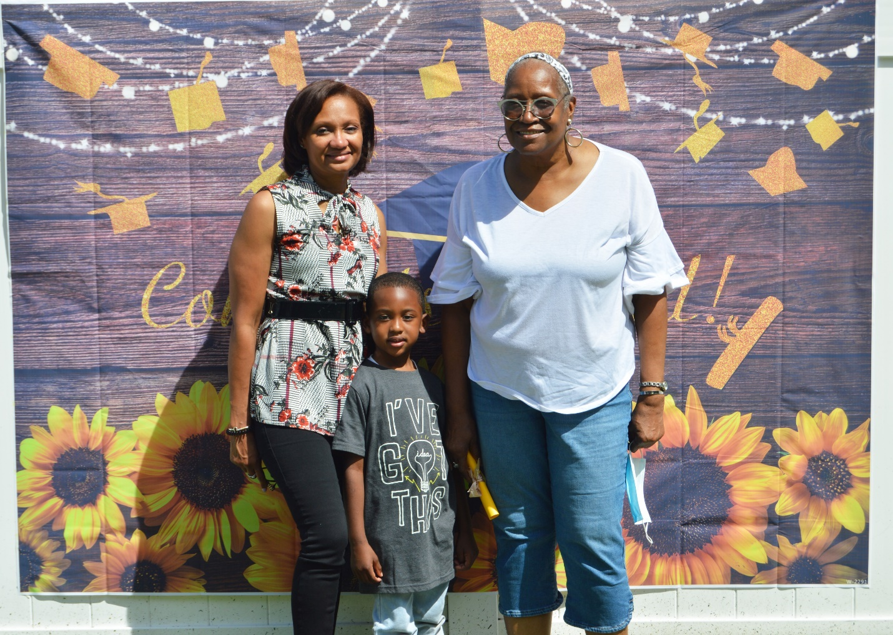
The Need
WORKFORCE CRISIS
Even before the pandemic, the workforce and industry faced a mounting crisis because of low pay scales. Many staff are on public assistance themselves.
COVID has exacerbated the problem, forcing centers to close and losing an already lean workforce to other industries and K-12 schools who offer higher salaries. St. Michael’s has rooms closed due to lack of staff.
The State contracts for the T.E.A.C.H. and WAGE$ programs that previously supported teachers through incentives and scholarships were not renewed this year.
LACK OF COMMUNITY RESOURCES
The Riverside and Eastside neighborhoods have high concentrations of children living
in poverty, as well as the densest percentages of people living in poverty, but appear to have relatively few community resources, including few
highly-rated licensed early childhood providers, operating
in those neighborhoods.
- Wilmington Community Asset and Resource Mapping; Wilmington Education Improvement Commission, May 2018.

Slide 9
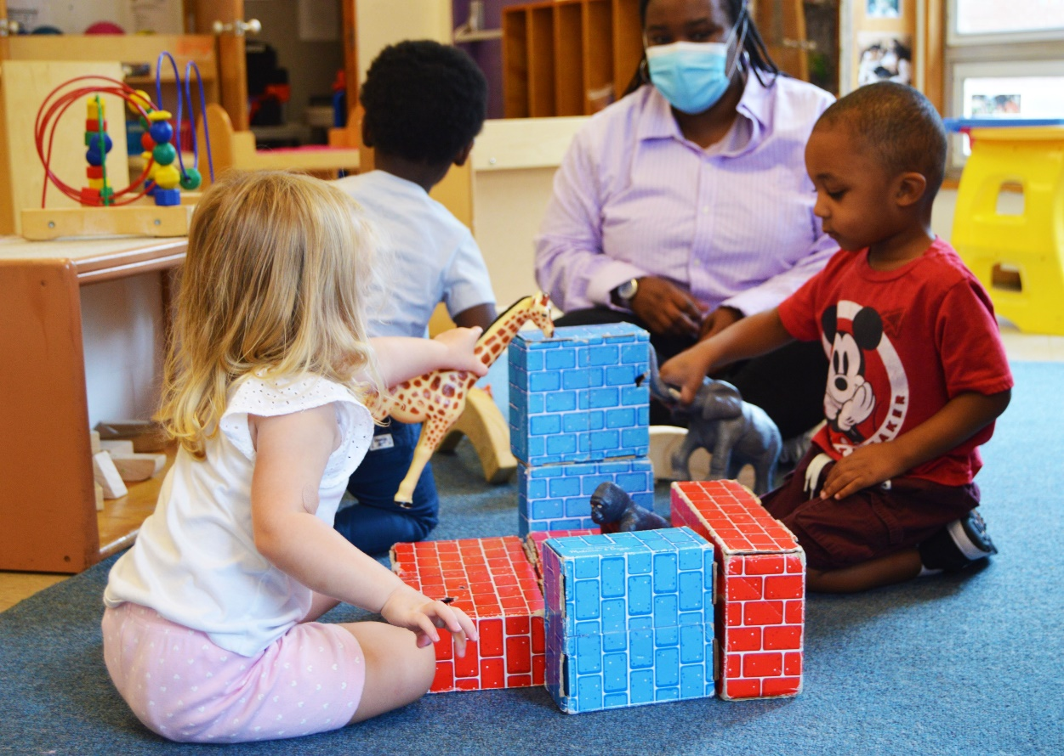
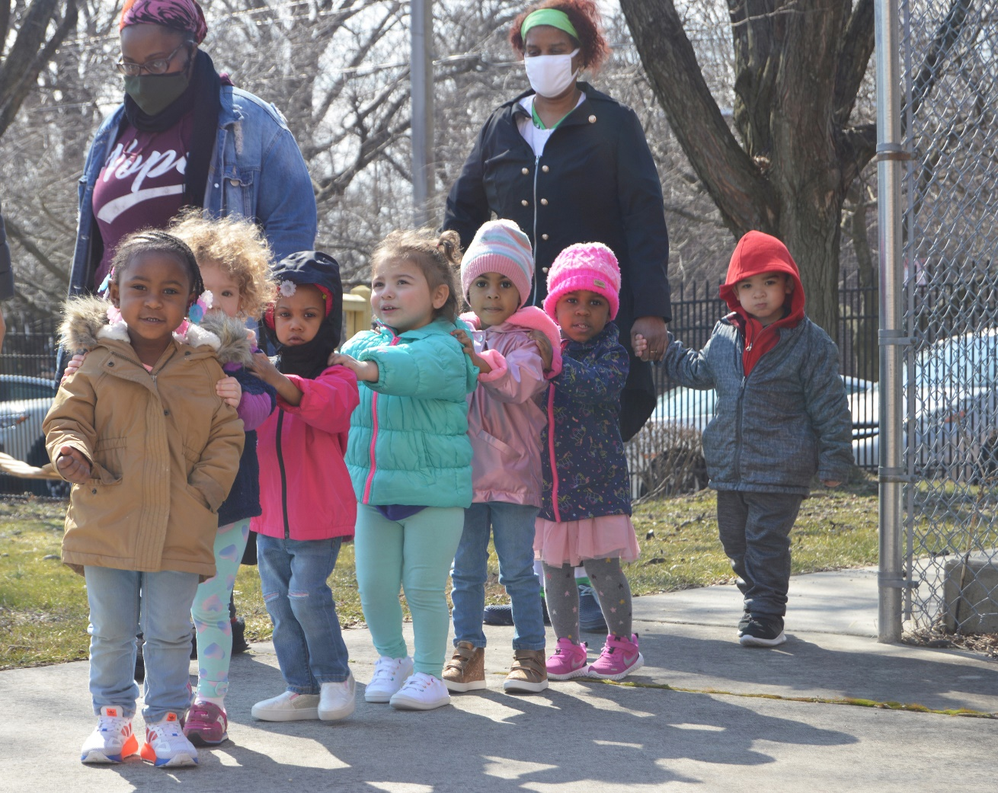
Objectives
KEY OBJECTIVES
Stabilize the physical infrastructure of the school to address immediate safety needs, maintain a quality learning environment and improve overall energy efficiency
Strengthen our role in the Eastside community by increasing the number of families who have equitable access to social services and parenting resources in a shared, safe, familiar neighborhood community space
Help address the early childhood workforce crisis by creating a pilot cohort program for professionals seeking to advance their careers through completion of their CDA certification

Slide 10
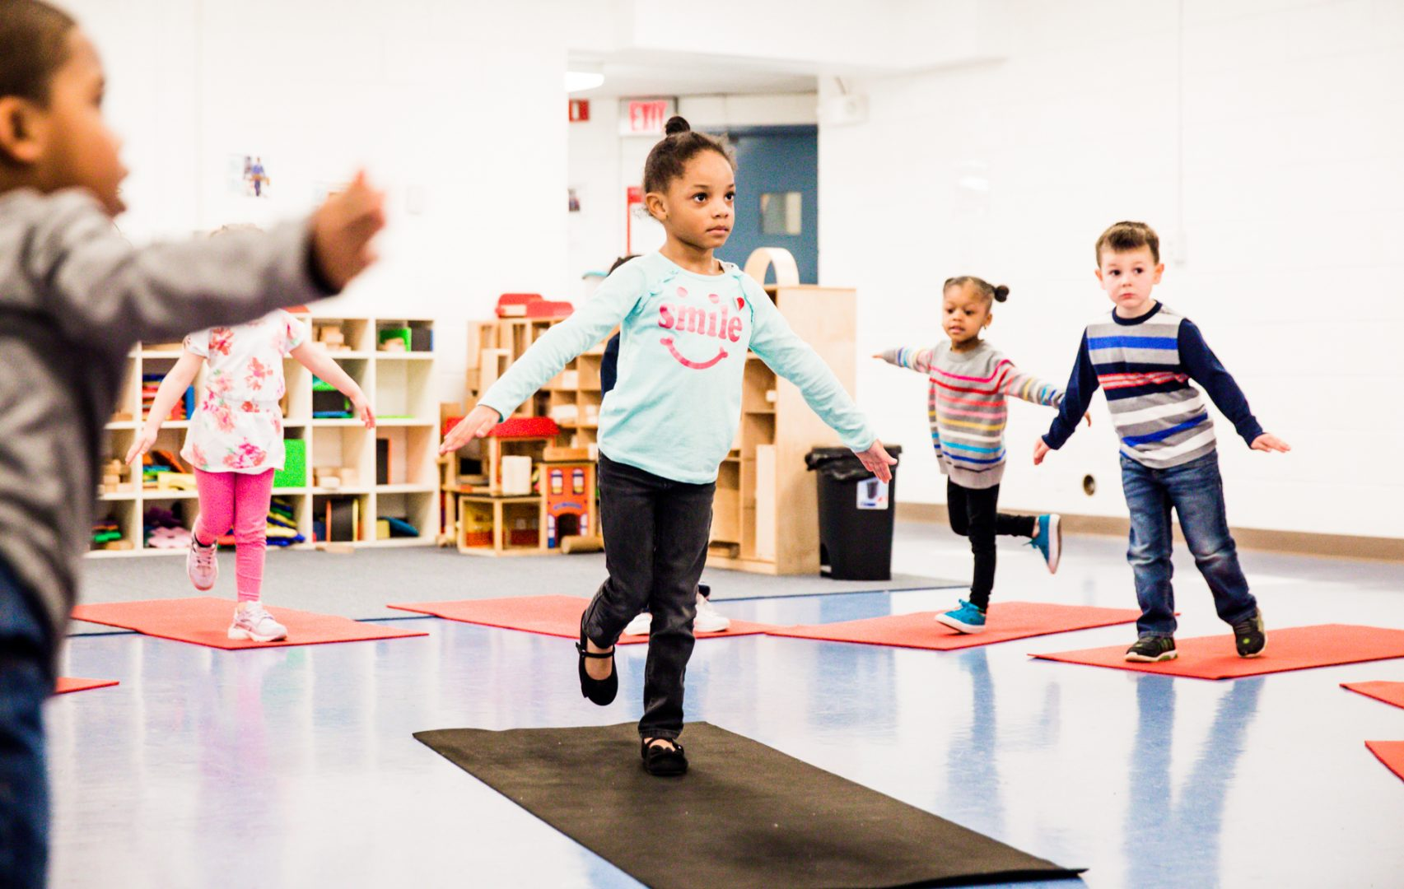
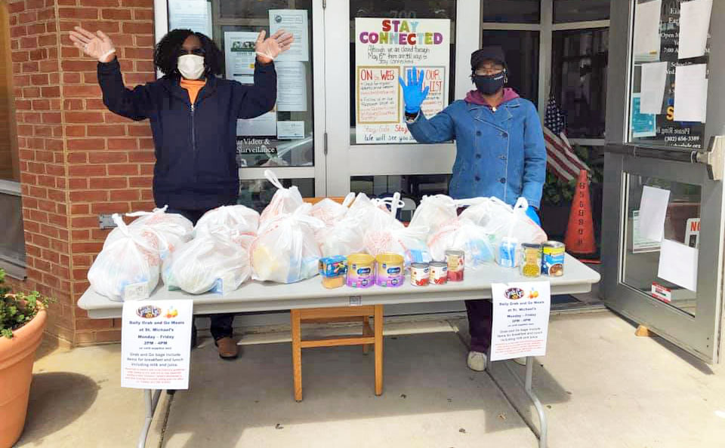
Impact
Research shows that access to high quality early education programs have a direct, lasting impact on the trajectory and success of a child’s life, particularly for low income children.
The pandemic – the second pandemic weathered by St. Michael’s - has shone an even brighter light on the critical role that St. Michael's plays as a consistent, safe, stabilizing factor in the Eastside neighborhood. We are a trusted resource for families raising young children.
Supporting and coaching the ECE workforce through career advancement will strengthen the field and the quality of programs. St. Michael’s has participated in cohort training models and is a strong advocate of those with life experience to attain more formal training.
This initiative is an investment in St. Michael's mission of welcoming all children, in our generational impact in the
lives of families in the city of Wilmington and in support of
the ECE workforce.

Slide 11
Cost Breakdown
Description | Total Cost | Notes
General Contractor: Bellevue Contractors Construction Costs (Labor & Materials) | $3,687,475*
General Contractor Overhead & Profit | $110,624
Administrative General Conditions | $110,624
TOTAL RENOVATION COSTS | $3,908,723
Library Repurposing: Community Space for Workforce Development/Cohort Program & Social Services for Families | $500,000 | This may include: Planning Studies Program Design Consultant Renovations Social Worker
Endowment | $1,500,000 | Building Maintenance Unforeseen Operating Costs
TOTAL PROGRAM & ENDOWMENT | $2,000,000
TOTAL FUNDRAISING CAMPAIGN = APPROX. $5,908,723
*Revised 7/20/21

Slide 12
Project Timeline
PROGRESS TO DATE
✓ $100,000 from private donor
$500,000 from the DE General Assembly’s FY 2022 Reinvestment Fund/Bond Bill
$150,000 from the DE Early Education and Child Care Stabilization Fund (American Rescue Plan $) to offset operating and personnel costs
Feasibility Study completed | March-June 2021
Fundraising Campaign | August 2021-June 2023
Building Renovations* | January 2022-December 2023
*Construction will occur in phases to ensure uninterrupted services.

