Slide 1
Wilmington City Council
Education, Youth & Family Services Committee Meeting
June 11th, 2021

Slide 2
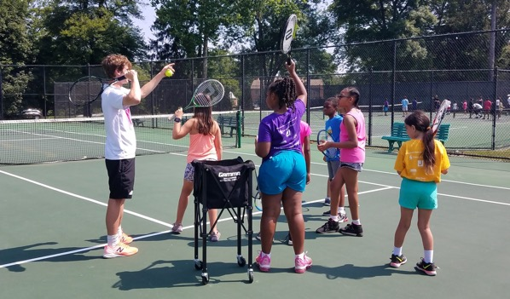
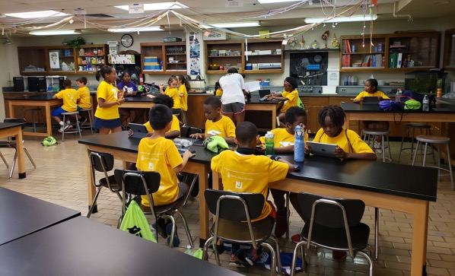
Our Important Role
Why we are important:
What we do:
Team dynamic
Education and growth oriented
Safe learning environment
Positive adult influence
Tennis
Enrichment
STEAM (Science, Technology, Engineering, Art, Math)
On-site and community outreach programming
Notes:
increase interest in tennis/education, provide environment, surround kids w/ positive influence
STEAM - say full acronym, give examples of activities, introduce project based learning

Slide 3
Program Model
All Stars
Weekly Advanced Programming + Tournament Play
1
After-School Programs
Meet onsite 2-3 days per week
(Includes tennis & STEAM)
2
Summer,
In-School, Community Programs
Full , PE takeovers (“play-weeks”), community centers
3

Slide 4
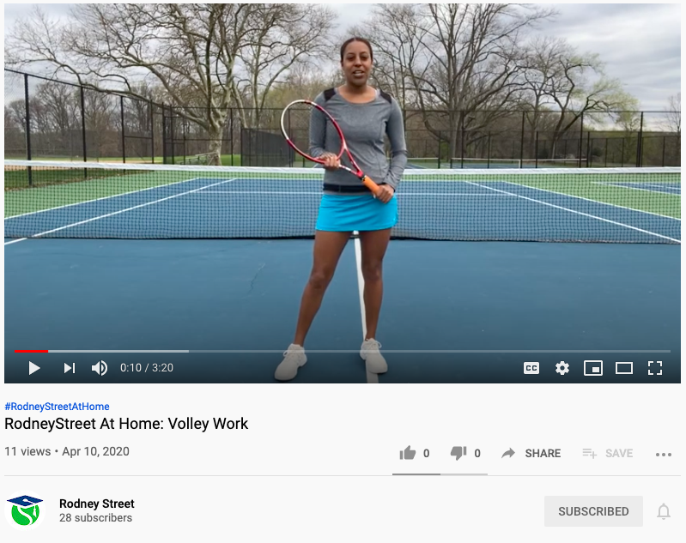
RodneyStreet at Home (March – May, 2020)
Instructional tennis and fitness videos posted to YouTube, Facebook and Instagram during the week
Weekly Nutrition Lesson Videos
Weekly STEAM Activity Videos
30+ video library

Slide 5
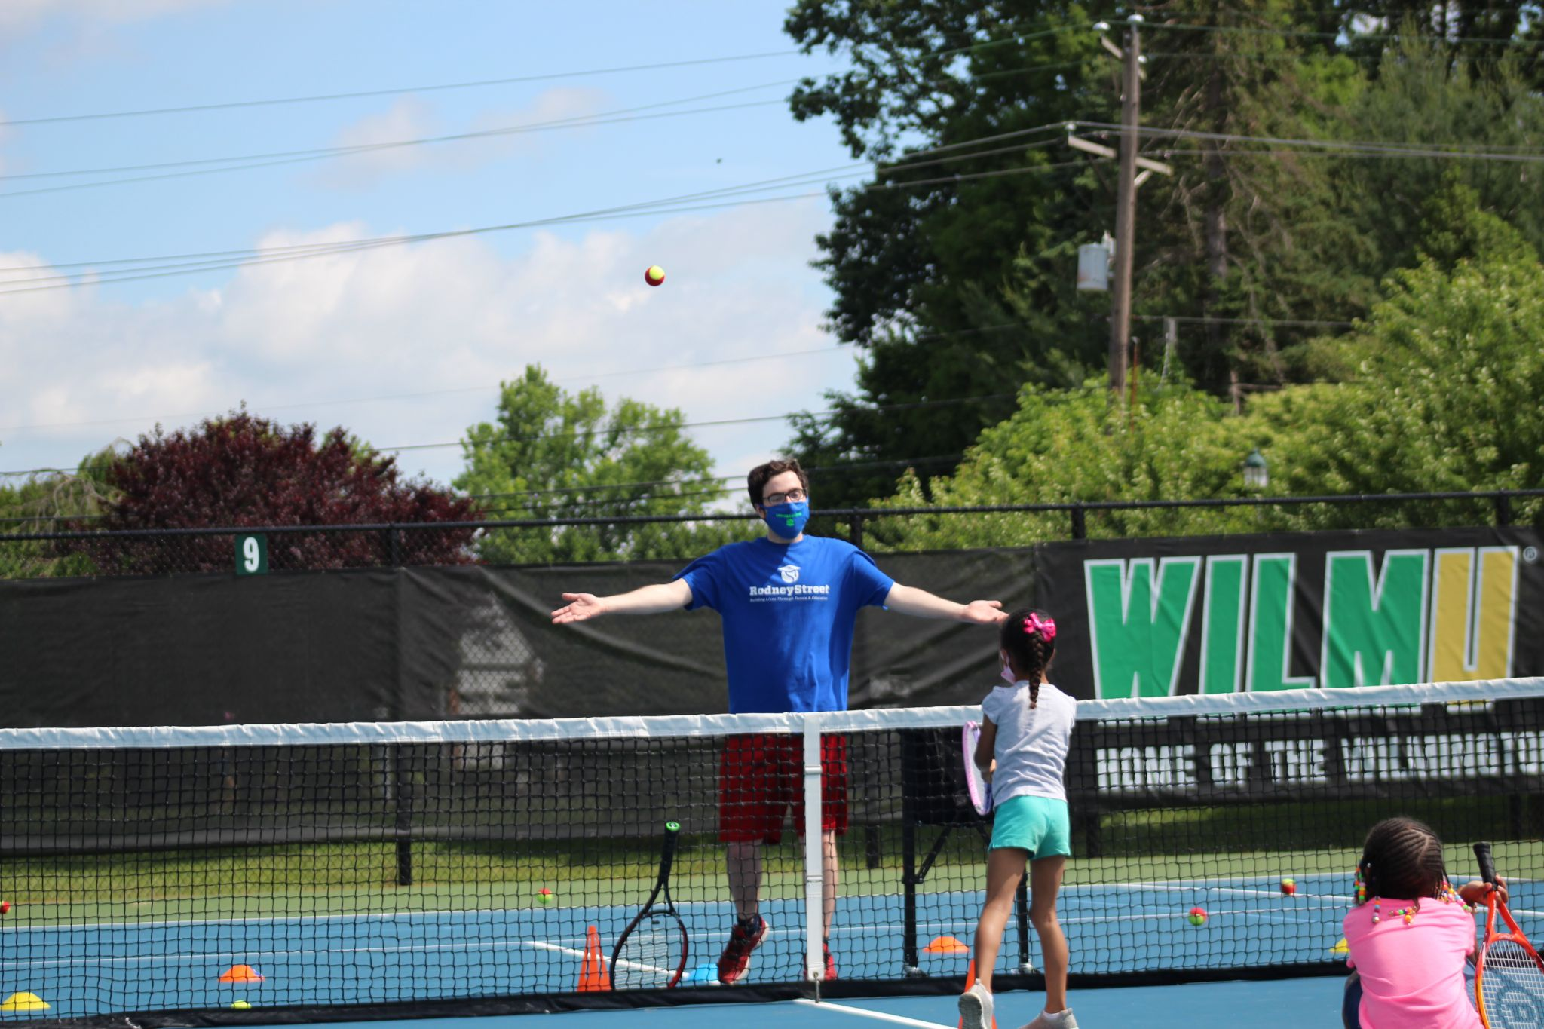
Summer 2020 (Summer during COVID-19)
72 total children served
Average daily attendance: 27
Partnered with West End Neighborhood House, 4 Sessions
In person tennis instruction at Rockford Park, 8AM – 1PM
Virtual enrichment, 2PM – 5PM
Included STEAM exercises, character building, and math & reading daily

Slide 6
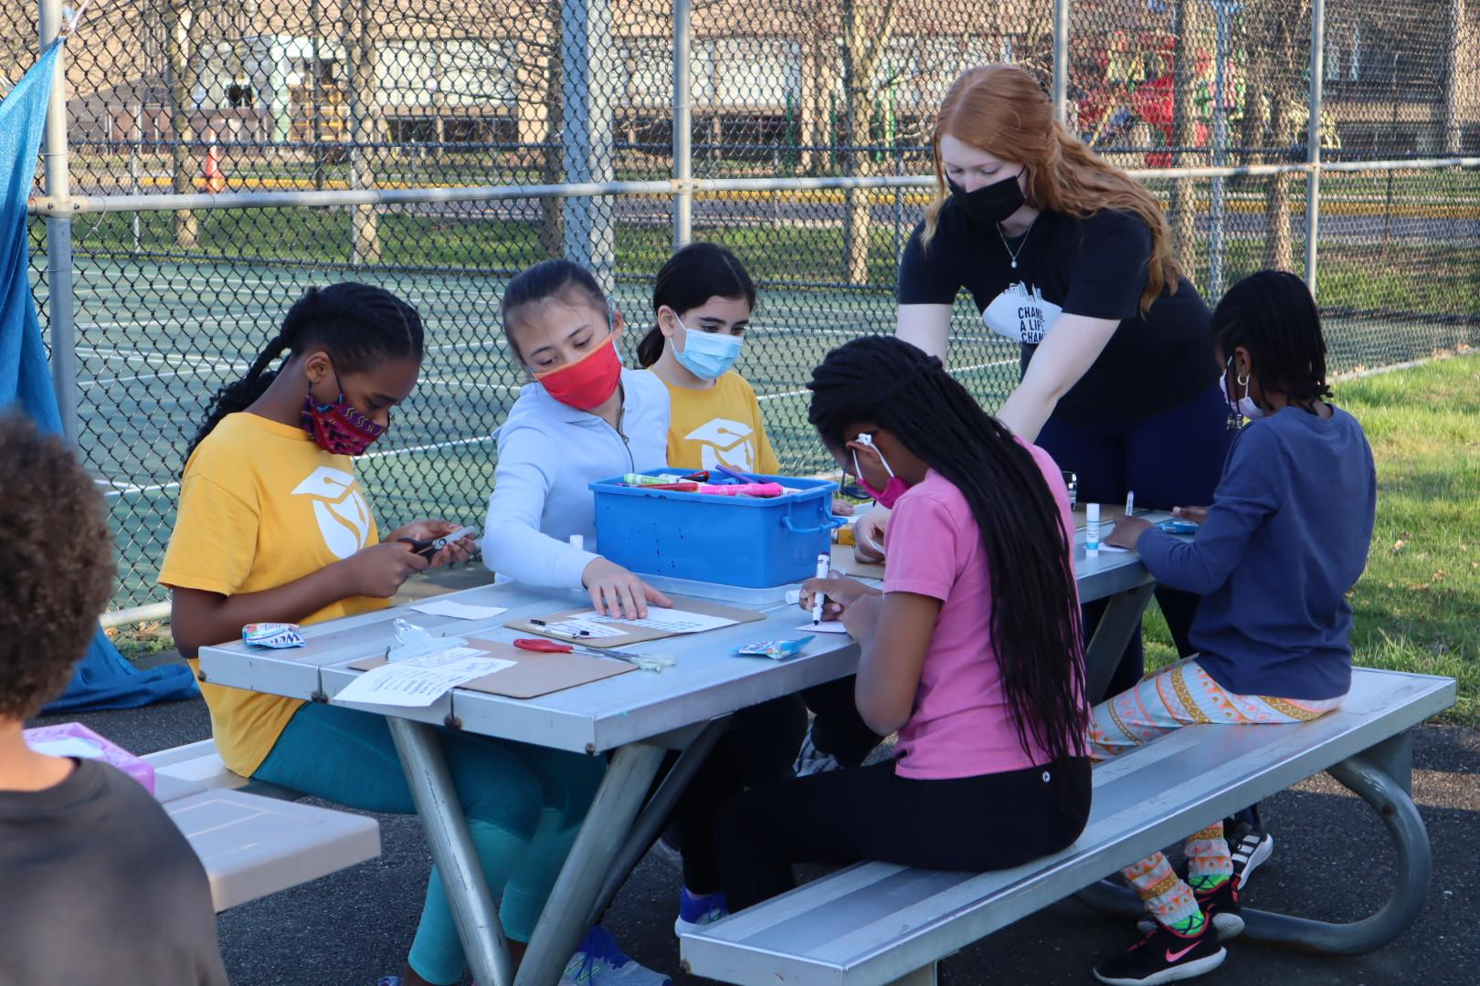
After School Program: Spring, 2021
April - May, 2021
Siegel JCC
46 enrolled
2x per week
Tennis instruction and STEAM enrichment
Free Match play 1x per week (select group, invite only)

Slide 7
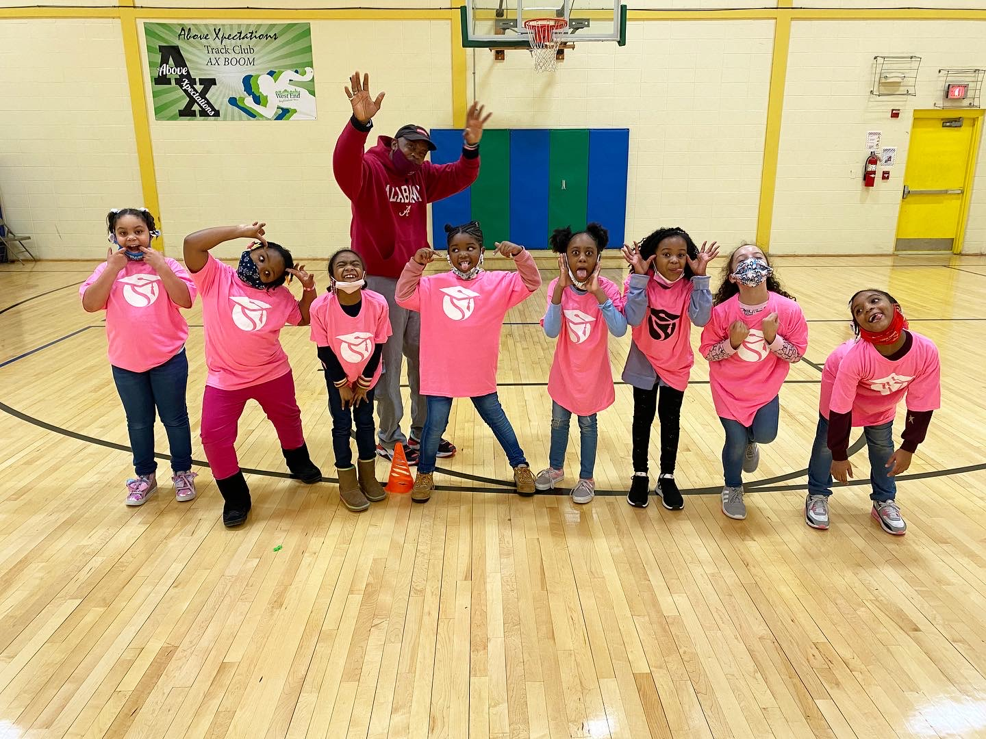
2020-2021 Community Partners (September, 2020 – May, 2021)
PAL Wilmington
William “Hicks” Anderson Community Center
West End Neighborhood House
127 total children served (between all program partners)

Slide 8
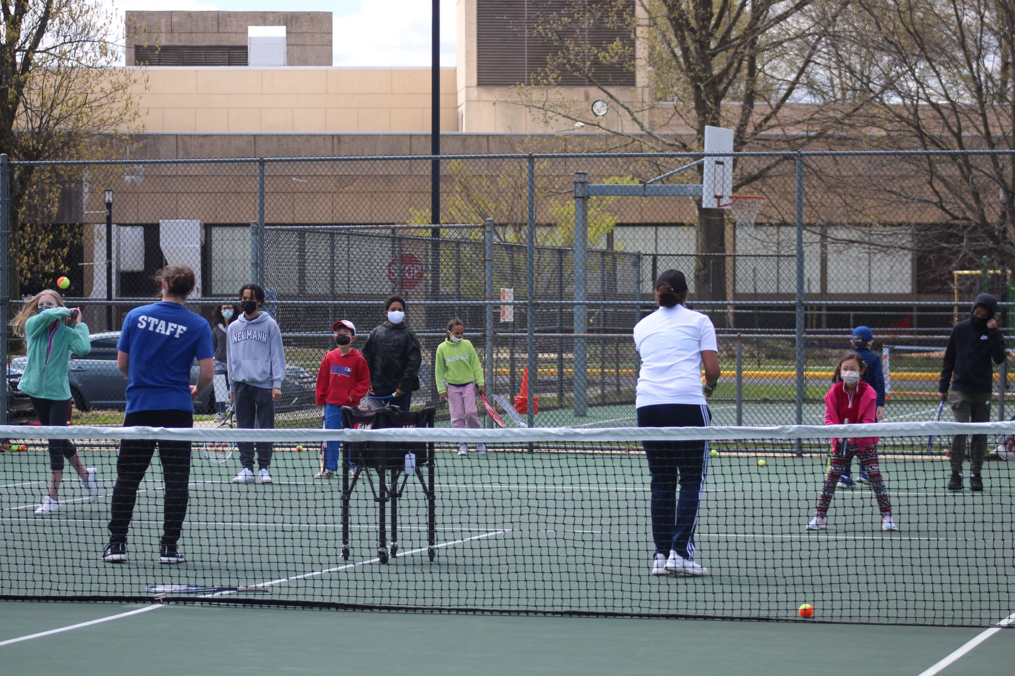
Additional Outreach
Free Youth Tennis Clinics
Siegel JCC
April 17th and June 5th
30+ in attendance

Slide 9
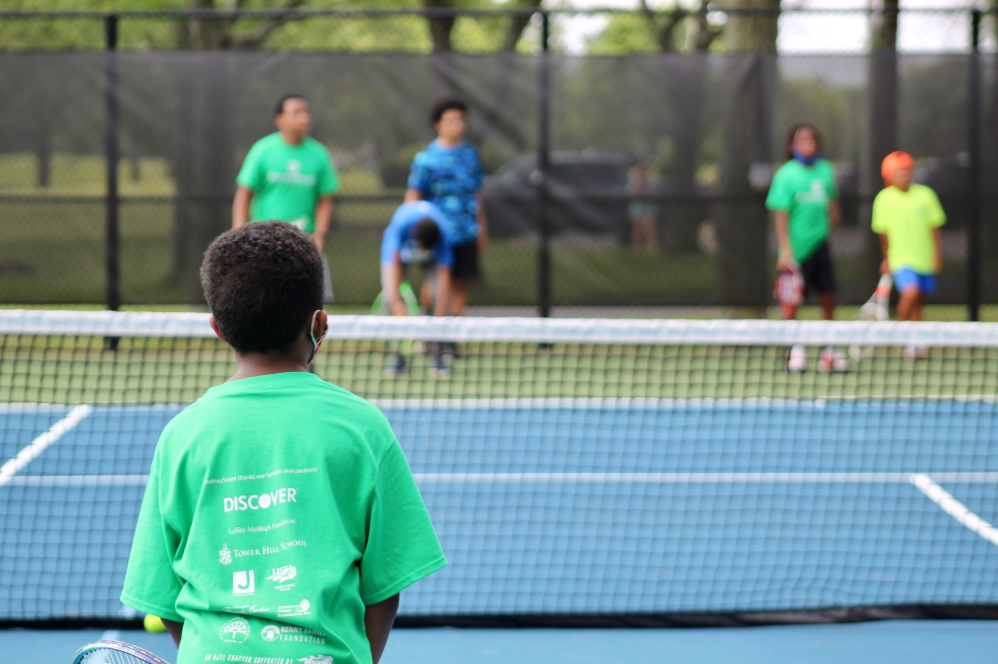
Summer, 2021: Outlook
Full day Tennis and Enrichment Programming
Tower Hill Campus & Rockford Park
88 enrolled as of 6/4 (full time attendees)
Community Programs:
PAL Wilmington (2x week)
Girls Inc. (1x week)

