Slide 1

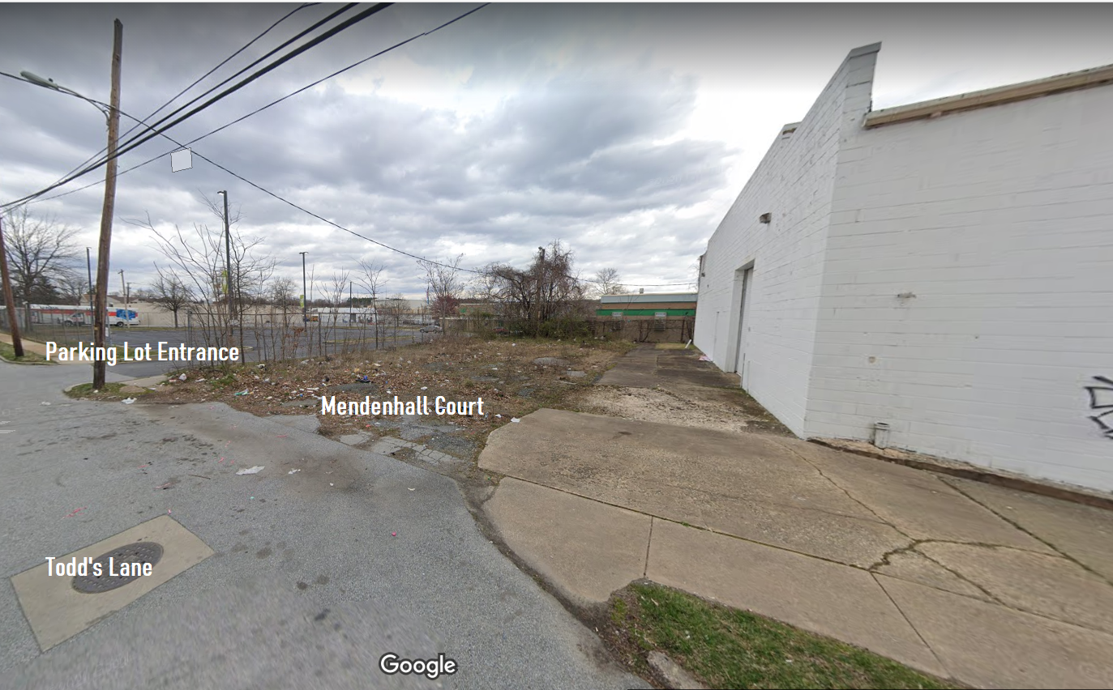
Community Development and Urban Planning Committee June 10, 2021 Ord. 21-032: Proposed Removal of Mendenhall Court

Slide 2
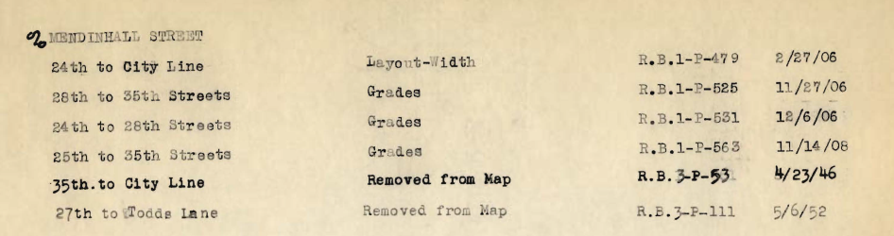
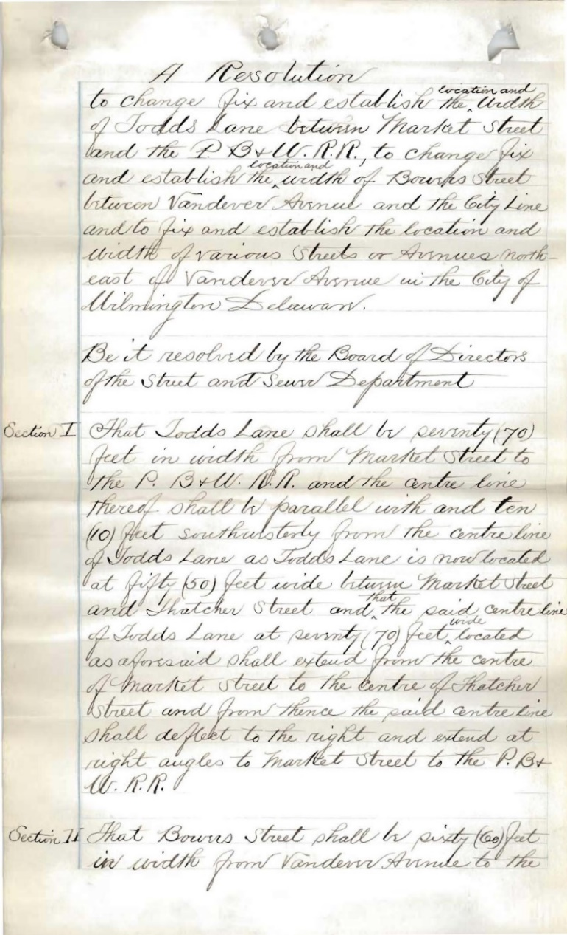
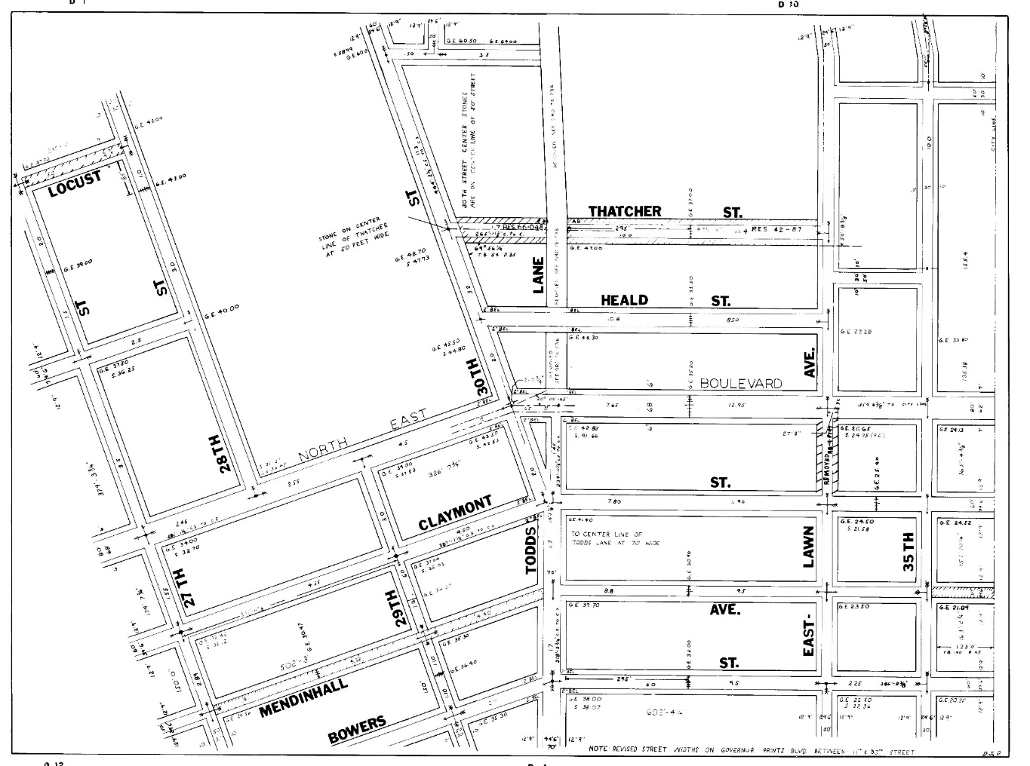
Historic Street
Actions
Documented Mendenhall Street Removals ( 1946; 1952 )

Slide 3
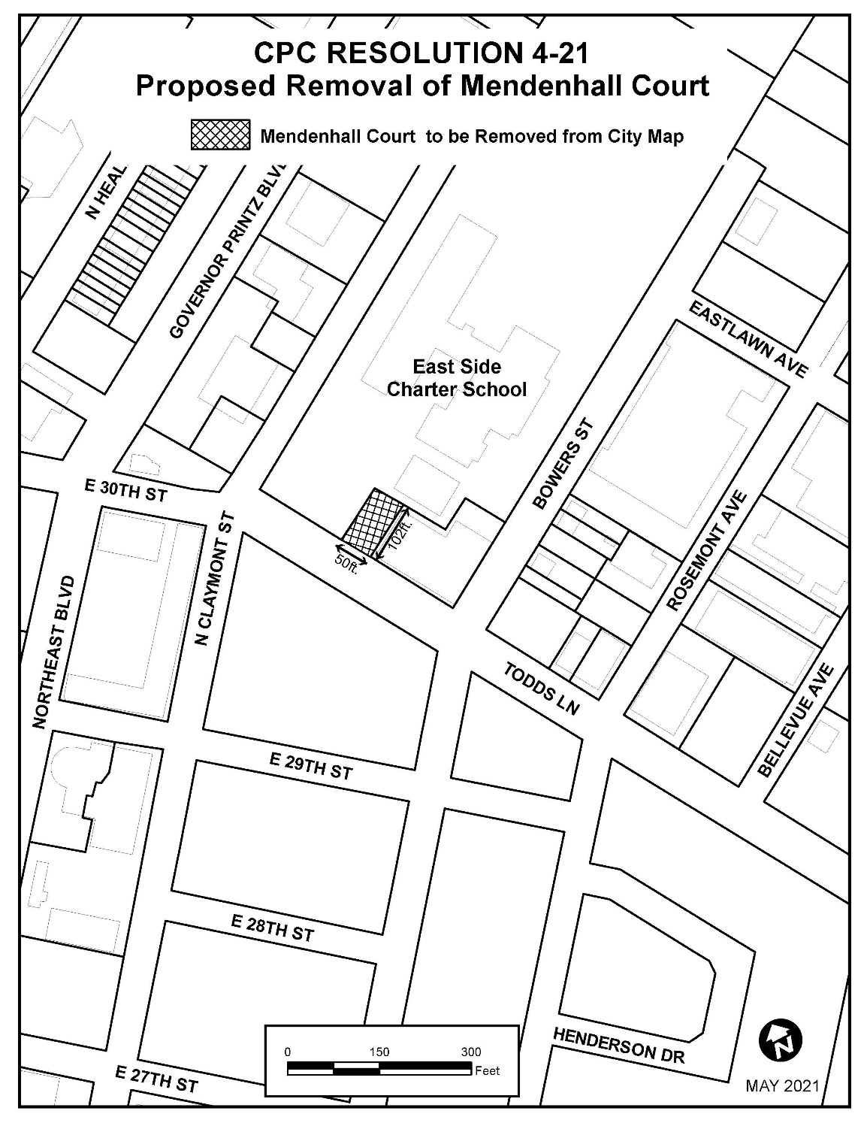
Removing
Mendenhall Court
from the
Official City Map
requires the recommendation of Planning Commission (CPC Res. 4-21)
and approval of
City Council
(Ord. 21-032)

Slide 4
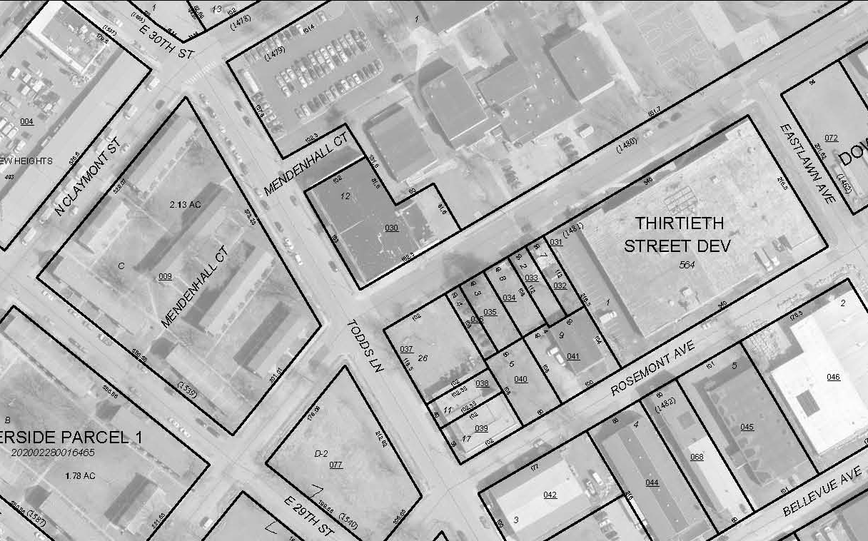
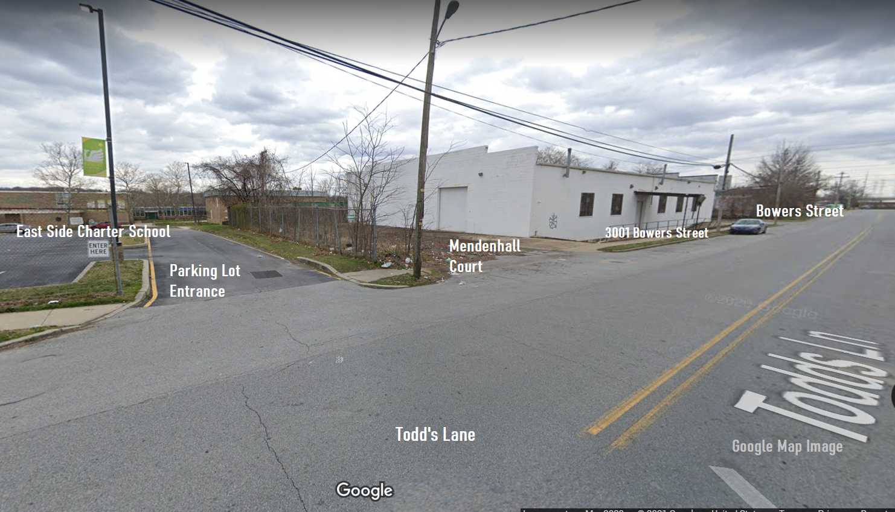
Surrounding Uses:
Charter School
School Parking Lot
Lot Access Road
Storage Building
Mendenhall Court
Claymont Street
Bowers Street
Todd’s Lane

Slide 5
Mendenhall Court – Current Conditions

Slide 6
City Department Comments
Public Works
Water Division: Abandoned 8" water main and 2” service line do not require easements
Sewer Division: Three sewer lines require easements
Division of Transportation: Roadway is not integral to the street network
Fire Marshal’s Office
No comments were received

Slide 7
Department Comments, Continued
Planning
No findings suggest R-O-W removal would create detriment to general public or public safety
Street does not contribute to general traffic circulation or distribution patterns
Necessary access to utilities can be provided with easements

Slide 8
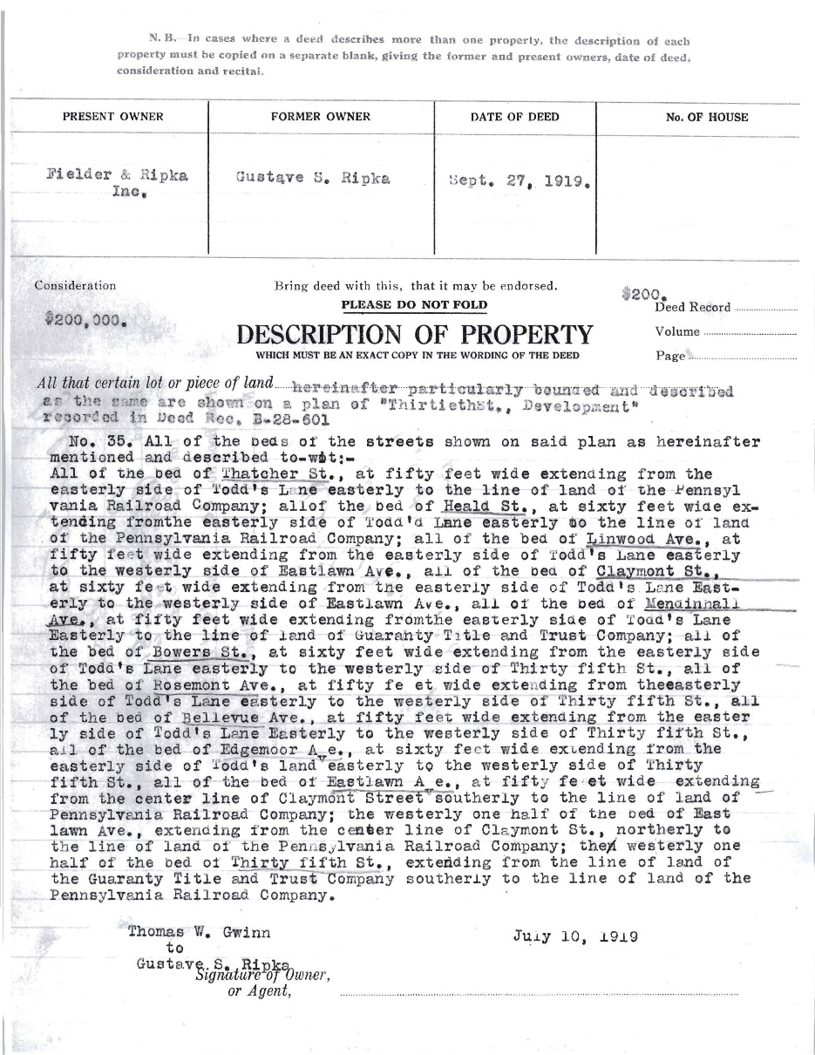
Ownership
Mendenhall Court was privately owned (1919)
Current ownership has not been established
No evidence that City owns street bed
No associated parcel information on NCC tax parcel maps

Slide 9
Street Removal / Disposition
City Code Sec. 42-11 (“City Street Closings and Official City Map Revisions”) addresses street removal procedures and R-O-W disposition
Once street is removed from Official City Map, disposition is determined by ownership
Where current ownership is not established, there can be a legislative finding of a lack of public interest which allows removal of street by ordinance, but the matter of property rights in the right-of-way shall be a judicial determination

Slide 10

Ordinance 21-032 _____ Planning Commission recommends the removal of Mendenhall Court from the Official City Map ______

