Slide 1
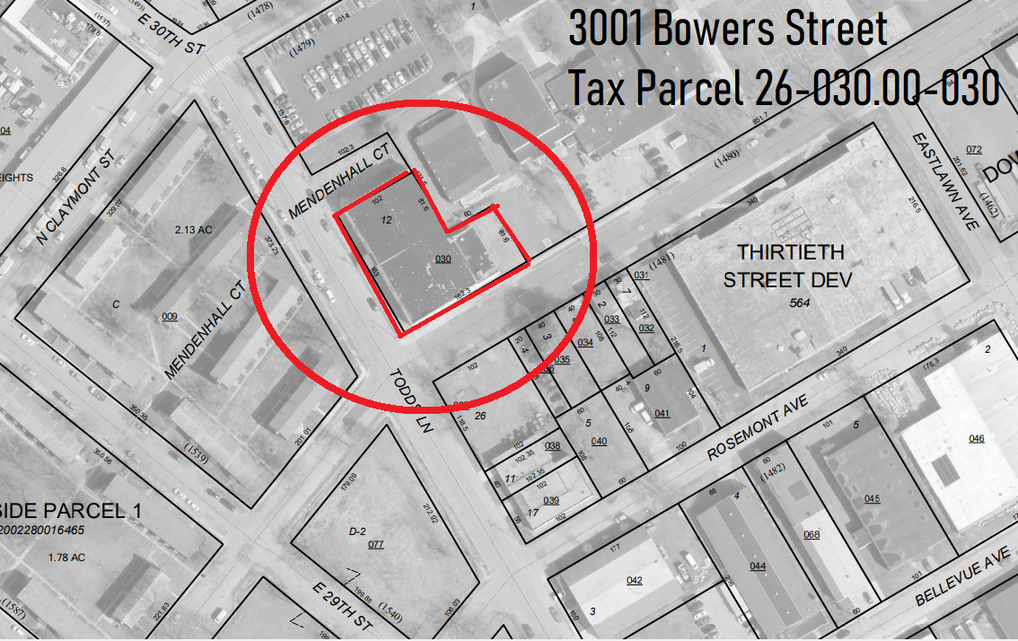
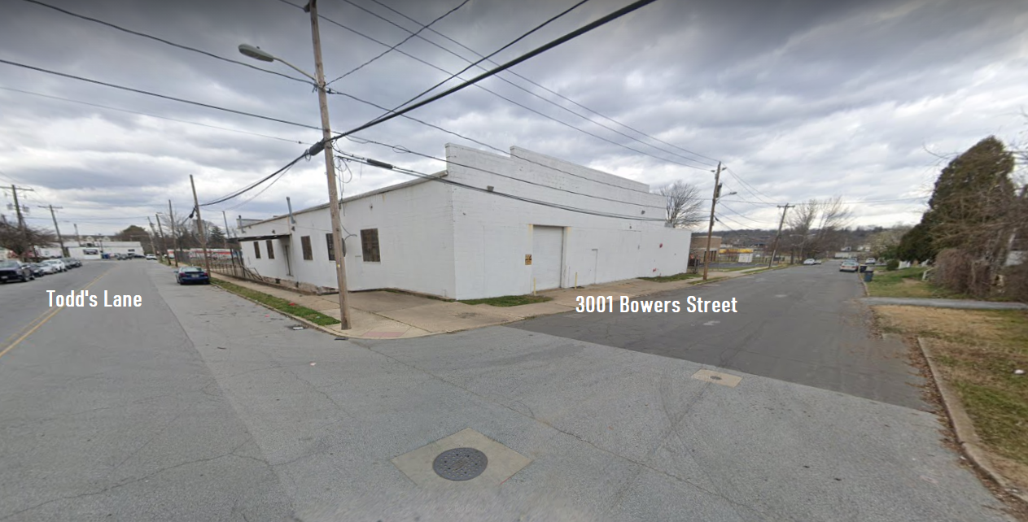
Community Development and Urban Planning Committee
June 10, 2021
Ord. 21-031:
Proposed Rezoning of
3001 Bowers Street

Slide 2
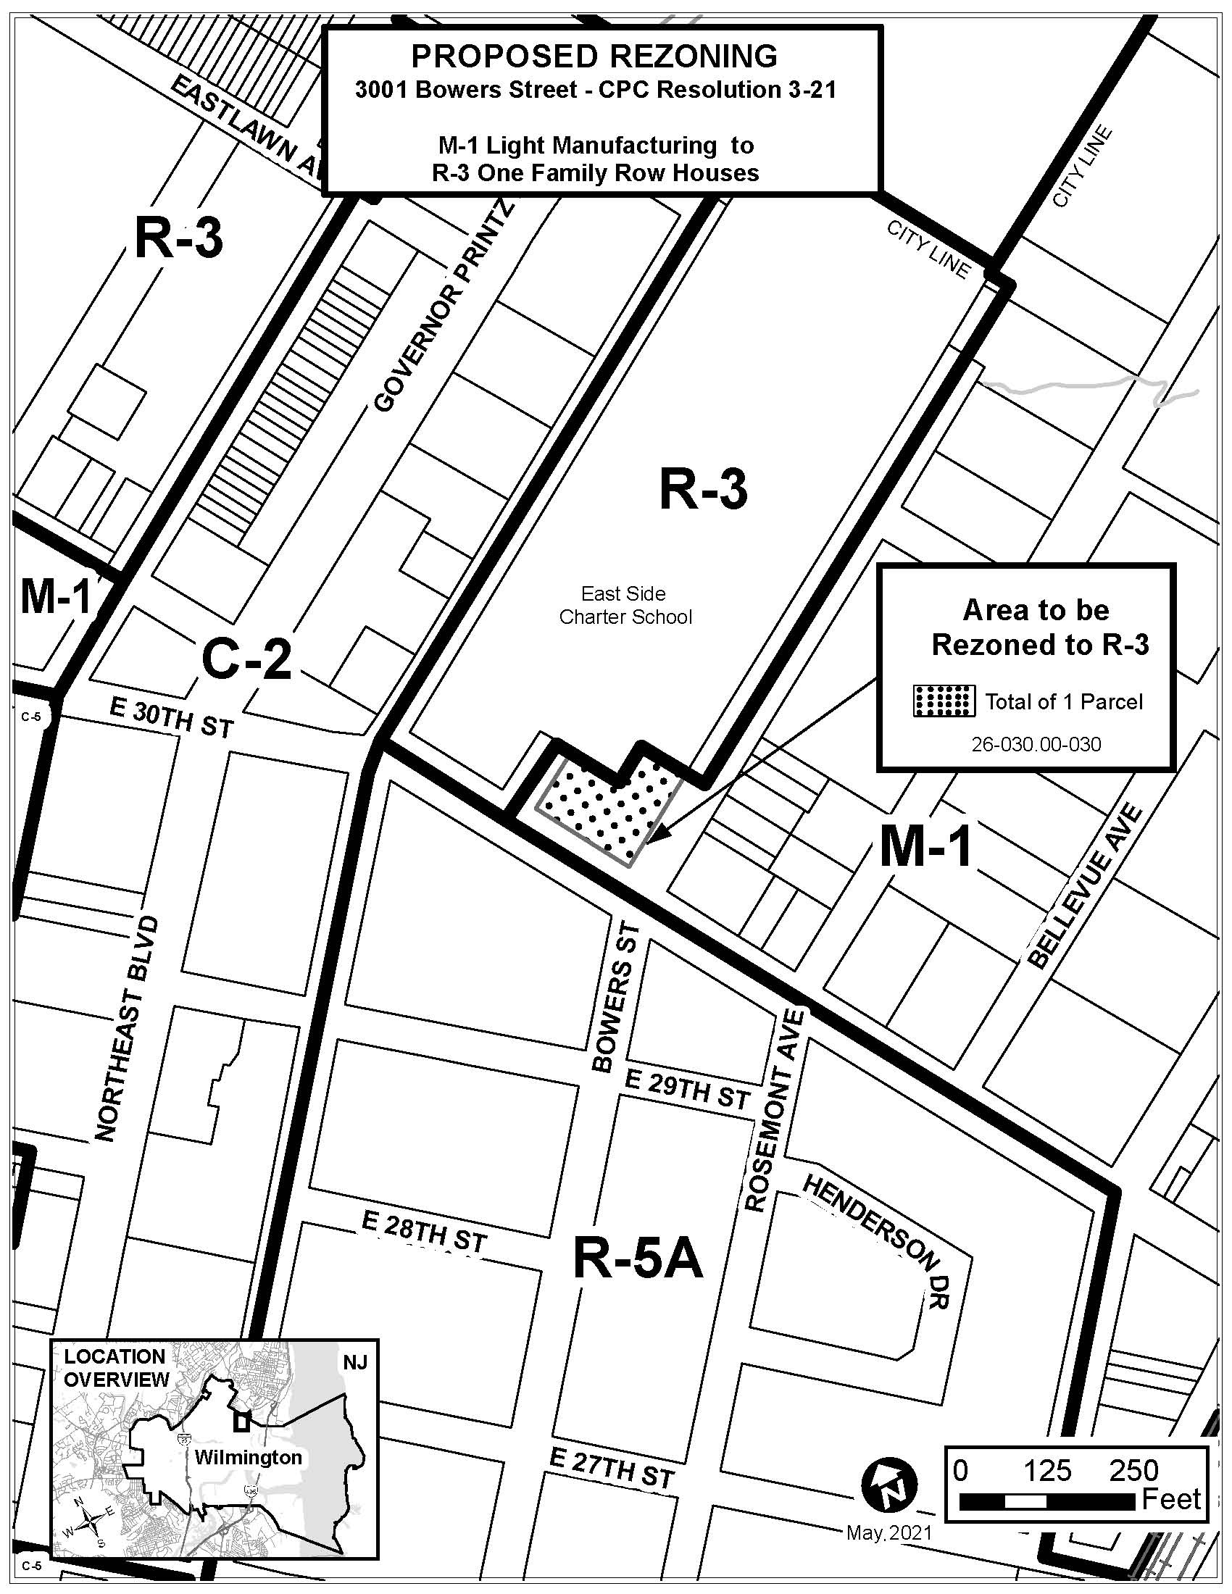
Ordinance 21-031:
A proposal to rezone
the parcel of land located at 3001 Bowers Street
from M-1 to R-3
CLAYMONT ST
TODD’S LANE

Slide 3
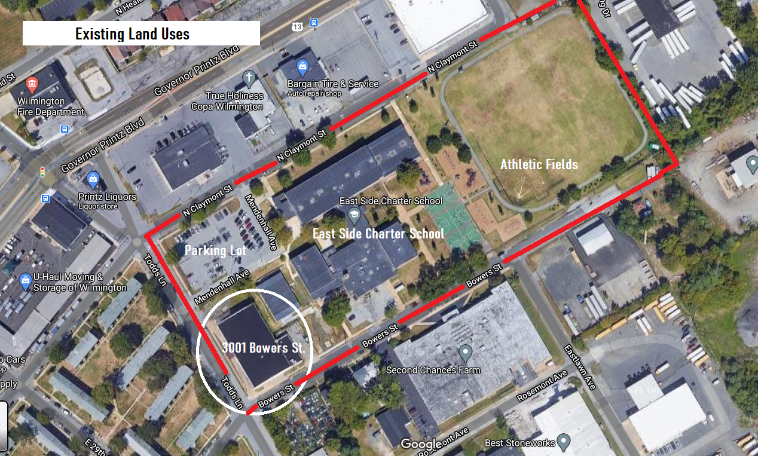
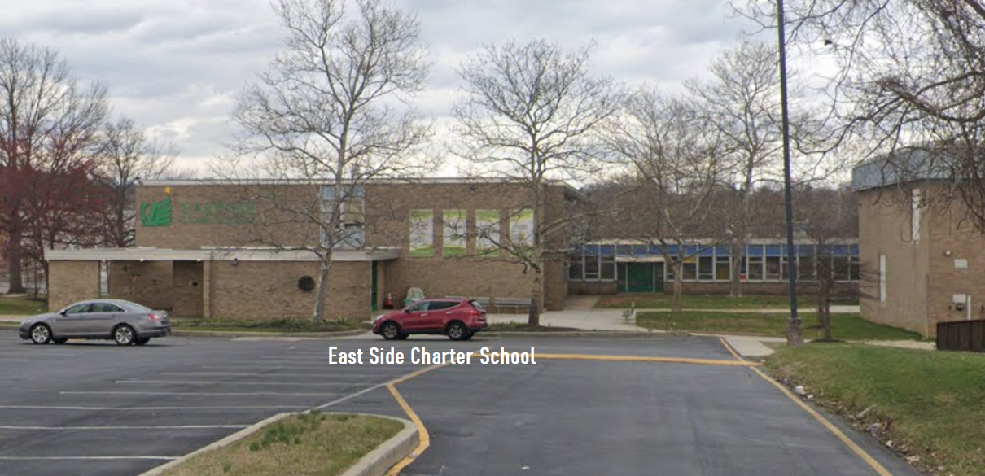
Existing Land Uses – Subject Block
3001 Bowers Street (Storage)
East Side Charter School
School buildings
Athletic fields
Parking lot
Mendenhall Court

Slide 4
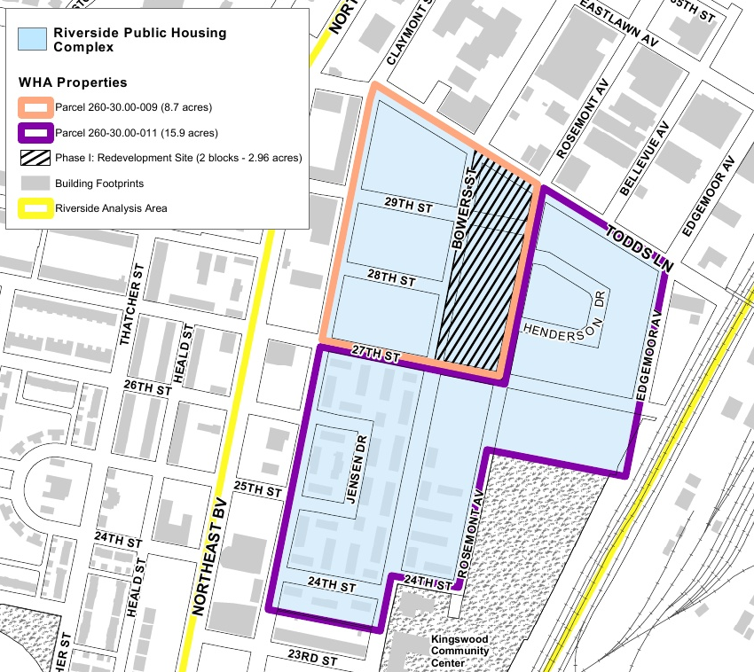
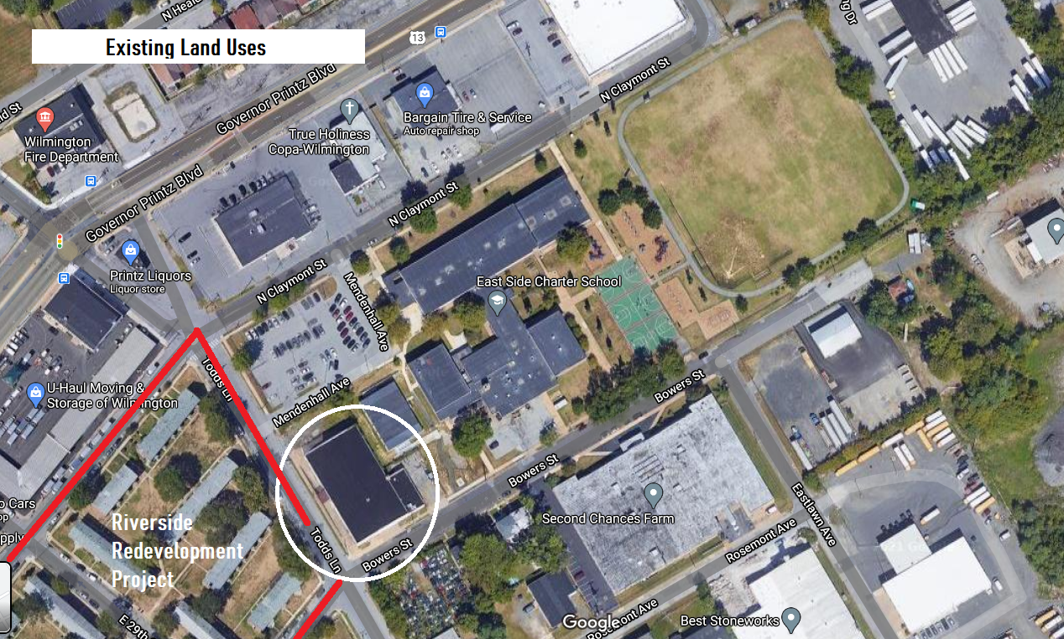
Existing Land Uses – Surrounding Blocks
Riverside Redevelopment
Project:
Mixed Income Housing
Support Services and Amenities

Slide 5
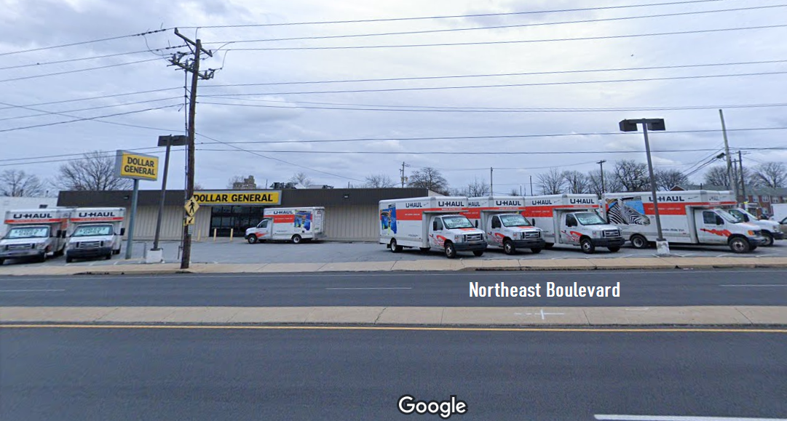
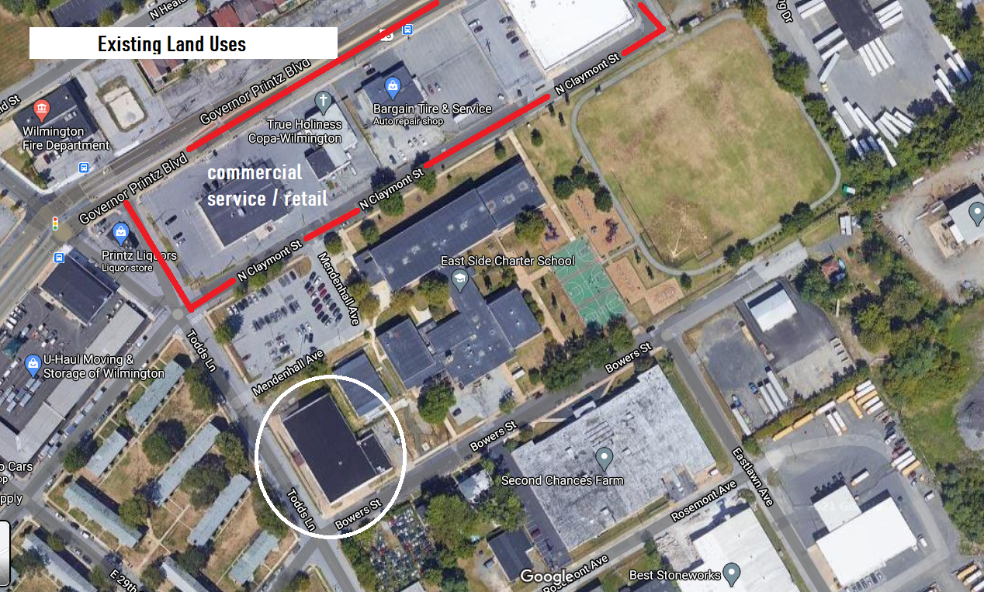
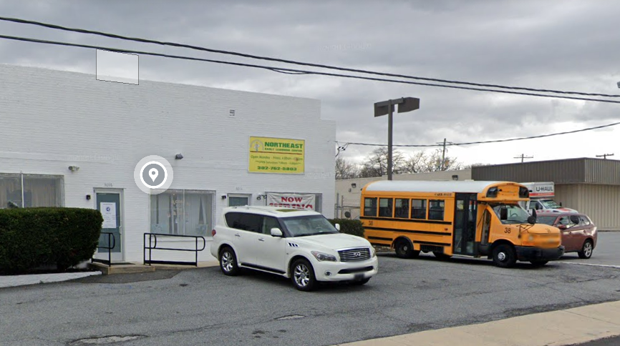
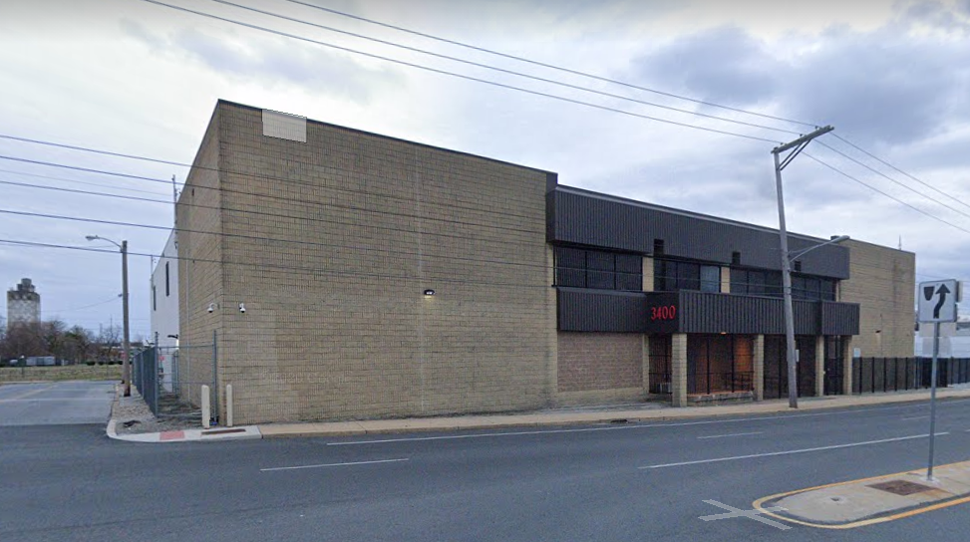
Existing Land Uses – Surrounding Blocks
Commercial Retail & Services

Slide 6
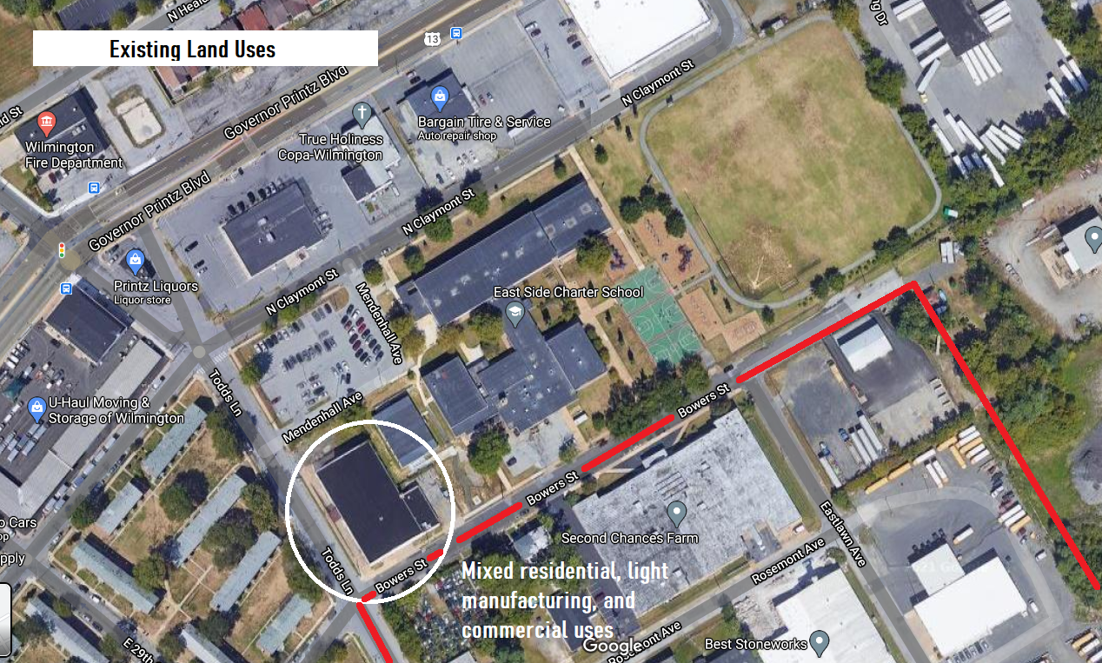
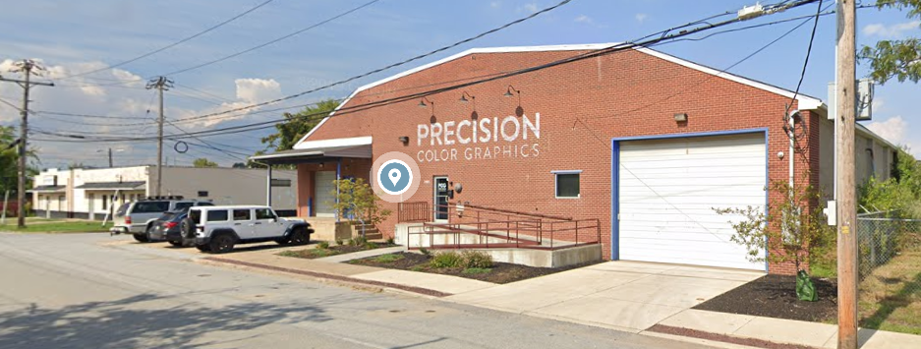
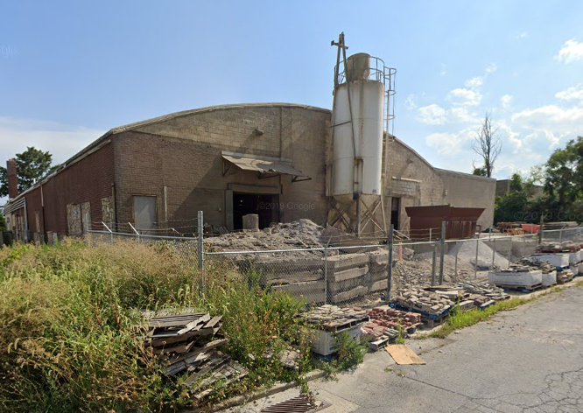
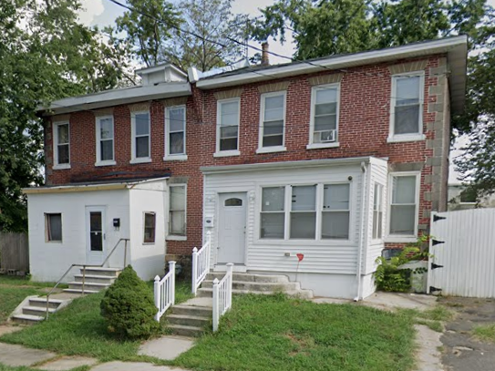
Existing Land Uses –
Surrounding Blocks
Residential
Social Services
Light Manufacturing
Commercial/Institutional
Indoor Farming

Slide 7
Rezoning Impact Summary
No Negative Land Use Impacts Result from Rezoning Action
Storage Use (3001 Bowers Street) ceases operation with sale of property
School expansion is consistent with proposed R-3 zoning
All Future Development must conform to R-3 Regulations

Slide 8
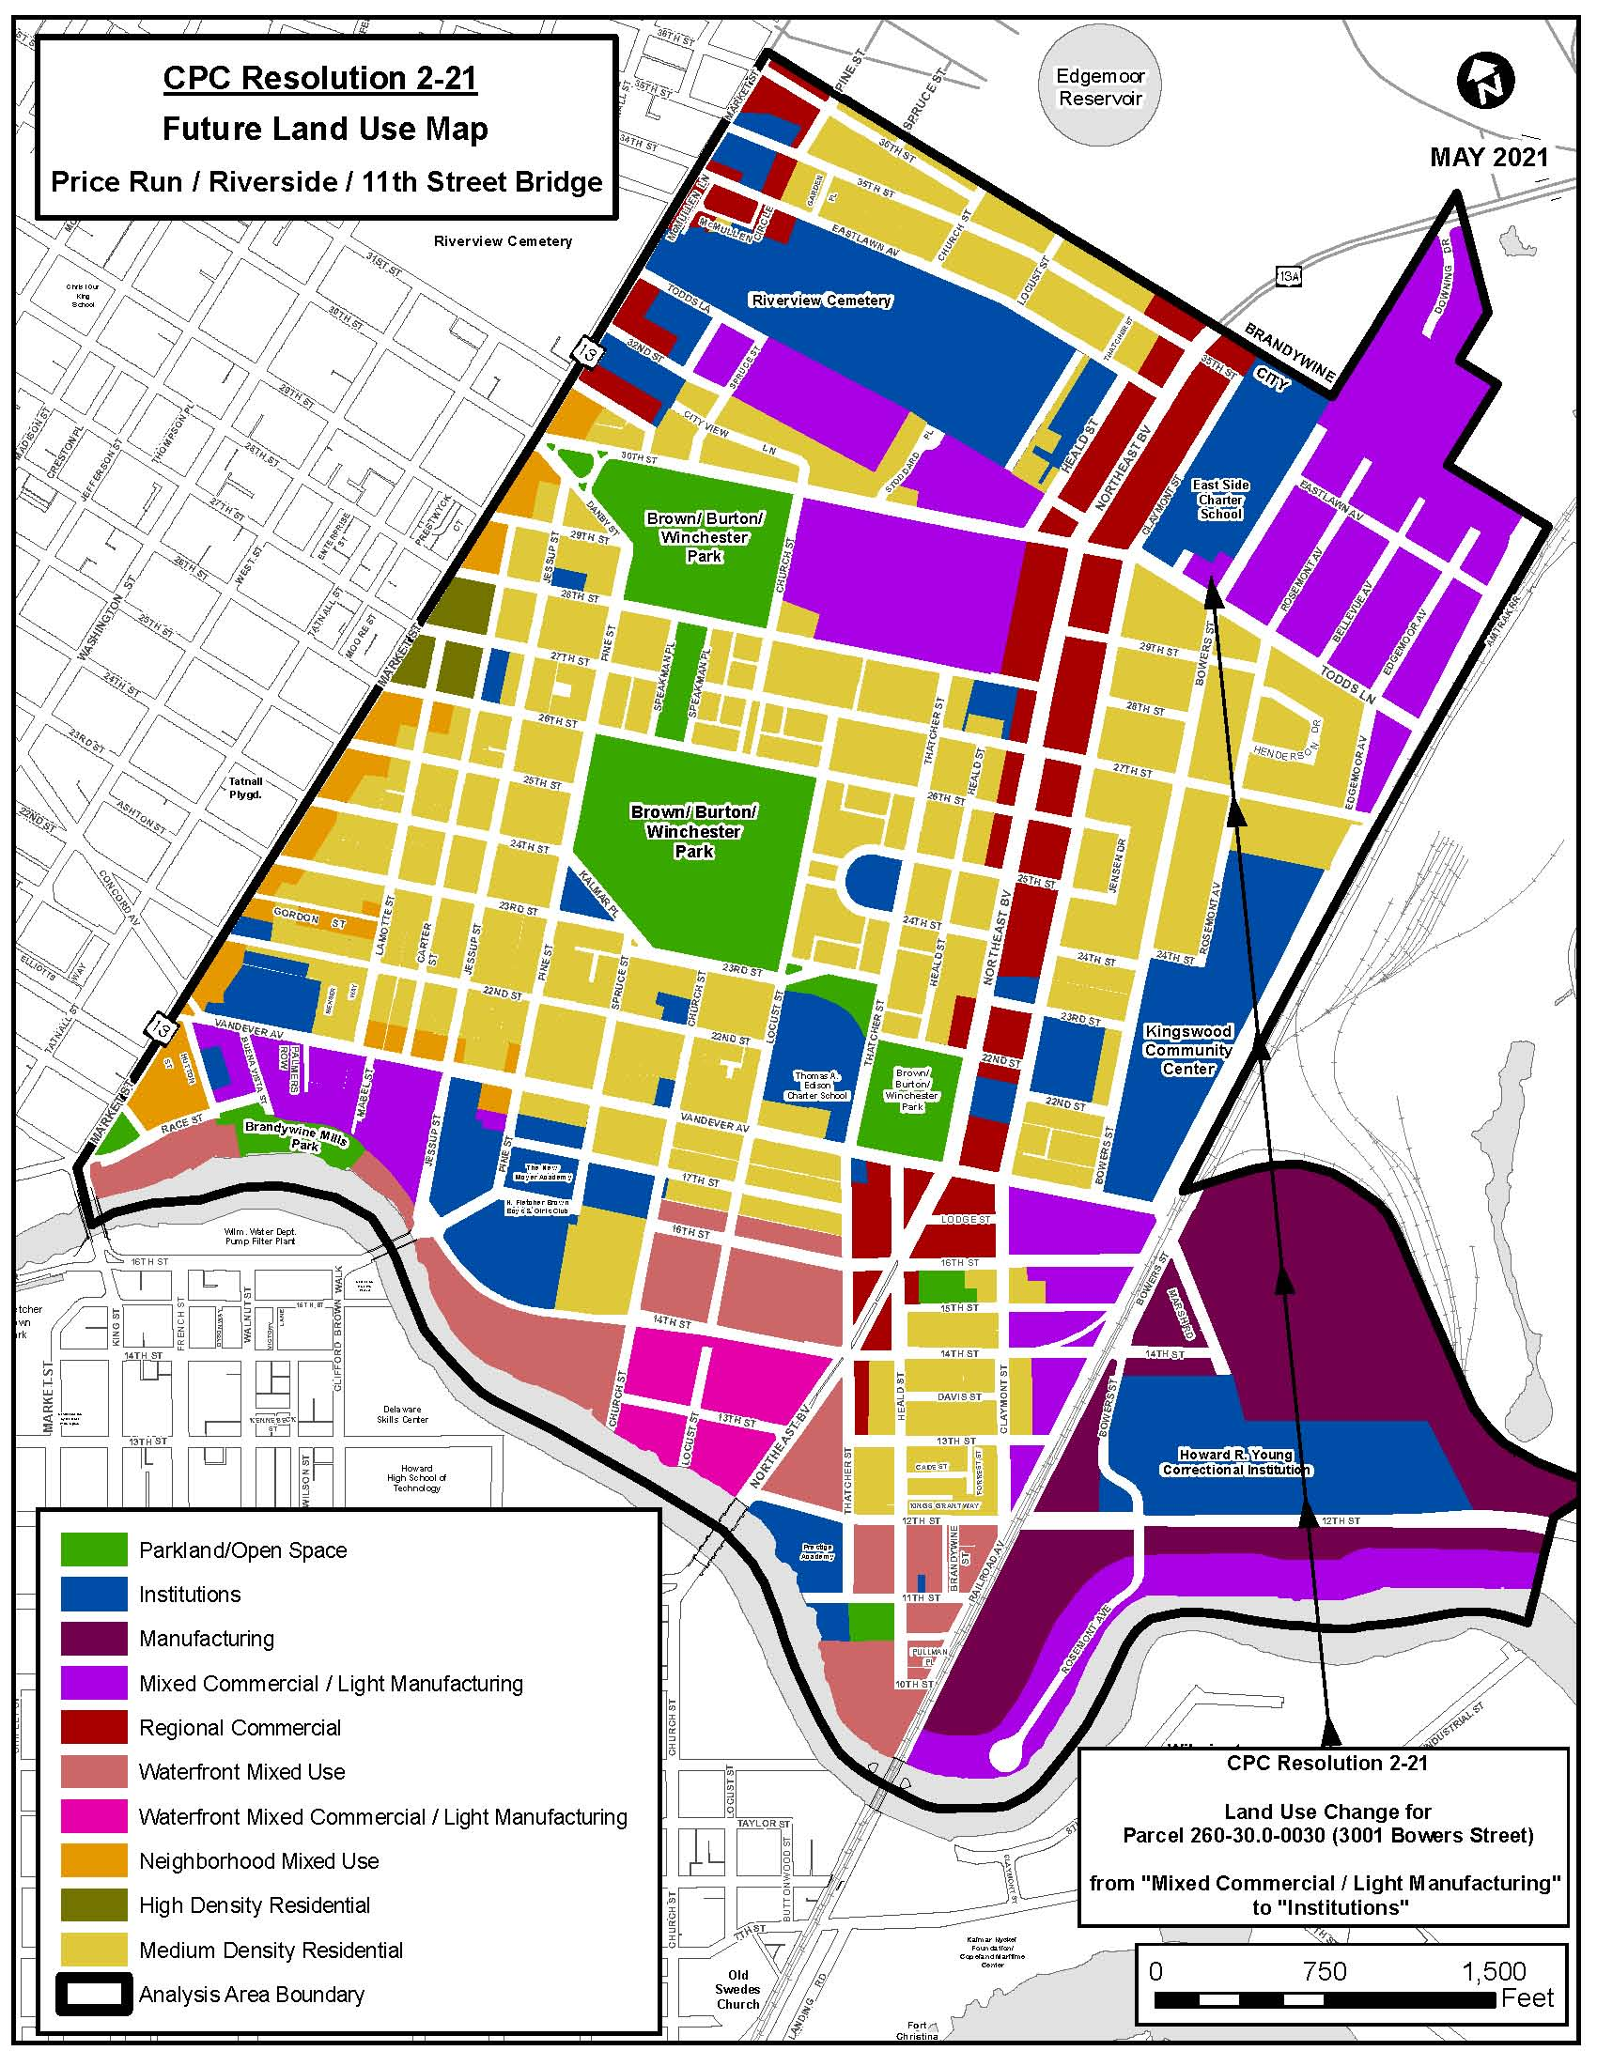
Wilmington 2028: A Comprehensive Plan for Our City and Communities
Proposed rezoning site located in Price’s Run/Riverside/11th Street Bridge Neighborhood
Future Land Use Plan currently recommends “Mixed Commercial/ Light Manufacturing” land use, consistent with existing M-1 zoning but not proposed R-3 zoning
Proposed “Institutions” land use is consistent with proposed R-3 zoning

Slide 9
Proposed Amendment to Future Land Use Map
from “Mixed Commercial/Light Manufacturing” to “Institutions”
“Mixed Commercial/Light Manufacturing” Supports:
Light Manufacturing
Warehousing / Wholesale, Assembly
Tech Services
Business Parks
Prohibited: Outdoor Storage, Automobile-Related Uses
Does NOT support R-3 Zoning
Consistent with Existing M-1 Zoning
“Institutions” Supports:
Schools
Libraries
Hospitals
Government Buildings
Cemeteries
Community Centers
Major Religious Meeting Spaces
Consistent with Proposed R-3 Zoning

Slide 10
CPC Action / Related Legislation
May 18, 2021 City Planning Commission adopted Resolution 3-21 recommending approval of the rezoning action
Legislation Sponsored by Council Member Zanthia L. Oliver, 3rd District
June 3 Ordinance 21-021 Introduced
July 1 Scheduled Council Public Hearings:
- Comprehensive Plan Amendment (by Resolution)
- Rezoning Action (by Ordinance)
Final Council Action

Slide 11
Planning Commission Recommendations
Approved proposed rezoning of 3001 Bowers Street from M-1 Light Manufacturing to R-3 One Family Row Houses (Ordinance 21-031)
Approved proposed amendment to the Price’s Run/Riverside/11th Street Bridge Future Land Use Map to designate “Institutions” land use which supports R-3 zoning

Slide 12
Thank You

