Slide 1
The City of Wilmington
November 2021

Slide 2
Economic Development Strategic Fund
Fund Balance as of November 1, 2021 | $915,216
Future Contractual Commitments Due (6) | $(1,150,000)
TOTAL Funds Available | $(234,784)
Proposed Budget Amendment | $1,200,000
Net Balance After Proposed Budget Amendment | $965,216
Notes:
Names of 4 commitments and years
Define the pipeline

Slide 3
Recent Strategic Fund Agreements
Notes:
Notes: Total agreements completed: 21; $2,795,779
Agreements to MBE: 10; $360,334
Future Commitments: 6 (2 mbe) ; $1,150,000 ($50,000)

Slide 4
Strategic Fund History
2002
Initial Funding: $1.25M
2004
2007
Second Round: $1.53M
Third Round: $3.5M
2008
Fourth Round: $8.575M
2013
Fifth Round: $225K for Minority Business Set Aside
2020
Sixth Round: $1.25M ($250K Minority Business Set Aside)
2021
PROPOSED Seventh Round: $1.2M ($250K Minority Business Set Aside)
Total Funding to date: $16.33M

Slide 5
Wage Taxes Collected from Strategic Fund Businesses
2020 2002 - 2019 | $10,188,523.82 $107,459,922.53
TOTAL | $117,648,446.35
*$16.33M Infusions to date

Slide 7
Strategic Fund
Established by legislation in 2002 to provide a “tool” to provide financial incentives to business
Purpose is to attract & retain jobs in city
Modeled after State’s fund
Amounts based on number of jobs and wages
Payback from wage taxes
Performance requirements and claw-backs
Notes:
Analytically-based and return-driven
Flexible to meet needs and respond to opportunity

Slide 8

Testimonial – Eat Clean Juice Bar
“We at Eat Clean Juice Bar have been delighted to work with the City of Wilmington's Office of Economic Development (OED). The support we received from the OED has helped us grow our brand awareness throughout the city and given us the assistance we needed to expand our business.”
~ Kamil Bass - Owner
Notes:
JW

Slide 9
Testimonial – James and Jesse’s Barbershop
“We would like to thank the Mayor’s Office of Economic Development for their $15,400 Minority Business Incentive grant. Our barbershop has served the Eastside community since 1972. This money will allow us to install air conditioning and make interior improvements, which will help bring in more business from our regulars and attract new customers. We look forward to working with the OED as we begin working on the improvements.”
~ Jesse and Michael Dendy - Owners
Notes:
JW

Slide 10
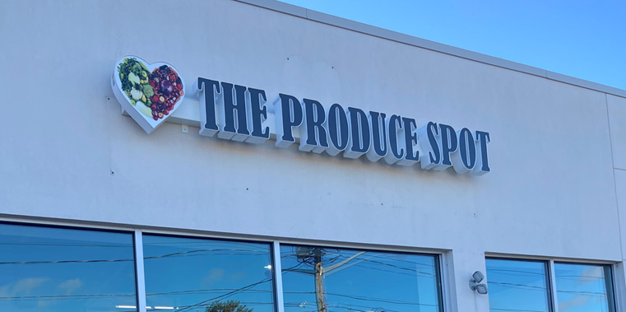
Testimonial – The Produce Spot
“Thanks to the City of Wilmington’s grant program, The Produce Spot was able to purchase extra refrigeration in efforts to help keep our produce nice and fresh for the community as well as enable us to purchase additional equipment for future projects..
As a result of this much needed resource, we are also able to add more items to our menu such as soups and salads this fall. We are truly appreciative of this grant. ”
~ Meenah and Adiyuh Munroe - Owners
Notes:
JW

Slide 11
Testimonial – Precious Little Hands Childcare Center
“ To Whom it May Concern,
I would like to take this opportunity to thank The City of Wilmington the Office of Economic Development for their generosity in funding Precious Little Hands Childcare Center LLC II. Thank you so much for your generous contribution of $ 20,000.00. I was very honored to be the proud recipient of this grant.
We recently, opened and purchased our building and needed additional funding to help repair the rear roof and assist with working capital.
By accepting this contribution, I immediately was able to put the funds to use by repairing the rear roof of the building. I have attached pictures for your review. Every time it rained our kitchen would leak and we would suffer great loss. This grant was essential and was given to the center just in time to help my business grow and be productive. ”
~ Tazeema Loatman - Owner
Notes:
JW

Slide 12
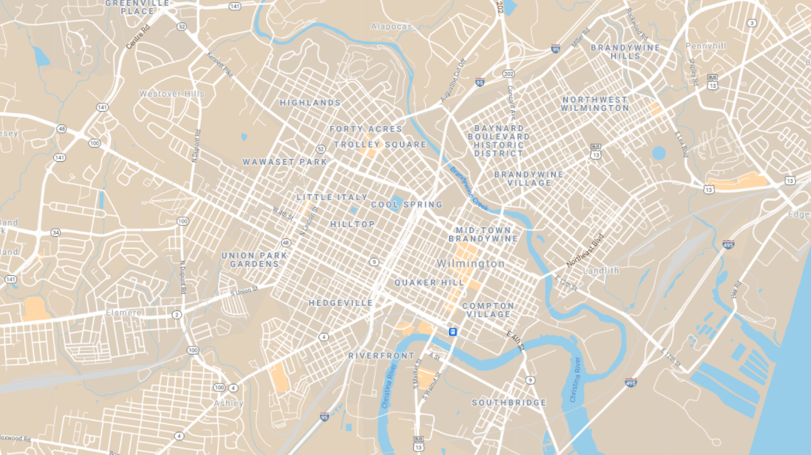






Strategic Fund (Minority Owned)
Strategic Fund Agreement
Grow Wilmington Fund
WEDCO
True Access Capital
State Job Incentive Agreement

Slide 13
End of Presentation

Slide 14
Appendix A - Partnerships
WEDCO provides loans to established small businesses, located in the City of Wilmington, who are growing and unable to secure financing on comparable terms from conventional financial institutions.
True Access Capital is a Community Development Financial Institution (CDFI) that specializes in loan capital and technical assistance to small businesses and community organizations throughout Delaware and southeastern Pennsylvania.
The Delaware SBDC delivers training programs and professional consulting services to help startup and existing businesses formulate and execute strategies to grow and succeed.
The SBA is a federal agency dedicated to small business and provides counseling, contracting, and capital such as the 7(a) Loan program for small businesses that have proven a need for financial assistance and demonstrated growth and expansion.
NDC directs capital to support the development and preservation of affordable housing, creates jobs through small business lending, advances livable communities with social infrastructure investment.
The Delaware Division of Small Business, part of the Delaware Department of State, is a service-focused agency helping small businesses navigate government processes, connect with resource organizations, and access capital.
DPP is the state economic development agency that leads Delaware’s economic development efforts. Services include working with prospects to review potential sites, cost-of-living details and funding opportunities, including available tax credits and incentives.

Slide 15
Appendix B -Small Business Financing
Goals
Financial Instruments
Reduce development costs
Reduce the cost of capital
Increase access to capital
Decrease operating costs
Attract outside equity
504 sba loan
7a loan
Micro loans
Grants

Slide 16
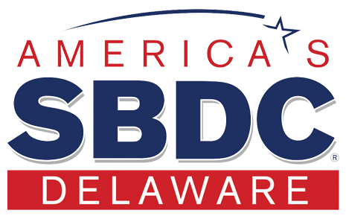
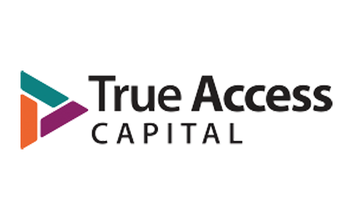


Appendix C - Common Small Bus. Scenarios
An individual with no business or plan, but an idea which they wish to develop through business education and plan
OED partners with SBDC,TAC and their WBC,
and the DEBCC to provide technical assistance
An existing business that has a plan, but needs assistance getting the plan to a “lender-ready” state -- these businesses are typically pre-revenue and may need start-up capital
WEDCO Microloan
An existing unstable business that has started, has revenue and customers, but which needs to increase revenue or customers in order to be considered for an SBA or other micro-loan product
True Access Capital
Grow Wilmington Fund
An existing, stable, business with revenue and customers that needs an SBA working capital or new equipment loan to sustain or expand
SBA Loans – 504 sba; 7a; EIDL Loan
Grow Wilmington Fund
An existing business in distress which needs technical or consulting assistance to ascertain whether a working capital loan will resolve the distress
True Access Capital, WEDCO, SBDC,
OED Disadvantaged Business grants

Slide 17
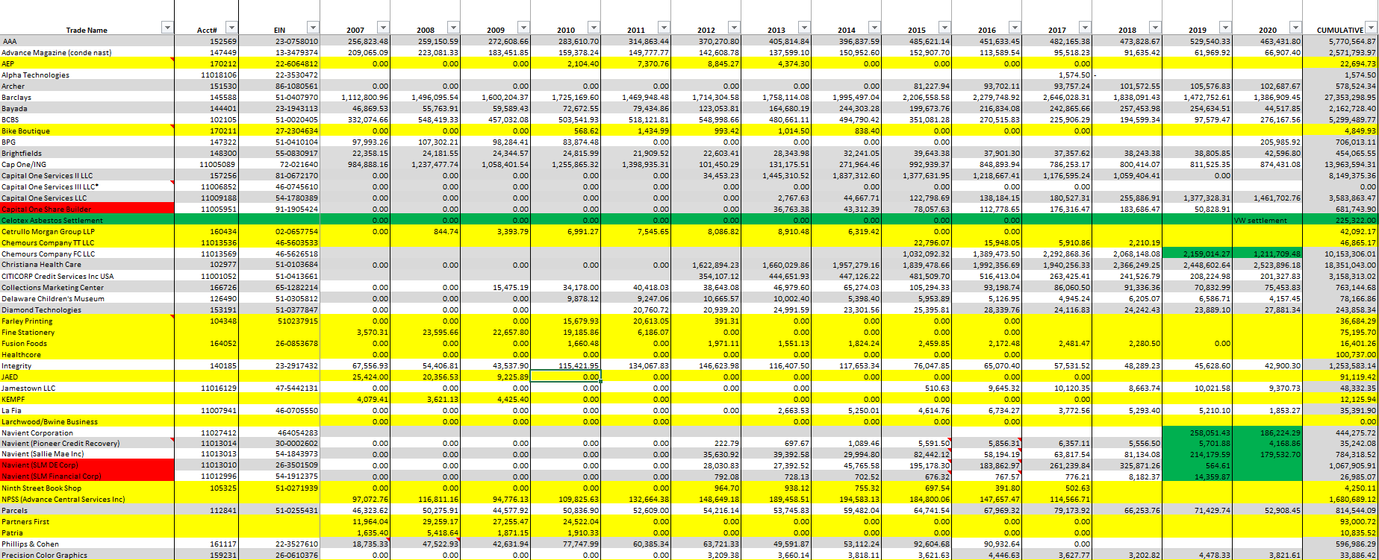
Notes:
Names of 4 commitments and years
Define the pipeline

Slide 18
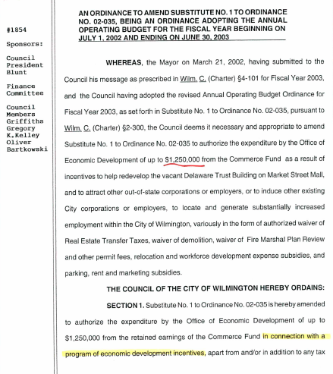
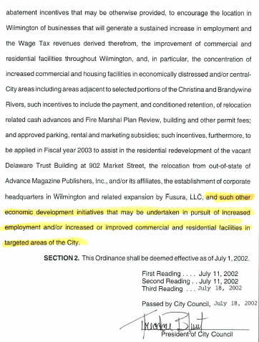

Slide 19
Minority Business Development Program
FY21 balance forward: $140,302
FY21 infusion: $250,000
SUBTOTAL: $390,302
FY21 Committed funds: $211,370
FY22 Committed funds: $126,191
FY22 TOTAL RESTRICTED FUNDS AVAILABLE: $52,741
Notes:
Prev balance from FY’20 Report
Committed Funds = WTP @ $200k, Juice @ $7.5k, James & Jesse @ $20k
M&P budget = $2.5k Print/Adv, $2k bldg. rental, $1.5k donations, $500 food

Slide 20
Minority Business Development Program
Proposed Budget Amendment: $1,200,000
Current Restricted Funds Available: $52,741
Proposed Increase in Restricted Funds $197,259
Proposed Restricted Funds Available: $250,000
Proposed Unrestricted Funds Available: $767,957
Notes:
Prev balance from FY’20 Report
Committed Funds = WTP @ $200k, Juice @ $7.5k, James & Jesse @ $20k
M&P budget = $2.5k Print/Adv, $2k bldg. rental, $1.5k donations, $500 food

