Slide 1
The importance of lead testing for 2 year olds
Amy Roe, Ph.D.
amywroe@gmail.com
Sarah Bucic, MSN
sarah.bucic@gmail.com

Slide 2
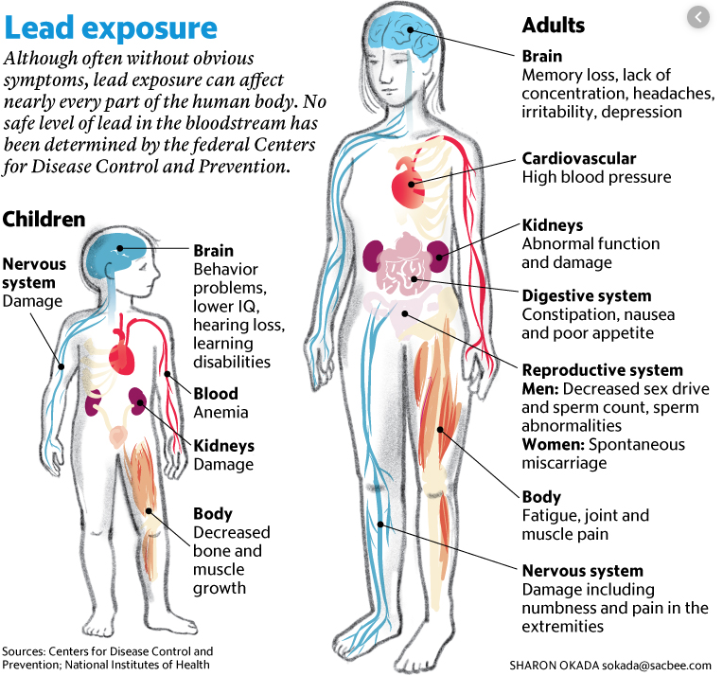
Lead: There is NO safe level
Learning Outcomes
Lower IQ
Lower test scores
Poor performance in reading, science and math
Behavior Outcomes
Reduced impulse control
Behavioral problems in school, family and society

Slide 3
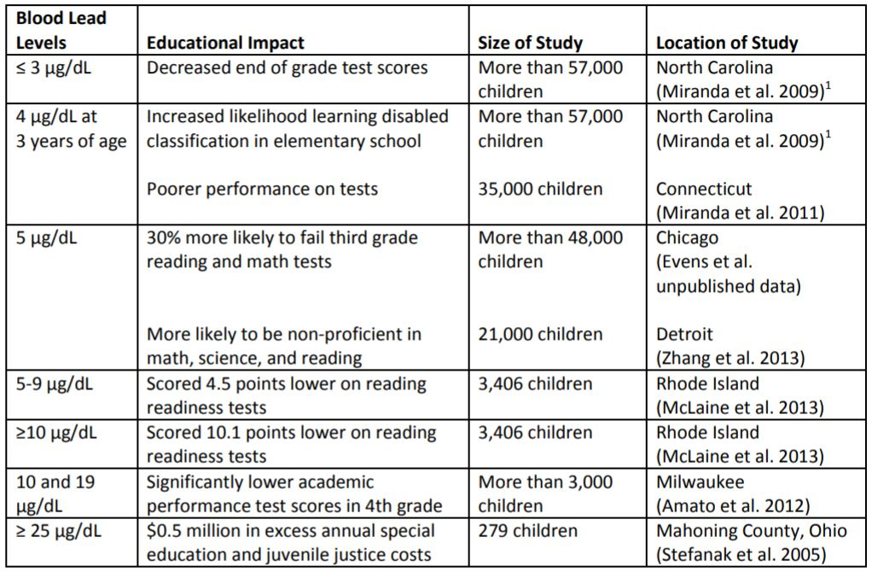
Lead exposure contributes to serious learning and behavioral outcomes.
Educational Services for Children Affected by Lead Expert Panel. Educational
interventions for children affected by lead. Atlanta: U.S. Department of Health and Human Services; 2015.

Slide 4
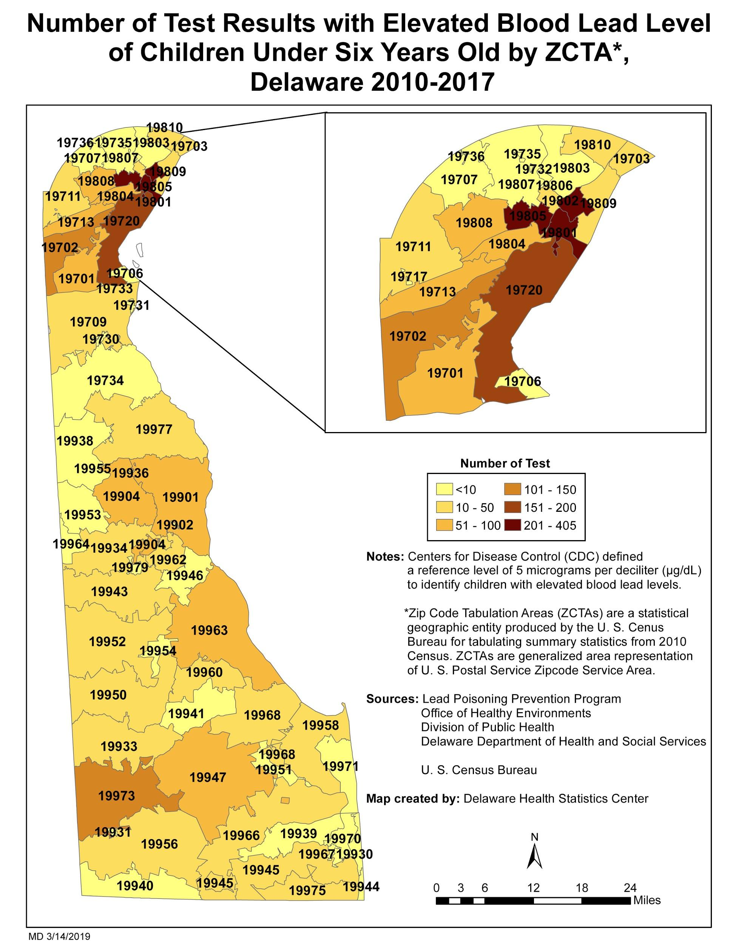
Childhood Lead Poisoning is a statewide issue
High concentration of children identified are in Wilmington
Map reflects only children who have been identified
The sources of exposure are only investigated in the ⅓ of lead poisoning cases where the blood lead level is 10 µg/dL or above
Map provided by Delaware’s Department of Public Health, Delaware Health Statistics Center, March 2019.

Slide 5
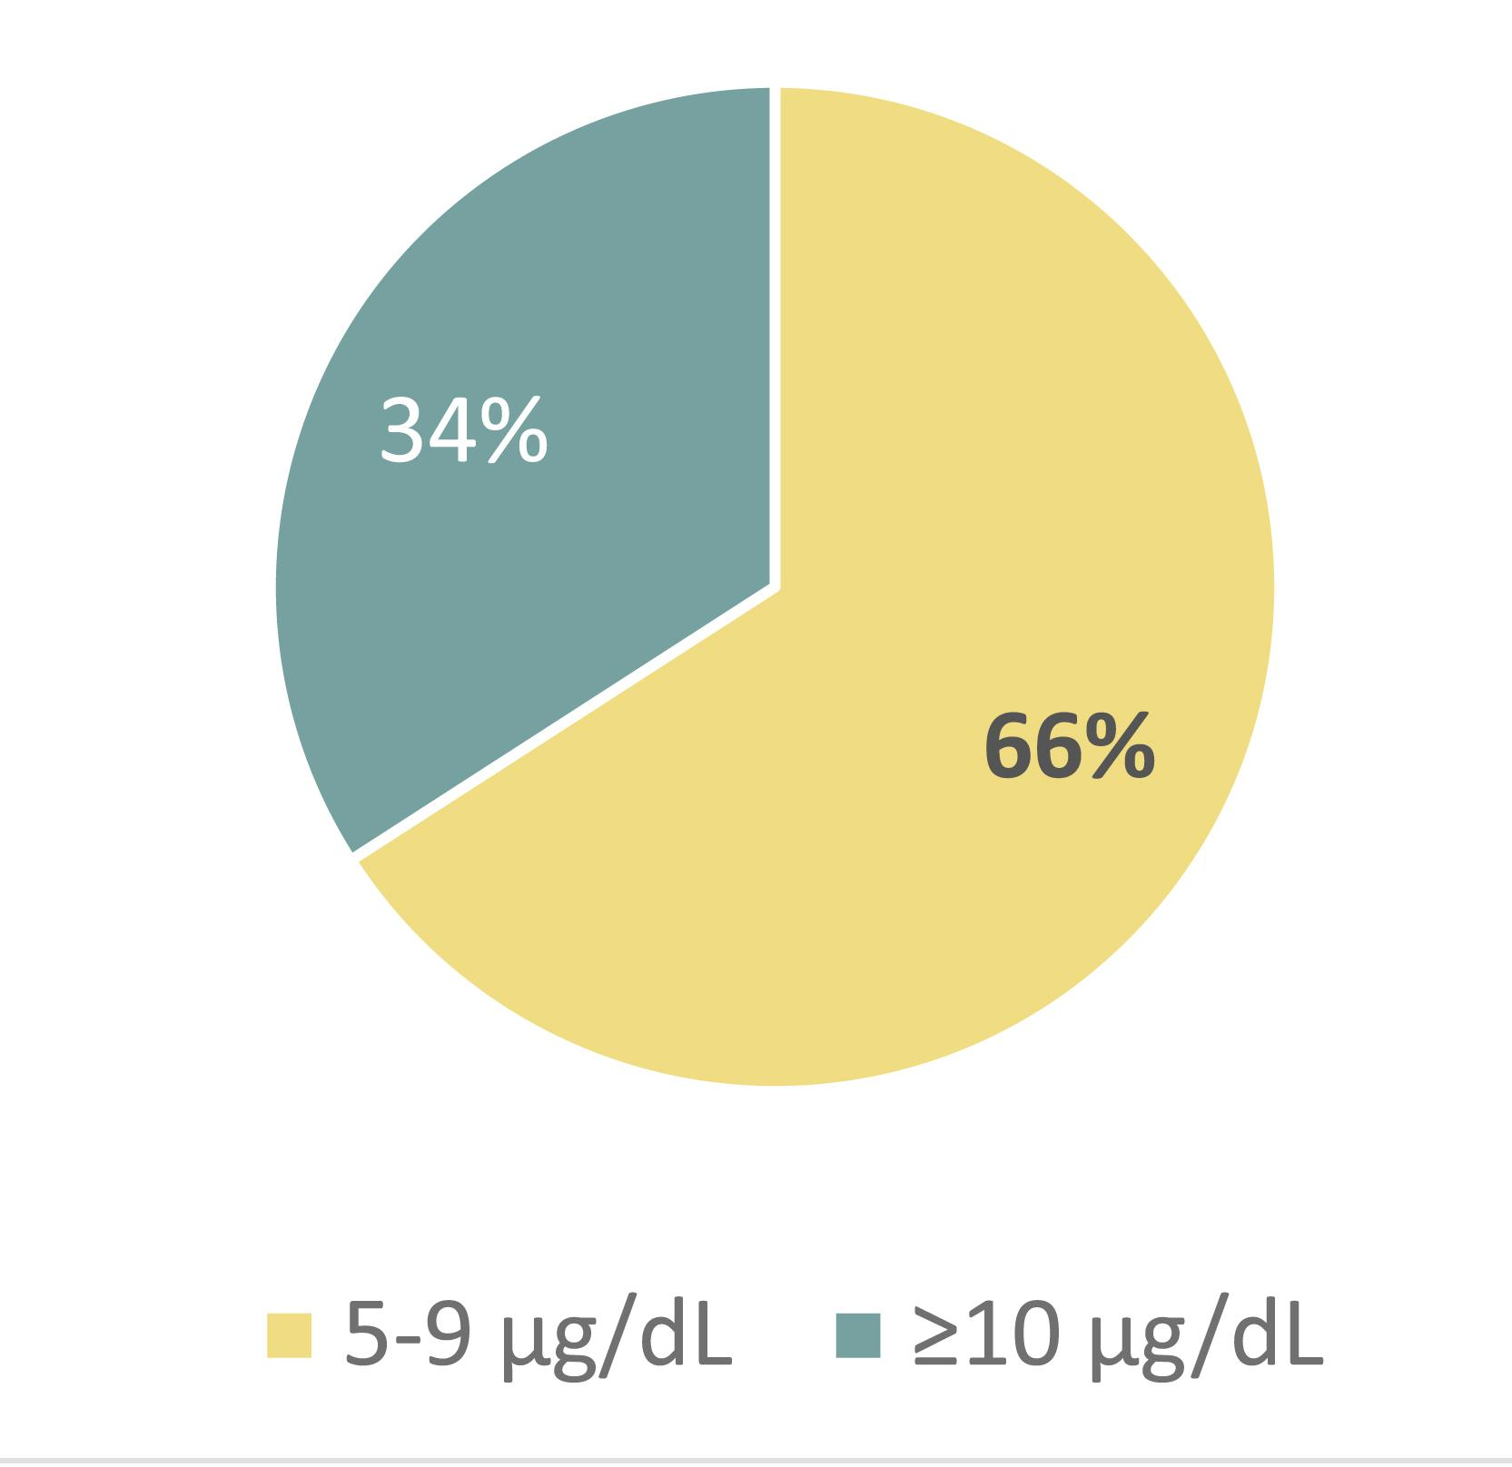
Even the lower IDEA Part C eligibility threshold for lead poisoning is missing too many children with lead poisoning.
Elevated blood lead levels by percent, Delaware children up to age 6, 2012-2016.
Data provided by Delaware’s Department of Public Health (2018) and Delaware Kids Count (2019).

Slide 6
Benefits of universal testing for lead poisoning at age 2:
Testing is Diagnostic: Testing is the most reliable mechanism to identify children who need help.
Testing is Age-Sensitive: 2 years old is an age where the brain can recover some of the long term learning and behavioral effects of lead exposure.
Testing Results in Prevention: allows the source of exposure to lead to be identified and removed (DHSS case workers visit homes at 10 µg/dL).
Testing Enables Help: Children are eligible for federally-funded early education through IDEA part C with a blood lead level test 5 µg/dL or above.

Slide 7
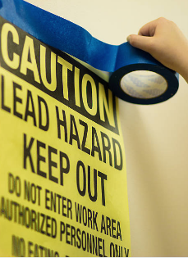
Potential Sources of Childhood Lead Exposure in Wilmington
Paint in housing older than 1978
Lead in drinking water pipes
Soil Contamination from prior land uses
Consumer products (toys, cosmetics, seasonings, candy, home goods)
Family members in high-risk occupations (construction, firearms use, industry)

Slide 8
Legislation on 2 Year Testing is Forthcoming!
Primary Sponsor: Representative Larry Lambert of the Claymont area
Bill expands universal testing for childhood lead poisoning to children at 2 years of age
Bill is currently being circulated for cosponsors
Universal testing at 2 years of age was a recommendation of the newly-restarted Childhood Lead Poisoning Advisory Committee in their April 2021 report to the General Assembly.

Slide 9
2 Year Testing Goals
Identify children who need help.
Direct resources to removing the source of exposure for each child.
Increase access to Early Education to Improve brain functioning during the critical time of brain development.
Reduce reliance on special education; students can begin kindergarten with a general education class.

Slide 10
Please support Rep. Lambert’s bill to expand universal testing to children at age 2.

Slide 11
References
American Academy of Pediatrics Council of Environmental Health, 2016. Pediatrics, (138)1. Policy Statement: Prevention of Childhood Lead Toxicity. http://pediatrics.aappublications.org/content/138/1/e20161493
Bellinger, D.C., 2012. A Strategy for Comparing the Contributions of Environmental Chemicals and Other Risk Factors to Neurodevelopment of Children, Environmental Health Perspectives, Volume 120(4), 501-507. https://www.ncbi.nlm.nih.gov/pmc/articles/PMC3339460/
Bellinger, D.C.,2017. Childhood lead exposure and adult outcomes. Journal of the American Medical Association, 317(12), 1219-1220. http://jamanetwork.com/journals/jama/article-abstract/2613136
CDC, 2017a. What Do Parents Need to Know to Protect Their Children? https://www.cdc.gov/nceh/lead/acclpp/blood_lead_levels.htm
CDC Advisory Committee on Childhood Lead Poisoning Prevention, 2012. Low Level Lead Exposure Harms Children: A Renewed Call for Primary Prevention. Atlanta, GA. www.cdc.gov/nceh/lead/ACCLPP/Final_Document_030712.pdf
Lamphear, B.P., 2017. Low-level toxicity of chemicals: No acceptable levels? PLOS Biology. https://doi.org/10.1371/journal.pbio.2003066
Lanphear, B.P., 2015. The Impact of Toxins on the Developing Brain, Annual Review of Public Health, 36, 211-230, https://www.annualreviews.org/doi/pdf/10.1146/annurev-publhealth-031912-114413
Reuben, A., Caspi, A., Belsky, D., Broadbent, J., Harrington, H., Sugden, K., Houts, R.M., Ramrakha, S., Poulton, R., & T. Moffitt, 2017. Association of childhood blood lead levels with cognitive function and socioeconomic status at age 38 years and with IQ change and socioeconomic mobility between childhood and adulthood. Journal of the American Medical Association, 317(12), 1244-1251. http://jamanetwork.com/journals/jama/article-abstract/2613157
Roberts et al., 2017. Pediatrics, https://pediatrics.aappublications.org/content/139/5/e20164266

