Slide 1
Wilmington Neighborhood Conservancy Land Bank
May 13, 2021
800 W 9th Street Revitalization Project

Slide 2
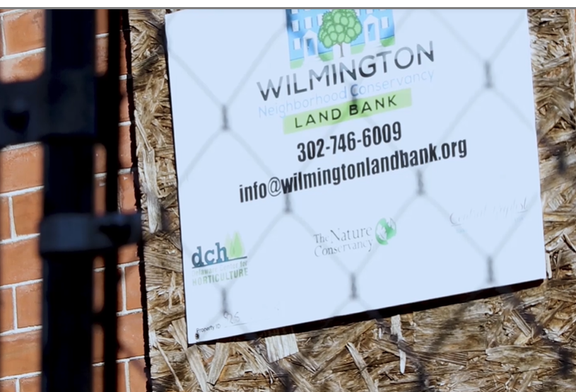
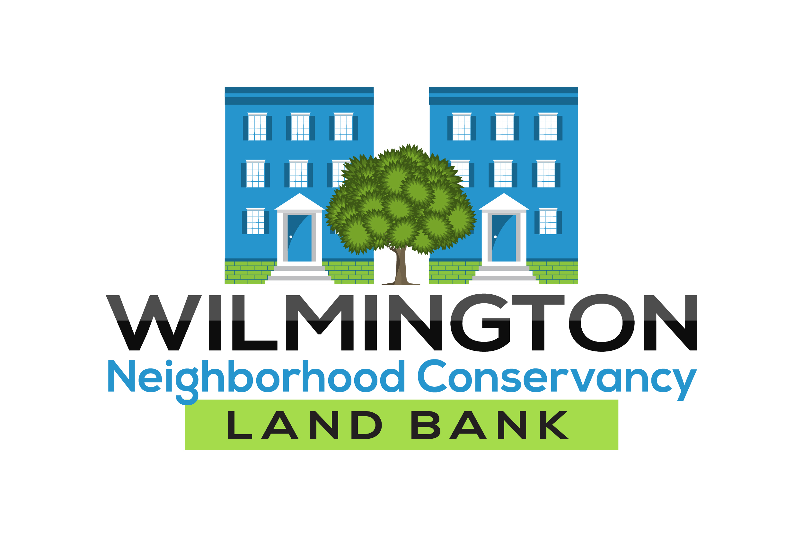
Our History And Mission
In 2016, the Wilmington Neighborhood Conservancy Land Bank (WNCLB) was created by the City of Wilmington and the State of Delaware legislation to return vacant, dilapidated, abandoned, and delinquent properties back to productive use.
WNCLB receives our properties from several sources: The City of Wilmington, tax sales, and donations.
Properties are held for redevelopment either individually or packaged and held for larger projects.
WNCLB acquires strategic properties and transfer to local nonprofits to support their revitalization objectives.

Slide 3
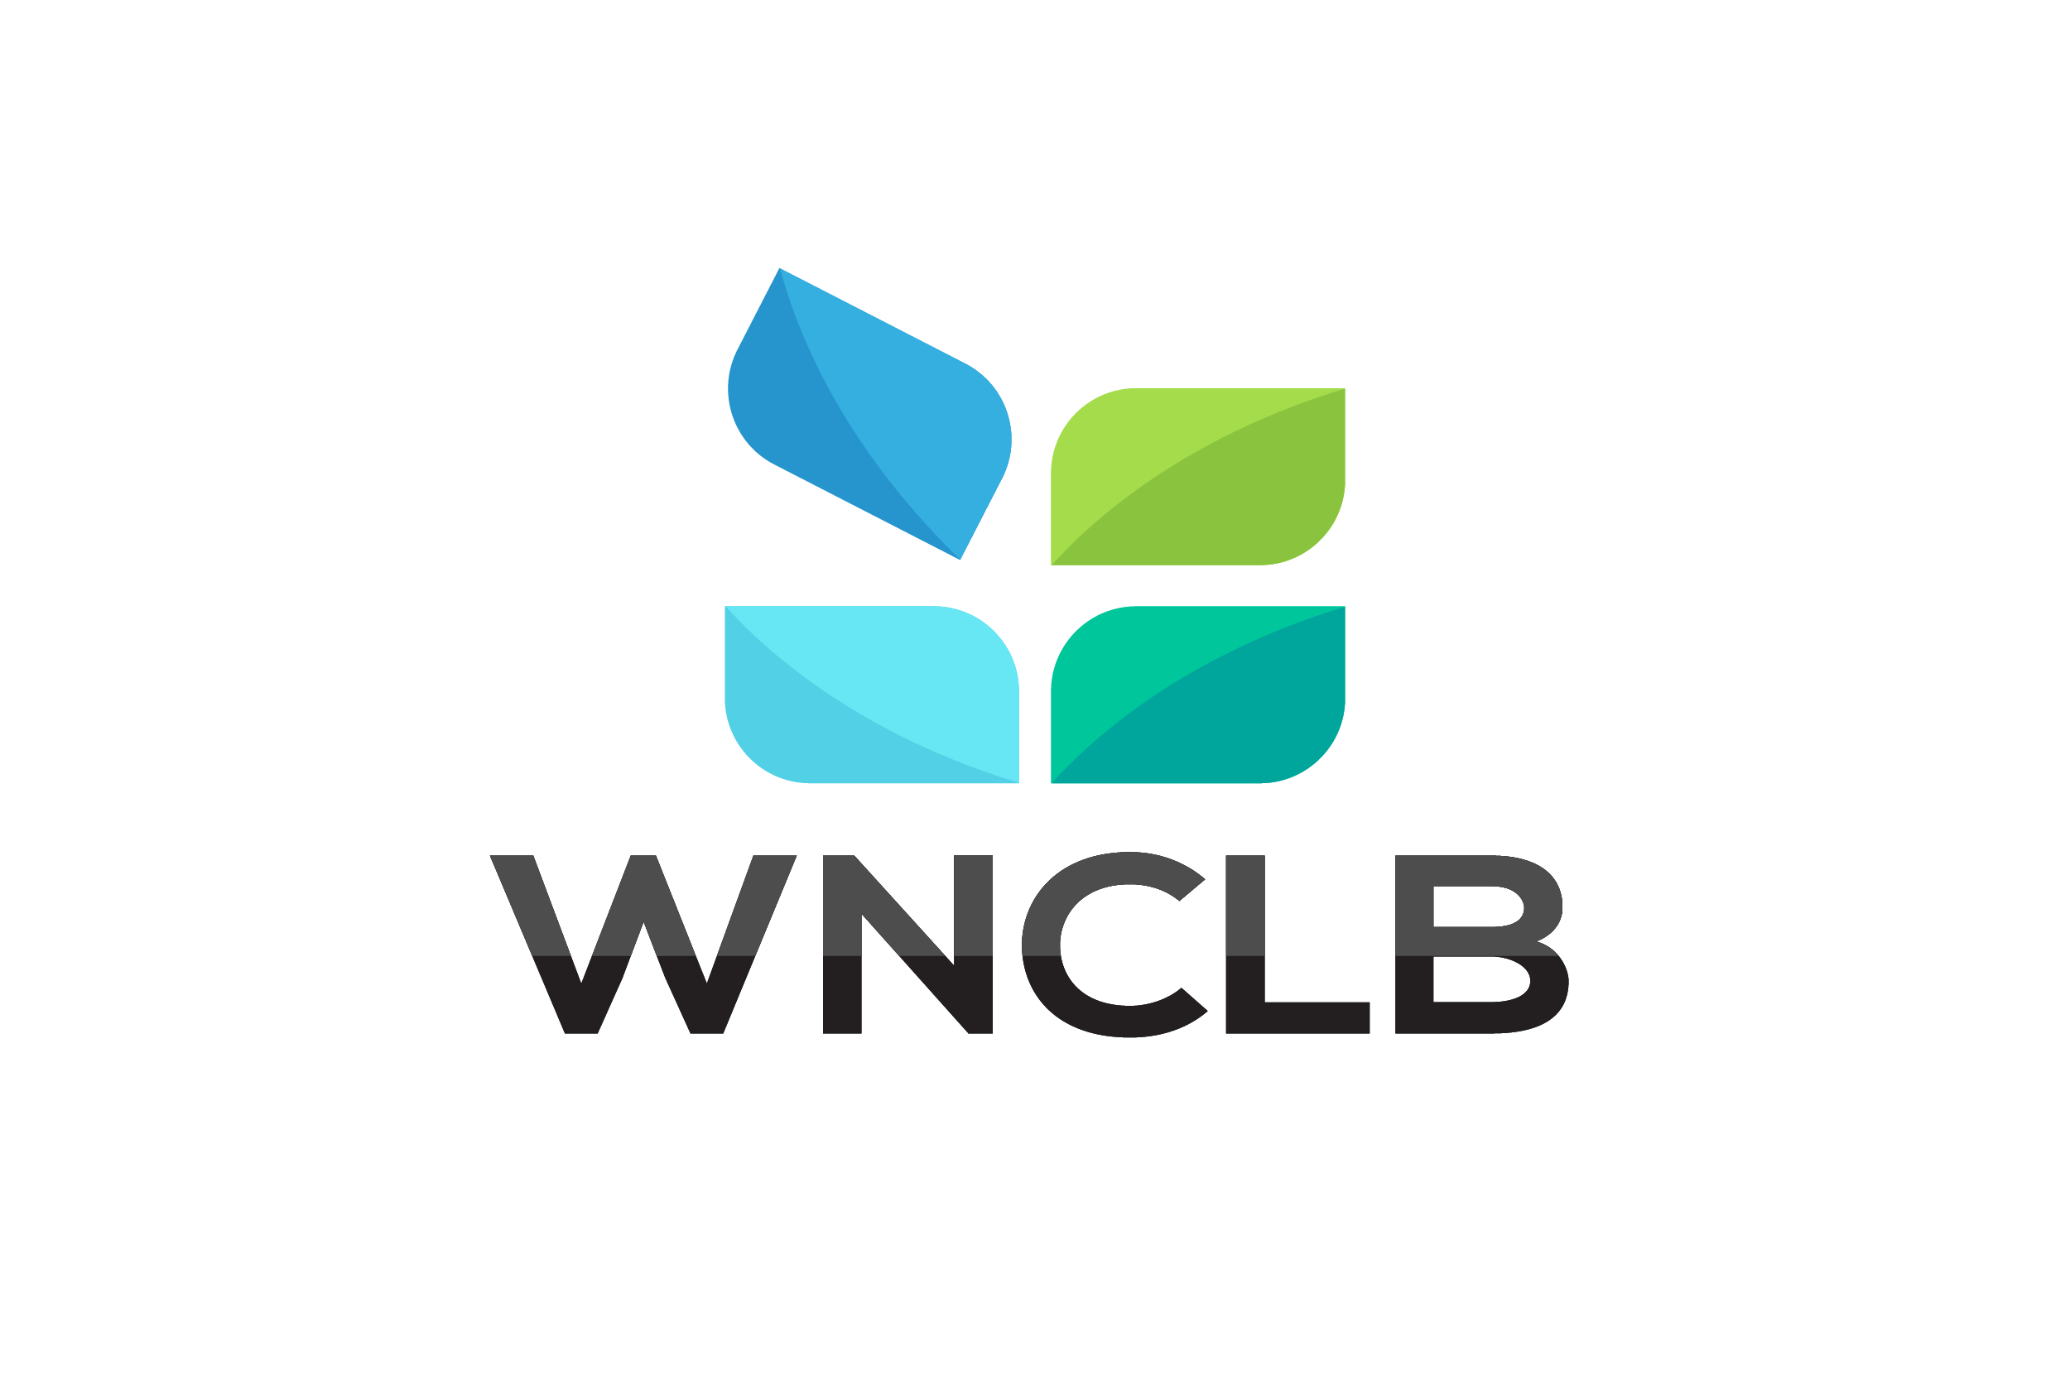


Removing Blight from Neighborhoods
Homestead
Investor Rehab for Homeownership
WNCLB will sell properties to responsible investors that will tackle the challenges of rehabilitating the vacant units for sale to homeowners.
Homeownership plays a vital role in building strong communities, improving health, reducing crime and promoting increased resident participation.
Started in 2019 in conjunction with the City of Wilmington, the Homestead Program was launched for homebuyers committed to renovating their own home.
Qualified buyers are able to purchase the property for $1.00.
13 W 27th Street Rehab

Slide 4
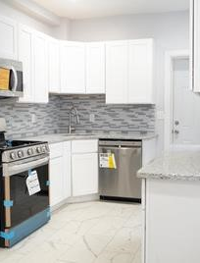

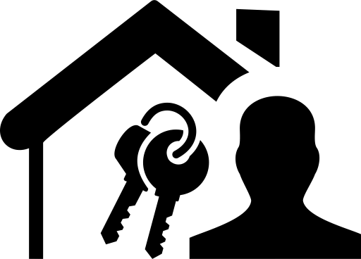
Removing Blight from neighborhoods
Side Yard Program
Investor Rehab for Affordable Rental
Sound rental housing stock is vital in each community for individuals where homeownership is not realistic or desirable.
WNCLB seeks to support neighborhood stability through a comprehensive housing approach which includes quality affordable rentals.
The Wilmington Neighborhood Conservancy Land Bank will sell our lots for a nominal fee if you live adjacent to the property. The Side Yard program allows residents to expand their yards.
Many Wilmington residents have taken advantage of the program improving the value of their properties and helping to beautify their streets and neighborhoods.
1105 Oak Street Rehab
Kitchen

Slide 5
Dispositions To-Date (2018-2021)
Year | Side Lot | Investor Rehab for Homeownership | Homestead $1 | Non-Profit Joint Ventures Housing Projects | Investor Rehab for Affordable Rental | Total Units Sold
2018 | 1 | 0 | 2 | 6 | 0 | 9
2019 | 7 | 21 | 7 | 7 | 0 | 42
2020 | 4 | 19 | 5 | 13 | 14 | 55
2021 | 2 | 17 | 2 | 1 | 14 | 36
TOTALS | 14 | 57 | 16 | 27 | 28 | 142
92 New Affordable Homeownership Opportunities Created and Underway
65% of Applicants from the City of Wilmington Reinvesting in their Communities

Slide 6
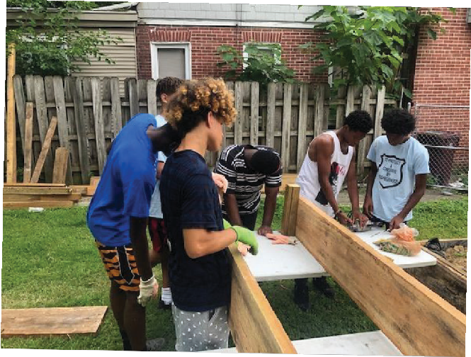

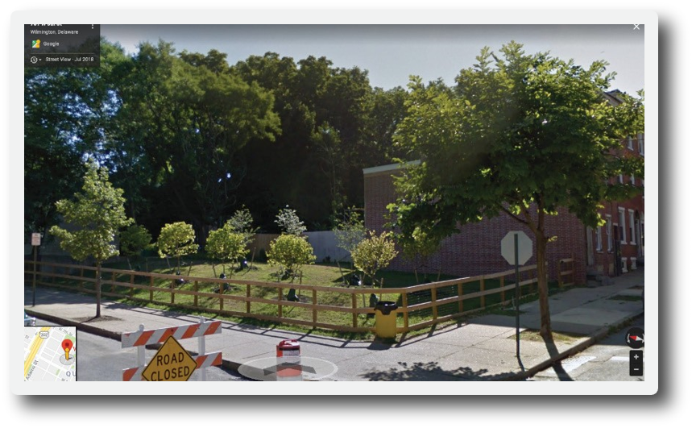

Green Space For Healthier communities
Clean and Green Program
Conscious Connections
26 E 23rd Street
In conjunction with The Nature Conservancy in Delaware (TNC) and The Delaware Center for Horticulture (DCH), WNCLB vacant lots are strategically targeted as a community-based greening intervention.
Vacant lots are transformed using a “Clean and Green” treatment that includes removing debris, weeds, grading the site, planting trees, sowing grass seed and installing a wooden fence around the perimeter to discourage future dumping.
WNCLB leases our vacant lots to community residents for our Urban Garden Lease Program. Applicants must first present their plans and get approvals from the following: designated city council member, local neighborhood association and The Delaware Center for Horticulture.
5th and Madison Street
Community Gardens

Slide 7
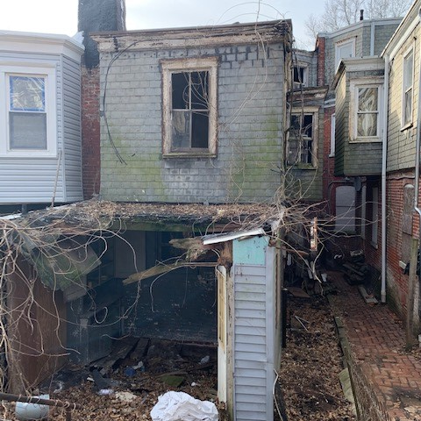
Removing Unsafe Structures for Safer Neighborhoods
Many of the homes in WNCLB’s inventory have been vacant and neglected for over 20 years.
Today, in the City of Wilmington, the average demolition cost per unit is $50,000.
To-date, WNCLB has removed 35 unsafe structures costing $1,500,000

Slide 8
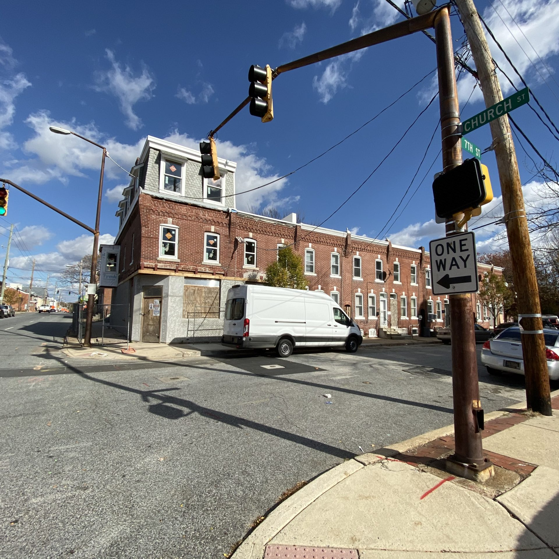
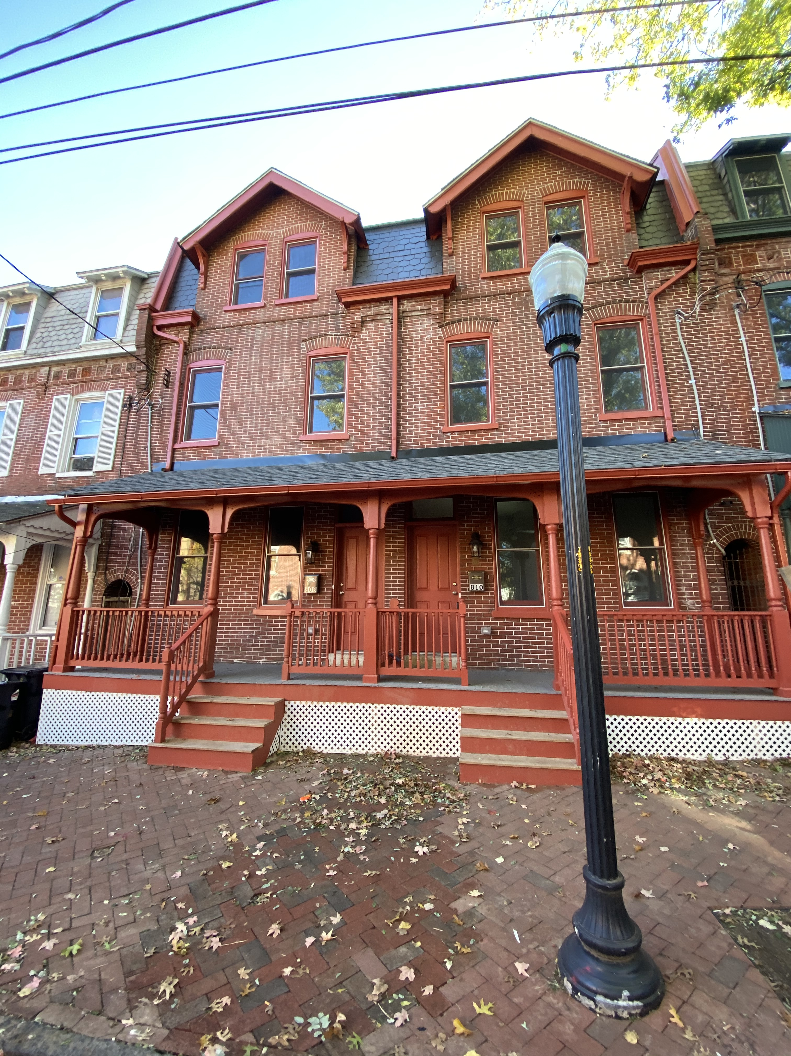
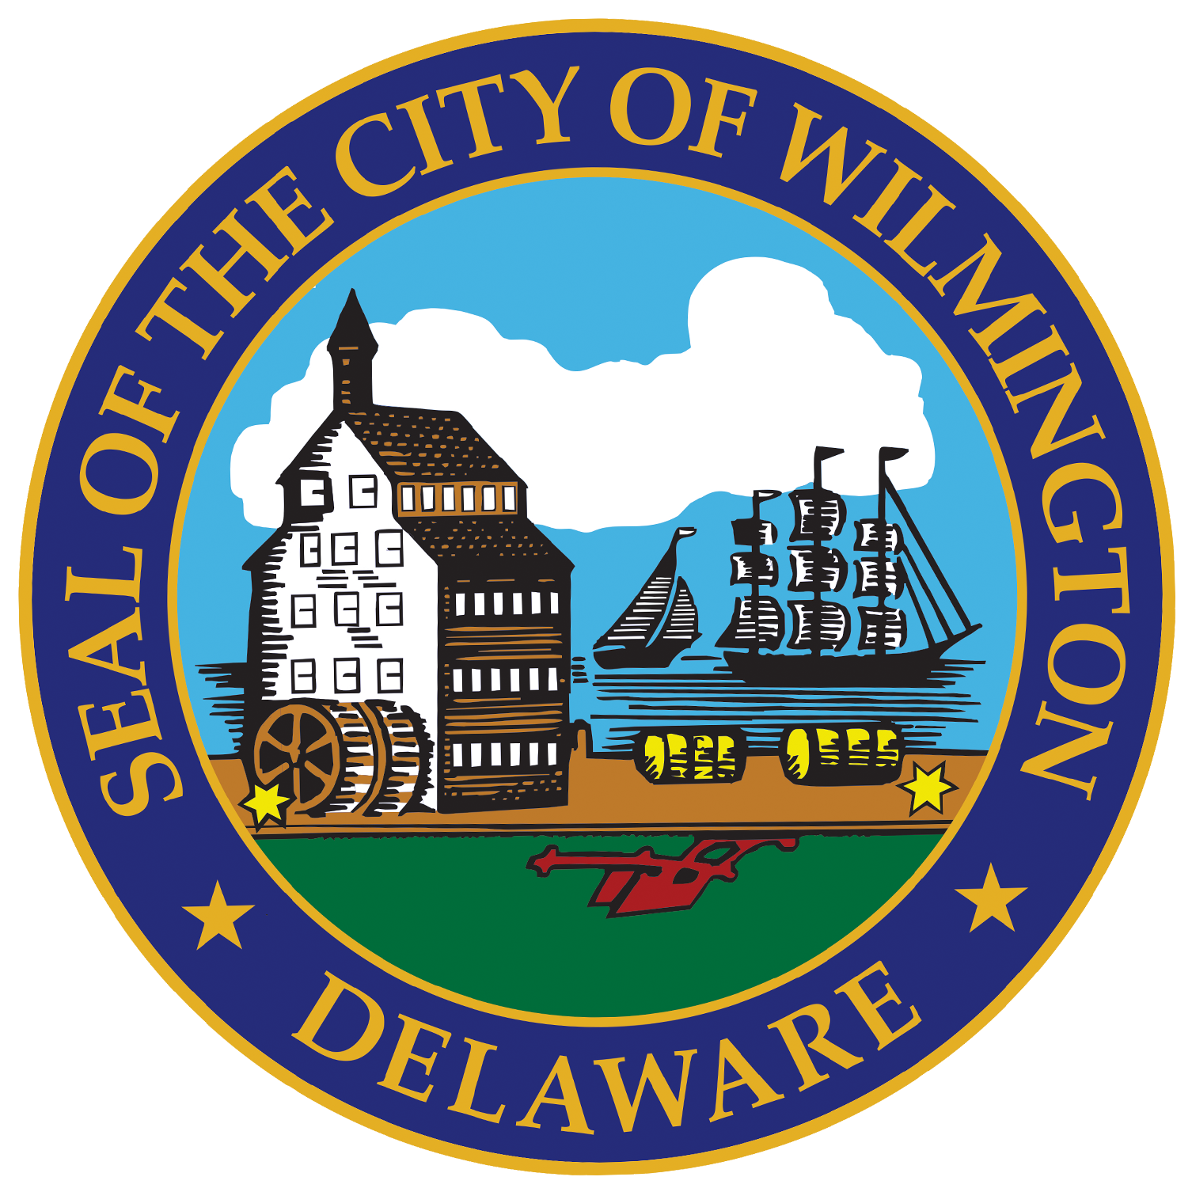
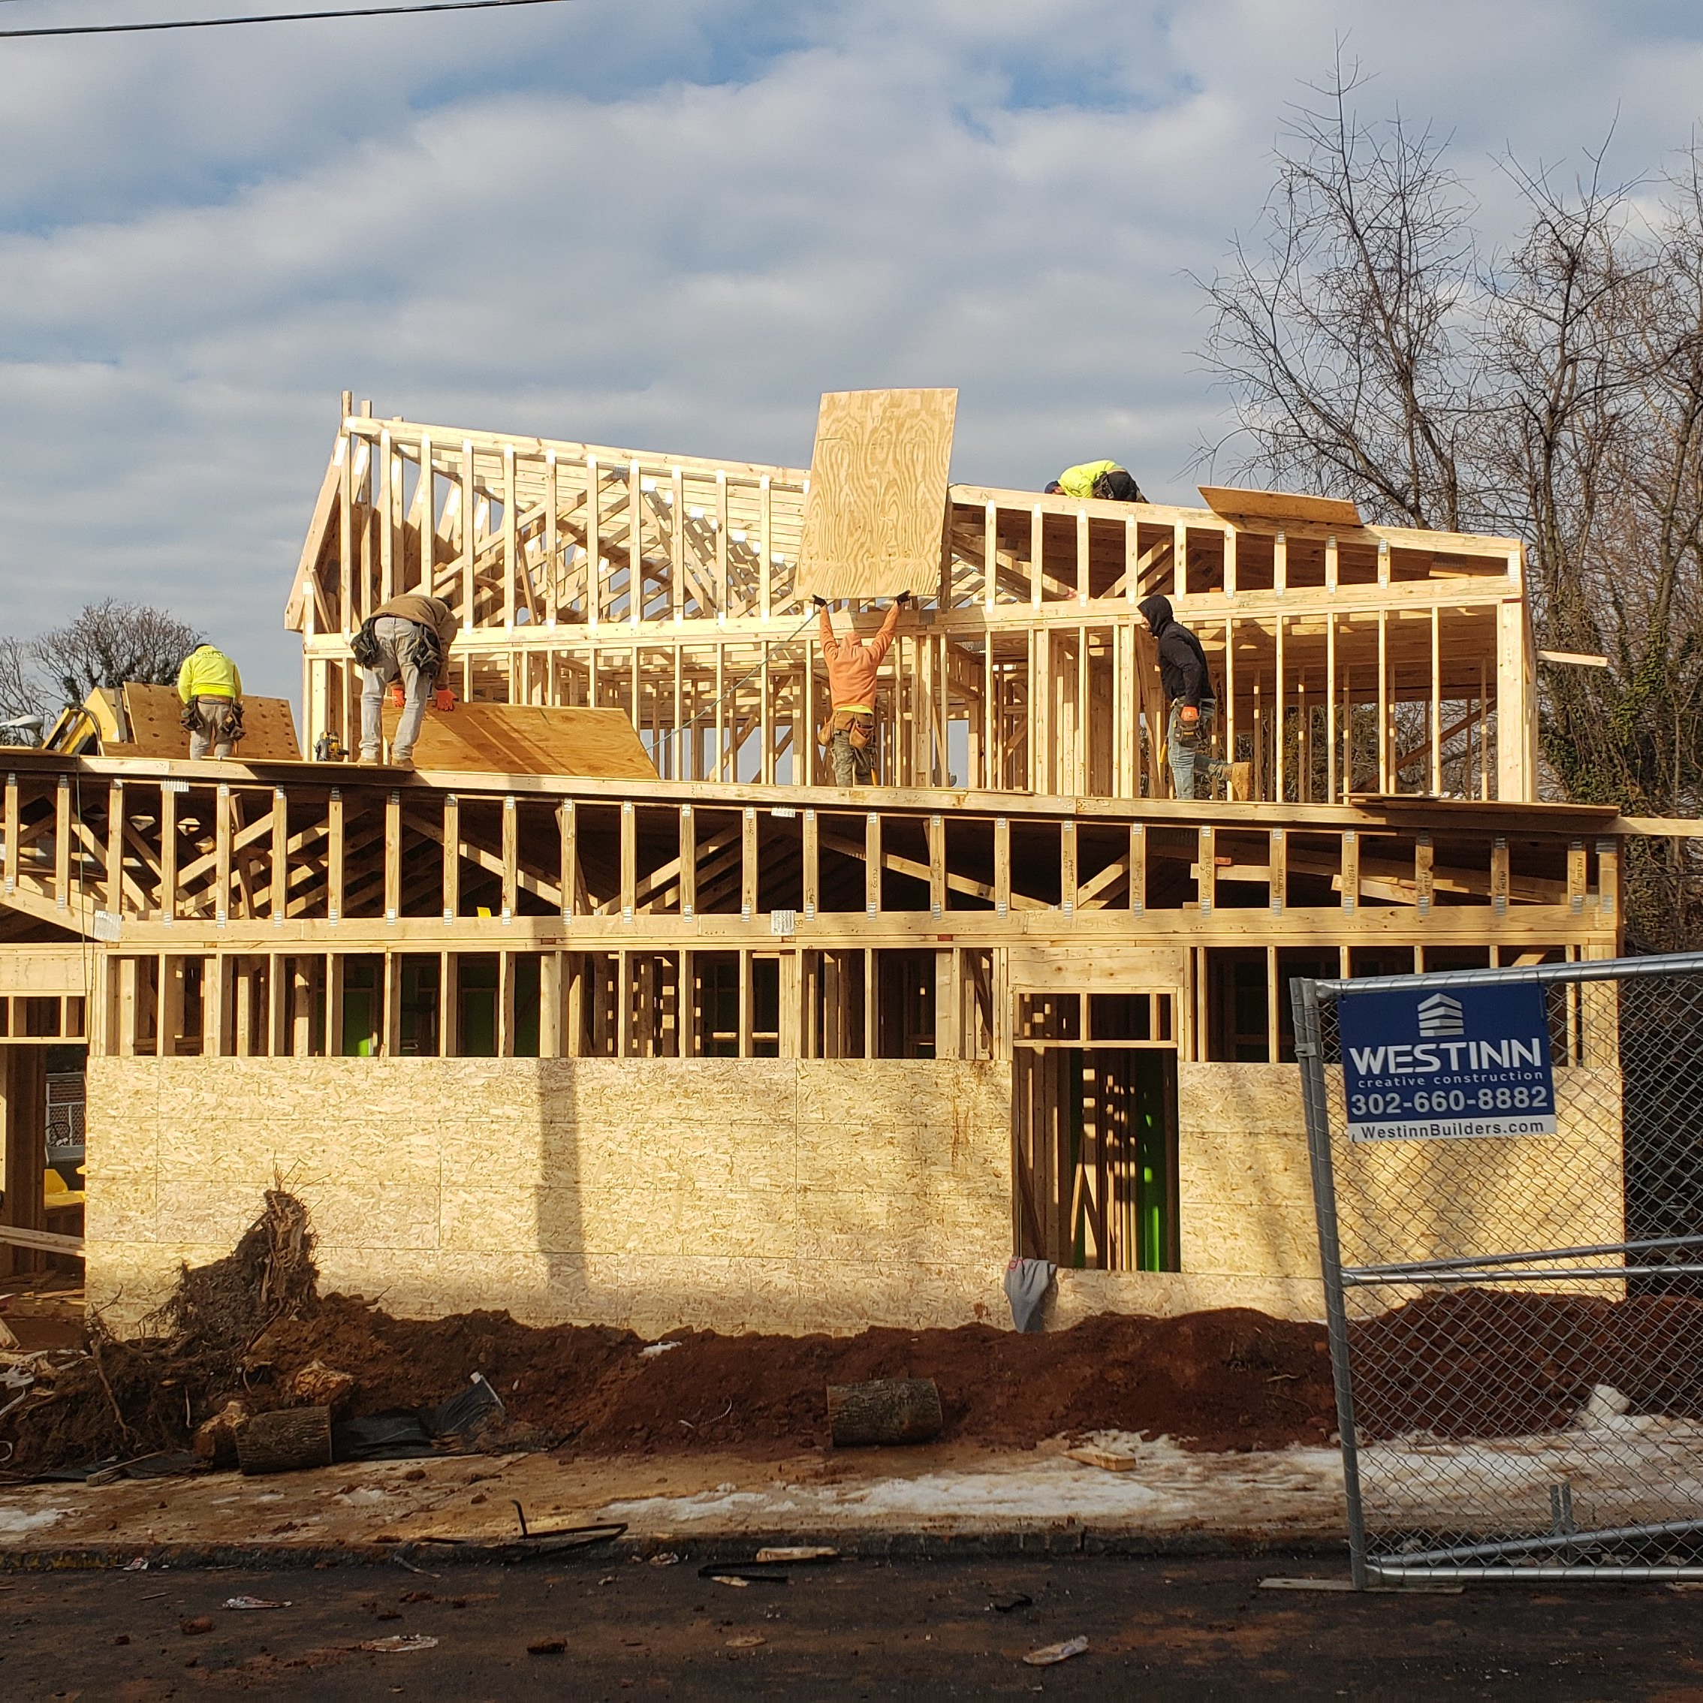
Building Valuable Partnerships
Technical Advisory Committee
9th Street Revitalization project
City of Wilmington
Cornerstone west cdc
Meet weekly with the City of Wilmington to collectively formulate strategic acquisitions/demolitions for large-scale redevelopment projects.
The City of Wilmington has transferred 76 properties to WNCLB and refined the Sheriff Sale process to directly assign units to WNCLB.
Provided $70,000 in funding for the acquisition and demolition on the 700 block of Douglas Street to support Cornerstone West CDC’s Life Lines III project-transitioning youths from foster care.
Established in 2017, WNCLB’s Technical Advisory Committee was created to advance policies, exchange ideas, and coordinate projects.
Today we have over 20 members from nonprofits, public administration, community members, and private investors.
Funded in conjunction with JPMorgan Chase and DSHA, the 9th Street Revitalization Project combines acquisition, demolition and construction subsidy.
Working with National Community Reinvestment Coalition creating 6 rehabilitated units and Interfaith Community Housing creating 3 newly constructed units.

Slide 9
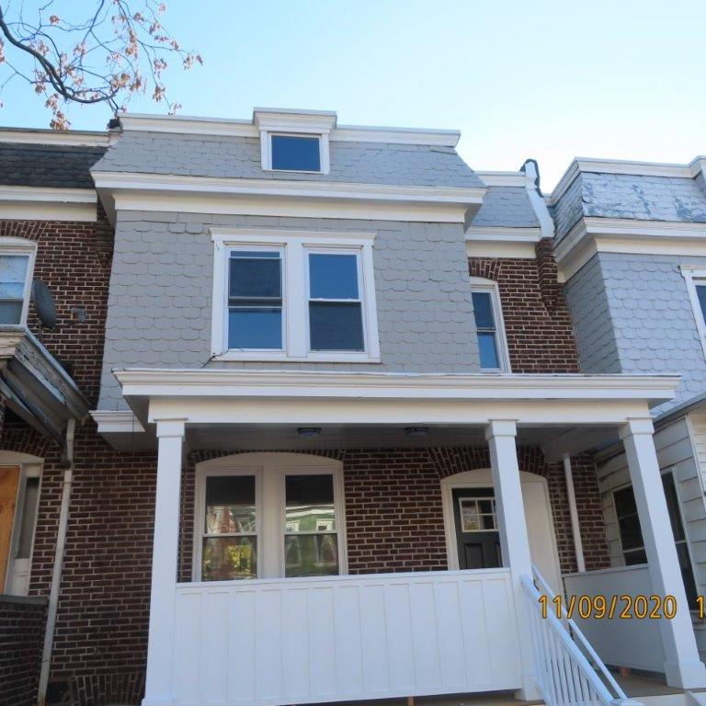
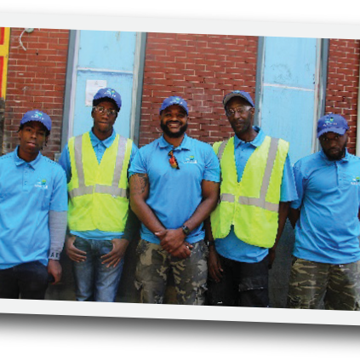
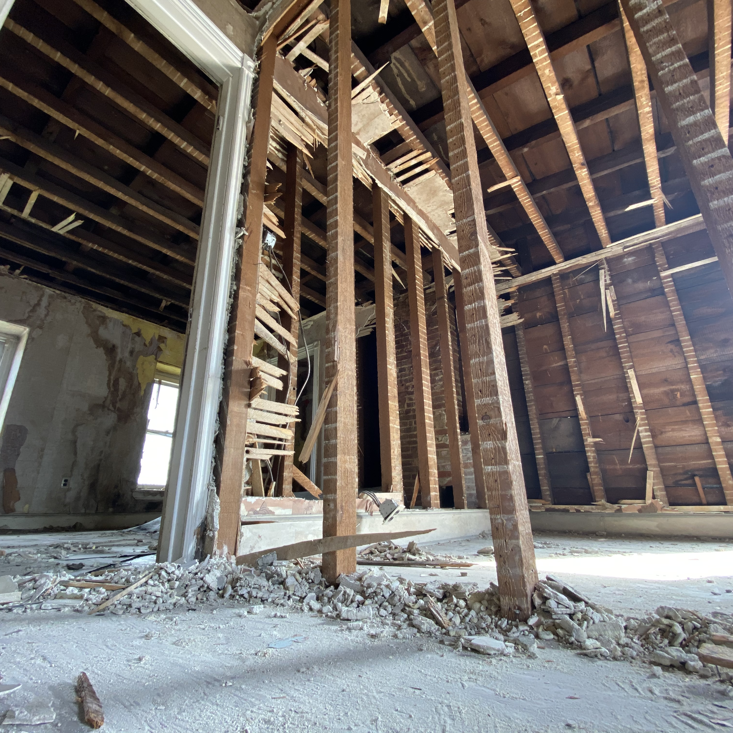
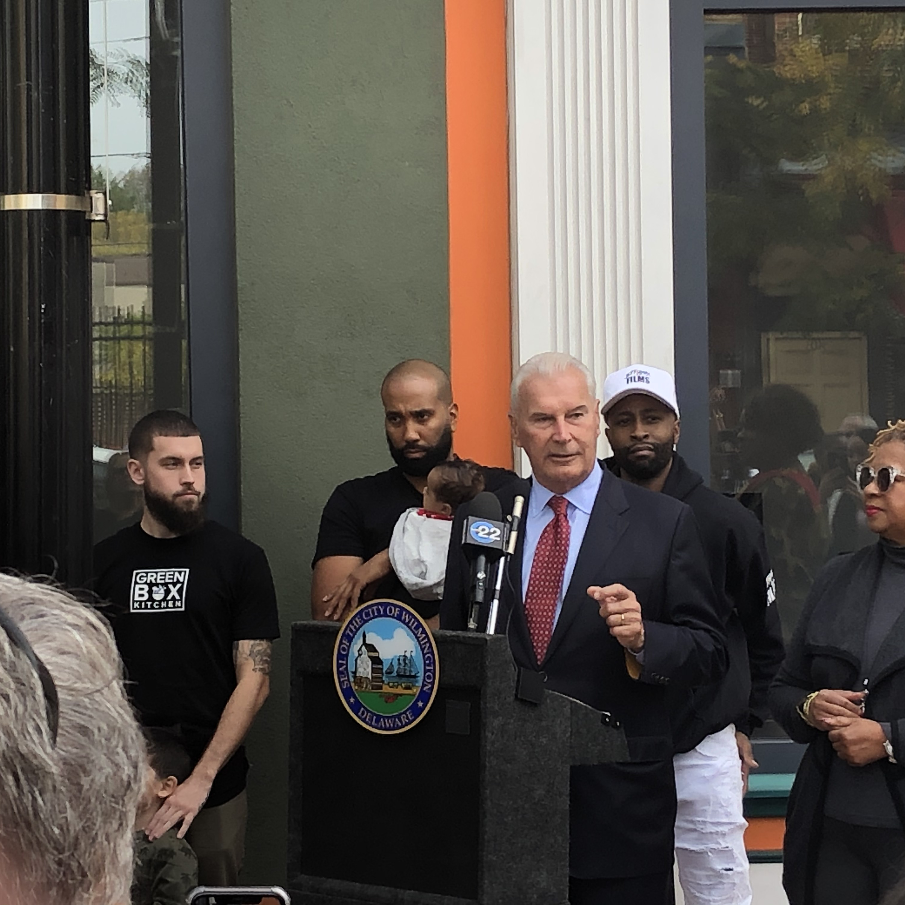
Building valuable partnerships
Collaborated with the National Community Reinvestment Coalition (NCRC), based in Washington DC. to create affordable housing projects by purchasing, holding, and transferring 10 units and employing City residents.
Central Baptist church cdc
NCRC
In April 2019, WNCLB and the Central Baptist Church CDC joined forces to create a workforce development program to employ the local residents of the East Side community responsible for WNCLB property maintenance.
WNCLB funds 8 full-time City residents and the maintenance program which oversees 260 properties including the City and Habitat for Humanity parcels.
West Center City
Additional partnerships
Joined together with the City of Wilmington, Cinnaire, and Delaware Valley Development Corporation to target the revitalization of the West Side Community developing a strategic plan to effectively deploy Delaware State Housing Authority funds.
Additional partnerships include: Cinnaire JumpStart Program, Habitat for Humanity, NCALL, Woodlawn Trustees, Neighborhood Assistance Corporation of America, and for-profit entities to meet the objectives of the City of Wilmington’s comprehensive plan.

Slide 10
Thank you!
Richard G. Gessner
Chairman

