Slide 1
Menstrual Equity in Wilmington, Delaware
Melissa Marlin, JLW President
Melissa Beiler, Co-Chair, Community Impact
Kelly Slabicki, Co-Chair, Community Impact
Merrie Goodlander, Chair, Public Policy & Advocacy

Slide 2
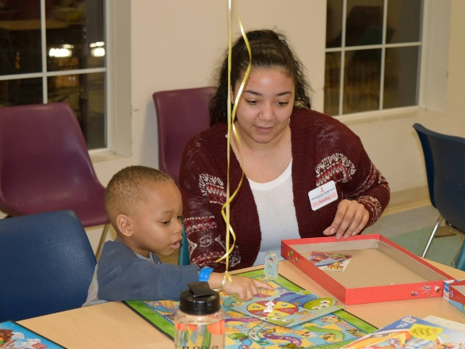
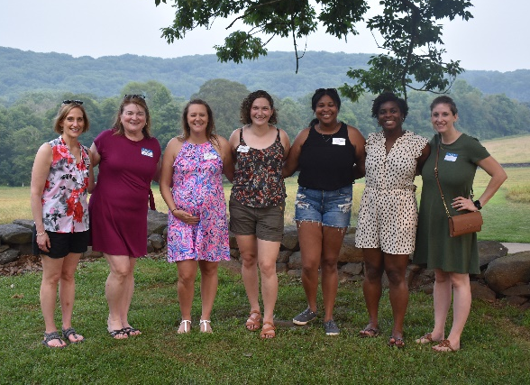
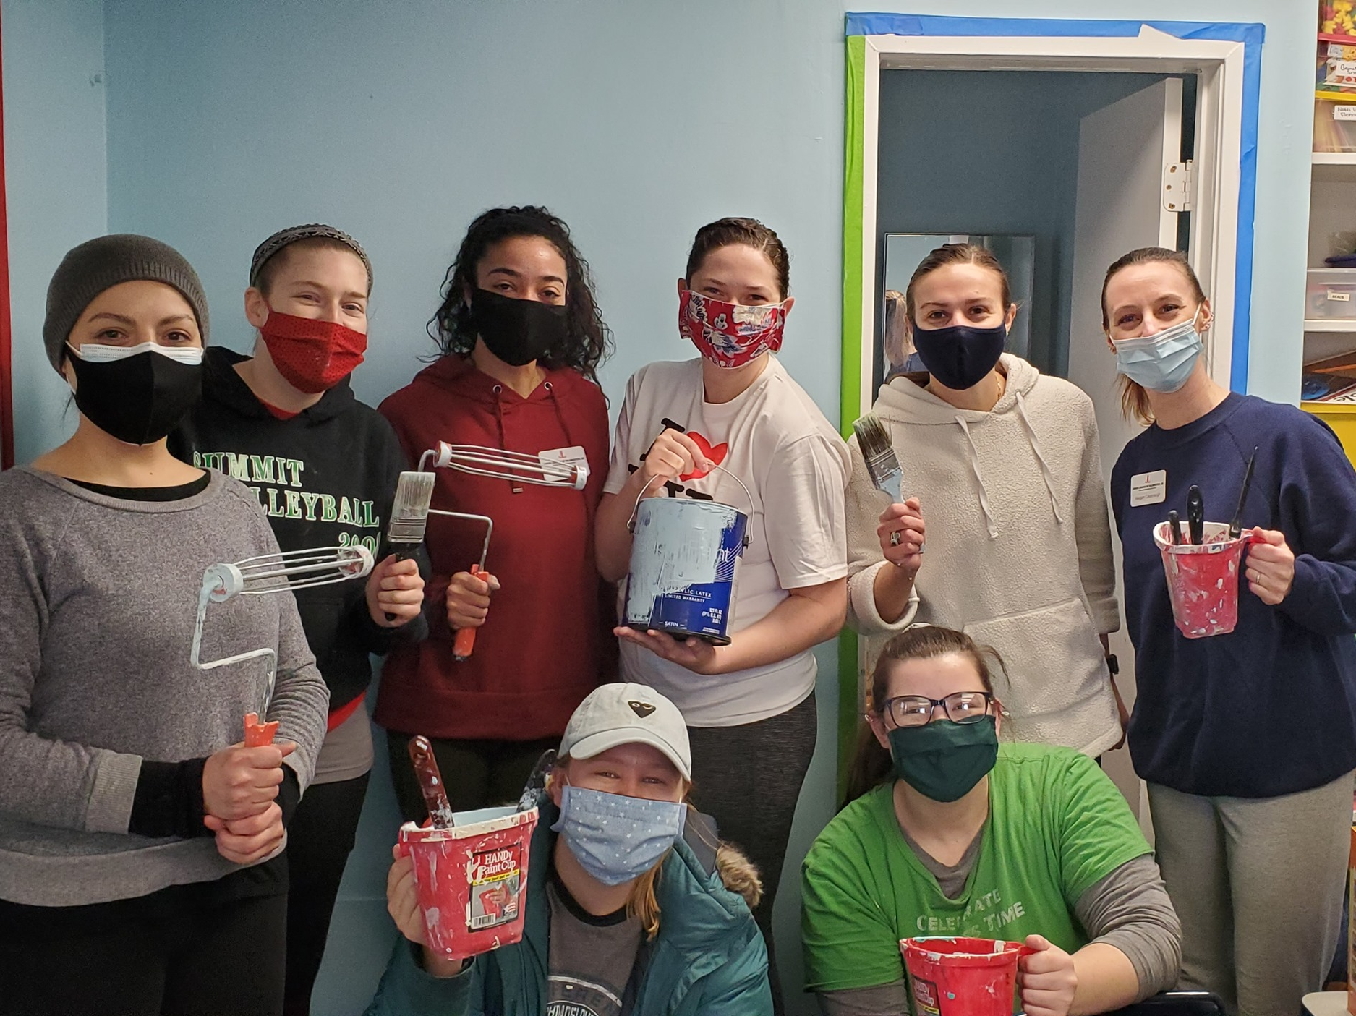
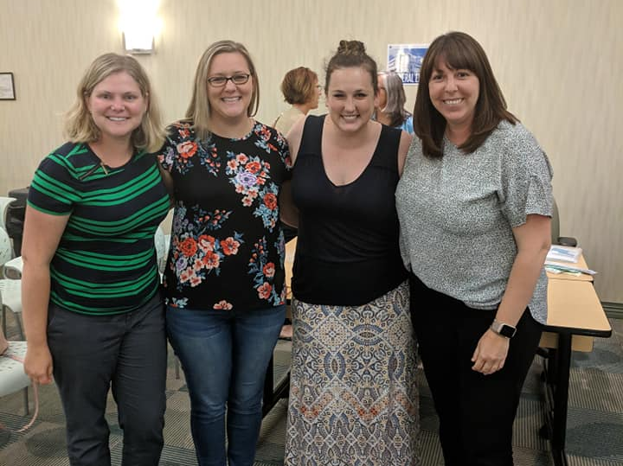
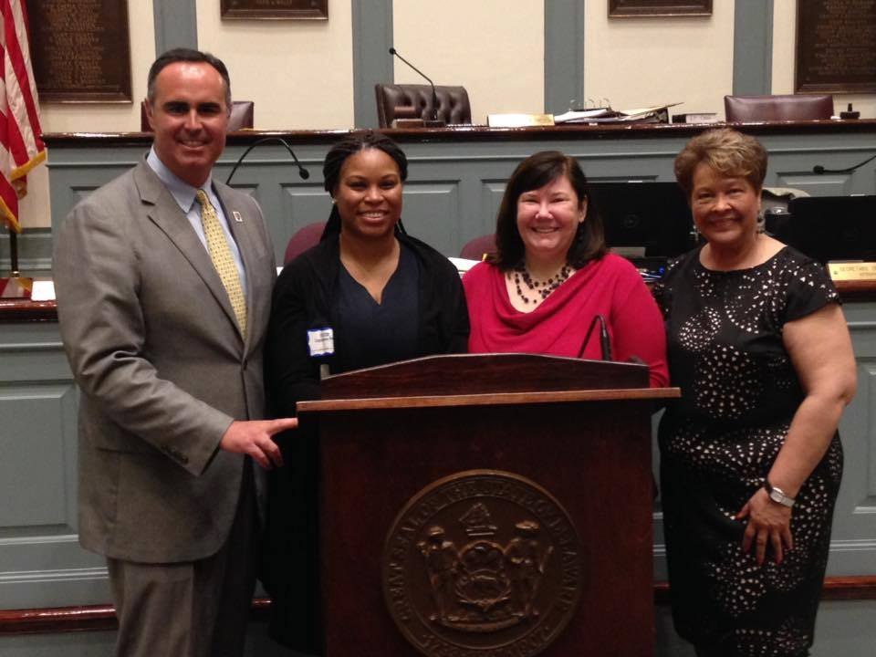
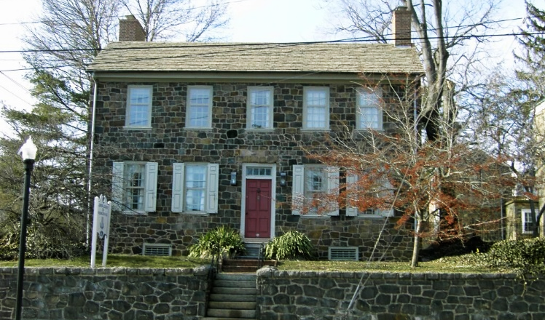
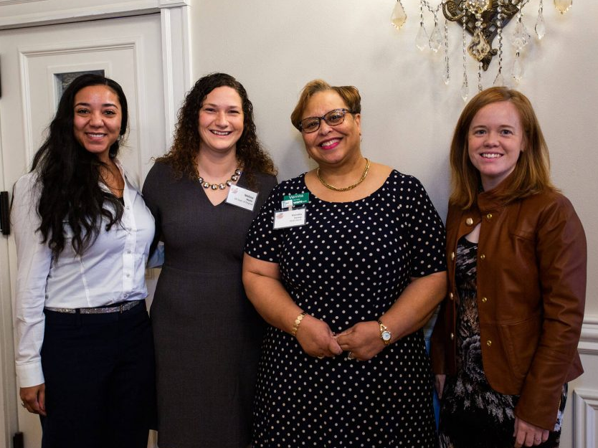
The Junior League of Wilmington, DE
The Junior League of Wilmington is an organization of women committed to promoting voluntarism, developing the potential of women, and improving the community through the effective action and leadership of trained volunteers. Its purpose is exclusively educational and charitable.

Slide 3
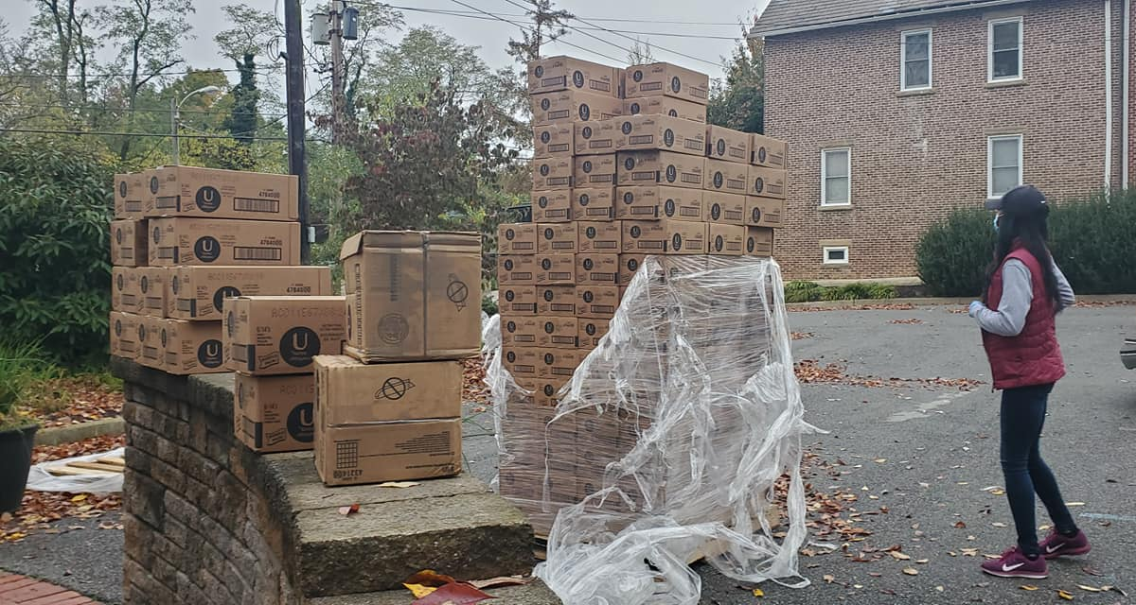
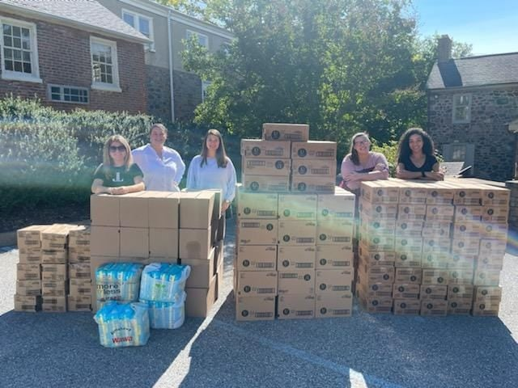
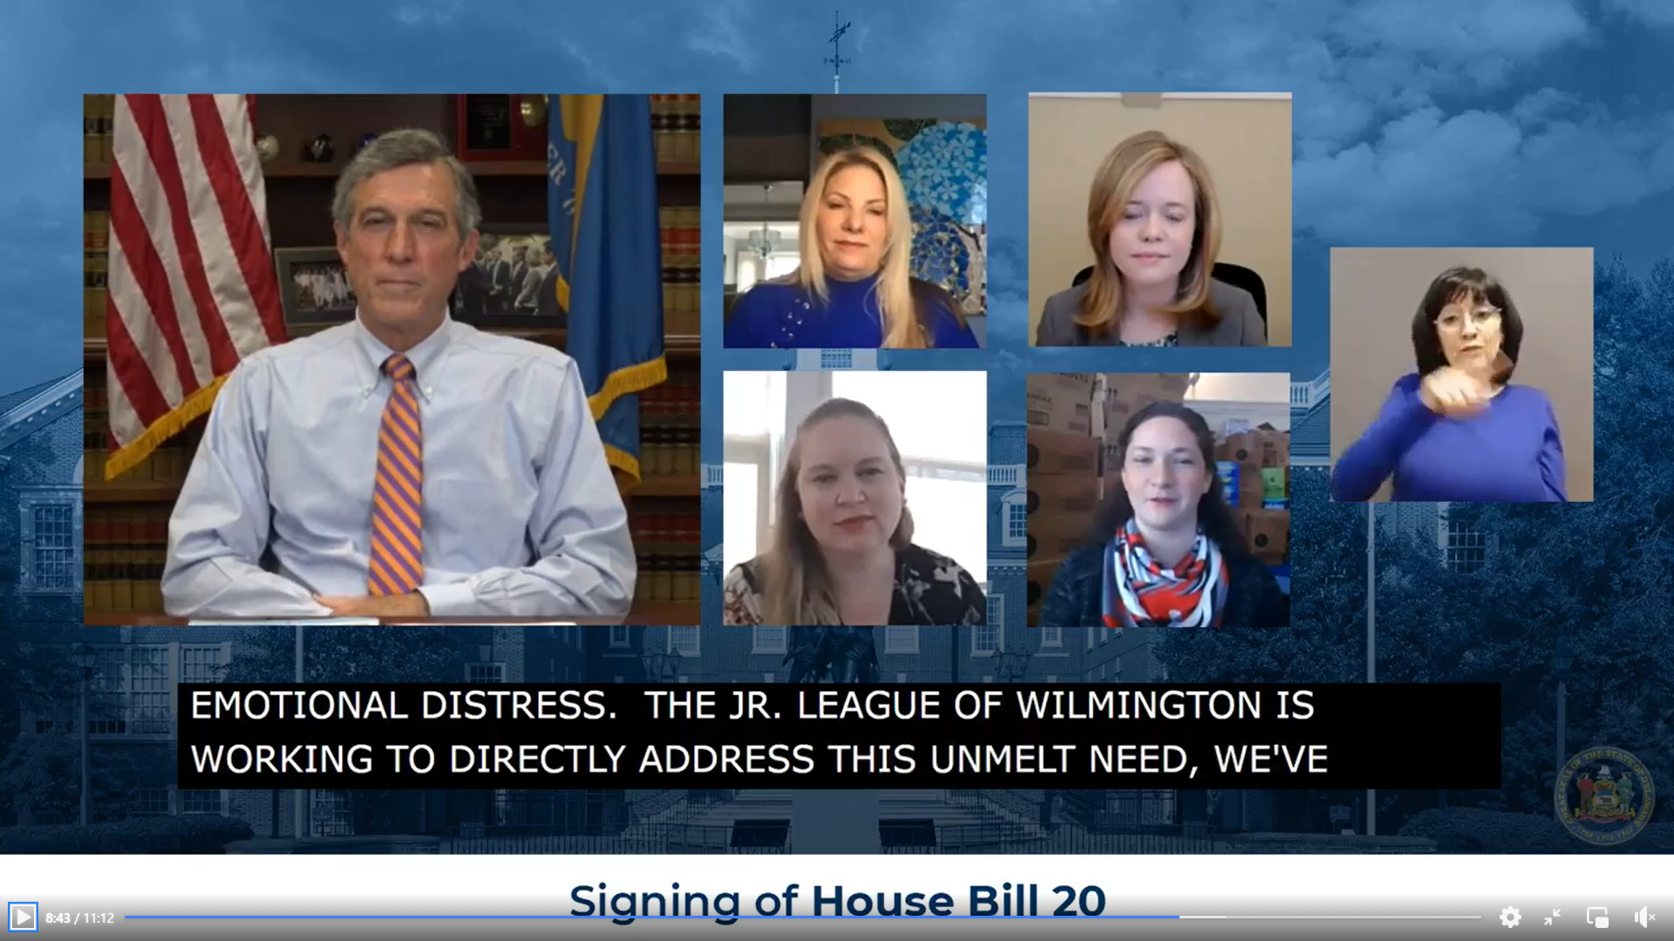
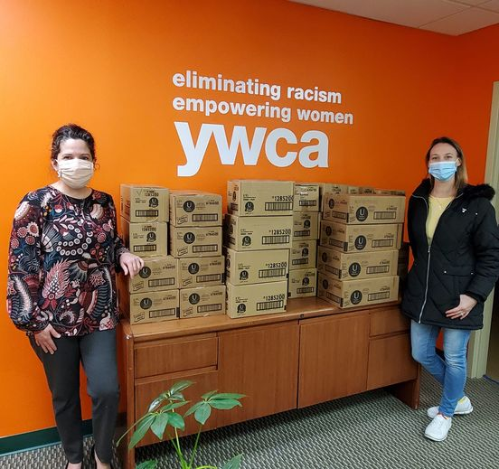
DIRECT SERVICE: JLW regularly attends community events to pass out free period supplies
October 2020: Received a shipment of over 125,000 period products from the Alliance for Period Supplies
ADVOCACY: JLW advocated for the passage of HB 20, requiring schools to provide period products
Awarded $37,000 in grant funds to purchase additional supplies
COALITION BUILDING: JLW has formed many partnerships throughout the community

Slide 4
Menstrual hygiene is an intersectional issue.
It impacts:
Quality of life
Physical, emotional, and sexual health
Education and extracurricular activities
Employment / income / financial stability
Personal safety
The impacts of menstrual health are not limited to the menstruator; they affect us all by means of economic opportunity cost and diminished dignity.

Slide 5
Menstrual hygiene in Delaware has room for improvement.
Nearly 200,000 women and girls between the ages of 12 and 44 live in Delaware
Of those, 1 in 6 lives below the Federal poverty line
60,300 women between the ages of 19 and 64 are covered by Medicaid
This does not address the need for menstrual supplies
Food assistance programs make this exclusion as well

Slide 6
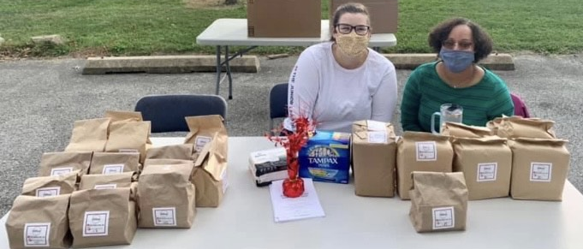
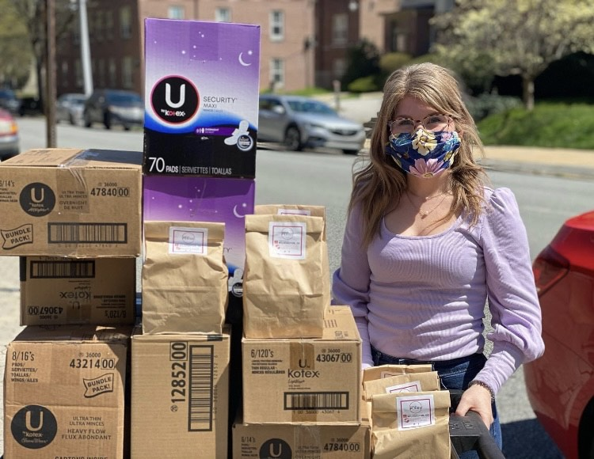
The Junior League of Wilmington’s Community Impact Committee participates in twice-monthly community resource events, supplying period packs at no cost to residents. We are currently on track to donate 19,000 individual supplies per month, and will approach a quarter of million supplies donated this year.

Slide 7
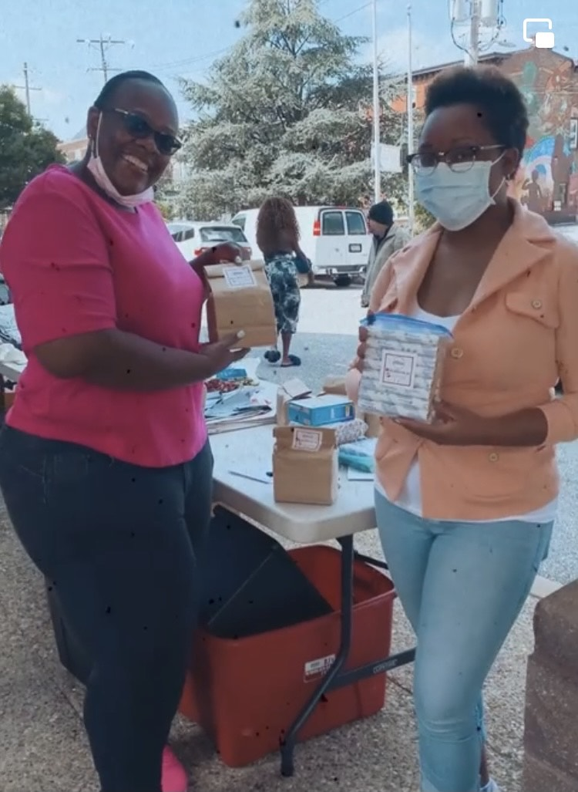
Since June of 2021, the Junior League of Wilmington’s Community Impact Committee has donated 23,800 liners, 24,400 tampons, and 62,300 pads. This includes the donation of over 27,000 menstrual products to all 15 New Castle County libraries.
Community events resource hosts and participants have included:
Lutheran Community Services
The Friendship House
REACH Teen Warehouse
Restoration Now (Salvations Army)
Grace United Methodist Church
Charity Crossing
Delaware Division of Public Health
Child Inc.
DAPI
Kingswood Community Center
NCC Libraries
AmeriHealth Caritas
Networks Connect
Domestic Violence Coordinating Council
Urban Promise

