Slide 1

ALL ABOUT HOND, INC.
Mission
As a non-profit ,Fair Housing Advocacy Agency , we promote and advocate for all Delawareans when seeking housing, protected under the State and National Fair Housing Laws shall have equal access to housing whether they are renting, buying ,getting a mortgage, acquiring home owners insurance, or selling their homes. We promotes diverse neighborhoods, which creates economically strong, safe and happy Communities.
History
HOND, Inc. was established to support New Castle County and City of Wilmington as they initially applied for Community Development Block Grant Funds (1981, US Department Housing and Urban Development)
Wilmington City Council passed an ordinance which designated HOND, Inc. as the known entity as its advisor on matters including equal housing opportunities. HOND Inc. has monitored the rental sales, mortgage industry through Fair Housing testing; HOND has provided more than 50 Fair Housing Law Education Workshops, 24 Fair Housing Law Forums; and 36 Annual Fair Housing Proclamation readings and 36 Annual Fair Housing Law and Observance and Awards Luncheon. HOND has provided client assistance to families who are faced with housing discrimination over the years. HOND, Inc. has provided 500 Fair Housing test sales, rental, mortgage and homeowners’ insurance. HOND has successfully helped 5 families and a Tenant Council to resolve issues (discriminatory) HOND , Inc. became a certified Housing Counseling Agency in 1989. It has serviced more than 6,000 families in the First Time Homebuyer Housing Certificate Course programs; Court ordered Mediation process(2013-), we assisted 900 families who participated in the Mortgage Default/Prevention Counseling program.

Slide 2
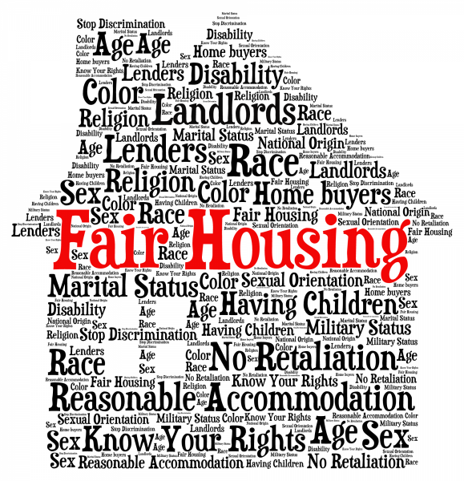
DELAWARE FAIR HOUSING LAW
About Delaware’s Fair Housing Law - Federal Fair Housing laws cover seven protected classes. Delaware’s Fair Housing laws prohibit discrimination on the basis of six additional protected classes. That means Delaware’s Fair Housing laws cover a total of 13 protected classes. That means Delaware’s Fair Housing laws cover a total of 13 protected classes.
Delaware’s protected classes:
Race
Color
National Origin
Familial Status
Sex (Gender)
Disability Status
Marital Status
Sexual Orientation
Gender Identity
Creed
Age
Source of Income
The Delaware Fair Housing Law congruent with Fair Housing Act, Title VIII in terms of what is prohibited under the Fair Housing Law in the areas of; Real Estate transactions, Disability and Public accommodations, and seeking rental housing.

Slide 3
Fair Housing Law Education and Counseling Program
Housing Opportunities of Northern DE.INC (HOND) was created non-profit Fair Housing Advocacy Agency. (November, 1981). The agency was charged to advocate and educate City of Wilmington and New Castle County Families as they seek housing (rental, sales, acquiring a mortgage, acquiring home owners insurance, or selling their homes).
HOND’s Fair Housing Law program services:
Fair Housing Law education program includes: U.S. Fair Housing Act, Title VIII; (1968; 1988); Delaware Fair Housing Law (1992) (2018; 2019).
HOND, INC provides Fair Housing Law education workshops/ seminars to educate Delawareans about the purpose of the Fair Housing Law and how to prevent housing discrimination.
To provide the resources and where to file a complaint when appropriate.
HOND also provides an Annual Fair Housing Law Forum with such topics as: “Court Ordered process; Mediation and Fair Housing Law”; “Predatory Lending and Mortgage Discrimination”; “Housing Discrimination vs Tenant / Landlord Code (Rights and Responsibilities)”; “Fair Housing Law 101”.
Annual Fair Housing Law Observance and Awards Symposium:
To provide our constituents information about the “Statewide Fair Housing Analysis and Impediments Study”. The symposium is designed to educate housing developers, housing professionals, housing counselors, Public Officials and consumers about preventive measures to eradicate housing discrimination.
Targeted Audience: Clients, Government employees, Real Estate agents, real estate attorneys, lending consultants, appraisers, Public Officials, housing counselors, and community organizations Statewide. HOND, INC partners with Delaware State Human Relations, Wilmington Housing Authority, US Department of HUD, National Fair Housing Alliance (NFHA), HomeFree USA, New Castle County, City of Wilmington, Delaware State Housing Authority, Delaware Federation of Housing Counselors and local financial institutions.

Slide 4
CERTIFIED HOUSING COUNSELING PROGRAMS
First Time Homebuyer Certified Housing Counseling Certificate
Homebuyer Education program is an eight hour course that covers the basics of home buying, i.e. household budgeting, credit awareness, shopping for a house, obtaining a mortgage, maintaining the home to avoid foreclosure and Fair Housing rights.
Homebuyer Education pre-purchase counseling is provided in both group and individual sessions.
One-on-one counseling includes developing a personal action plan to overcome obstacles to achieve goals.
Fair Housing Education Pre-Purchase Workshops
This workshop covers the fair housing and lending laws. We discuss the seven protected classes covered under the Fair Housing Act and discrimination with regard to mortgage loans. We give examples of discrimination and the actions to take if discrimination occurs. We cover how to file a Fair Housing complaint beginning with our local government.

Slide 5
Fair Housing Law Education and Counseling Program
Housing Opportunities of Northern DE.INC (HOND) was created non-profit Fair Housing Advocacy Agency. (November, 1981). The agency was charged to advocate and educate City of Wilmington and New Castle County Families as they seek housing (rental, sales, acquiring a mortgage, acquiring home owners insurance, or selling their homes).
HOND’s Fair Housing Law program services:
Fair Housing Law education program includes: U.S. Fair Housing Act, Title VIII; (1968; 1988); Delaware Fair Housing Law (1992) (2018; 2019).
HOND, INC provides Fair Housing Law education workshops/ seminars to educate Delawareans about the purpose of the Fair Housing Law and how to prevent housing discrimination.
To provide the resources and where to file a complaint when appropriate.
HOND also provides an Annual Fair Housing Law Forum with such topics as: “Court Ordered process; Mediation and Fair Housing Law”; “Predatory Lending and Mortgage Discrimination”; “Housing Discrimination vs Tenant / Landlord Code (Rights and Responsibilities)”; “Fair Housing Law 101”.
Annual Fair Housing Law Observance and Awards Symposium:
To provide our constituents information about the “Statewide Fair Housing Analysis and Impediments Study”. The symposium is designed to educate housing developers, housing professionals, housing counselors, Public Officials and consumers about preventive measures to eradicate housing discrimination.
Targeted Audience: Clients, Government employees, Real Estate agents, real estate attorneys, lending consultants, appraisers, Public Officials, housing counselors, and community organizations Statewide. HOND, INC partners with Delaware State Human Relations, Wilmington Housing Authority, US Department of HUD, National Fair Housing Alliance (NFHA), HomeFree USA, New Castle County, City of Wilmington, Delaware State Housing Authority, Delaware Federation of Housing Counselors and local financial institutions.

Slide 6


Slide 7
CERTIFIED HOUSING COUNSELING PROGRAMS
First Time Homebuyer Certified Housing Counseling Certificate
Homebuyer Education program is an eight hour course that covers the basics of home buying, i.e. household budgeting, credit awareness, shopping for a house, obtaining a mortgage, maintaining the home to avoid foreclosure and Fair Housing rights.
Homebuyer Education pre-purchase counseling is provided in both group and individual sessions.
One-on-one counseling includes developing a personal action plan to overcome obstacles to achieve goals.
Fair Housing Education Pre-Purchase Workshops
This workshop covers the fair housing and lending laws. We discuss the seven protected classes covered under the Fair Housing Act and discrimination with regard to mortgage loans. We give examples of discrimination and the actions to take if discrimination occurs. We cover how to file a Fair Housing complaint beginning with our local government.

Slide 8
Mortgage Delinquency and Default Resolution Counseling
HOND offers one-on-one counseling designed to help homeowners resolve mortgage delinquency and/or prevent foreclosure.
HOND’s housing counselors will typically work with clients to achieve the following:
Loss mitigation
Forbearance
Loan Modification
Partial Claim
Repayment Plan
Deed in Lieu
Short Sale
Additional Assistance with Mediation process to prevent foreclosure sales is offered also.

Slide 9
Credit/Budget Management Counseling
Purpose of the program is to promote prosperity for Delawareans, especially Low to Moderate Income (LM) and neighborhoods; Utilizing Financial literacy education, counseling/coaching. Program will address budgeting, financial basics including banking, credit, loans and identity theft.
Financial Literacy Counseling: Counselor will provide financial counseling/coaching (Financial Literacy) that will help clients stabilize their finances, rebuild credit and establish a savings plan. Clients will identify their financial goal to achieve and the counselor will assist client by creating an Action Plan to achieve their goals.

Slide 10
Q&A
Save the Date:
Date: June 4, 2021
Event: 24th Annual Fair Housing Law Forum - Fair Housing Law 101
Location: ZOOM
Contact Information:
Housing Opportunities of Northern Delaware, Inc.
Gladys B. Spikes
Executive Director
100 West 10th Street
Suite 1001
Wilmington, DE 19801
(302) 429-0794 Office
(302) 429-0795 Fax
Spikes@hond.org
www.hond.org
Thanks

