Slide 1
Health Education, Lifestyle Interventions, and Early Detection of Cognitive Impairment:
The Mission of our “Memory Ambassadors”
James M. Ellison MD, MPH
Swank Foundation Endowed Chair in Memory Care and Geriatrics
Professor of Psychiatry and Behavior, Sidney Kimmel Medical College, Thomas Jefferson University
Jennifer Rittereiser MPH
Program Director, Memory Ambassadors

Slide 2


Slide 3
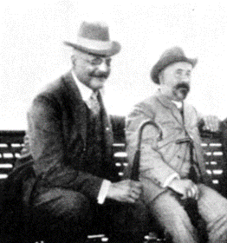
From Discovery to Prevention, Our
Understanding of Dementia has Come a Long Way.
113 years since Dr Alzheimer described the dementia that bears his name.
It is our “hidden pandemic”.
We know a little about its origins, inheritance, and demographics.
We know a lot about healthy vs unhealthy physical and cognitive aging and progression of cognitive decline.

Slide 4
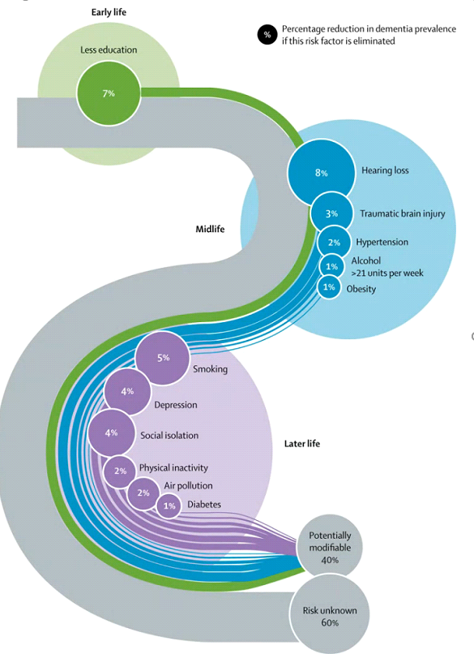
WHO Now Considers Up To 40% Of
Dementia Cases Could Be Delayed or Prevented
New to risk factor model:
  TBI
  Alcohol Use (>21 u/wk)
  Air Pollution
Less education
Hearing Loss
TBI
HT
Alcohol > 21 u/wk
Obesity
Smoking
Depression
Social isolation
Physical inactivity
Air pollution
Diabetes
Potentially modifiable risk = 40%

Slide 5
Notes:
150 minutes per week
Nutrition: med diet, fruits, vegetable
Books /puzzles

Slide 6
What is the Swank Center?
Delaware’s first and largest program for assessment, diagnosis, and management of people with neurocognitive disorders.
Holistic, interdisciplinary, and multifaceted
Our Mission: To Improve the detection and care of all older adults with neurocognitive disorders, beginning in Delaware.

Slide 7
Swank Center’s 3 Dimensions
Clinical services: Evaluation, Consultation, Management
Education: Academic presentations, Mentoring, Bedside teaching
Research: Trials, Innovative treatments, Data collection/evaluation

Slide 8
The Swank Memory Ambassadors Program
Memory Wellness Education

Slide 9
Statistics
Population 65 years old and older in DE 185,000
Delawareans with Alzheimer’s Disease 19,000
Number of Caregivers (unpaid) in DE 46,000
Alzheimer’s ED Visits in DE , 2015 28,522
Dementia pts admission to hospice in DE, 2016 667
Estimated deaths due to AD in DE, 2017 660
Memory Disorder Clinics in DE 2
Geriatric Psychiatrists in DE 3
Inpatient Geriatric Psychiatry Units in DE 4

Slide 10
Did You Know?
The average caregiver is a woman in her 40s who is married, employed and caring for her 60+ year old mother who does not live with her.
The risk is 1.5 times higher for individuals who identify as Hispanic/Latino, and 2-3 times higher for those who identify as Black or African-American than for non-Hispanic whites.
Nearly two-thirds of Americans with Alzheimer’s disease are women.
In her 60s, a woman’s estimated lifetime risk for developing Alzheimer’s disease is 1 in 6. Compare that to a 1 in 11 risk of developing breast cancer.

Slide 11
T00 Few Assessments
Alzheimer's Association surveys regarding brief cognitive assessments for detection of dementia found that while a large majority of seniors and primary care physicians say the assessments are important, only half of seniors have received an assessment, and only 16 percent of seniors receive regular cognitive assessments. Many educational opportunities (2019)
Notes:
*The current estimate for the US has increased from 5.8 million to 6.2 million

Slide 12

Who Are The Memory Ambassadors
Screeners are qualified and trained
Via ZOOM:
We facilitate free, confidential memory screenings in the community
Provide educational materials and community resources about memory loss, dementia, caregiving, and healthy aging
Recommend follow up with a complete medical exam by a qualified healthcare professional depending on results
Share results with primary care provider with patient’s permission
Notes:
Name and brief explanation of AD8 and Mini Cog

Slide 13
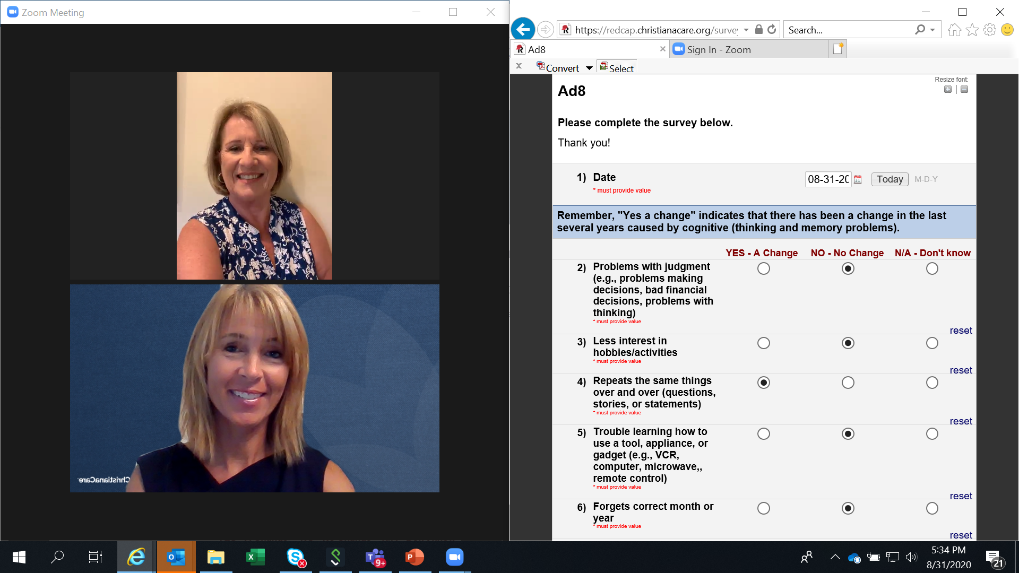
Virtual Rooms for Individual, Confidential Memory Screenings
Notes:
Memory Ambassadors – Jennifer Rittereiser
Example of a virtual breakout room for individual, confidential memory screenings. Participant and Screener one side / screening tool on other side of screen. Participant sees all 3 images.

Slide 14
Dear Care Provider: Patient Name:____________________ DOB:_______
Your patient participated in a Memory Screening on ____­­­­­______________. She / He requested that we share the screening results with you, as her/his Primary Care Provider.
AD8 Score: ____________ (score of 2 or higher suggests clinically significant cognitive difficulties)
Mini-Cog Score: ________ (score less than 4 suggests clinically significant cognitive impairment)
When significant cognitive impairment is present, we recommend, if you have not already done so, a standard cognitive assessment. This can occur in primary care. If you would like discussion or want to make a referral to the Swank Center, please feel free to contact Jennifer Rittereiser, Program Director, at 302-320-9403.
Respectfully,
James Ellison, MD, MPH
Swank Foundation Endowed Chair in Memory Care and Geriatrics
Swank Center for Memory Care and Geriatrics

Slide 15
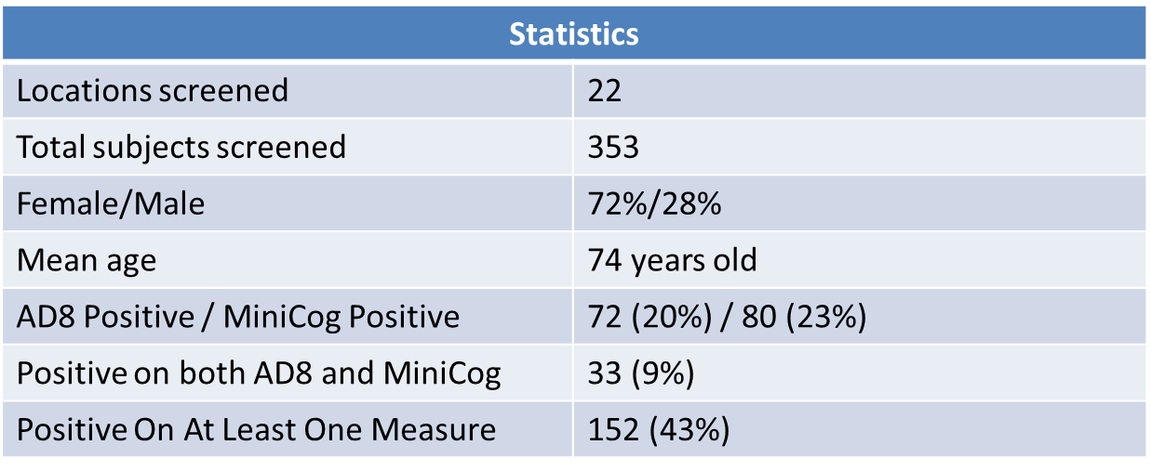
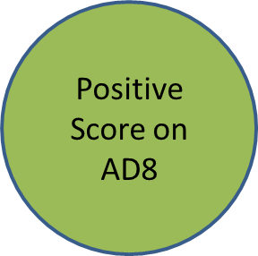
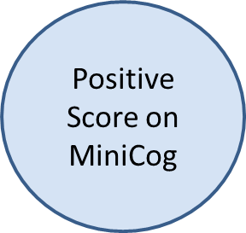
2019 Ambassador Statistics

Slide 16
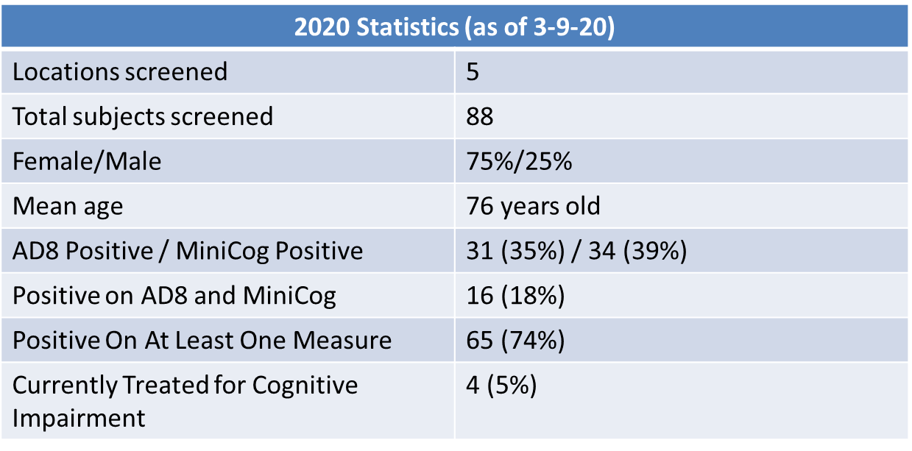
2020 Ambassador Statistics

Slide 17
https://christianacare.org/services/seniors/swankmemorycare/swank-memory-ambassadors-program/
JENNIFER Rittereiser, Program Director
Jrittereiser@Christianacare.org
Register at the Swank Memory Ambassadors
Web Page

Slide 18

Questions/Discussion
This Photo by Unknown Author is licensed under CC BY-SA

