Slide 1
Community Intervention Team
A Community-Based Prevention and Intervention Program
December 14, 2020

Slide 2
INTRODUCTIONS

Slide 3
WHAT IS C.I.T
Grassroots organization—views violence as a public health issue
Employ street-identified and credible messengers
Health Navigators mediate conflicts and prevent retaliatory violence
Notes:
Street Outreach treats gun violence as a public health issue.
Programs employ street-identified, credible messengers to interrupt the spread of violence among communities.
Street Outreach Workers mediate conflicts and prevent retaliatory violence.

Slide 4
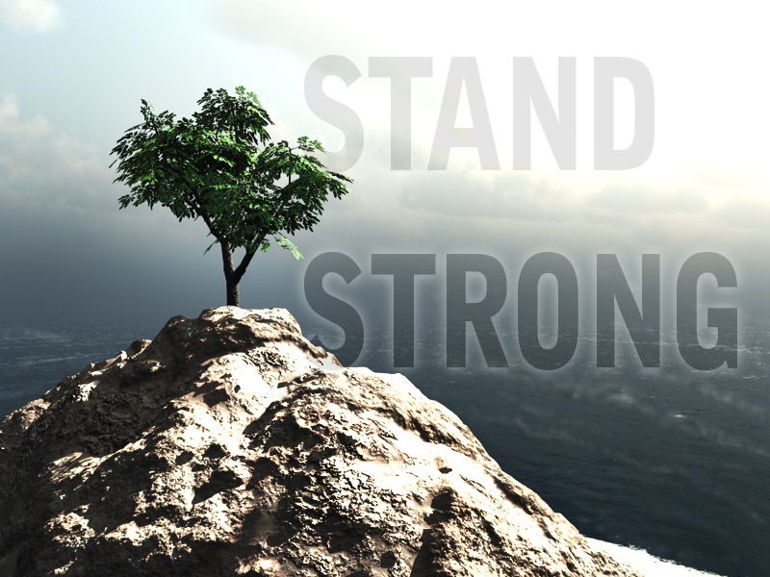
THE P.A.R. FAMILY
Notes:
Theoretical framework-not the community violence prevention program from the late 90s, compassion

Slide 5
COMMUNITY OF PARTNERS
Notes:
School-Learning Pods United Way, All the superintendents, Great Oaks, Matt Meyer New Castle County
Employment—The state Ray Fitzgerald, Kevin Kelley
Wilmington Alliance and the Longwood Foundation

Slide 6
OUTCOMES ARE IMPORTANT
At least 50% of clients avoid arrest for gun violence
At least 50% of clients avoid shooting (re)victimization
At least 60% of clients make progress on case management plan
All youth maintain a 2.0 GPA
Increase in school attendance
Decrease in disciplinary infractions
Notes:
Not the old traditional program, the naïve person wants to simply look how many shootings and homicides happen….dangerous and should interrupted with caution. Example
At least 60% of clients making progress on identified case management plan
At least 50% of clients avoid arrest for gun related crimes
At least 50% of clients avoid shooting victimization/revictimization

Slide 7
PROGRAMS
Y.E.S. (Youth Empowerment Solutions)
Workforce Development
Learning Pod
Afterschool tutorial service
S.A.V.E. (Sisters Against Violence thru Education)
Character Count: 6 Pillars T.R.R.F.C.C.
Notes:
Family Reunification
Trauma Presentations

Slide 8
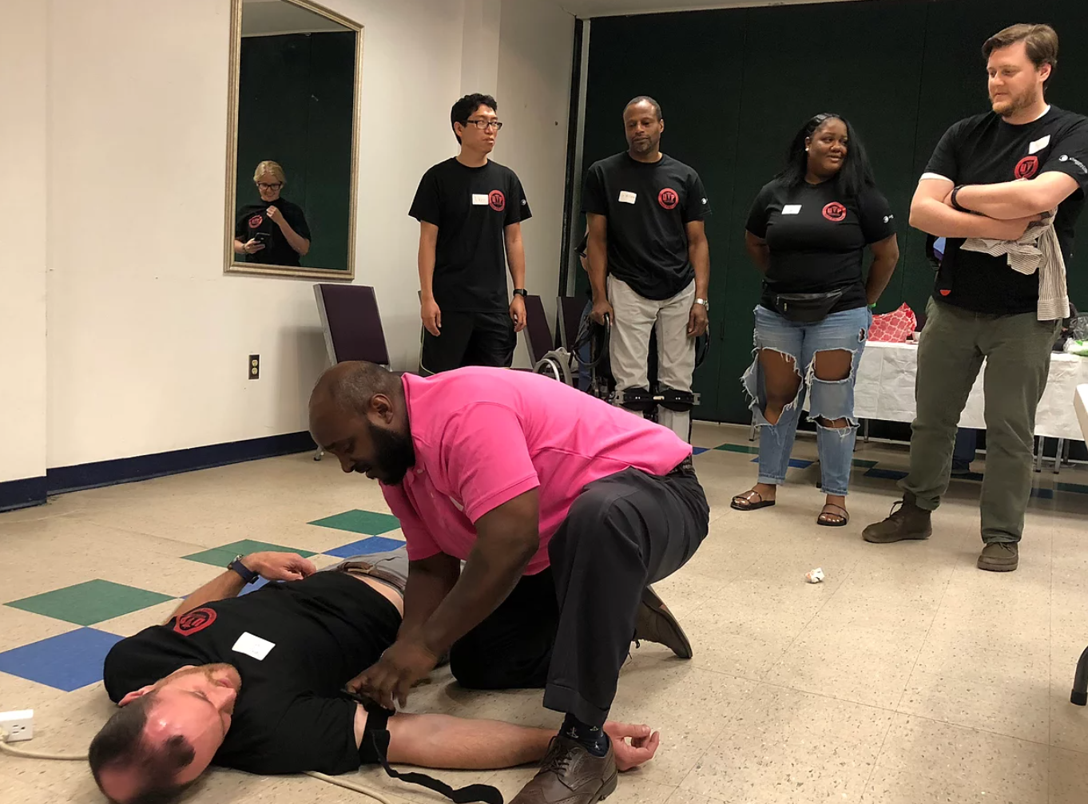
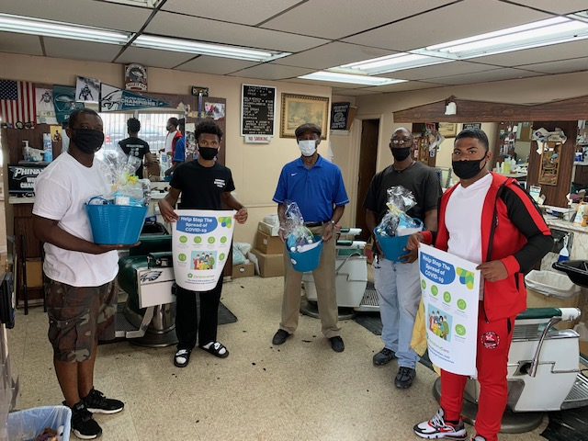
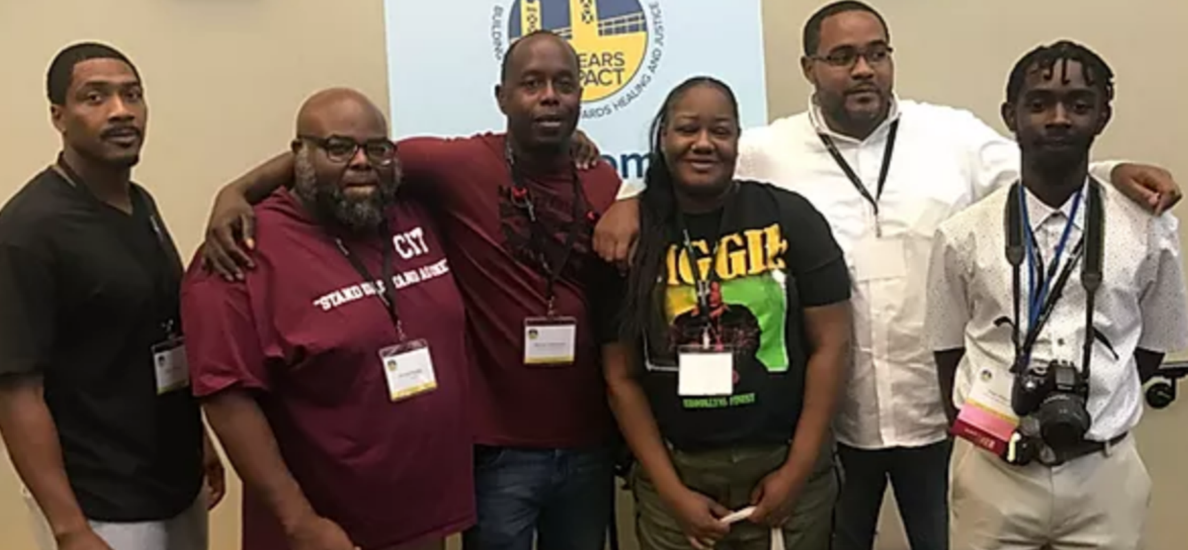
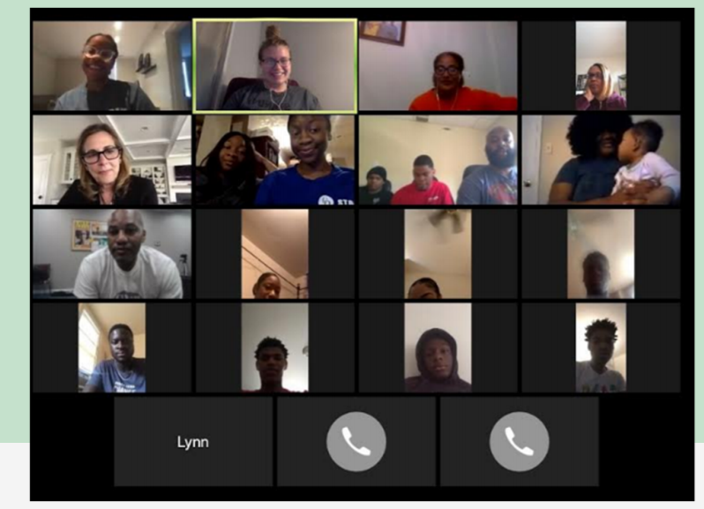
C.I.T in Action

Slide 9
THANK YOU

