Slide 1
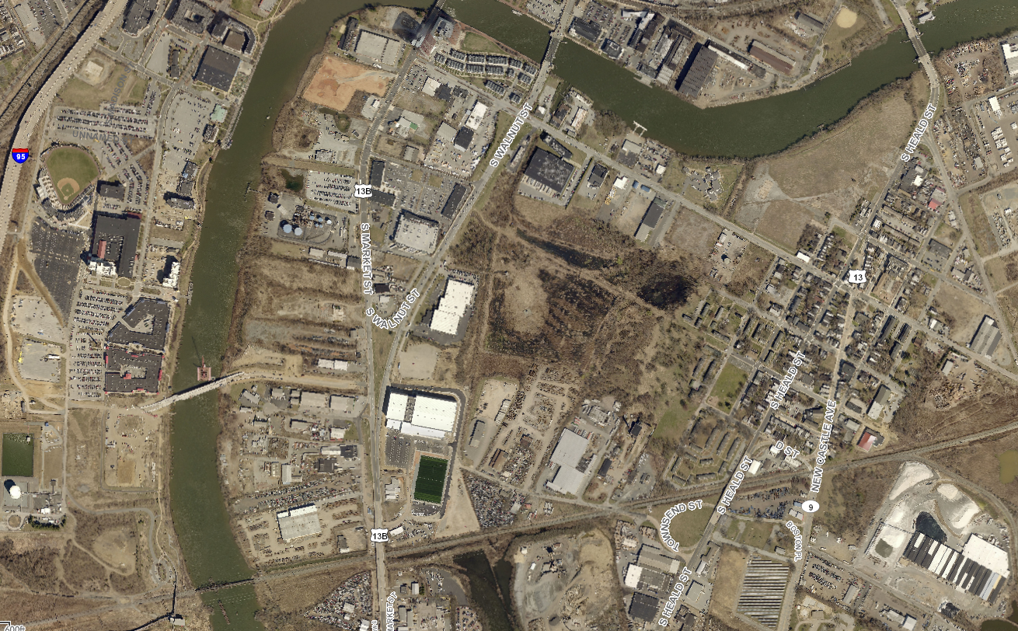
South Wilmington Wetlands Park
Christina River Bridge
615 S Church St
76ers Fieldhouse

Slide 2
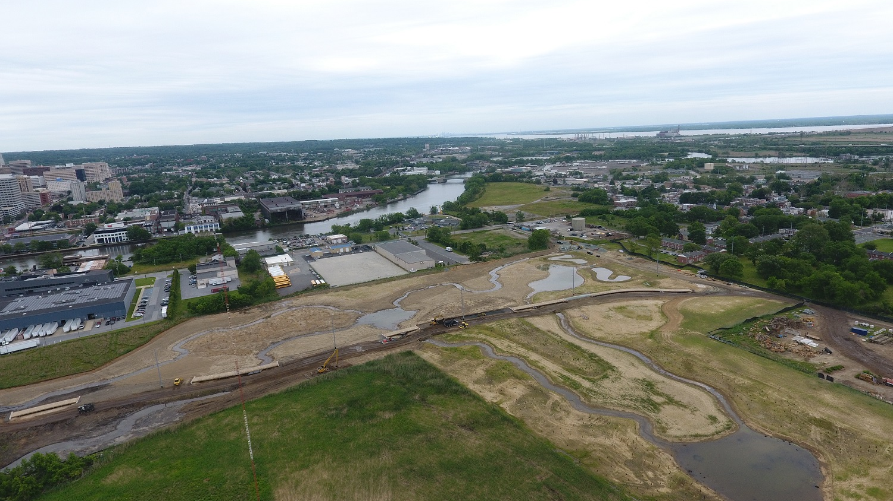

Slide 3
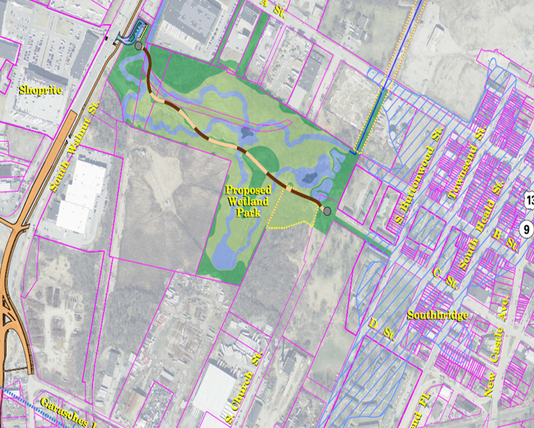

Slide 4
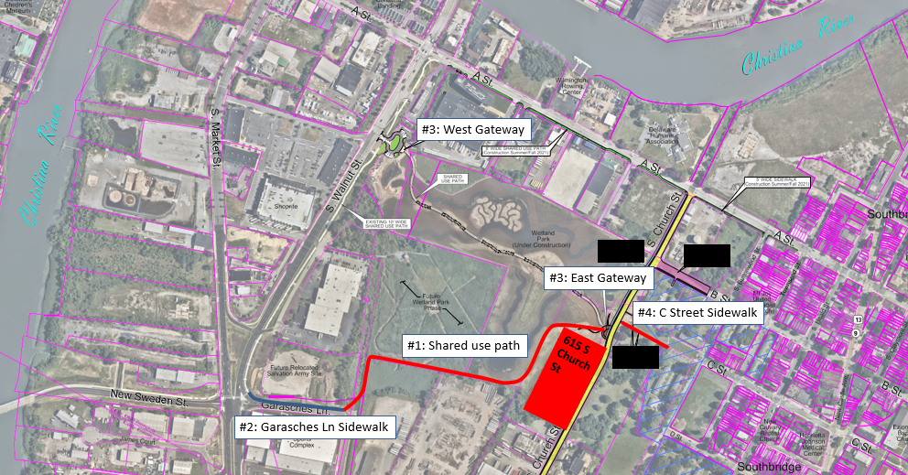

Slide 5
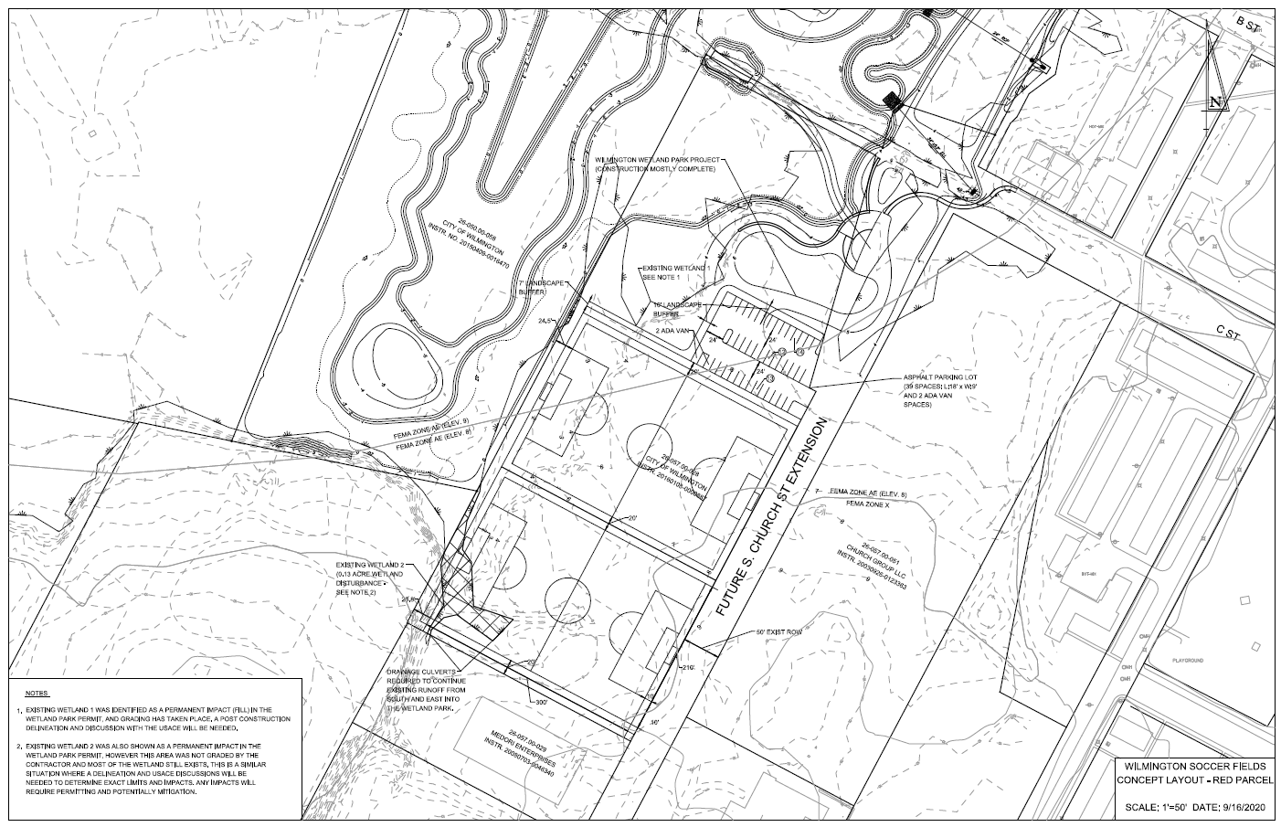

Slide 6
