Slide 1
Community Development and Urban Planning Committee
Ordinance 20-036
September 2, 2020

Slide 2
Ordinance 20-036
ORD. 20-036 An Ordinance to Rezone the Parcels of Land Located at (i) 1914, 1920, 2004, and 2006 North Market Street; (ii) 50 Race Street; and (iii) 1901, 1903, 1905, 1907, 1915, 1925, 1927, and 1929 Hutton Street from C-1 (Neighborhood Shopping) Zoning Classification to C-2 (Secondary Business Centers) Zoning Classification

Slide 3
Background
Sacred Heart Housing, Inc. applied for the rezoning of the properties C-1 to C-2.
The applicant, Sacred Heart Housing, Inc. is the contract purchaser and equitable owner of the properties. The properties are owned by Brandywine Village LLC and BVII, LLC.
Market Street buildings are vacant and the adjacent Hutton Street properties are partially paved vacant lots.
Low to moderate income senior apartments are proposed for site
Proposal
Demolition of 1914, 1920, 2004 and 2006 North Market Street
Development of a new three-story mixed-use building with ground floor commercial storefronts along North Market Street and upper story apartments.
A new four-story apartment building along Hutton Street will be constructed including a roof deck and lounge.

Slide 4
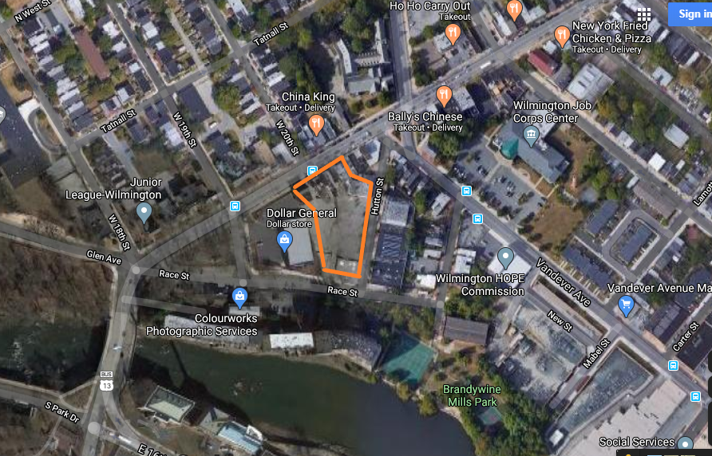
Existing Land Use

Slide 5
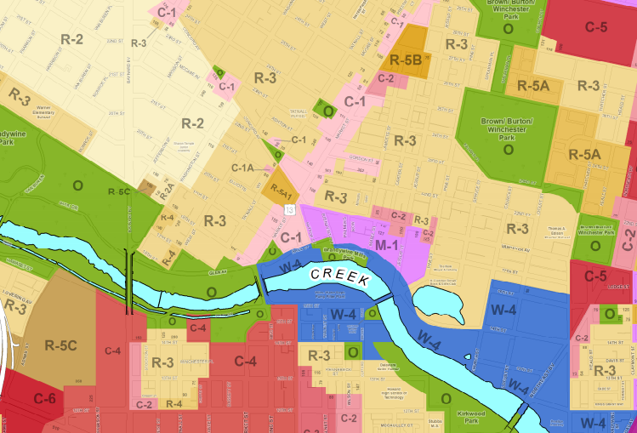
Zoning

Slide 6
Existing/Proposed Zoning
Existing Zoning
C-1 Neighborhood Shopping
Designed to provide sites for convenient retail and personal service establishments for a small tributary are.
Residential uses are limited to two families per floor which would not support the proposed development.
Proposed Zoning
C-2 Secondary Business Commercial Centers
Located along major corridors
Designed to permit neighborhood commercial establishments
Heights are limited to 15 stories
Residential Density will support the proposed development
C-2 Zoning is established along North Market Street beginning at 34th Street, however that is the closest C-2 zoning along the corridor.

Slide 7
Surrounding Zoning
O Open Space
Small passive park located directly south of the proposed rezoning.
R-3 One Family Row Houses
One Family Row Houses limited to 3 stories.
Institutional uses such as schools, community centers and hospitals.
W-4 Waterfront Residential Commercial
Medium to high density residential, retail and office development can take place.
Mixed-use buildings are permitted with a limited number of commercial uses.

Slide 8
Comprehensive Development Plan
Wilmington 2028: A Comprehensive Plan for our City and Communities
No Amendments to Comprehensive Plan as part of this zoning action
C-2 Zoning is consistent with the land use recommendation in Wilmington 2028
Plan calls for Neighborhood Mixed Use which C-2 supports.
This rezoning also supports several objectives of the Prices Run/Riverside/11th Street Bridge and Baynard Boulevard sections of Wilmington 2028.
  Prevent nuisance properties and stabilize vacant properties.
  Make neighborhood commercial corridors and centers clean, safe and attractive.
  Enhance the attractiveness of city gateways.
  Enhance Concord Avenue and North Market Street as attractive gateway corridors.

Slide 9
Brandywine Village National Register Historic District
Area was added to the National Register of Historic Places in 1971. This is different then a City Historic District.
Greater Brandywine Village Urban Renewal Plan was adopted in 2001.
C-1 limits scale of development to remain in character with the historic district. Heights of buildings are limited to three stories.
C-2 zoning permits heights up to 15 stories which would be out of character with the historic district.

Slide 10
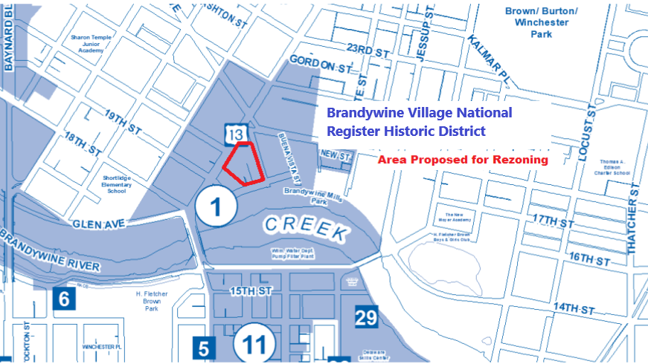
Brandywine Village National Register Historic District

Slide 11
Analysis
Both the current C-1 zoning and the proposed C-2 zoning are consistent with the recommendation of the Comprehensive Plan.
The existing C-1 zoning does not support the proposed development; however the proposed C-2 does support the development.
Neighborhood Mixed Use is appropriate along major corridors.
While no C-2 zoning is in the immediate area, there is C-2 zoning beginning at 34th Street on Market Street.
No nonconforming uses will be created.
The rezoning permits a level of density and heights up to 15 stories that would be out of character with the Brandywine Village National Register Historic District.
In addition, C-2 permits in some cases unlimited hours of operation for some commercial businesses.

Slide 12
Recommendation
On August 18th, 2020 City Planning Commission voted to approve the rezoning of 1914, 1920, 2004 and 2006 N. Market Street; 50 Race Street; and 1901, 1903, 1905, 1907, 1915, 1925, 1927 and 1929 Hutton Street from C-1 (Neighborhood Shopping) to C-2 (Secondary Business Commercial Centers). Zoning Referral 553-20.

