Slide 1

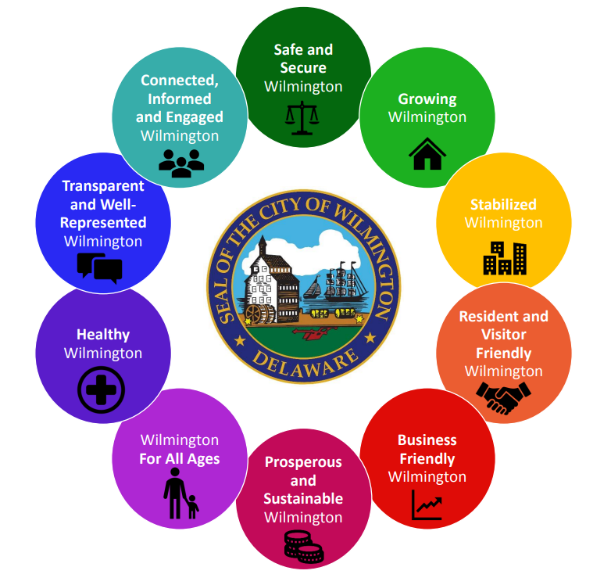
Strategic Planning Process
Survey Update
  This survey seeks to obtain your input regarding:
  The policy and legislative areas District Council Members and At-Large Council Members believe have not been adequately addressed;
  Identifying the current Priority Areas that are affecting your Districts and/or the City-At-Large the most;

Slide 2
Strategic Planning Process
Survey Update
  This survey serves to obtain your input regarding:
  Any proposed changes to the 10 Priority Areas
  Policy(s) or Legislation that that would best address the mission of Standing Committees

Slide 3
Strategic Planning Process
Survey Update
  Completed Surveys are welcomed at the conclusion of this Council Committee Meeting with the last day for submission of completed surveys being Tuesday, March 31, 2020.
  Completed surveys can be submitted to the Receptionist in the Wilmington City Council Office in the Louis L. Redding Building.
  _____________________________________________________
  The results will be synthesized and presented in a report submitted to All Council Members through email and hard copies by the first week in May.

