Slide 1

YOUTH CAREER DEVELOPMENT

Slide 2
Youth Career Development
The City of Wilmington has been providing employment and internship opportunities for youth for over 50 years. The program is open to all household income levels with a focus on youth from lower-income households. By promoting work readiness, career exploration and financial literacy, YCD helps to prepare young people for the adult workforce.
Notes:
In existence for over 50 years
Open to all income levels with a focus on lower-income households
The program promotes work readiness, career exploration and financial literacy
And finally, YCD helps to prepare young people for the adult workforce.

Slide 3


About the YCD Program
Career Pathway Track
(Oct – Apr)
Workforce Track
Internship Track
(Jun-Aug)
Notes:
Started out as the City’s Summer Youth Employment program
2 years ago, we changed the name to Youth Career Development (YCD) after realizing we wanted to do more than just place kids in jobs.
We wanted to provide workforce training in addition to providing a paycheck. So we rebranded and split the summer program into two tracks.
This year, for the first time in the programs existence, we are a year-round youth employment program.
the fall and winter program places emphasis on placing youth, as best we can, in jobs that correspond to their career pathway

Slide 4
YCD Career Pathway Track
City employees approximately 120 youth.
16 – Week Term (October – April).
Salary = $10.00/Hr. - 15 hours per week.
Must be 14-21 years of age.
Placement is based upon the youth’s career pathway or career interest.
Focus is life skills development.
Weekly training provided.
Assigned a youth counselor and Jr Counselor

Slide 5

Protocol
Timeliness
Communication
Respect
Complete Virtual weekly training

Slide 6

PAYROLL
Time sheets are due on Wednesday to your counselor
Sign-In sheet for the previous week is due on Wednesday
Training is paid (1) hour must be completed by Thursday each week
Timesheets will be adjusted for those that do not complete the virtual training
Review the timesheet in your packet

Slide 7
Virtual World
What are your thoughts on learning online?
How has it shaped you outlook on Technology?
https://www.youtube.com/watch?v=ldL9TZbg-5A

Slide 8



Virtual Training
Notes:
In existence for over 50 years
Open to all income levels with a focus on lower-income households
The program promotes work readiness, career exploration and financial literacy
And finally, YCD helps to prepare young people for the adult workforce.

Slide 9
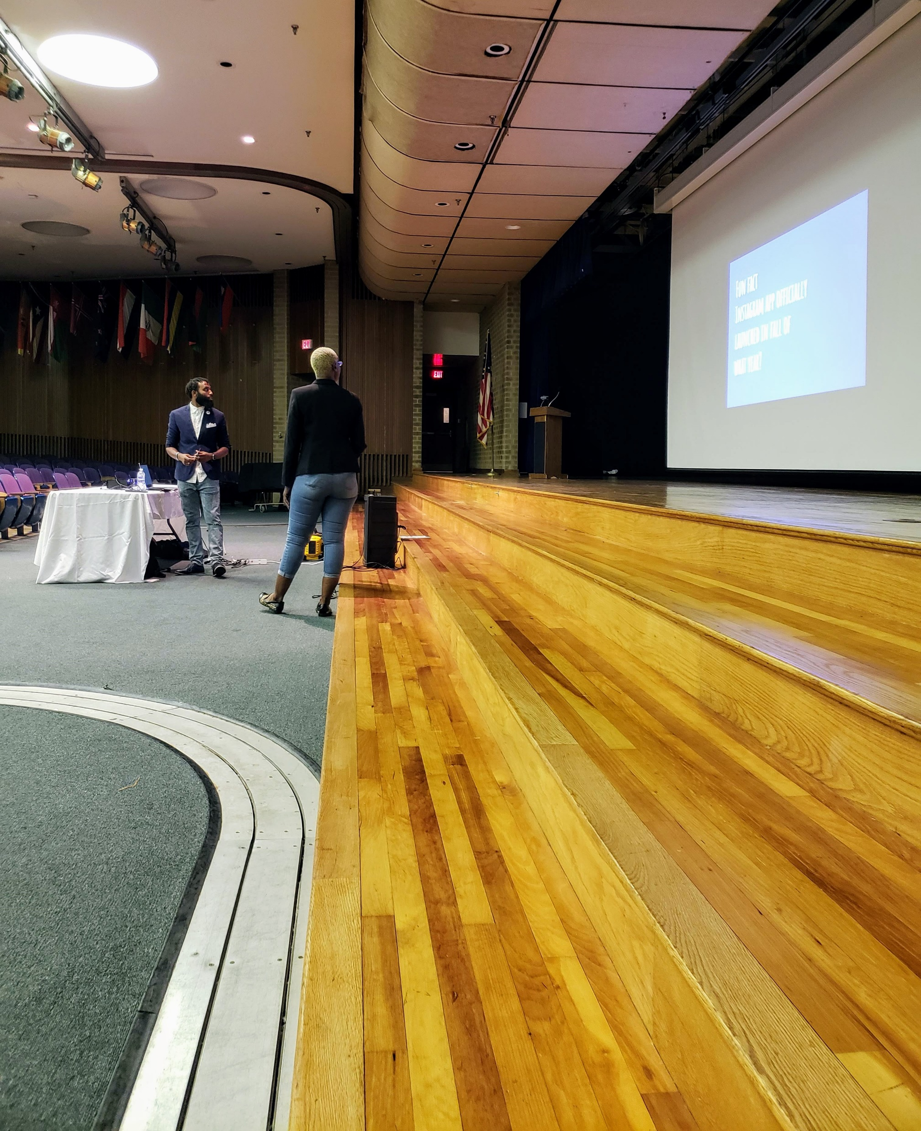

Career Pathway VIRTUAL Training
All three YCD tracks provide training in the following areas:
Work-based learning
Leadership training
Soft skills development
Career readiness.

Slide 10
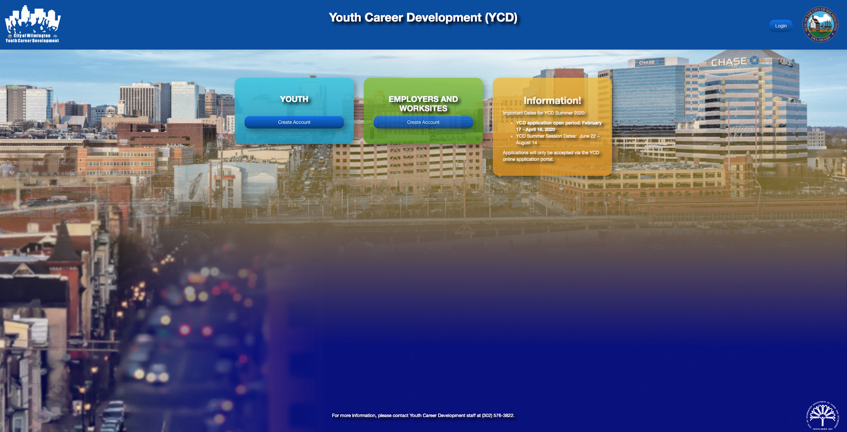
Career Pathway VIRTUAL Training
Login from the main page:
www.wilmingtonyouthjobs.com

Slide 11
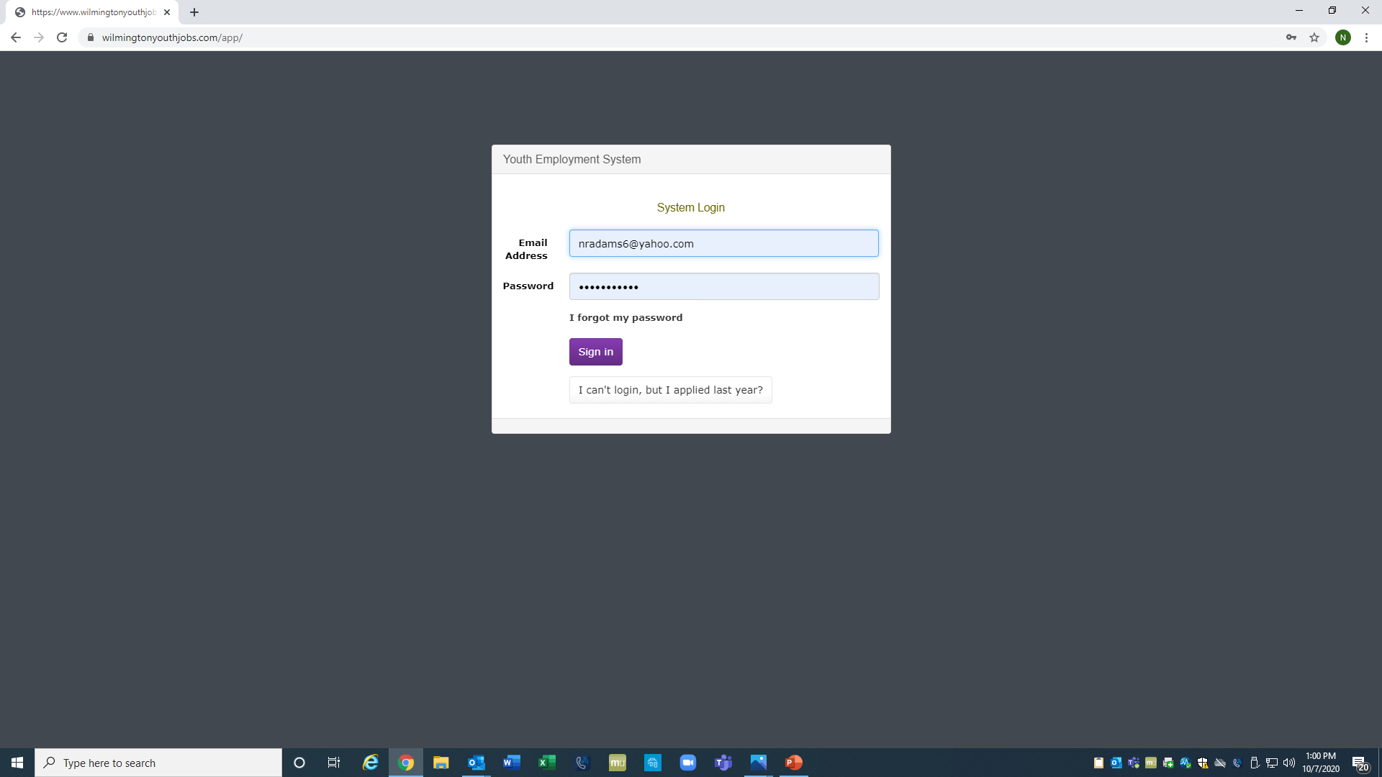
Career Pathway VIRTUAL Training
Login:
Username/password

Slide 12
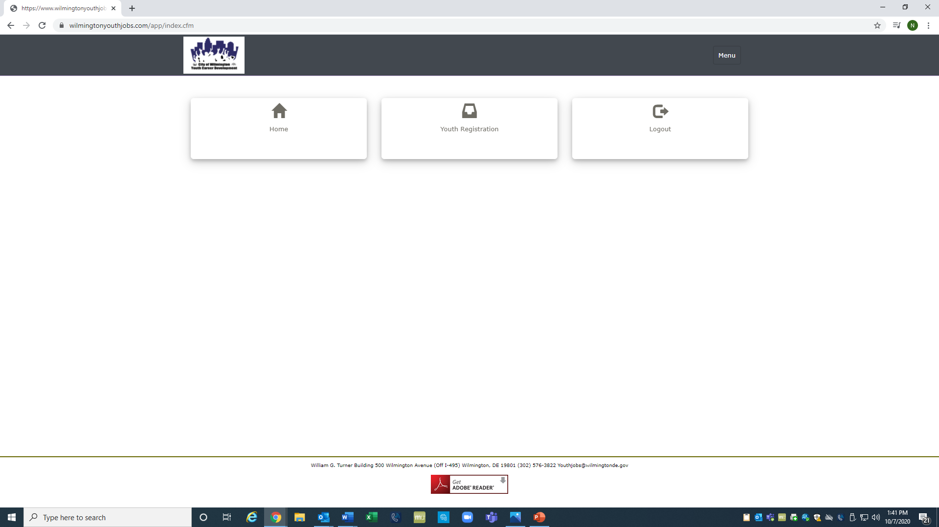
Career Pathway VIRTUAL Training
Select:
Youth Registration

Slide 13
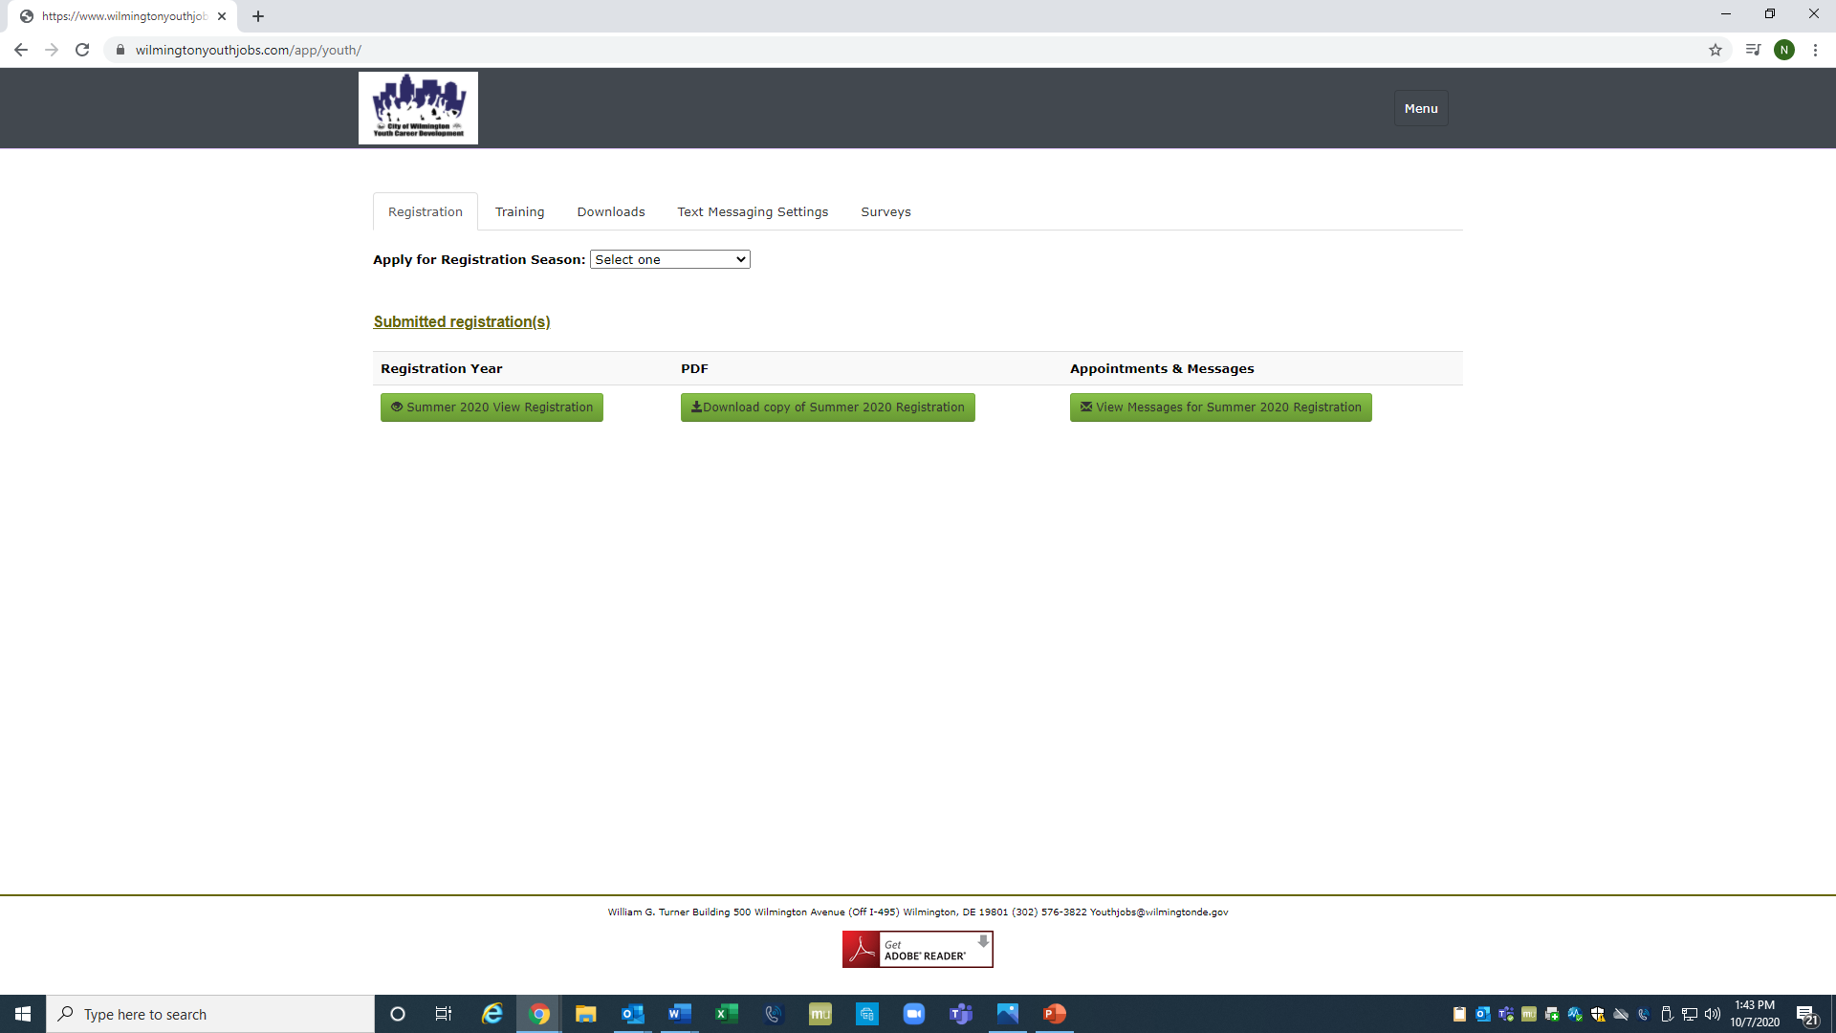
Career Pathway VIRTUAL Training
Select:
Training

Slide 14
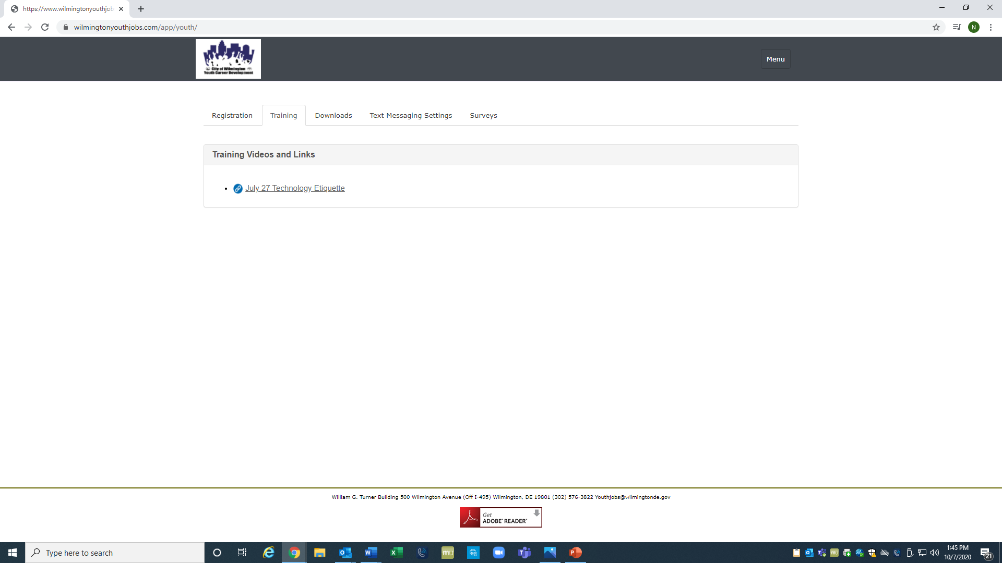
Career Pathway VIRTUAL Training
Select:
Training

Slide 15

Career Pathway VIRTUAL Training
Select:
Downloads
Click for Questions for the week

Slide 16
FALL / WINTER SESSIONS
Organizational Chart
Program Supervisor
Office Assistant
4 Counselors
2 JR Counselors

Slide 17
FALL / WINTER SESSIONS
Cohorts
Cohort 1 October 12-February 12
Cohort 2 November 2-March 5
Cohort 3 December 7-April 2
Holiday Breaks: November 21-27
December 19-25
December 31-January 1

Slide 18
YCD Career Pathway Track
Ms. LaShada Wooten, Counselor
Mr. Jaquine Williams, Counselor
Ms. Charisse Dryden, Counselor
Jr Counselors
Aniyah Daubert
Karizzma Rizzo

Slide 19

Career Pathway Track
Leadership Training
You will be expected to attend an annual Youth Leadership Conference held in January 2021
Employment Skills
Financial Literacy
Career Development
Community Trip

Slide 20

If you have additional Questions, please contact our program office at (302) 576-3822

