Slide 1
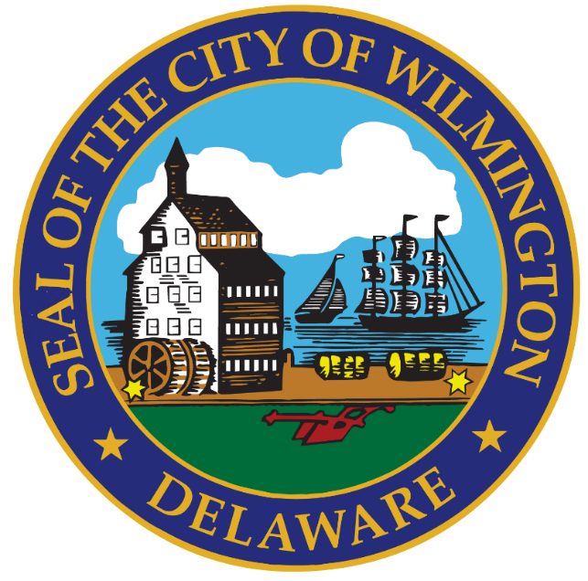
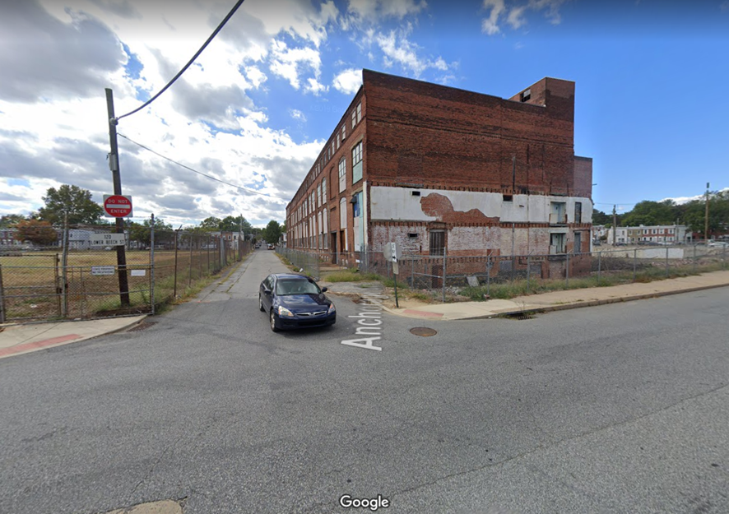
City Council Community Development and Urban Planning Committee September 2, 2020 Ord. 20-038

Slide 3
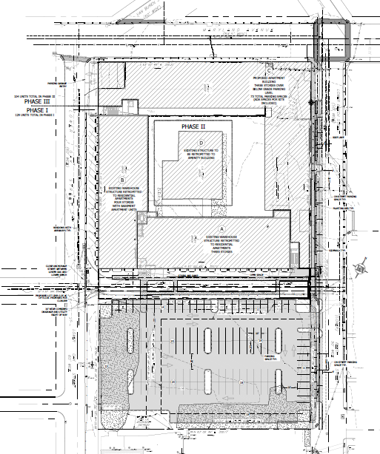
Proposed Redevelopment Plans
Maryland Avenue
New Bldg
Existing Bldgs
Beech Street
Lower Oak Street
Anchorage Street
Surface Parking

Slide 4
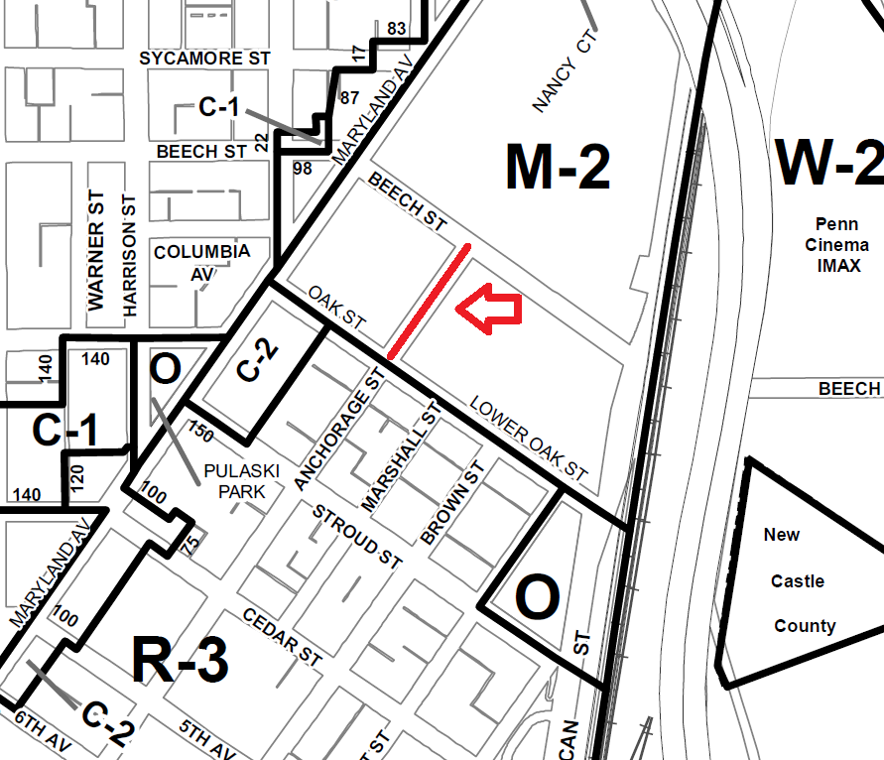
Area Zoning
R-3 One Family Rowhouses
O Open Space
C-1 Neighborhood Shopping
C-2 Secondary Business Centers
M-2 General Industrial
Pennsylvania Ave
Segment
Proposed
to be Removed
Brobson’s Lane
Pasture
Street
Lincoln

Slide 5
Traffic Circulation Patterns

Slide 6
Department Comments
Public Works
8" water main and 65” sewer line within R-O-W require 15’ easements.
Segment is not integral to street network.
City would not be responsible for future street maintenance or lighting.
Supports the street removal request.

Slide 7
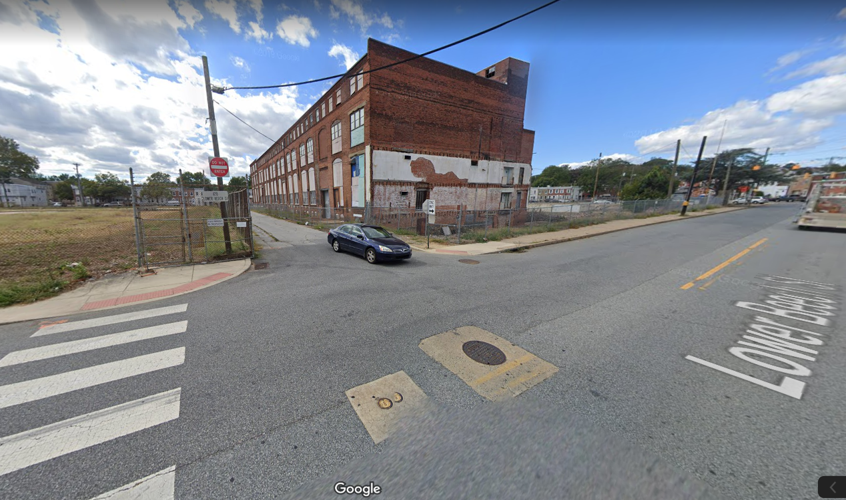
Anchorage Street View from Beech Street Looking Southeast

Slide 8
Fire Marshal’s Office
No comments were received.
Department of Planning
Street does not contribute to general traffic circulation or distribution patterns.
No findings to suggest that R-O-W removal would create detriment to general public or public safety.
Street bed will remain undeveloped, have utility easements, and is not privately owned.

Slide 9
Street Removal / Disposition
City Code Sec. 42-11 (“City Street Closings and Official City Map Revisions”) addresses removal procedures and disposition of R-O-W.
Anchorage Street is owned by the City of Wilmington.
Applicant owns parcels on both sides of street.
Ordinance 20-038 will authorize the street removal and conveyance to abutting property owner.

Slide 10
SUMMARY Planning Commission Approved CPC Res. 10-20 Recommending the Removal of Anchorage Street, between Lower Oak and Beech Streets, from the Official City Map

