Slide 1
COMMUNITY DEVELOPMENT & URBAN PLANNING COMMITTEE
ORDINANCE 20-049
NOVEMBER 12, 2020

Slide 2
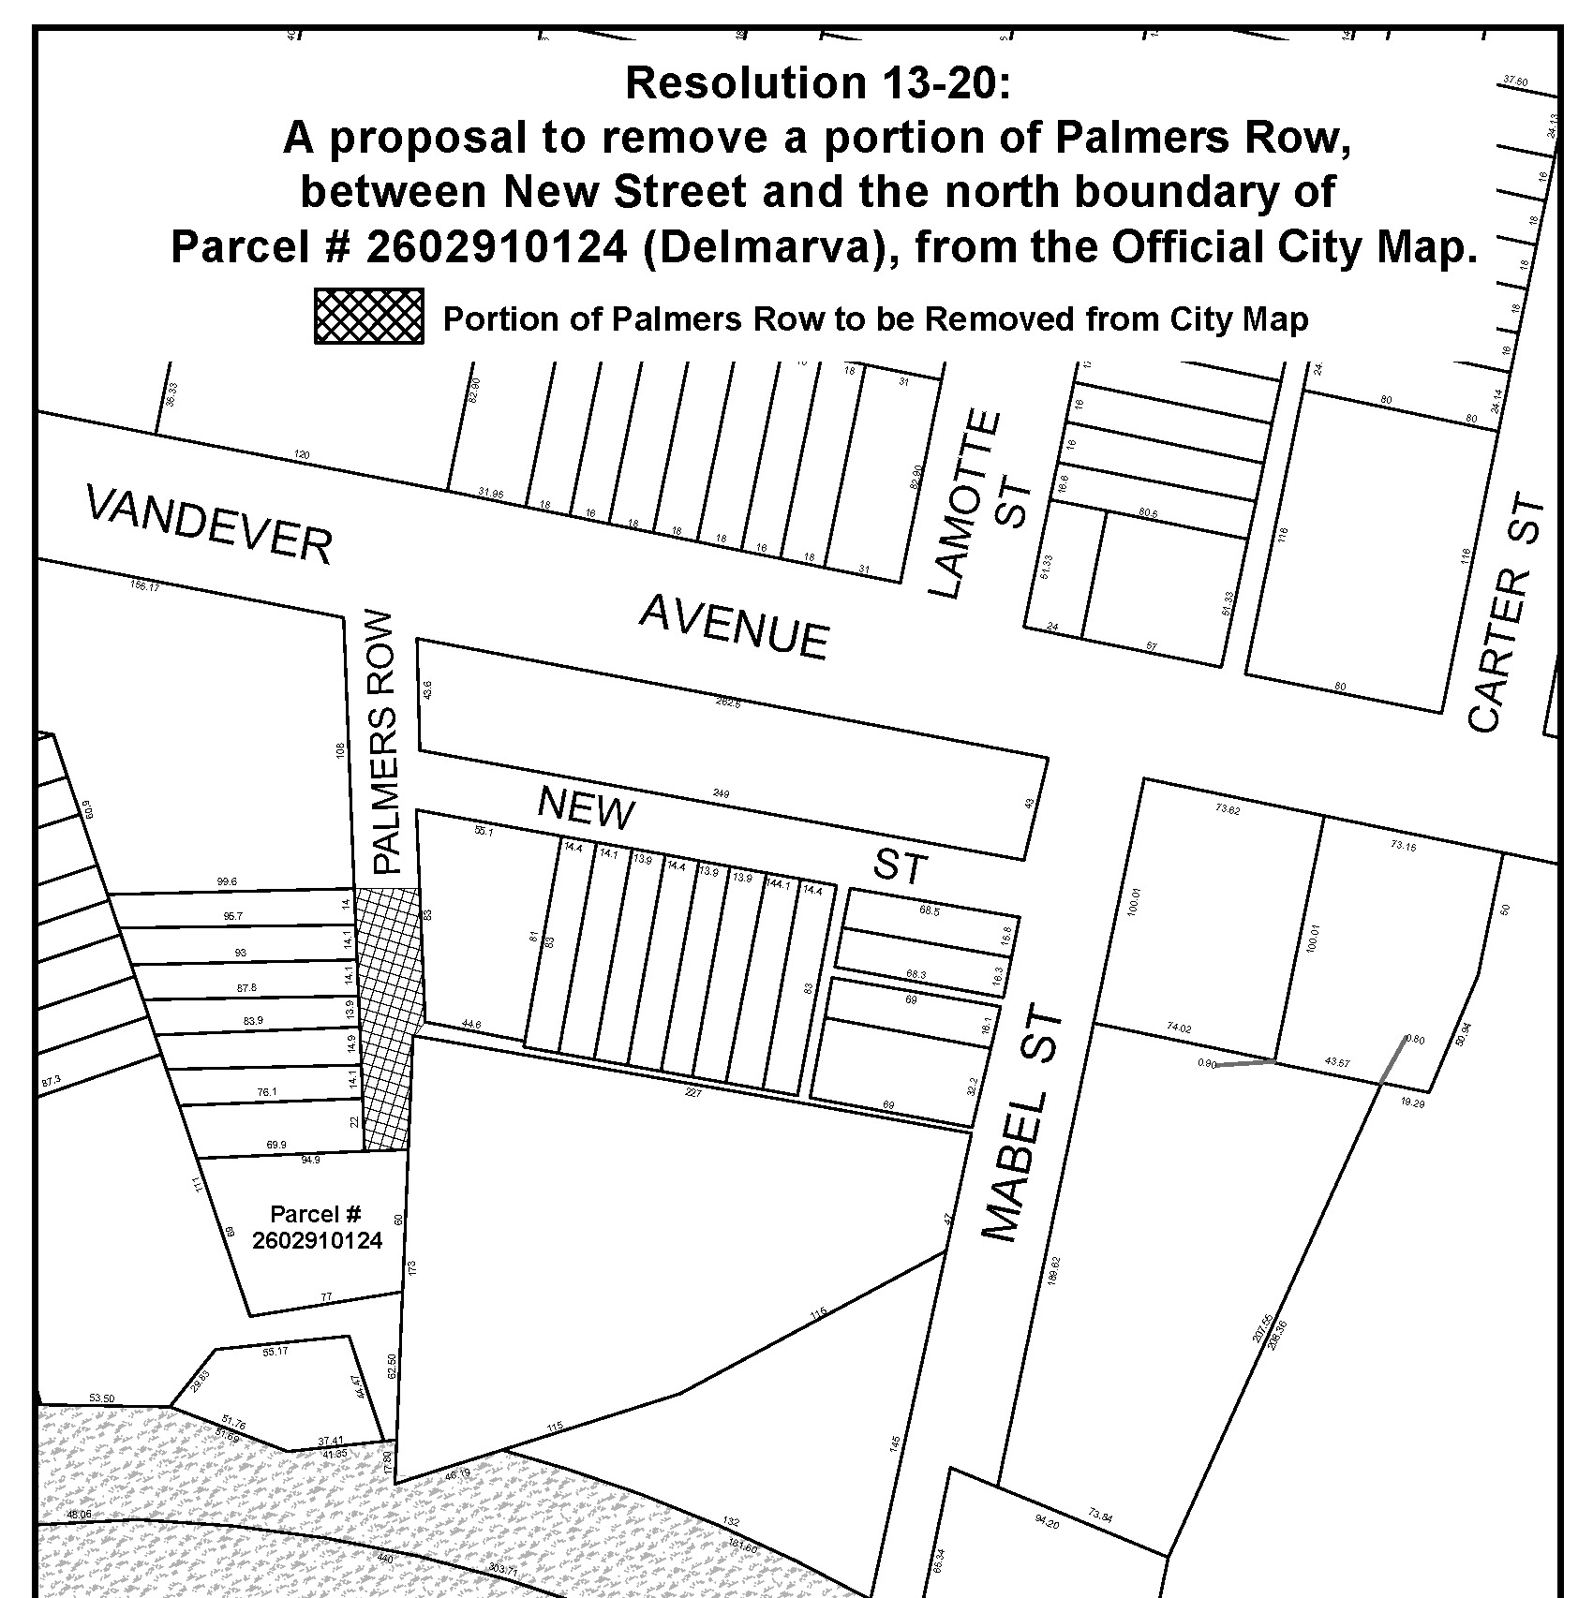

Slide 3
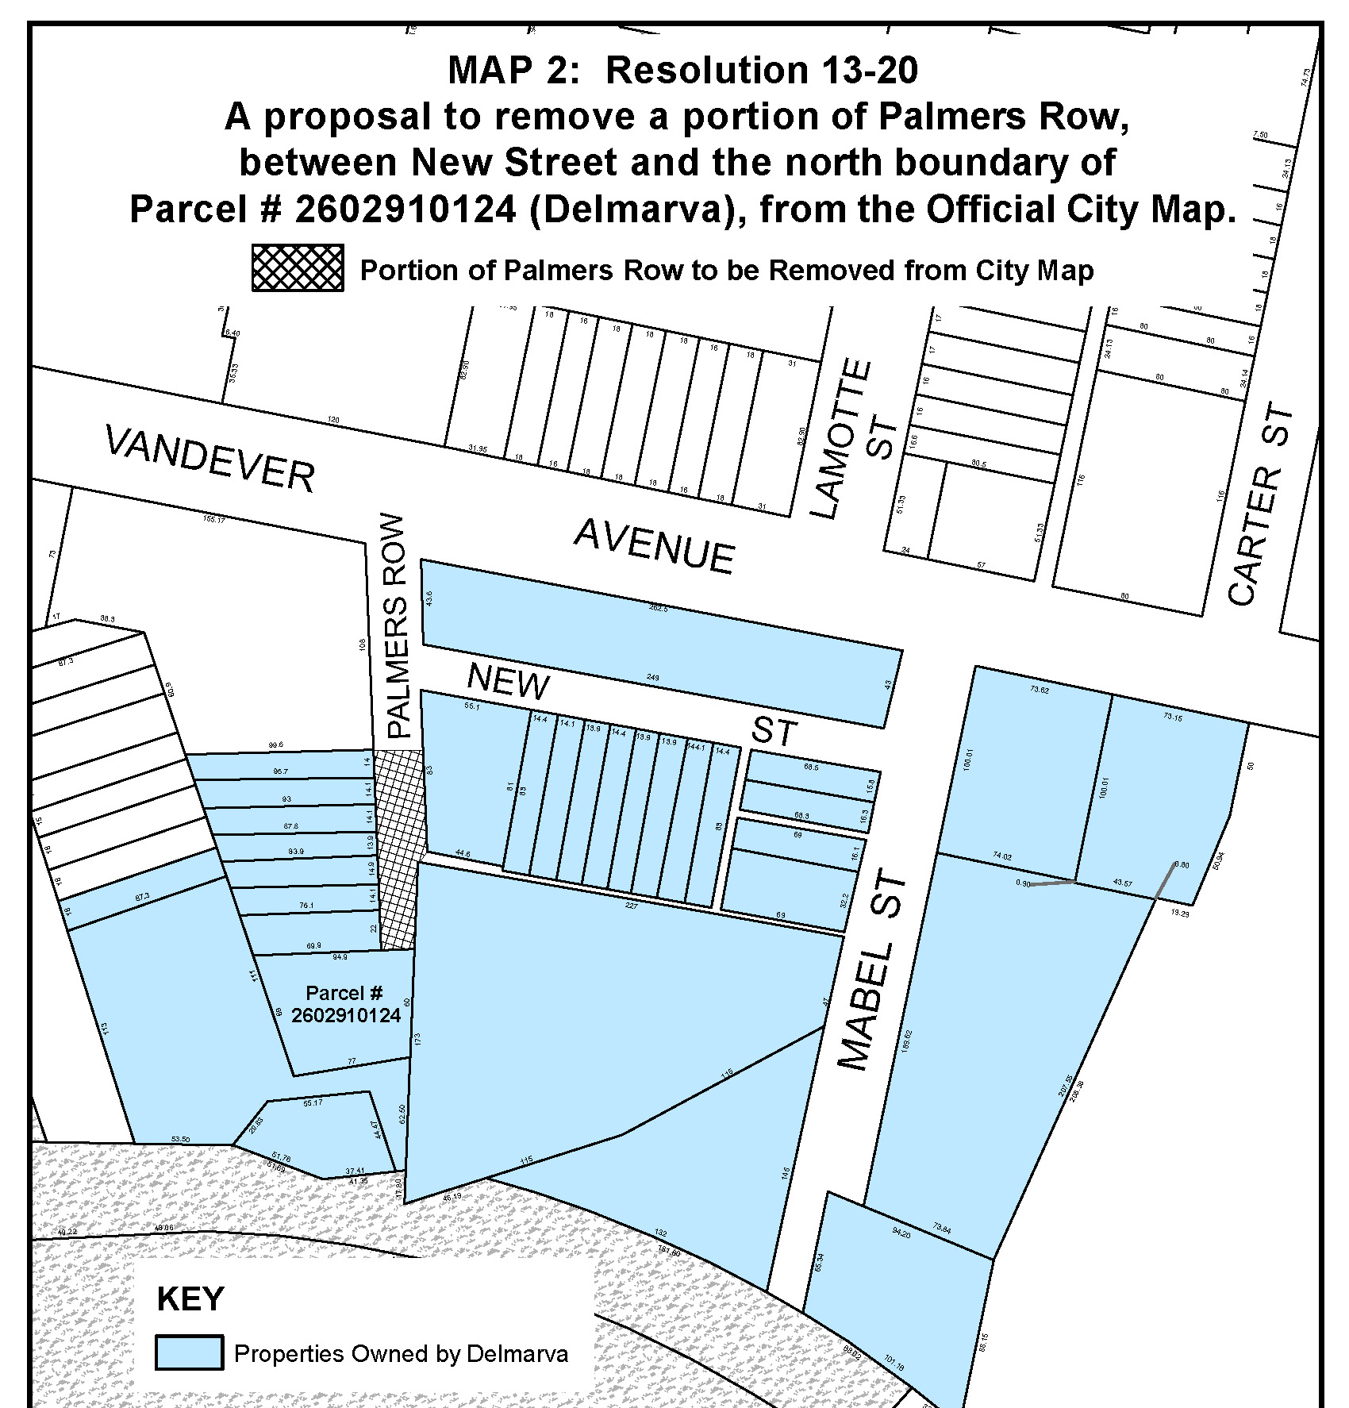

Slide 4
Wilmington
HOPE Commission

Slide 6
Questions?
JESSICA MOLINA
JMOLINA@WILMINGTONDE.GOV

