Slide 1
Community Development and Urban Planning Committee
Ordinance 20-037
September 2, 2020

Slide 2
Ordinance 20-037
ORD. 20-037 An Ordinance to Rezone the Parcels of Land Located at 700 Maryland Avenue, 101 Lower Oak Street, and 120 Lower Beech Street from M-2 (General Industrial) Zoning Classification to C-2 (Secondary Business Centers) Zoning Classification

Slide 3
Background
Reybold Venture Group applied for the rezoning of the NVF Factory and two adjacent properties from M-2 to C-2.
Factory is vacant and two adjacent lots are partially paved vacant lots.
Reybold purchased the factory in 2006 and the adjacent lots in March of 2018.
Market rate apartments are proposed for site
Proposal
Adaptive reuse of factory and new construction apartments along Maryland Avenue and Beech Street.
Open space on the potentially vacated Anchorage Street and parking on the vacant lots located to the east of Anchorage Street.

Slide 4
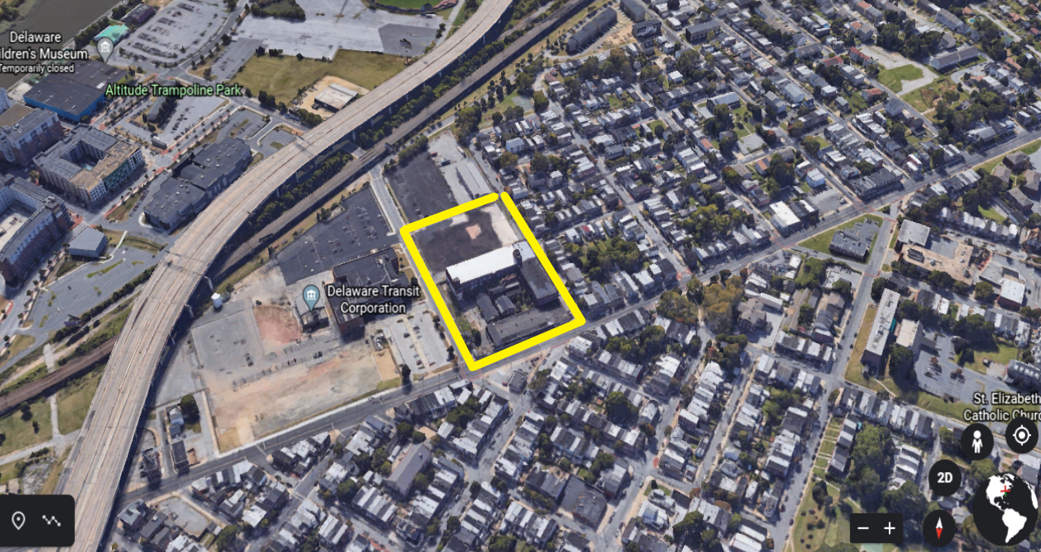
Existing Land Use

Slide 5
Existing/Proposed Zoning
Existing
M-2 General Industrial
Large Scale Industries with little restriction
Heights are limited to four stories
No residential uses are permitted in M-2 districts
Proposed
C-2 Secondary Business Commercial Centers
Located along major highways
Designed to permit neighborhood commercial establishments
Heights are limited to 15 stories
Residential uses are permitted

Slide 6
Surrounding Zoning
C-2 Secondary Business Commercial Centers
Located along major highways
Designed to permit neighborhood commercial establishments
Heights are limited to 15 stories
R-3 One Family Row Houses
One Family Row Houses limited to 3 stories
Institutional uses such as schools, community centers and hospitals.
M-2 General Industrial
Large Scale Industries with little restriction
Heights are limited to four stories

Slide 7
Comprehensive Development Plan
Wilmington 2028: A Comprehensive Plan for our City and Communities
No Amendments to Comprehensive Plan as part of this zoning action
M-2 Zoning is inconsistent with the land use recommendation in Wilmington 2028.
Plan calls for Neighborhood Mixed Use which C-2 supports.
This rezoning also supports several other objectives of the Browntown/Hedgeville Section of Wilmington 2028
Prevent nuisance properties and stabilize vacant properties.
Make neighborhood commercial corridors and centers clean, safe and attractive.
Enhance the attractiveness of city gateways.

Slide 8
Analysis
The rezoning implements one of the Future Land Use recommendations in our new Comprehensive Plan which identifies this parcel for mixed use instead of the current industrial use.
The rezoning will support the proposed development for the site
Neighborhood Mixed Use is appropriate along major corridors
Rezoning logically expands the existing C-2 zoning along Maryland Avenue.
No nonconforming uses will be created
The rezoning also supports the objectives specifically outlined in the Browntown/Hedgeville section of the comprehensive plan. These include:
Prevent nuisance properties and stabilize vacant properties.
Make neighborhood commercial corridors and centers clean, safe and attractive.
Enhance the attractiveness of city gateways.

Slide 9
Recommendation
On July 21, 2020 City Planning Commission voted to approve the rezoning of the three parcels, (260-423-0079, 260-423-0308 and 260-423-0309) generally bounded by Maryland Avenue, Lower Oak Street, Beech Street and the rail viaduct from M-2 (General Industrial) to C-2 (Secondary Business Commercial Centers).

