Slide 1
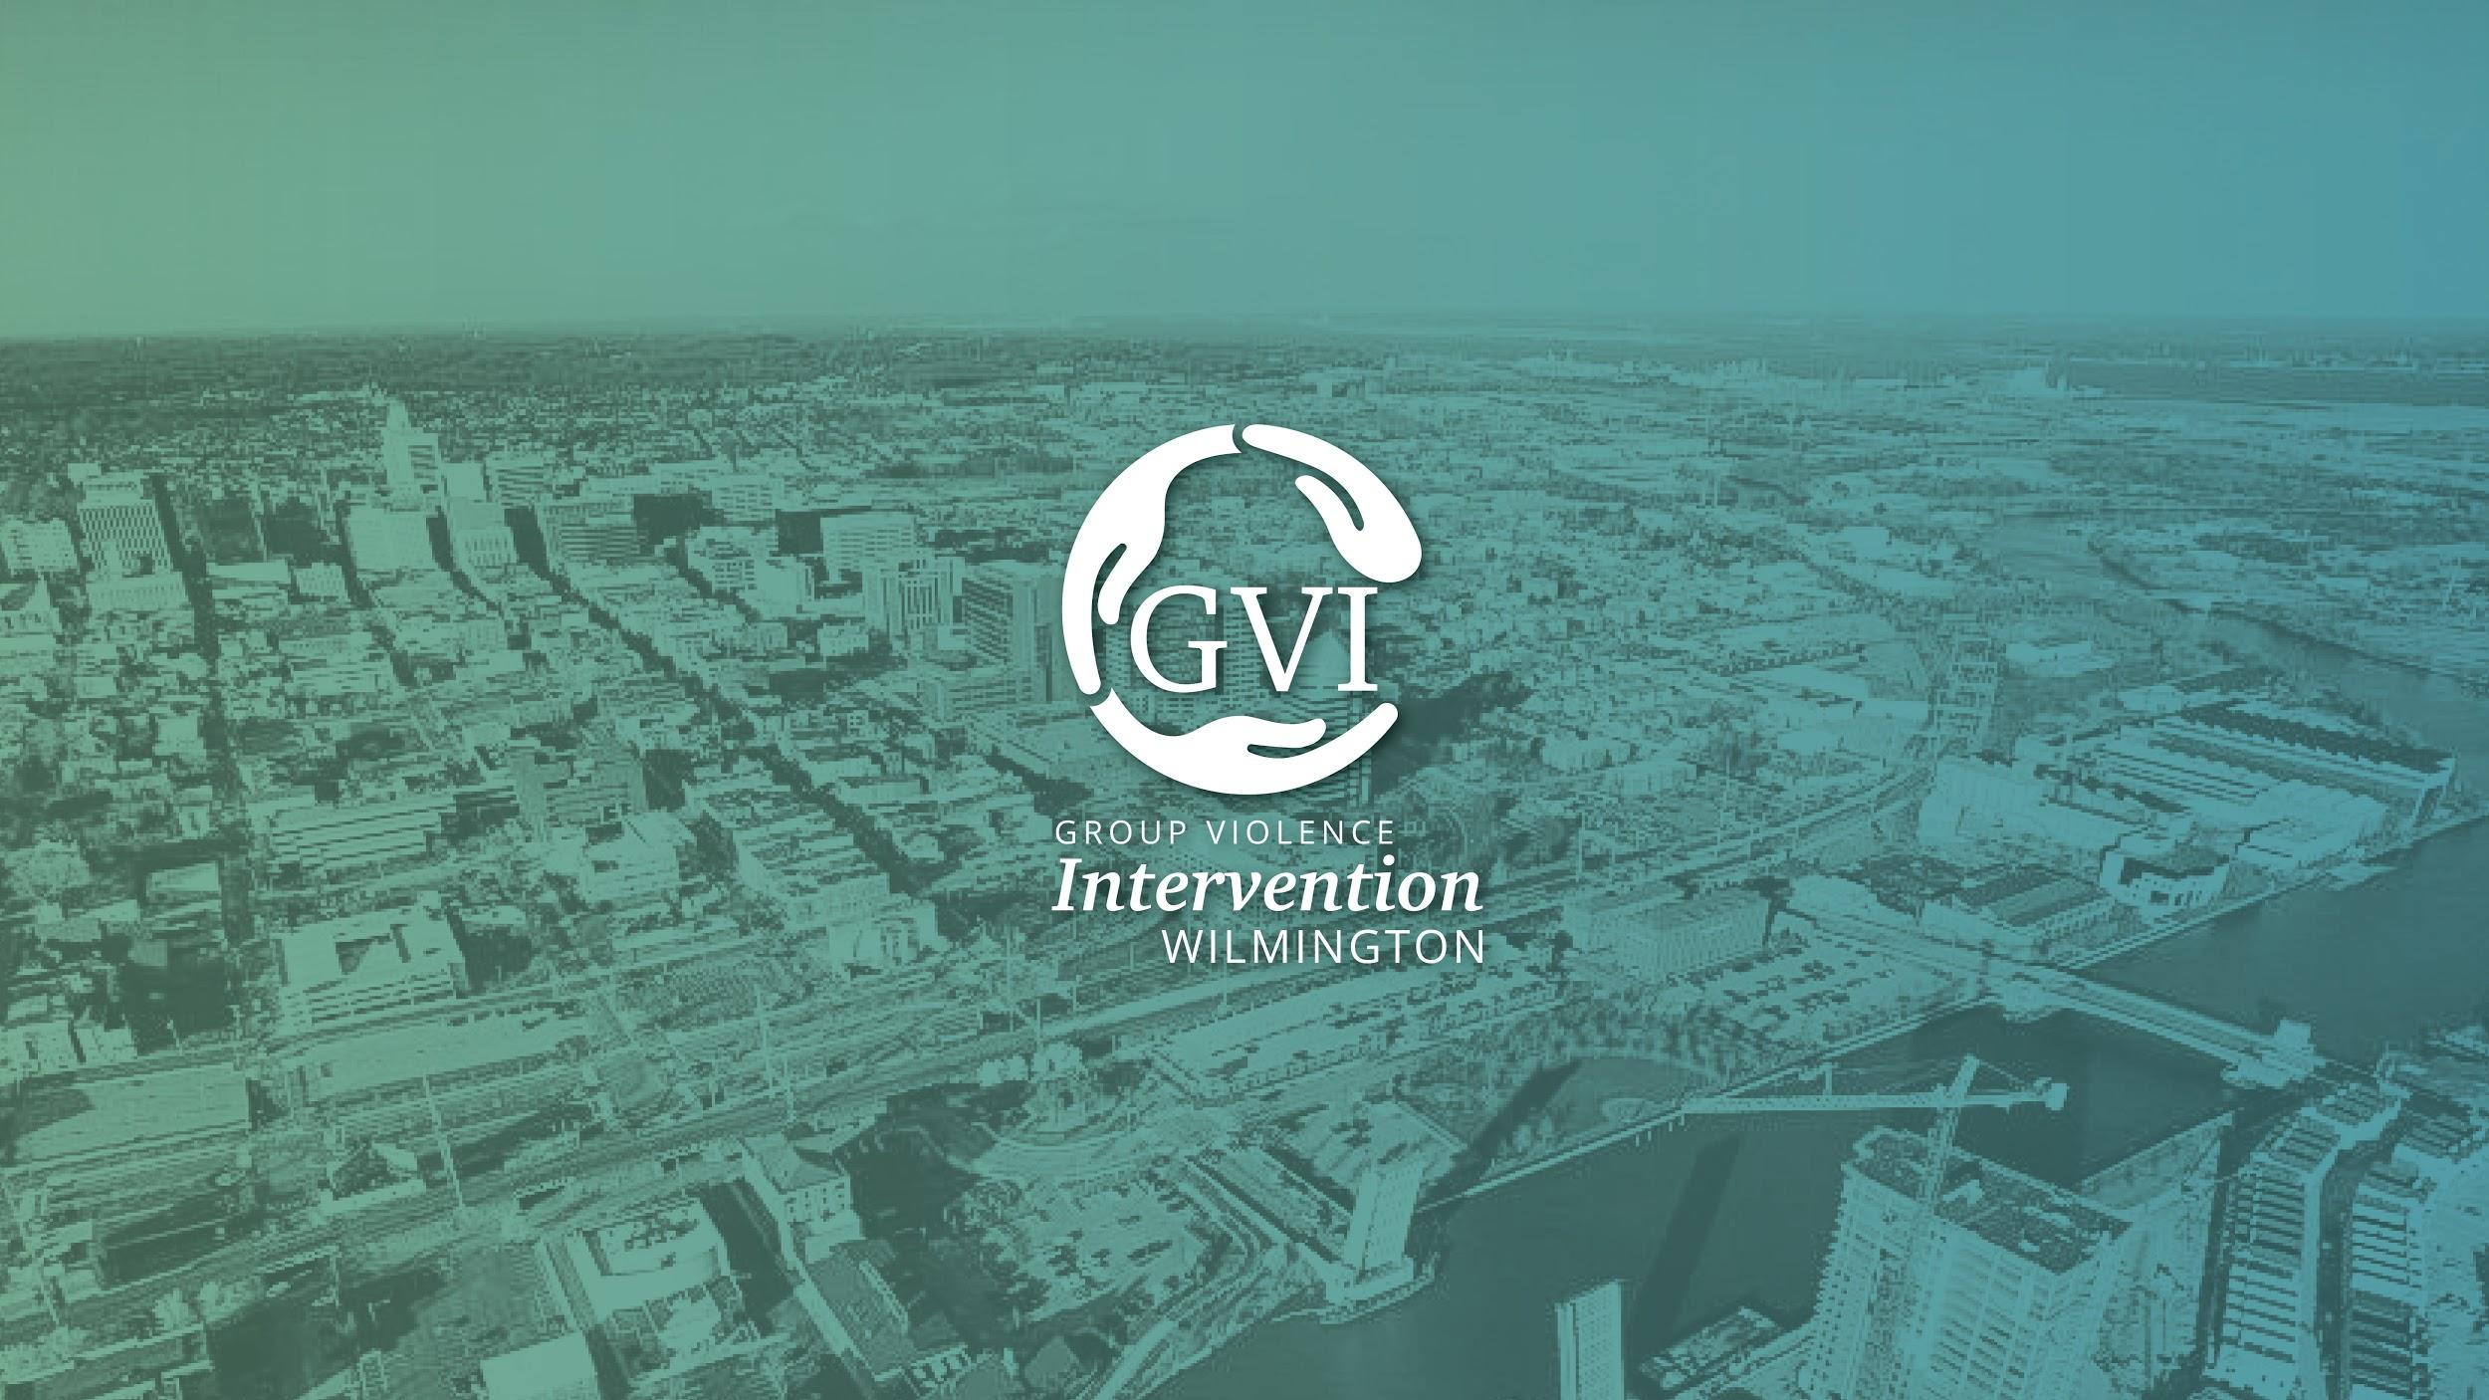
Notes:
Team Introductions

Slide 2

Background Information
Overview of the Group Violence Intervention (GVI) Strategy
GVI Implementation Partners
Investments made to date
Support and Outreach effort
Questions & Answers
Today’s Discussion
Notes:
Meghan

Slide 3
A convergence of leadership to resolve Gun Violence...
In 2015, the CDC identified gun violence in Wilmington as an epidemic, conducted a study and submitted a report of its findings to the CDC Advisory Council
In 2017, Mayor Purzycki brought on Robert Tracy as Wilmington’s Chief of Police
Since 2016, CDC Advisory Council continued meeting as the Wilmington Community Advisory Council (WCAC) under Council President Shabazz
In 2017, Governor Carney reinstituted the Family Service Cabinet Council and directed a focus on Wilmington, including gun violence efforts with WPD
Notes:
Meghan

Slide 4
Potential Shooters likely have:
History of emergency room visits as victims of violent incidents (shooting, stabbing, assault)
Juvenile Justice Involvement
Childhood Trauma and Maltreatment
School Disciplinary Events and Truancy
Current and past periods of unemployment
CDC identified
risk
factors
Notes:
Meghan

Slide 5
Groups and Gangs
The CDC Report did not address the role of group-driven gun violence in the Wilmington landscape.
Like many cities, Wilmington's gun violence is perpetuated on a retaliatory basis by less than half of 1% of the city’s population.
GVI is a strategy that exclusively addresses this highest risk target population.
What
the CDC
didn’t say
Notes:
Bobby

Slide 6
“The aim of the GVI strategy is to reduce peer dynamics in the group that promote violence by creating collective accountability, to foster internal social pressure that deters violence, to establish clear community standards against violence, to offer group members an ‘honorable exit’ from committing acts of violence, and to provide a supported path for those who want to change.”
National Network for Safe Communities
Notes:
Bobby

Slide 7
Do no harm.
Strengthen community capacity to prevent violence.
Enhance police legitimacy.
Offer supportive services to those who want help.
Get deterrence right.
Use enforcement strategically.
GVI Core
Principles
Notes:
Bobby

Slide 8
Meeting Group Members with clear messages and coordinated action:
Community Moral Voice: “Your community does not accept your actions. You are hurting the community.”
Social Service Support: “We want to help you and will do whatever we can to help you, for as long as you need it.”
Law Enforcement: “If you continue shooting, you and your group will receive full attention of law enforcement. Here is what will happen if someone in your group shoots…”
GVI Key Messages
Notes:
Bobby

Slide 9
How do GVI Partners deliver this message to groups and their members?
GVI Key Message
Delivery
Notes:
Bobby

Slide 10
A Call-in is a face-to-face meeting of law enforcement representatives, community figures, social service providers, and group-involved adults; typically those on probation. The call-in is a communication strategy; its primary purpose is to deliver key messages clearly to the group members present, and through them, back to the entire group with which they are associated.
“Call-in”
Notes:
Bobby

Slide 11
When GVI leaders and/or law enforcement visit with key adult group members at their homes or on the streets to keep the anti-violence and offer of support messages alive between call-ins
When GVI leaders and/or law enforcement visit with juveniles and/or their legal guardians to introduce or reinforce the anti-violence and offer of support messages
“Custom Notification”
Notes:
Bobby

Slide 12
“In reach Notification”
When GVI leaders and/or law enforcement visit with key adult group members while incarcerated or juvenile group members while in detention or other residential settings to deliver the anti-violence message and proactively offer services pending their release back into the community.
Notes:
Bobby

Slide 13
Law Enforcement
Wilmington Police Department
Department of Correction
Department of Services for Children, Youth and Their Families
Delaware Department of Justice
United States Attorney’s Office
Federal Agencies
(FBI, DEA, ATF, US Marshals)
Social Services
DHSS, DOE, DSCYF, DOL, DSHA
Nonprofit and philanthropic community
Community Members and Community Leaders
Partnership
Implementation
Notes:
Meghan

Slide 14
State Infrastructure Investment
for GVI Wilmington
Department Health and Social Services
Establishment of a new Division:
Director of GVI
Deputy Director of Operations
Deputy Director of Support and Outreach
Management Analyst; Program Manager, (2) Master Case Managers and (2) Youth Advocates in 2020
Department of Correction
Establishment of new, specially trained, GVI Probation and Parole unit:
1 supervisor
5 probation and parole officers
additional equipment and vehicles
Department of Services for Children, Youth and Their Families
dedicated staff resources
Notes:
Meghan

Slide 15

Governor’s FSCC
(OGOV, LTGOV, DOC, DOL, OMB, DTI, DOE, DSCYF, DHSS, DSHA, DSHS)
Executive Committee
(Governor’s Office, WPD, DOJ, DHSS, DSCYF, DOC, USAO)
Answers to FSCC and GVI partners
Manage GVI partnership(s)
Accountable for program outcomes
Provide ongoing, intensive case management to group-involved clients
Director of GVI & staff
(DHSS)
Law Enforcement
Support & Outreach
Community Partnerships
Notes:
Meghan

Slide 16
According to national averages, NNSC predicted that we would see a 10-20% rate of acceptance of social services from the total population outreached.
GVI Wilmington Support and Outreach has exceeded the national standard for excellence in engaging the adult group-involved population in year one with an acceptance rate of 42%.
Notes:
Chris

Slide 17
In the first year of Support and Outreach implementation:
43 - Offers made through Call-in/Custom Notifications
42% (18) - currently enrolled with Support and Outreach and receiving social services and supports
No Exit Policy – Individuals/families may request services at any time after initial contact; ongoing periodic follow-up (phone, text, in-person) continues indefinitely
Support and Outreach Effort
Notes:
Chris

Slide 18
The team has a “no handoff” policy and collaborates directly with public/private partners including:
DOJ Community Engagement
DSS (SNAP, Medicaid, TANF, etc.)
DMV
DSHA
DPH
DSAMH/Community Behavioral Health Providers
DSCYF – Youth Rehabilitation Services/Prevention and Behavioral Health
DOL
Re-entry service providers
Remanned Project
Employers and Landlords
DOE/Community-based Educational programs
Artisans Bank
Support and Outreach Provider Network
Notes:
Chris

Slide 19
18-24 month experience:
Voluntary commitment to participate
Case Manager/Life Coach assignment
Holistic support to household/family
Life mapping and navigation
Goal attainment
Transformative travel
Community involvement, advocacy, and restorative justice activities
Graduation
Alumni Fellowship and Leadership opportunities
Support and Outreach Program Vision
Notes:
Chris

Slide 20
Additional
Questions & Answers
Notes:
Team

