Slide 1

WILMINGTON Public LIBRARY: Funding Increase proposal
MEETING THE needs OF WILMINGTON’S COMMUNITIES
WILMINGTON LIBRARy manager of community engagement
Carl shaw, M. Ed.

Slide 2
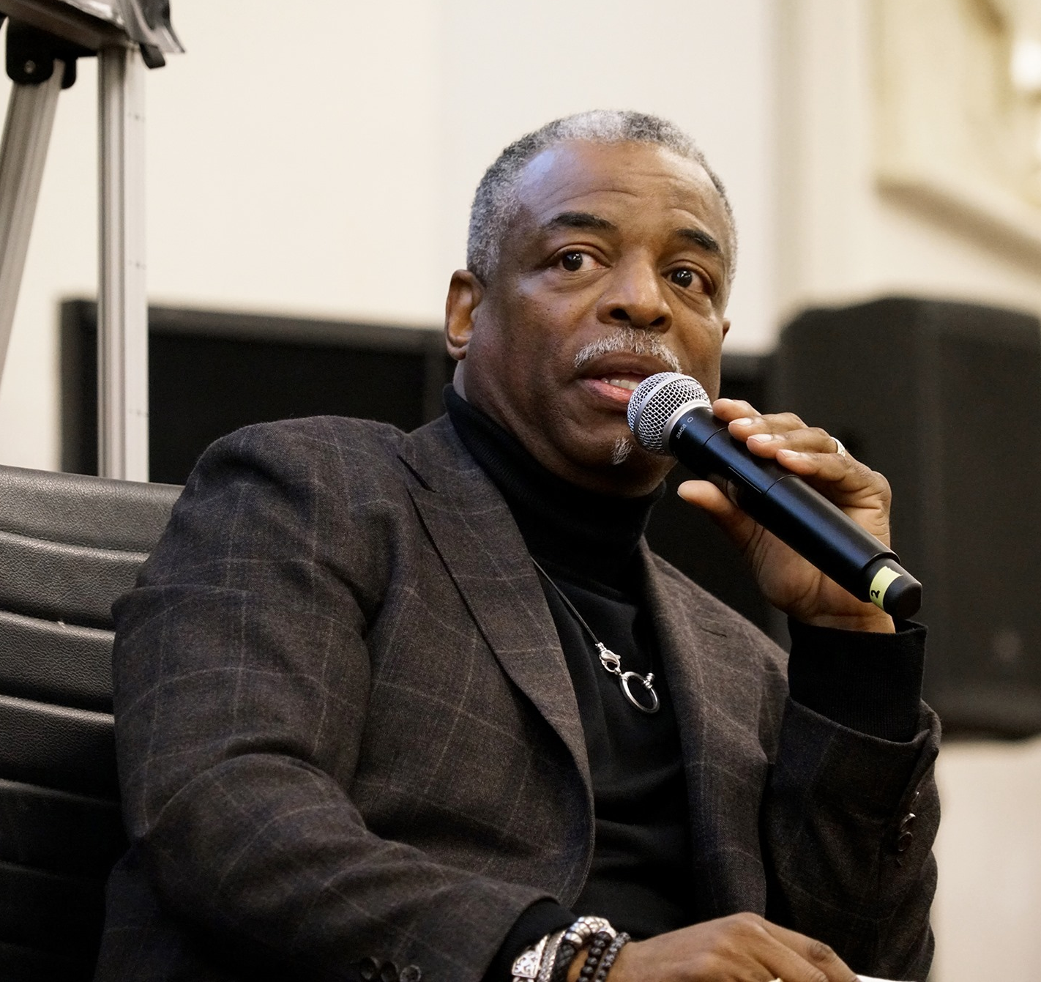
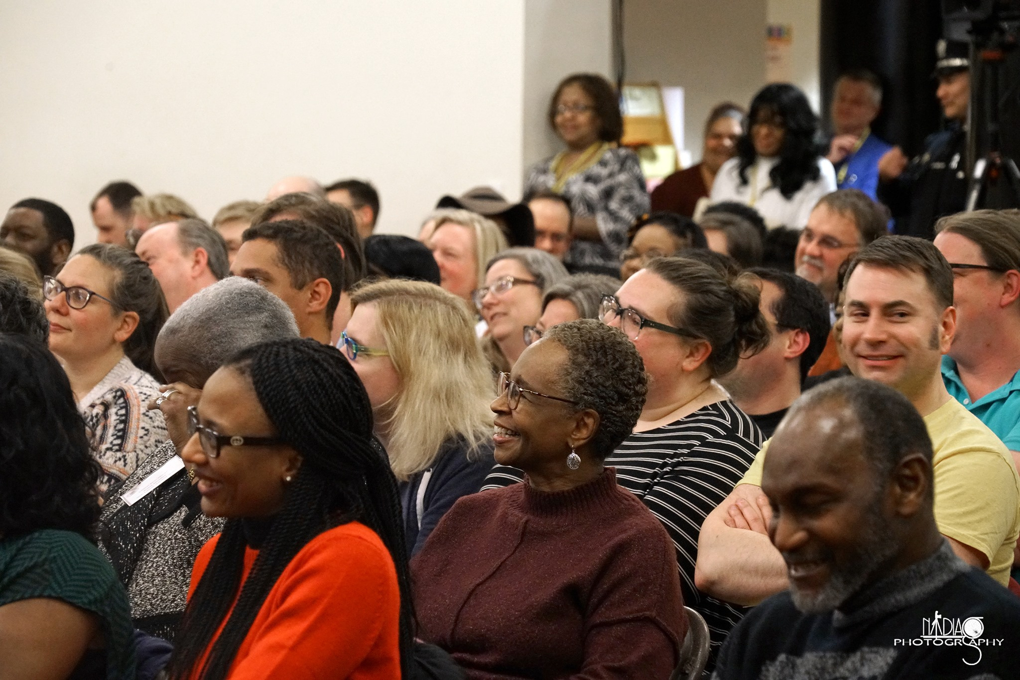
As Wilmington Evolves… Wilmington Library Evolves
Goals
Robust Community Programs
Enhanced Library Environment
Increase in Resources/Services

Slide 3
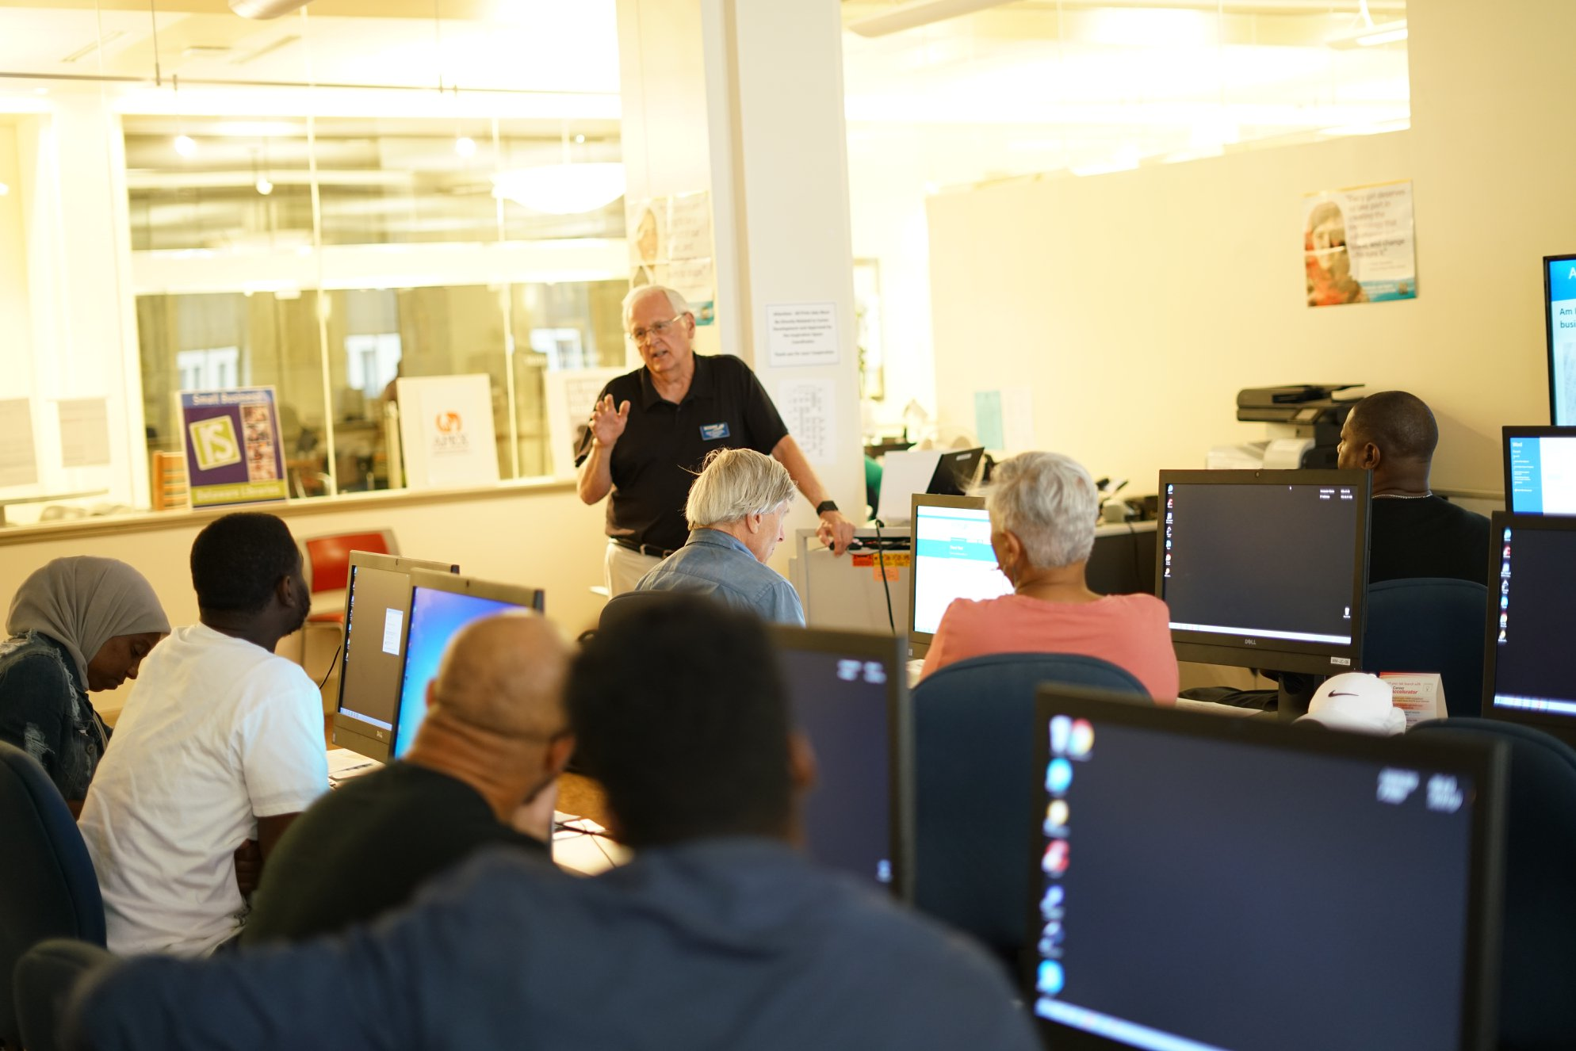
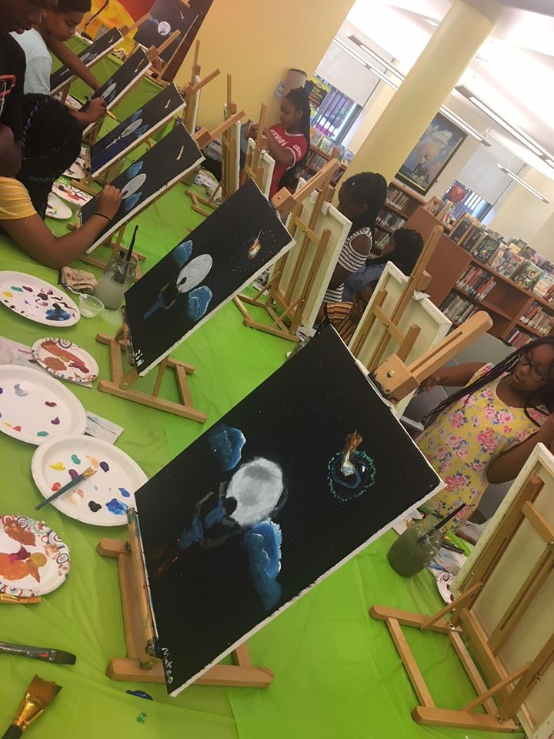
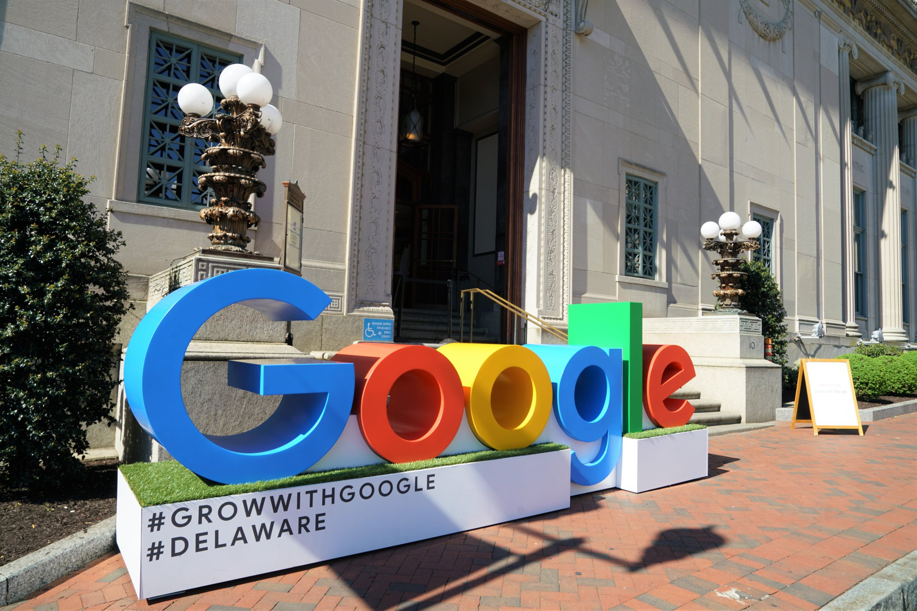
As Wilmington Evolves… Wilmington Library Evolves
Robust Programming
Education and History
Literature and Entertainment
Arts and Sciences
Career and Entrepreneurship
Computers and Emerging Technology

Slide 4
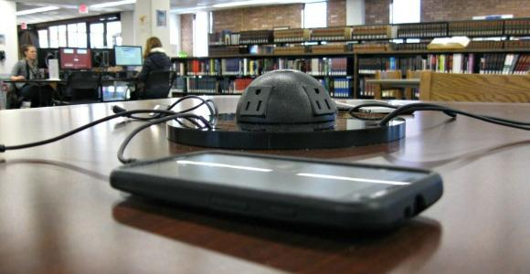
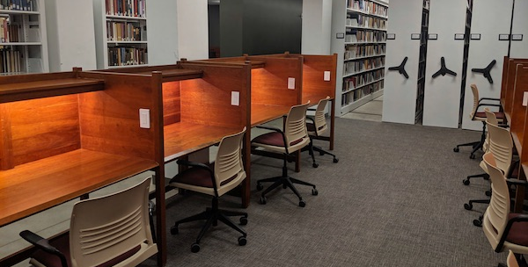
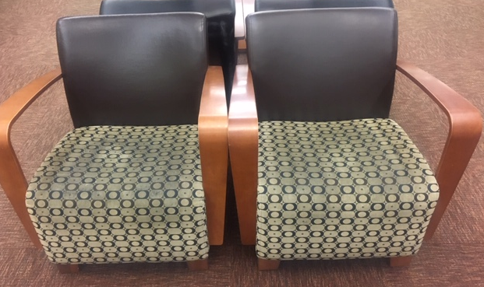
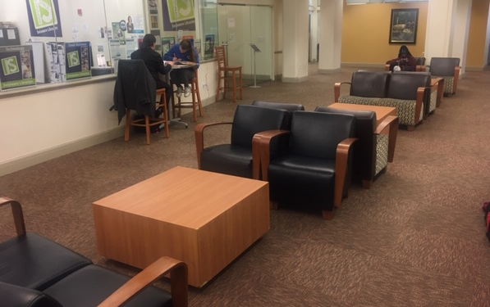
As Wilmington Evolves… Wilmington Library Evolves
Enhanced Library Environment
More study areas
Updated areas to charge phones
Homeless/At Risk Population
STREAM MakerSpace
Environmentally safe furniture

Slide 5
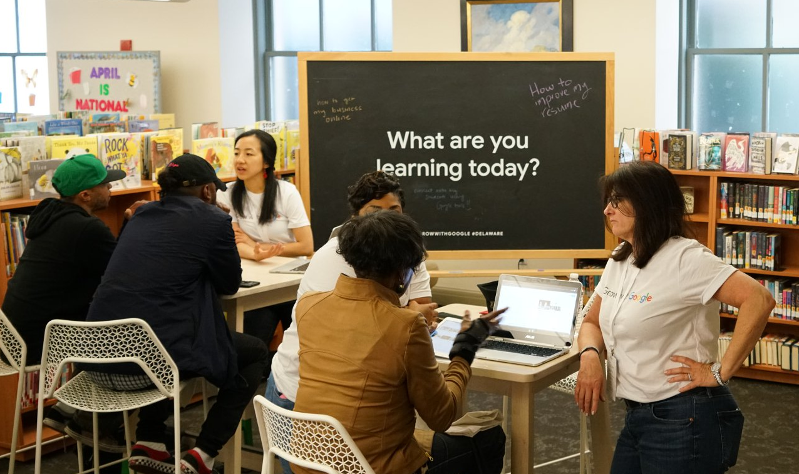


As Wilmington Evolves… Wilmington Library Evolves
Increase in Resources and Library Services
Updated books and material collection/circulation
Career & Business Specialists
Technology Specialist
Security equipment to protect resources

Slide 6
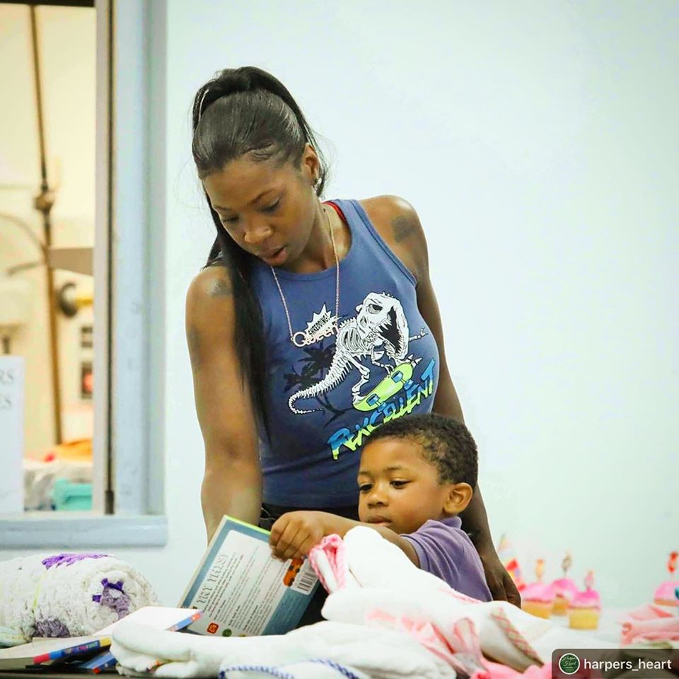
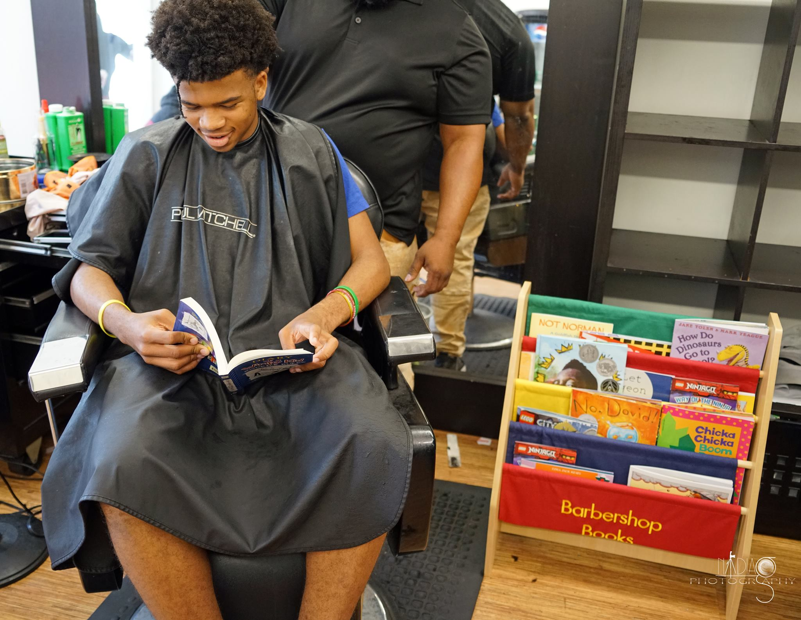

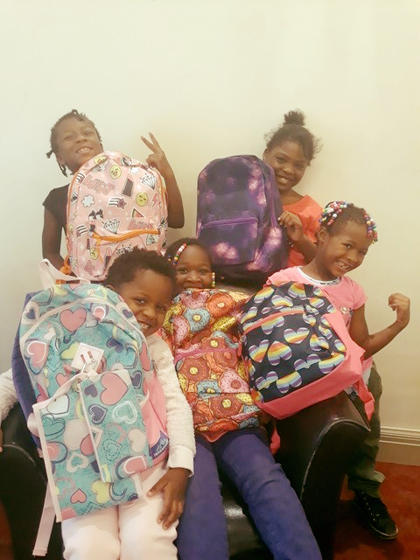
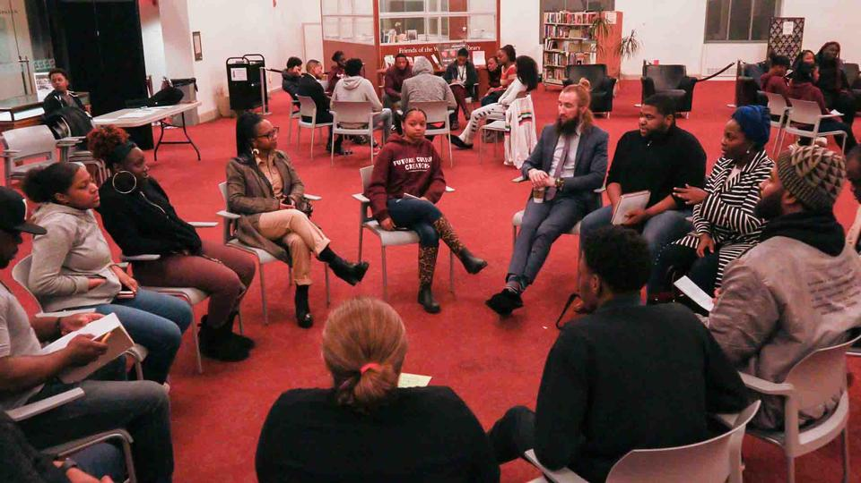

Library Programs for youth and teens

Slide 7
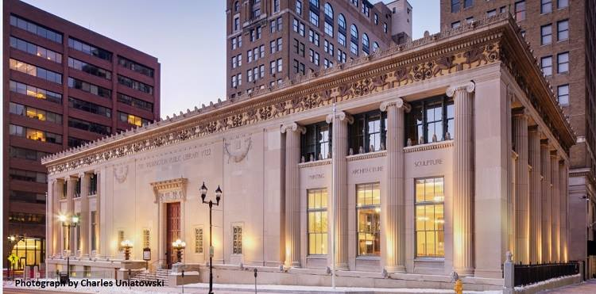

Library operates on flat budget despite inflation

