Slide 1
Wilmington City Council
_________________
Community Development
&
Urban Planning Committee
November 12, 2020

Slide 2
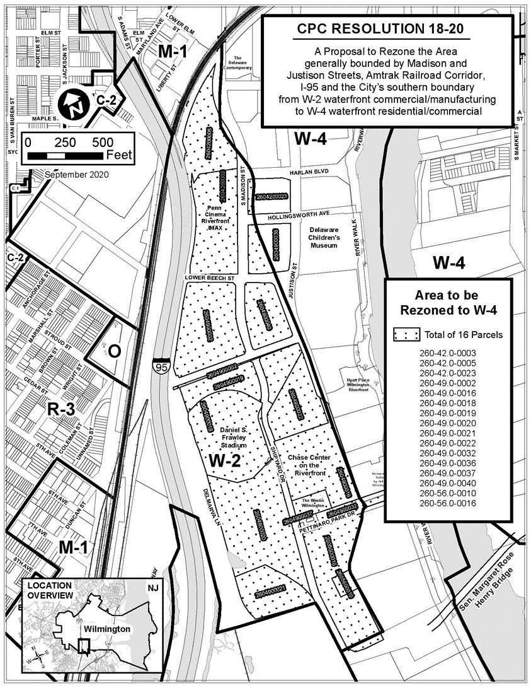
Ordinance 20-044
Proposal to rezone 16 parcels within the area generally bounded by Madison and Justison Streets, Amtrak Railroad Corridor, I-95 and the City’s southern boundary
Existing Zoning: W-2 Waterfront Manufacturing/Commercial
Proposed Zoning: W-4 Waterfront Residential/Commercial

Slide 3
Ordinance 20-044
Proposal to rezone 16 parcels within the area generally bounded by Madison and Justison Streets, Amtrak Railroad Corridor, I-95 and the City’s southern boundary
Existing Zoning: W-2 Waterfront Manufacturing/Commercial
Proposed Zoning: W-4 Waterfront Residential/Commercial

Slide 4
Property Ownership
Beech Street Property LLC (1 parcel)
Buccini/Pollin Group (3 parcels)
Delaware Stadium Corp. (3 parcels)
Pettinaro Management LLC (5 parcels)
Riverfront Development Corp. (4 parcels)

Slide 5
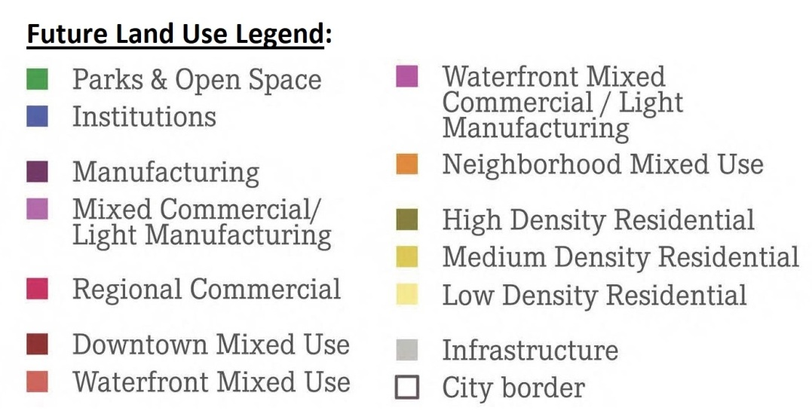
Wilmington 2028
Proposed rezoning is located within the Browntown-Hedgeville Neighborhood
Plan recommends “Waterfront Mixed Use”
Waterfront Mixed Use defined as medium density residential buildings (with ground floor retail), office buildings, civic centers, hotels, restaurants, commercial retail/services, nightlife/performance venues, and recreation
Uses are consistent with proposed W-4 Waterfront Residential/Commercial Zoning

Slide 6
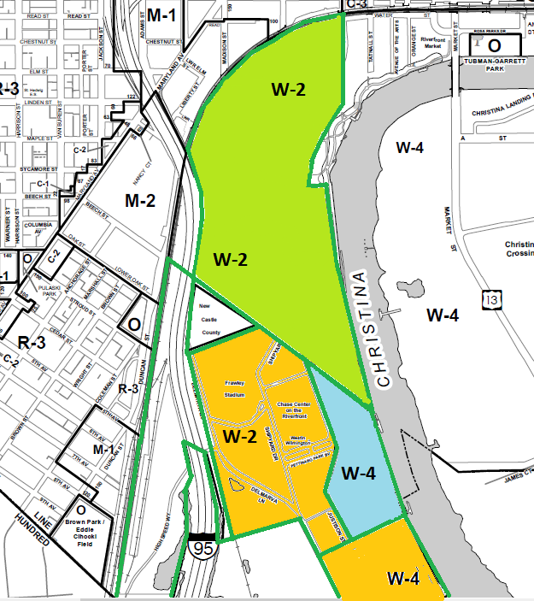
Zoning History
1981 - Waterfront Zoning Districts Created
- Initial Rezoning Effort along Christina &
Brandywine Waterfront
1988 Annexation / Rezoned to W-2 & W-4
1992 Rezoned from M-2 & W-1 to W-2
1998 Annexation / Rezoned to W-4

Slide 7
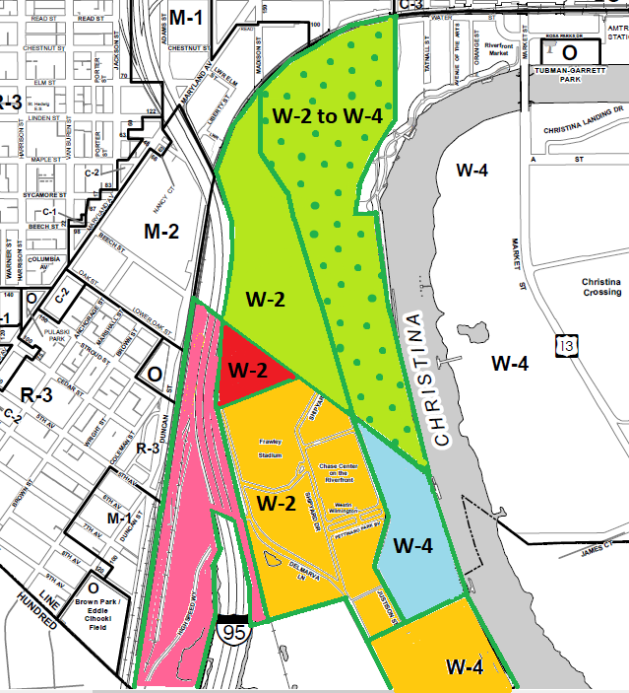
Zoning History
1997 Rezoned from W-2 to W-4
1999 Annexation / Rezoned to W-2
2018 Annexation / Rezoned to W-2

Slide 8
Current Area
proposed for
Rezoning
(W-2 to W-4)

Slide 9
Uses Permitted as a
Matter-of-Right
W-4 Permitted Uses (Proposed Zoning):
SF / MF Residential, excluding SF Detached and SF Conversions
Bed and Breakfast Facilities
Library, Museum, Gallery
Private or Public School
Private Club or Lodge
Hotel or Motel
Parking Lot (accessory to permitted uses)
Printing Plant (sheet fed presses only)
Passenger Terminal, Rail, Bus, Helicopter
Nonprofit Charitable Institution (not correctional)
Indoor Theater / Performing Arts
Family Day Care Home
W-2 Permitted Uses (Existing Zoning):
Manufacturing, Fabricating, Processing or Repair Establishment
Warehousing / Wholesale Sales
Laboratory, Research or Testing
Carting Express, Moving or Building Terminal or Yard
Automobile Services
Hydropower Facility
Commercial parking structure or lot
On-premises Dwelling/Apartment for Caretaker/Janitor
Outdoor Storage of Construction Materials/Dry Commodities
Consumer Recycling Collection Center
Antenna Uses (except tower farm)
Indoor Commercial Horticultural Operation

Slide 10
Matter-of-Right Uses Permitted in Both W-2 and W-4
Office, Bank, Financial Institution
Retail Store / Service
Restaurant / Lunchroom
Commercial Marine Use
Group Day Care Home / Day Care Center
Commercial Recreation (W-4 excludes arcades/games)
Public Service Use
Sign (other than billboard)

Slide 11
Zoning Regulations
W-2
Height: 6 stories / 72 feet
Bldg Setback: 30 - 50 feet
FAR: All Uses 2.0
Building Coverage Ratio: 0.60
Subject to Waterfront Development Review Process
W-4
Height: 6 stories / 72 feet
Bldg Setback: 30 - 50 feet
FAR: Residential 0.8 – 2.0
All Other 2.0
Building Coverage Ratio: 0.4 to 0.5
Subject to Waterfront Development Review Process

Slide 12
Land Uses
in the Surrounding W-4 District
Multi-Family Residential
Commercial Retail/Services
Offices
Financial Institutions
Restaurants
Hotels
Museums
Commercial Recreation

Slide 13
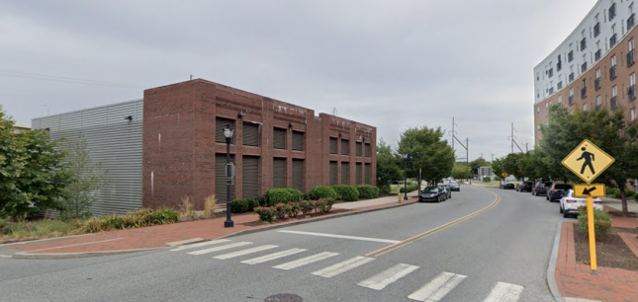
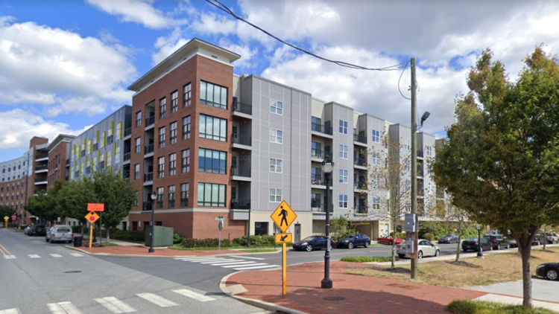
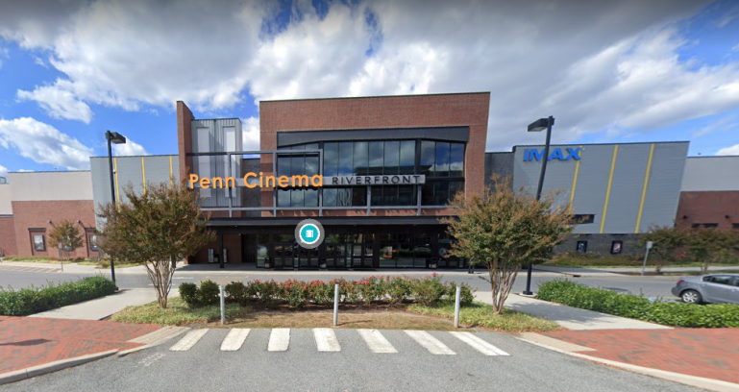
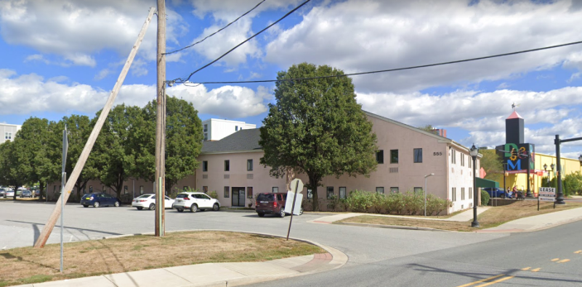
Existing Land Use
North of Beech St
City Operations Center
Harlan Flats
Penn Cinema
Vacant Office Building

Slide 15
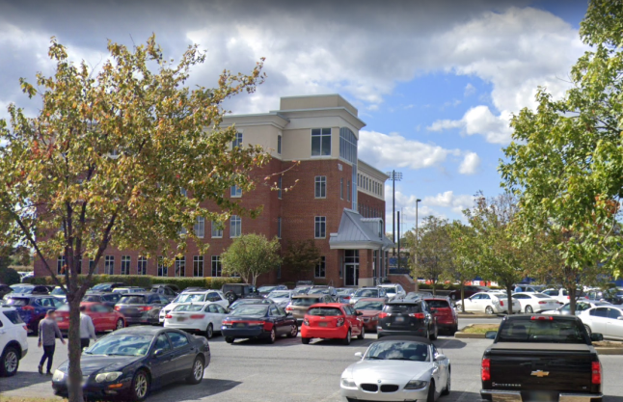
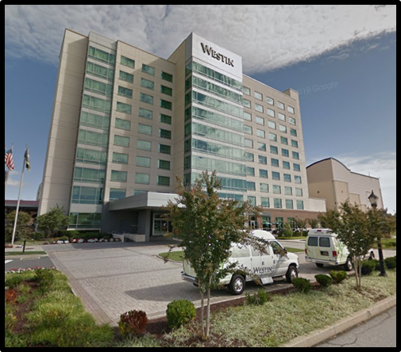
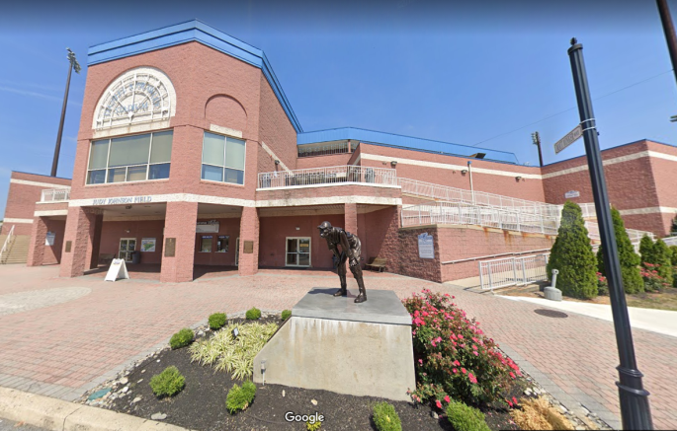
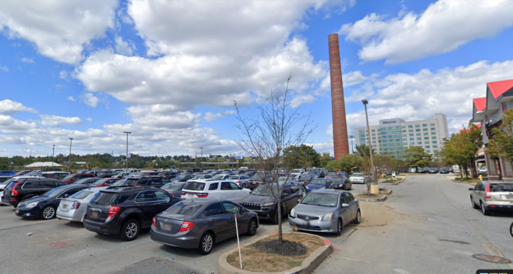
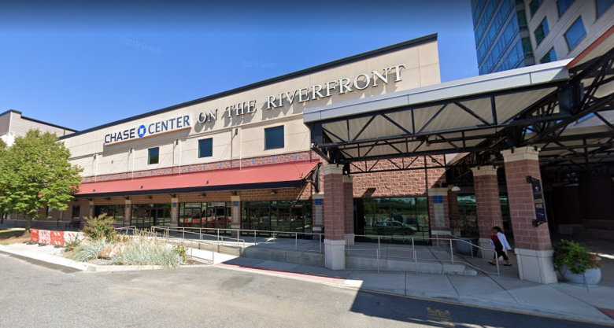
Existing Land Use
South of Frawley Dr.
Office Building
Westin
Frawley Stadium/Ball Field
Former Industrial
Smoke Stack
Chase Center

Slide 16
Rezoning Impact Summary
No Negative Land Use Impacts from Rezoning Action
All Uses (except Westin Hotel) Remain Matter-of-Right
Current ZBA Approved Use (Westin Hotel) converts to Matter-of-Right in W-4
Split W-2/W-4 Zone Condition is eliminated for two parcels (Harlan Flats, Vacant Building)
All Future Development must conform to W-4 Regulations

Slide 17
Outreach / Public Notice / Legislation
Outreach August 31 Council Briefing
September 23 Property Owner Meeting
CPC Action October 5-12 Public Notice, Agenda, Legal Notice
October 20 Planning Commission Public Hearing
CPC Resolution 18-20 Approved
Legislation September 17 Ordinance 20-044 Introduced
Council Public Hearing Scheduled
November 12 CD&UP Committee Review
November 19 Council Public Hearing / Final Action

Slide 18
Summary
W-2 and W-4 share similarities, including certain permitted uses, and height and building requirements.
However:
- W-2 does NOT permit residential uses
- W-2 DOES permit manufacturing, warehousing and more
intensive uses which could potentially impact existing
and future development
The proposed rezoning action (Ordinance 20-44):
Expands existing W-4 district to immediate east
Encourages compatible growth by allowing more agreeable land uses to establish
Does not impact nature and character of the area
Implements Wilmington 2028 Plan recommendations

Slide 19
