Slide 1
Department of parks and recreation
Overview of programs and activities

Slide 2
William hicks Anderson community center (hicks)
Hours of Operation:
Monday through Friday: 8:30am-8pm
Saturday: 10am-4pm

Slide 3
Department of parks and recreation Food Program
New sites:
Route 5 Compton Houses Mobile Route (65)
Route 8 N. Market Mobile Route (65)
Route 12 Lancaster Mobile Route (145)
Johnny’s Market (50)
4th & Rodney (50)
PAL (30)

Slide 4
Programs & Activities:
Partnership with Christiana School District for Virtual Learning
Wilmington Youth Environmental Corp
Safe-Haven
High School Basketball League (Saturday AM)

Slide 5
Department of parks and recreation (recreation)
COVID-19 plan submitted and approved by State for Indoor/Outdoor Sports
Youth Flag Football
Eden Park Utilization (Practicing/Games)

Slide 6
Department of parks and recreation Food Program
Existing Sites
Ark Learning Center Grace United Methodist Tender Care Learning Academy
Ark Learning Center South Helen Chambers Park The Glorious Church
Beacon of Hope Kingswood Community Center Teen Warehouse
Christiana Cultural Arts Nativity Prep-Wilmington Urban Promise (4 Locations)
Cool Shoes Neighborhood House Westend Neighborhood House
Darul-Amaanah Academy Nolan’s Learning Academy William Hicks Virtual Learning
Elsmere Presbyterian CCC PAL-Police Athletic League (eve) Winston Truitt
Youth Empowerment Xavier Camp Z & Z Early Learning Center

Slide 7
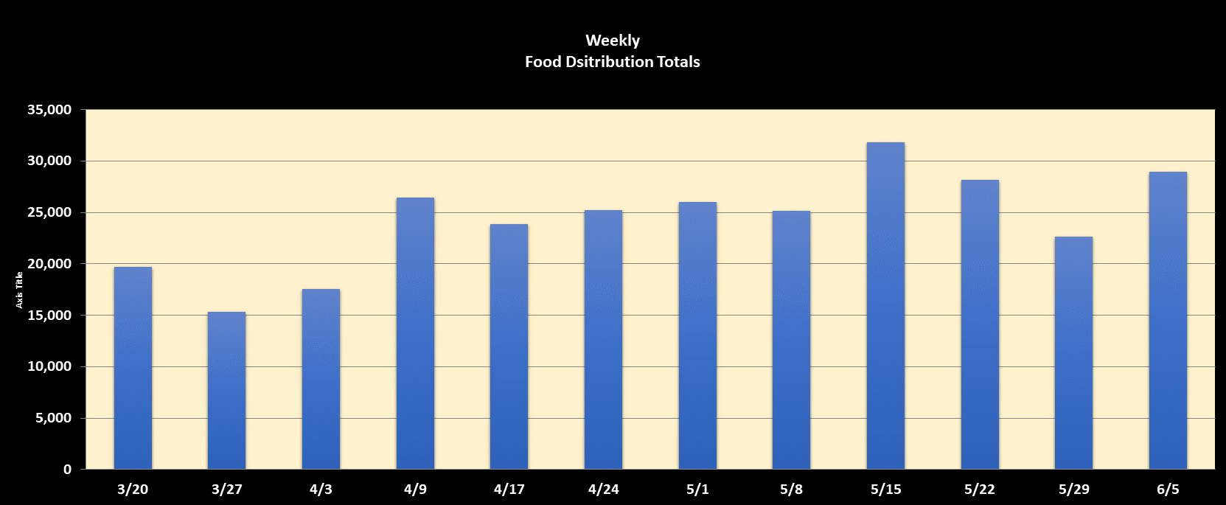
Feeding during covid-19
 | 3/20 | 3/27 | 4/3 | 4/9 | 4/17 | 4/24 | 5/1 | 5/8 | 5/15 | 5/22 | 5/29 | 6/5 | 6/12 | 6/19 | TOTAL
Weekly Total | 19,714 | 15,314 | 17,554 | 26,486 | 23,854 | 25,254 | 26,036 | 25,130 | 31,818 | 28,160 | 22,688 | 28,946 |  |  | 290,954

Slide 8
DEPARTMENT OF PARKS AND RECREATION
SEVERAL GRANTS NEEDS TO BE PRESENTED TO COUNCIL—TBA
QUESTIONS & ANSWERS

