Slide 1
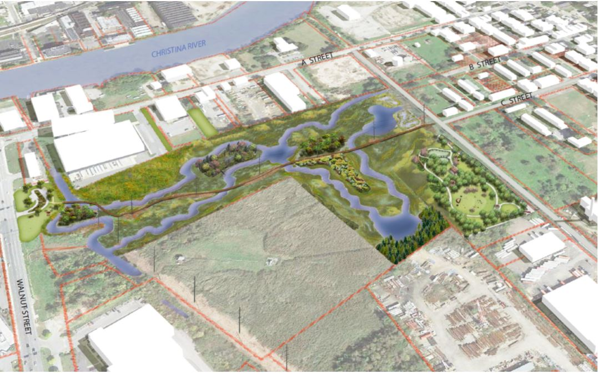
Department of Planning
and Development
Public Works and Transportation Committee Meeting
March 16, 2020
Ordinance 20-009: An Ordinance to Officially Name the South Wilmington Wetlands Park Project as the “Southbridge Wilmington Wetlands Park”

Slide 2
City Code Section 2-3: Official Names of Streets, Parks, Playgrounds, Plazas, Buildings, Facilities, Statues and Monuments, Other Lands Reserved for Public Use. ____________________________________________
Proposed names requires the recommendation of Planning Commission and approval of City Council.
Per Section 2-3, naming guidelines were adopted (CPC Resolution 8-92), which are used when evaluating naming proposals.
Wilmington Department of Planning and Development

Slide 4
South Wilmington Wetlands Park Project

Slide 5
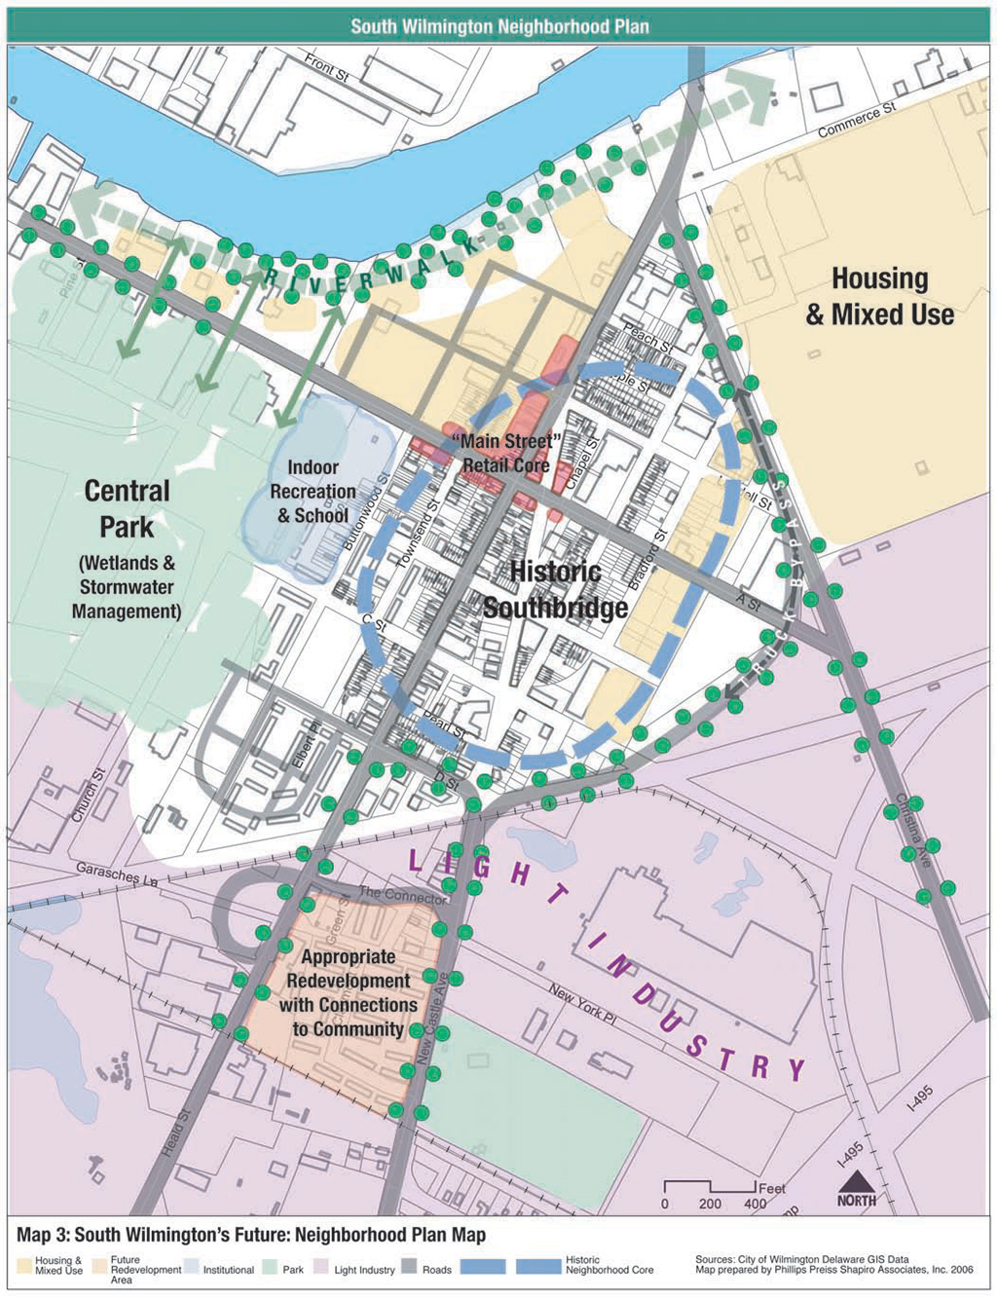
SAMP
Neighborhood Plan

Slide 6
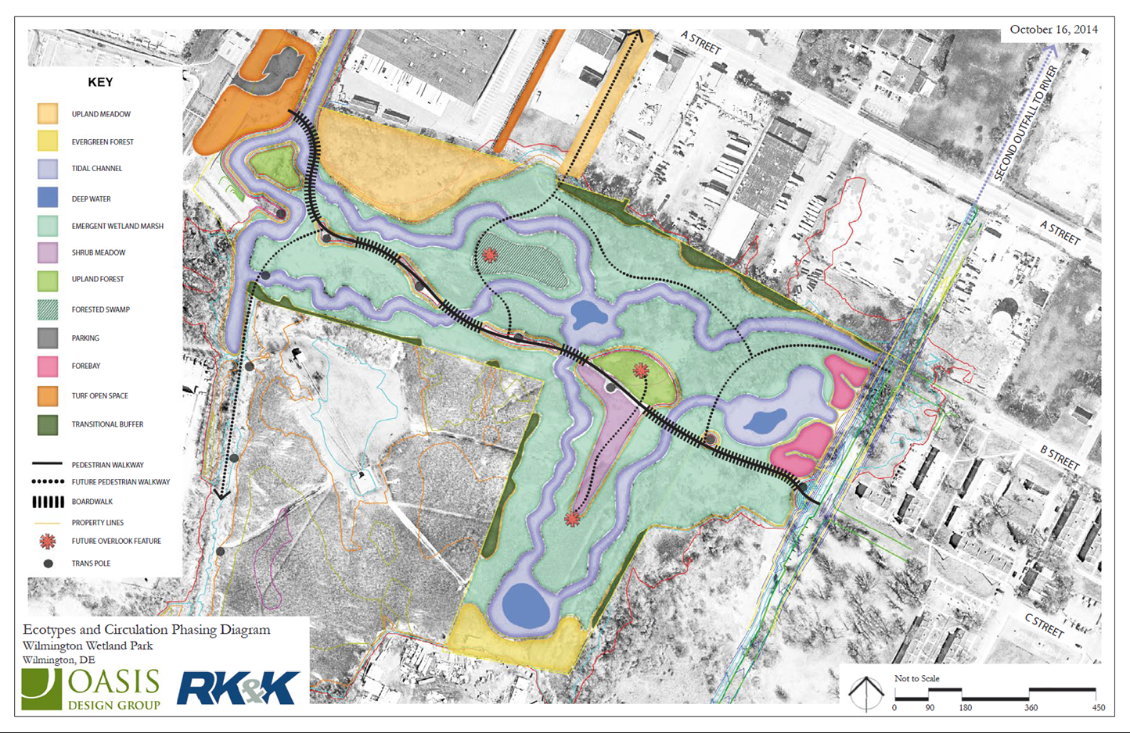
Proposed Wetland Park Features

Slide 8
Naming Guidelines

Slide 9
Naming Guidelines
1. Proposed name reflects the geography, location, physical setting or history of the area and helps to provide a sense of place.
2. Proposed name recognizes a prominent individual whose life has had a significant impact upon the community, or a meaningful association with the facility.
3. Proposed name reflects a historical or cultural event or place that is important to the residents of the City.
4. Proposed name does not duplicate names of other existing, similar type facilities.
5. Proposed name has been reviewed and endorsed by the appropriate city departments, (e.g., Parks and Recreation, Public Works, etc.).
6. Person for whom the facility is being named has retired or is no longer living.
7. Proposed name does not conflict with geographic location or type of facility being named.
8. Significance of proposed name is not of-the-moment and its meaning will be retained over time.
9. Current facility name does not already commemorate an individual. (If it does, a strong case should be made that the individual should no longer be recognized or honored.
10. Current facility name is inappropriate/improper and should be renamed.
11. Current facility name is not historically, traditionally or geographically appropriate or important.
MET NOT APPLICABLE NOT MET

Slide 10
Planning Commission
Recommendation
The Wetlands Park naming proposal (Ord. 20-009) was considered at the February 18, 2020 meeting of the City Planning Commission.
The Commission adopted CPC Res. 2-20 which recommends approval of the proposed name, “Southbridge Wilmington Wetlands Park”.

