Slide 1
Community Development and Urban Planning Committee June 27, 2019 ___ Ordinance 19-033
Proposed Amendments
to
Wilmington’s Zoning Code
to Permit
“Indoor Commercial Horticultural Operations”

Slide 2
Initial Proposal
Second Chances Farm, LLC
Seeks to establish an indoor vertical hydroponic farm at 3030 Bowers Street in an M-1 district
A C-5 site is also being considered
M-1 and C-5 don’t permit indoor farming
2

Slide 3
Current Code Provisions
Indoor Commercial Horticultural Operations are only permitted in two districts:
M-2 (Heavy Manufacturing)
W-3 (Waterfront Low-Intensity Manufacturing/Commercial Recreation)
Allows “horticultural use” (undefined)
3

Slide 4
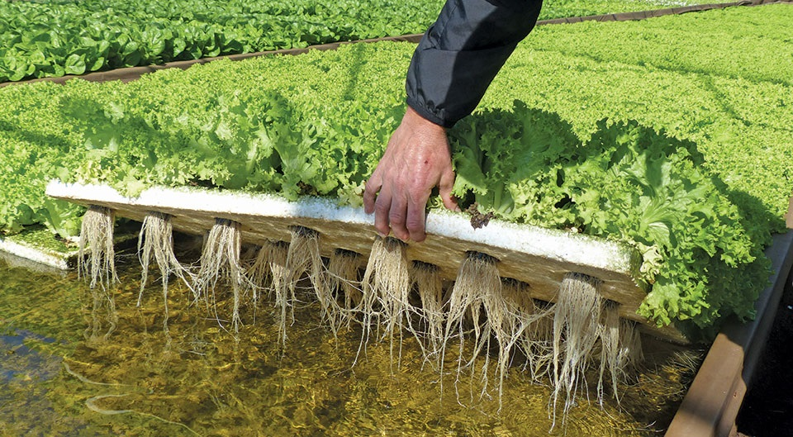
Innovative Indoor Agricultural
Production Practices
Code Amendments Required to
Encourage and Promote these Uses
4

Slide 5
Indoor Urban Farming Benefits
Job creation/workforce development
Supports food infrastructure
Increases year-round food production
New markets for agricultural producers, consumers, and businesses
Reuses abandoned/underused property
Community engagement
5

Slide 6
Related Industry Practices
Plant Cultivation
Harvesting
Transportation
Aggregation
Packaging
Distribution
Marketing
6

Slide 7
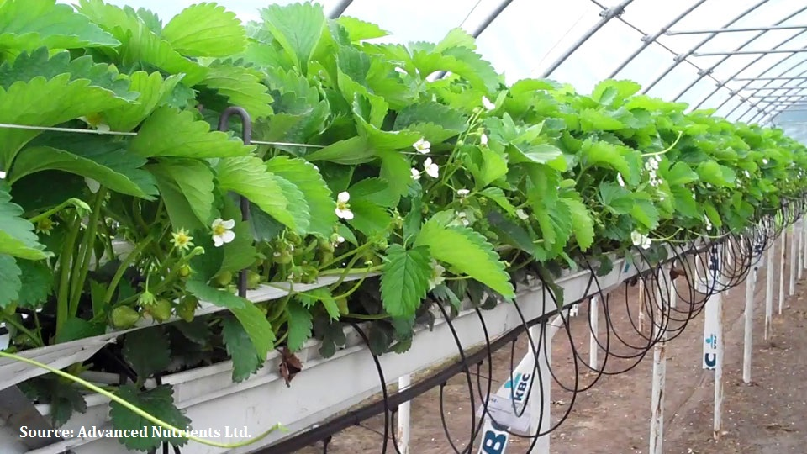
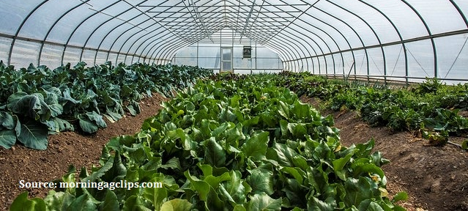
Applicability
Code Amendments will address Indoor Commercial Horticultural Operations which utilize a wide variety of growing methods and mediums:
- soil-based
- soil-less
- hydroponics
7

Slide 8
Current Proposal
Allow Indoor Commercial Horticultural Operations as a matter-of-right
Define, permit and regulate operations in which vegetables, herbs, fruits, flowers and other plants are cultivated commercially for wholesale / retail sales and distribution
8

Slide 9
Operations limited to enclosed buildings or greenhouses:
Secure space provides controlled environment
Minimizes impacts from harmful pests and pathogens
Protects against harsh weather conditions allowing year-round operation
Reduces water usage and site runoff
Keeps pollutants from entering groundwater and soil
9

Slide 10
Prohibits cultivation of plants that are illegal to grow, possess, or distribute under federal/state law
Operations may not create, emit, or discharge noxious or offensive odors
10

Slide 11
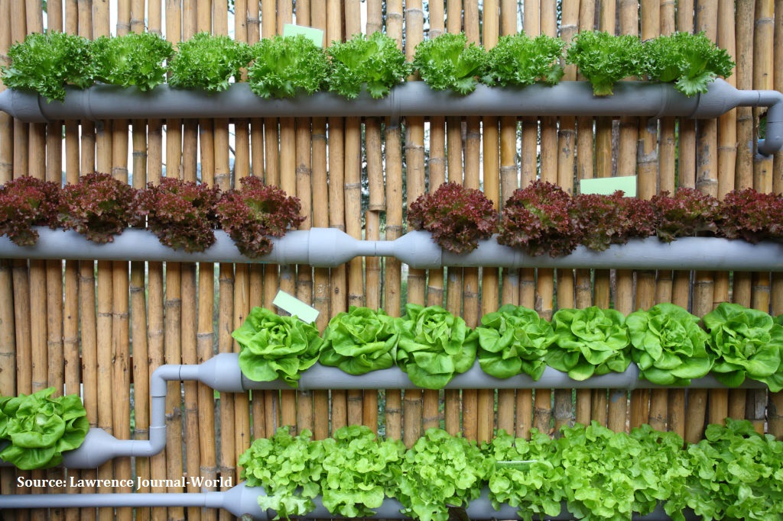
Proposed Code Amendments
11

Slide 12
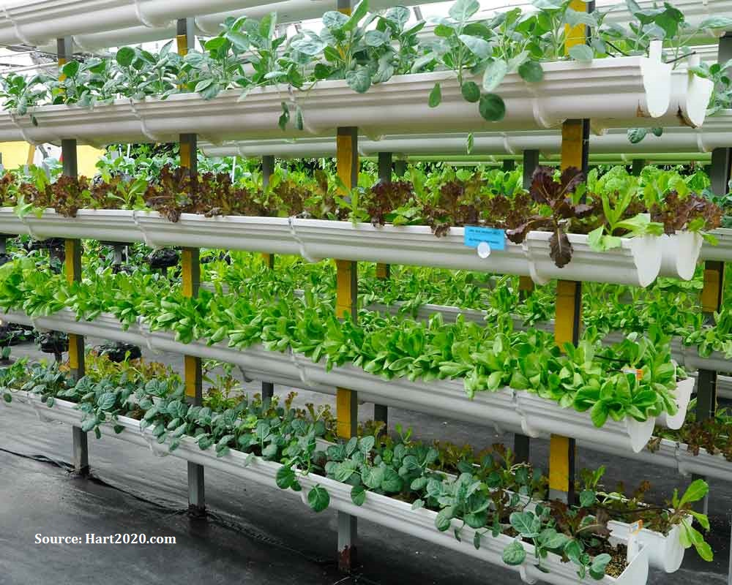
Section 48-2 Definitions
Indoor Commercial Horticultural Operation
Greenhouse
Hydroponic Farm
Hydroponic
Plant Nursery
Vertical Farm
12

Slide 13
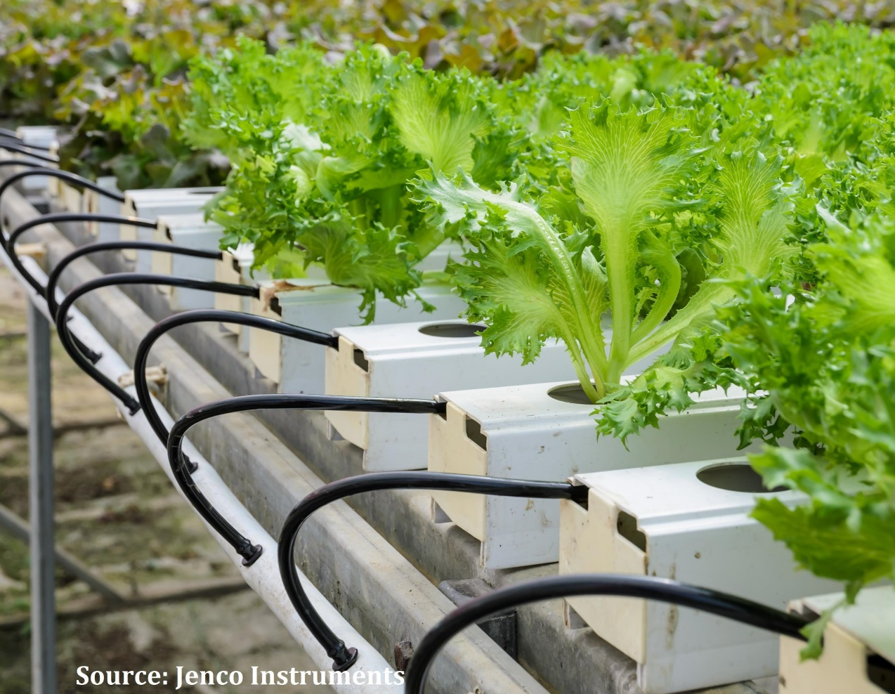
Zoning District Use Provisions
Allow “Indoor
Commercial
Horticultural
Operations”
in:
M-1 Sec. 48-246
C-5 Sec. 48-197
W-1 Sec. 48-336
W-2 Sec. 48-337
W-3 Sec. 48-338
13

Slide 14
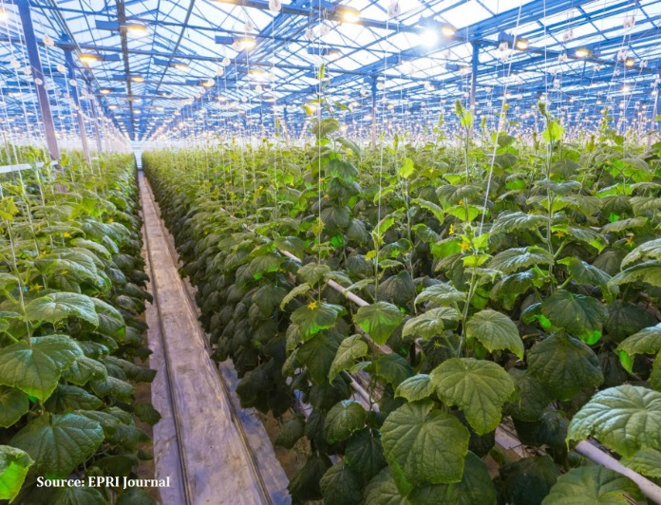
Section 48-445 Parking
Establish Parking Requirements:
one parking space for each 3,000 sq. feet of gross floor area
14

Slide 15
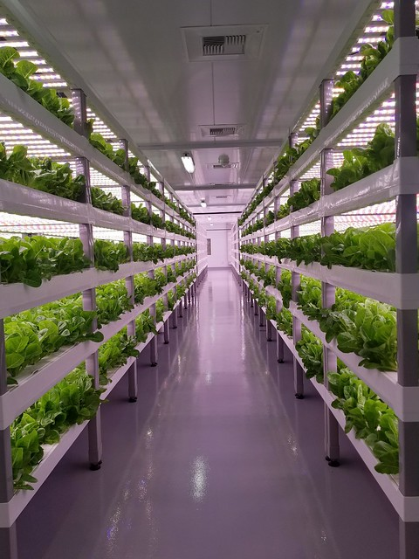
Local Community Codes
Local Zoning Ordinances / Regulations reviewed for guidance:
New Castle County
Newark, Delaware
Dover, Delaware
Newark, New Jersey
15

Slide 16
City Planning Commission Action
CPC held duly advertised Public Hearing at their June 18, 2019 meeting
Adopted Resolution 8-19 which recommends that City Council approve the Urban Farming Amendments
16

Slide 17
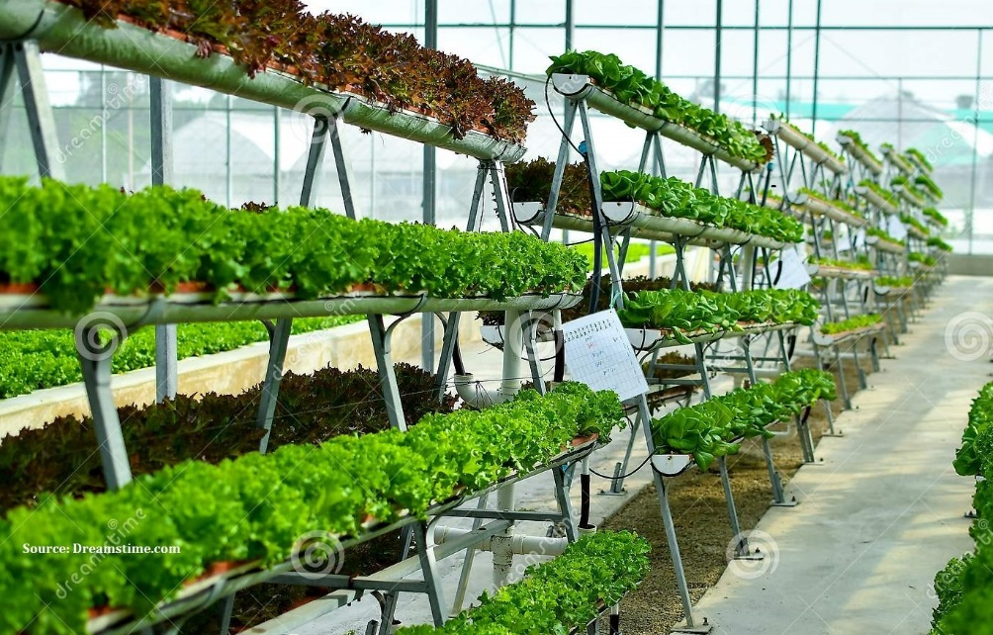
SUMMARY ------- Ordinance 19-033 would define “Indoor Commercial Horticultural Operations” and permit them in M-1, C-5, W-1, W-2 and W-3

