Slide 1
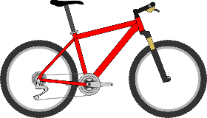
City of Wilmington Bike Plan Update
Community Input and Planning Session
March 8, 2018
^{Department of Planning}
^{Matthew Harris, Planner II}
^{Gemma Tierney, Planner I}
- - - - - - - - - - - - - - - - - - - - - - - -

Slide 2
What is the Purpose of a Bike Plan?
Improve the bicycling environment for all riders (safe and coordinated network for all users, all ages and abilities).
Provide coordinated and connected transportation options throughout the City (access to employment, services, institutions, recreation) .
Support a healthy and active lifestyle for all residents.
Coordinate and direct the implementation of improvements and City investment for a continuous network of routes and facilities.
Recommend policy and improvement priorities.
Identify funding opportunities.
- - - - - - - - - - - - - -
City of Wilmington Bike Plan

Slide 3
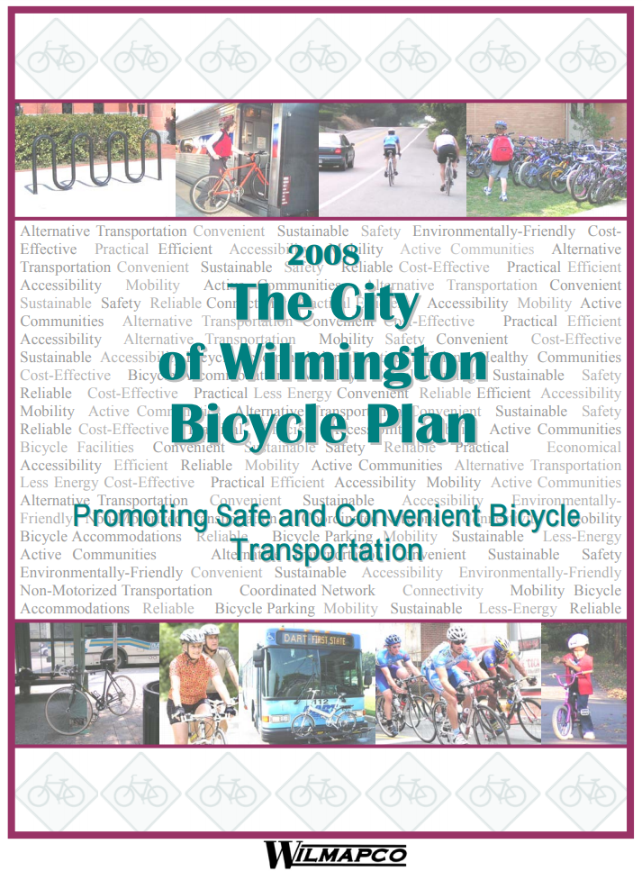
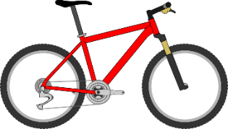
The City’s first Bike Plan is from 2008
Several accomplishments since then:
Sharrows on Market Street
Creation of Bike Wilmington Committee
Bike Share Feasibility Study Completed
Bicycle Parking Expanded
Delaware Bicycle Council Grant awarded to City and County in 2018 to study Augustine Cut-Off.
- - - - - - - - - - - - - -
City of Wilmington Bike Plan

Slide 4
The Benefits of a Coordinated Bike Network:
Convenience
Low-cost
Exercise
Traffic calming- safer for bikers, pedestrians and children
Better air quality
Local economic development
= Quality of Life
- - - - - - - - - - - - - -
City of Wilmington Bike Plan

Slide 5
What have we been up to?
Data Analysis –
Using DelDOT data, we have developed some ideas of what a bike network in Wilmington could look like.
Better data allows us to make better decisions.
Checking data accuracy for:
Road widths
Parking
Speed
- - - - - - - - - - - - - -
City of Wilmington Bike Plan

Slide 6
- - - - - - - - - - - - - -
City of Wilmington Bike Plan

Slide 7
The Study Area
- - - - - - - - - - - - - -
City of Wilmington Bike Plan

Slide 8
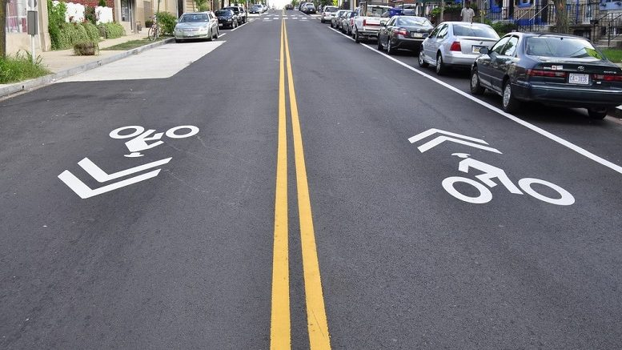
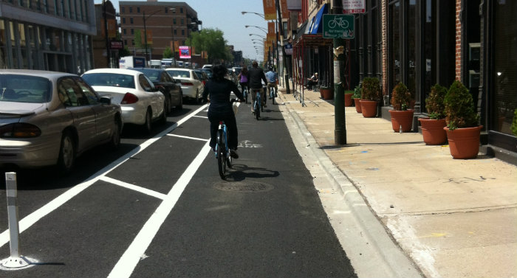
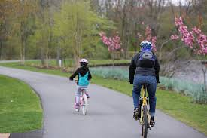
So what are some different types of bike infrastructure?
Shared with cars
Sharrows
Bicycle Boulevards
Bike Lanes
Separated Pathways
Separate from cars
- - - - - - - - - - - - - -
City of Wilmington Bike Plan

Slide 9
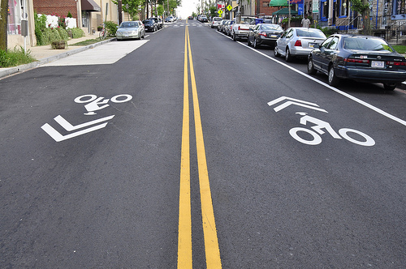
Sharrows
In traffic lane
Indicates that bike may use entire traffic lane
Do not need to change street layout
For low-speed, low-volume streets
Enhanced when paired with bicycle signage
http://sdotblog.seattle.gov/2009/09/24/sharing-the-road-with-sharrows/

Slide 10
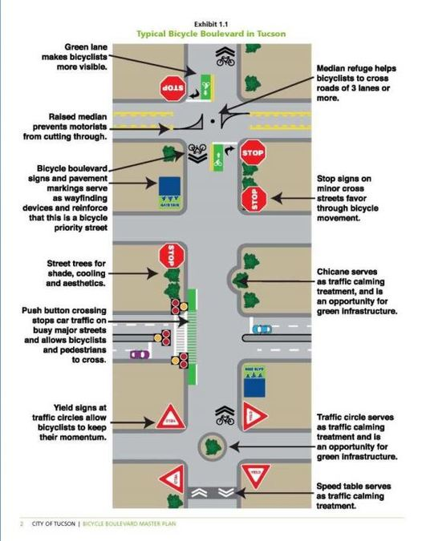
“Bicycle Boulevards”
Cars can still use the street, but it is designed to slow down car traffic
Elements can include:
Pavement markings and signs
Alternating the direction of car travel from block to block to reduce non-local traffic cutting through neighborhood
Traffic calming measures like narrower traffic lanes, roundabouts, bump outs
A low-speed, low-traffic street- safer for pedestrians, cyclists, children

Slide 11
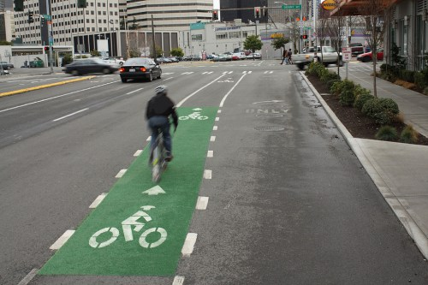
Bike Lanes
Bike-only lanes but next to cars
Minimum 5’ wide
Many different configurations
https://seattletransitblog.com/2011/09/15/more-bike-boulevards-please/seattle-bike-lane/

Slide 12
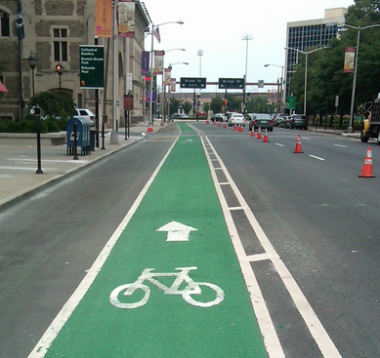
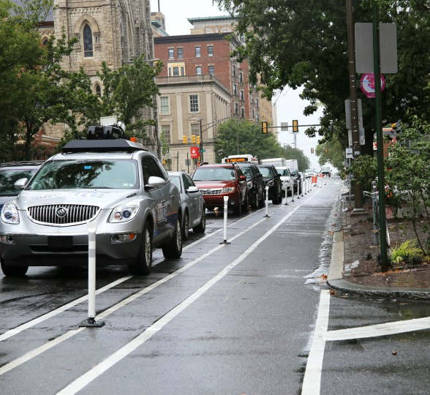
Beyond the basic bike lane
Buffered bike lane:
Protected bike lane:
https://www.phillymag.com/news/2017/08/31/west-philly-protected-bike-lane/
http://www.newarktransitauthority.com/

Slide 13
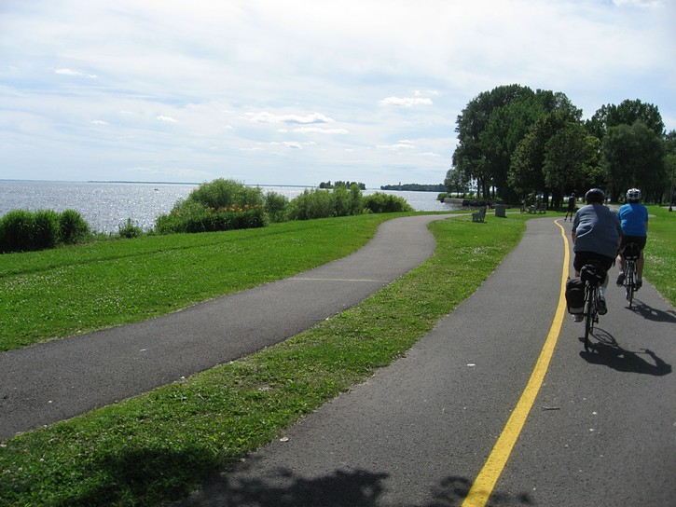
Separated Pathways
Separated from the road network
May run alongside roads
Typically found in parks
Low-stress
http://gobiking.ca/quebec-rides/cycling-in-montreal/

Slide 14
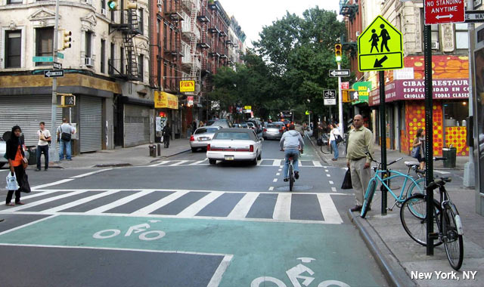
Bike Boxes
Or advanced stop lines (ASL)
In front of line where cars stop
Used at intersections with traffic signals
NACTO Urban Bikeway Design Guide

Slide 15
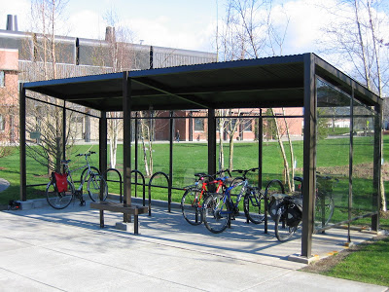
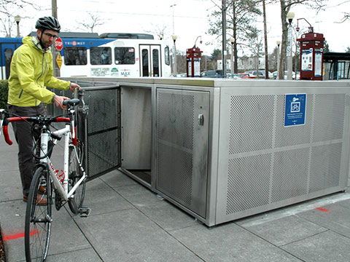
Bike Parking
Sheltered bike parking
Bike lockers
http://bellinghambikeblog.blogspot.com/2011/05/denise-guren-memorial-bike-shellter.html
https://trimet.org/bikes/lockersavailable.htm

Slide 16
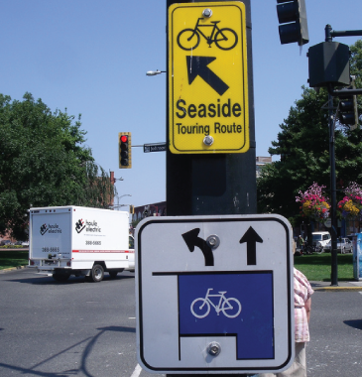
Bike Signage and Traffic Signals
NACTO Urban Bikeway Design Guide

Slide 17
What’s next and how can you help?
Plan Phases:
Data Gathering and Analysis (Spring 2018) – WE ARE HERE
Plan Development: use data to form recommendations for potential routes and policy changes (Summer 2018 – Fall 2018)
Finalize Plan (Winter 2019)
Please complete our short bicycle survey, either in person here today or online.
Plan updates are given at Bike Wilmington meetings- all are welcome to attend!
Provide your email on our sign-up sheet if you would like to be included in emails about Bike Wilmington meetings.
Ongoing conversations.
- - - - - - - - - - - - - -
City of Wilmington Bike Plan

Slide 18
Thank You!
Matthew Harris, Planner II
mharris@wilmingtonde.gov
(302) 576-3110
Gemma Tierney, Planner I
grtierney@wilmingtonde.gov
(302) 576-3117
- - - - - - - - - - - - - -
City of Wilmington Bike Plan

